Slide 1
Predicting Children’s Social Skills: Supervised Learning & PCA
Greg Condit

Slide 2
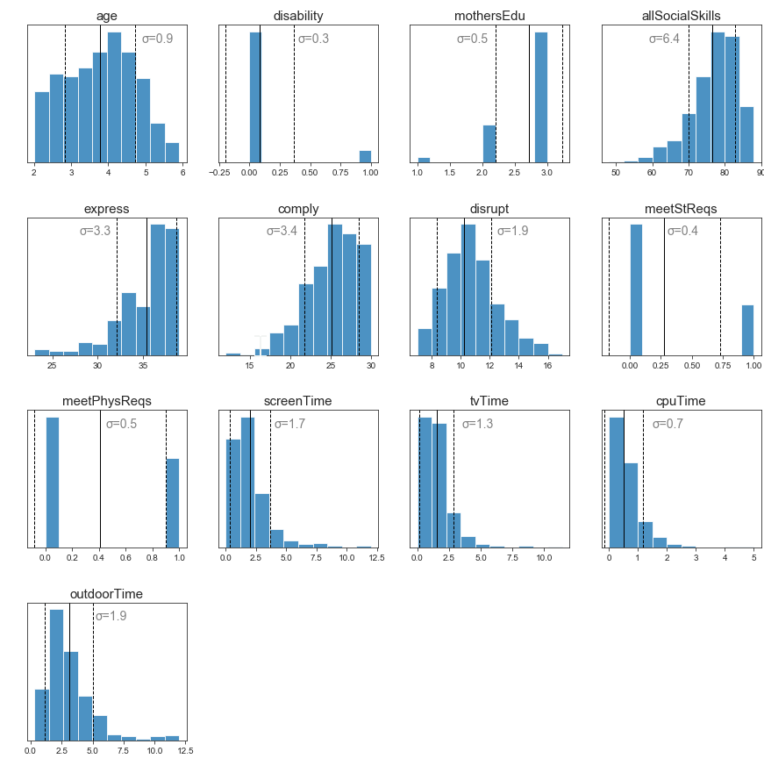
Dataset:
Name | Description | Type
age | Age, ranges 2-6 | Continuous Float
express | Child’s Ability to express themselves | “continuous” integer (really a sum of 13 Likert scales)
comply | Child’s Ability to comply | “continuous” integer (really a sum of 10 Likert scales)
disrupt | Child’s tendency to disrupt | “continuous” integer (really a sum of 7 Likert scales)
tvTime | Hours watching TV / day | Continuous Float
cpuTime | Hours on Computer / day | Continuous Float
outdoorTime | Hours outside / day | Continuous Float
disability | Whether Mother considers child disabled | Boolean
mothersEdu | Mother’s education level: 1 = <10 years, 2 = 11-13 years, 3 = 14+ years | Discrete
meetStReqs | Whether child meets government recommendations for screen time | Boolean
meetPhysReqs | Whether child meets government recommendations for outdoor time | Boolean
gender | Male/female | Boolean
575 mothers with a child (54% boys) aged 2–5 years in diverse neighborhoods throughout Melbourne.
Mothers were found via ads on parenting and child education blogs
Mothers were instructed to report their child’s screen time, outdoor play time and social skills (ASBI system)
https://journals.plos.org/plosone/article?id=10.1371/journal.pone.0193700
Notes:
Intro to Data first, then the questions we’re asking
Call out the distribution of all social skills, and why (bias)

Slide 3
Topics
Can we predict a child’s “Social Skill” score be predicated based on demographics and activities (screen time, outdoor time)?
Can we predict whether a child will show disruptive behavior?
Sidebar: What does PCA do (visually) when we create components out of binary variables?

Slide 4
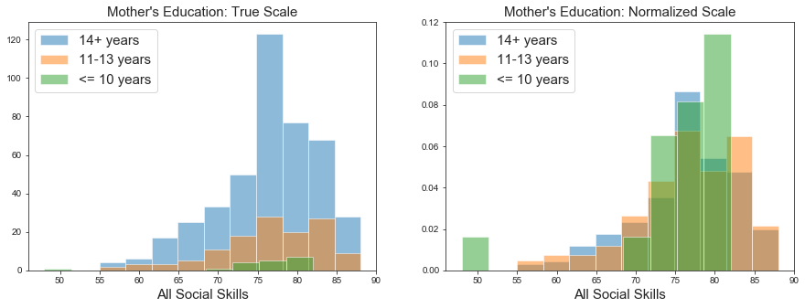
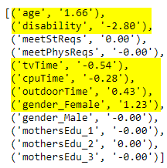
Predicting Social Skill
1) One-hot encode ‘gender’ and ‘mother’s education’
2) Use Lasso Regression to find the useful features:
?
Notes:
Start out with lasso to see what features are most meaningful in this context
Walk through each one, explain coefficient
Revisit bias

Slide 5
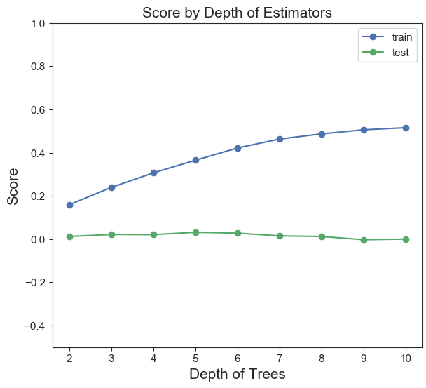
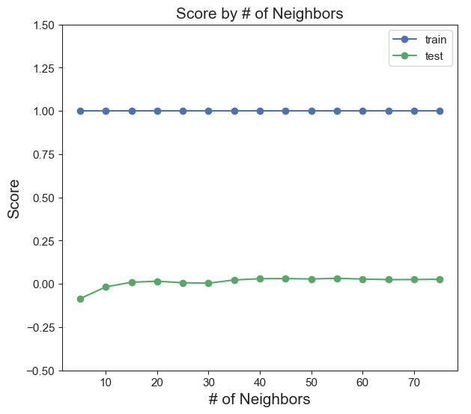
Predicting Social Skill
3) Grid searching Random Forest, KNN Regressors
Random Forest Regressor
KNN Regressor
Notes:
Repeated Grid Searches failed to find any predictive power

Slide 6
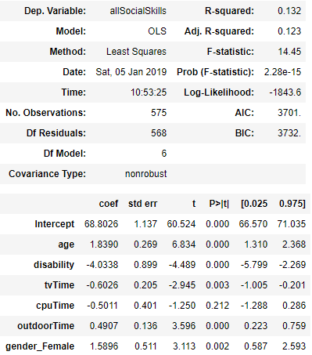
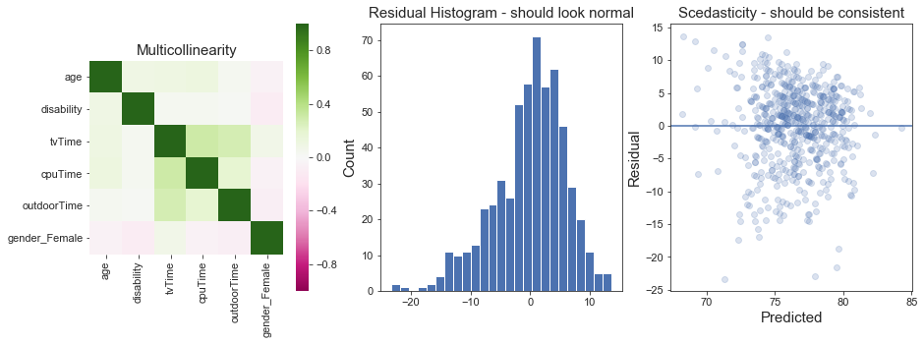
Predicting Social Skill
4) Simple Linear Regression – examine output
Notes:
R-squared – how much variance is explained by our model

Slide 7
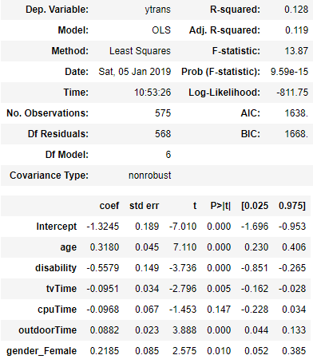
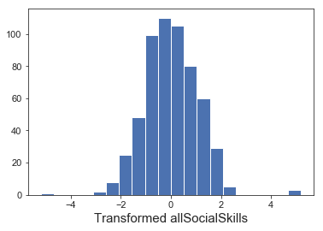
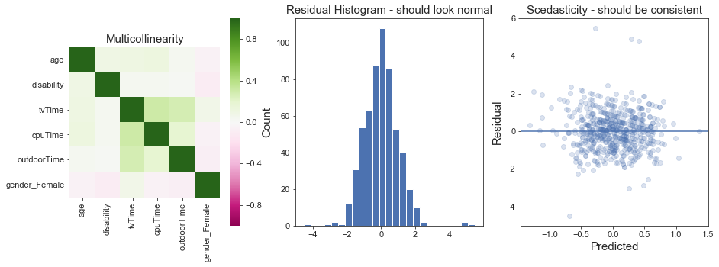
Predicting Social Skill
5) Our Target variable is a skewed distribution. Does Quantile-transforming it help?

Slide 8
Topics
Can we predict a child’s “Social Skill” score be predicated based on demographics and activities (screen time, outdoor time)?
Can we predict whether a child will show disruptive behavior?
Sidebar: What does PCA do (visually) when we create components out of binary variables?

Slide 9
Name | Description | Type
age | Age, ranges 2-6 | Continuous Float
express | Child’s Ability to express themselves | “continuous” integer (really a sum of 13 Likert scales)
comply | Child’s Ability to comply | “continuous” integer (really a sum of 10 Likert scales)
Disrupt | Child’s tendency to be disruptive | “continuous” integer (really a sum of 7 Likert scales)
tvTime | Hours watching TV / day | Continuous Float
cpuTime | Hours on Computer / day | Continuous Float
outdoorTime | Hours outside / day | Continuous Float
disability | Whether Mother considers child disabled | Boolean
mothersEdu | Mother’s education level: 1 = <10 years, 2 = 11-13 years, 3 = 14+ years | Discrete
meetStReqs | Whether child meets govt recommendations for screen time | Boolean
meetPhysReqs | Whether child meets govt recommendations for outdoor time | Boolean
gender | Male/female | Boolean
Notes:
Call out express/comply as new additions to feature set

Slide 10
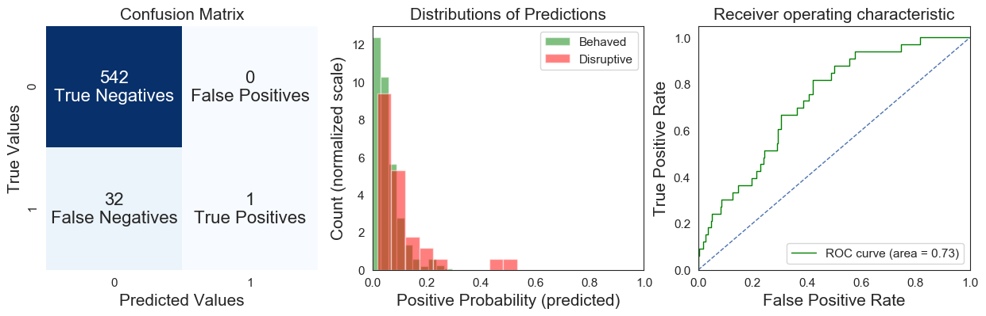
Predicting Disruptive Behavior
Example: A school administration is trying to prevent classrooms from having too many disruptive students, so they are trying to identify which of their incoming students are likely to be disruptive in advance (disrupt score > x)
Basic Logistic Regression
Notes:
True values (class imbalance), which makes sense from the distribution
.5 default decision criterion
Those two charts are representative of one decision point. We could alter our Logistic regression function to have a new decision point, and this ROC curve is a broader representation of the possibilities
End with call back to class imbalance – how can we gridsearch that when we have multiple values to optimize?

Slide 11
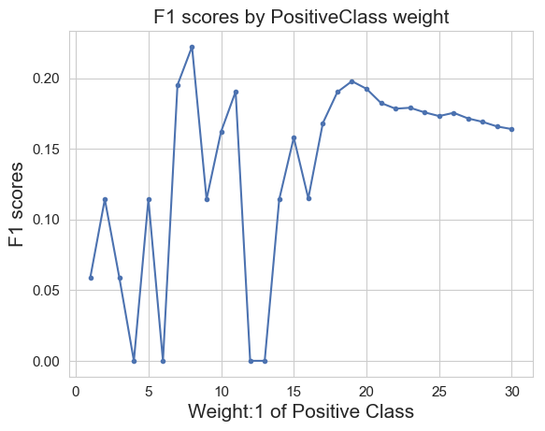


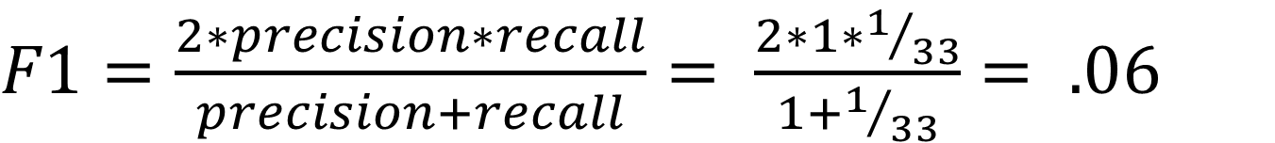
Predicting Disruptive Behavior
Search for the correct class balance, then retry:
$precision=\frac{True Positives}{True Positives+False Positives}= \frac{1}{1+0}=1$00%
$$recall=\frac{True Positives}{True Positives+False Negatives}= \frac{1}{1+32}=3\%$$
$F1=\frac{2∗precision∗recall}{precision+recall}= \frac{2∗1∗1/{33}}{1+1/{33}}= .06$
Bottom line – F1-score (aka F-measure or F-score) gives us a single number to understand the confusion matrix, enabling grid searching that doesn’t penalize small classes
Notes:
Precision, aka – how many of our positive predictions were correct? (type 1)
Recall, aka – how many of the positive cases did we catch? (type 2)
F1 – harmonic mean of the two

Slide 12
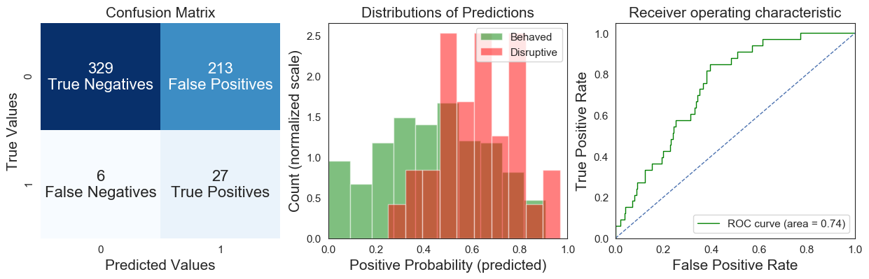
Predicting Disruptive Behavior
F1 Score: .20
Logistic Regression with Class weights 1:19
At this point, we could tell the school something like this, based on the ROC curve above and choosing a decision threshold: "Our current model could correctly identify ~ 85% of disruptive students; however, it would also result in almost 40% of well-behaved students being mistakenly labelled as disruptive"
Notes:
F1 Score: .2

Slide 13
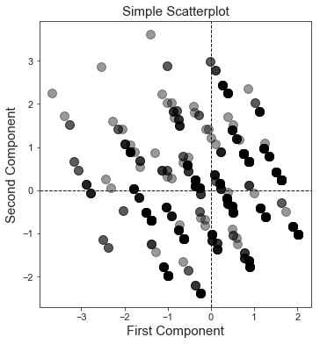
Binary Features
First 2 components created by PCA on 8 Boolean features
Features Used: | True if:
Disability | Mother considers child disabled
meetStReqs | Child meets gov’t recommendations for screen time
meetPhysReqs | Child meets gov’t recommendations for outdoor time
Gender_Male | Child is male
MothersEdu_3 | Mother educated 14+ years
bothSTabovemean | Both tv time and cpu time over the mean
expressive | Above average expressiveness
compliant | Above average compliance
16% of variance
18% of variance
Notes:
Make sure to explain the finite permutations due to categories

Slide 14
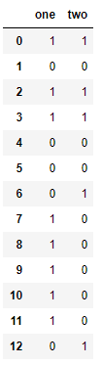
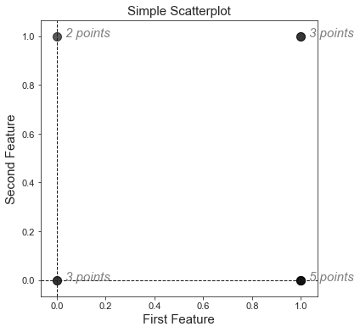
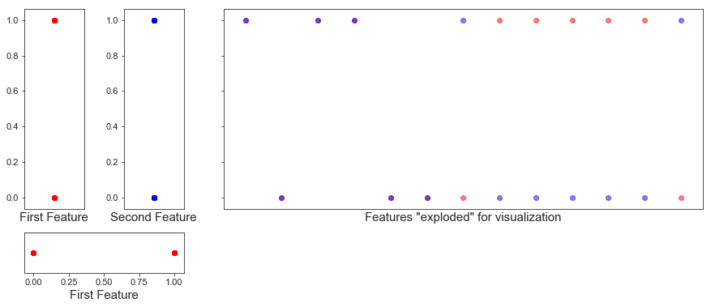
Sidebar: Visualizing PCA for Boolean Variables
How would these look on a scatter plot?
We'd expect just 4 clusters of points:
Notes:
Not necessarily a good idea: Multiple Correspondence Analysis is more appropriate
Fake data with just 2 dimensions for easy visualization. Hope is that we can get some intuition around what’s happening here and extrapolate that to larger dimensional data

Slide 15
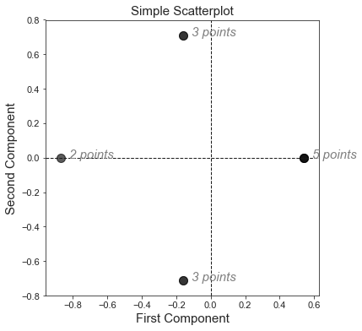
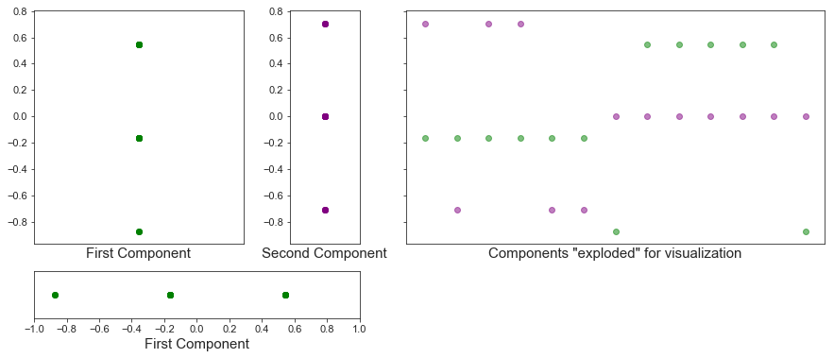
Sidebar: Visualizing PCA for Boolean Variables
What if we ran PCA on these 2 features with mean-only scaling?
Notes:
Also note – the 3 points each component picks up are not the same 3 values as the other

Slide 16
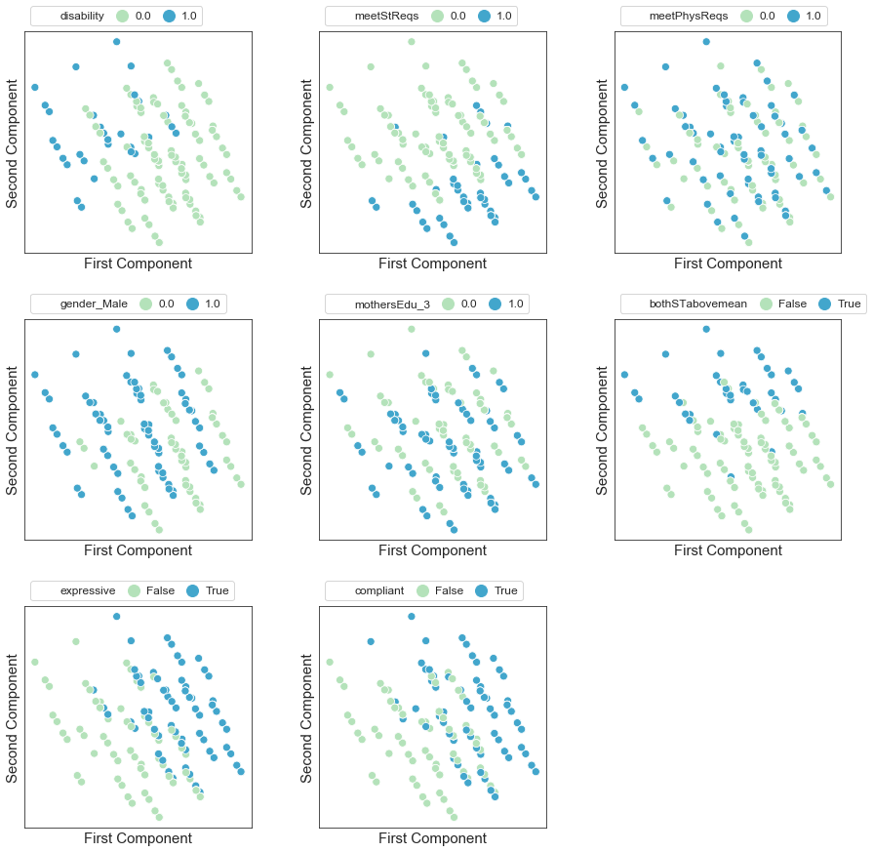
Back to our Data…
Features Used: | True if:
Disability | Mother considers child disabled
meetStReqs | Child meets gov’t recommendations for screen time
meetPhysReqs | Child meets gov’t recommendations for outdoor time
Gender_Male | Child is male
MothersEdu_3 | Mother educated 14+ years
bothSTabovemean | Both tv time and cpu time over the mean
expressive | Above average expressiveness
compliant | Above average compliance
First 2 components created by PCA on 8 Boolean features
Notes:
Make sure to explain the finite permutations due to categories

Slide 17
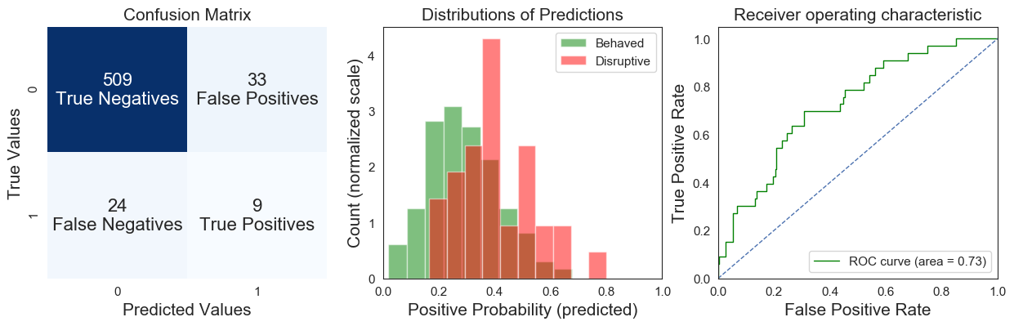
Predicting Disruptive Behavior
F1 Score: .24
Logistic Regression with PCA components, and Class weights 1:7

Slide 18
Predicting Disruptive Behavior
Logistic Regressor Summary | n Features | Class Weights | F1Score | AUC
Basic | 15 | 1:1 | .06 | .73
Balanced | 15 | 1:16 | .12 | .65
"Optimized" Weights | 15 | 1:19 | .20 | .74
Ridge | 15 | 1:19 | .20 | .74
With continuous components | 14 | 1:19 | .20 | .74
With continuous & binary components | 12 | 1:7 | .24 | .73

Slide 19
Resources
Full study including original dataset:
Cross sectional associations of screen time and outdoor play with social skills in preschool children
https://journals.plos.org/plosone/article?id=10.1371/journal.pone.0193700
The best way for visual learners to gain an intuition for PCA/matrix transformations
3blue1brown: Essence of Linear Algebra - https://www.youtube.com/playlist?list=PLZHQObOWTQDPD3MizzM2xVFitgF8hE_ab
A visualization for MCA (the more stable alternative to PCA for categorical data):
François Husson - https://www.youtube.com/watch?v=b4kRAt4mkB8
The github repo for this project:
https://github.com/conditg/predicting-disruption

Slide 20
Appendix
Notes:
RESOURCES

Slide 21
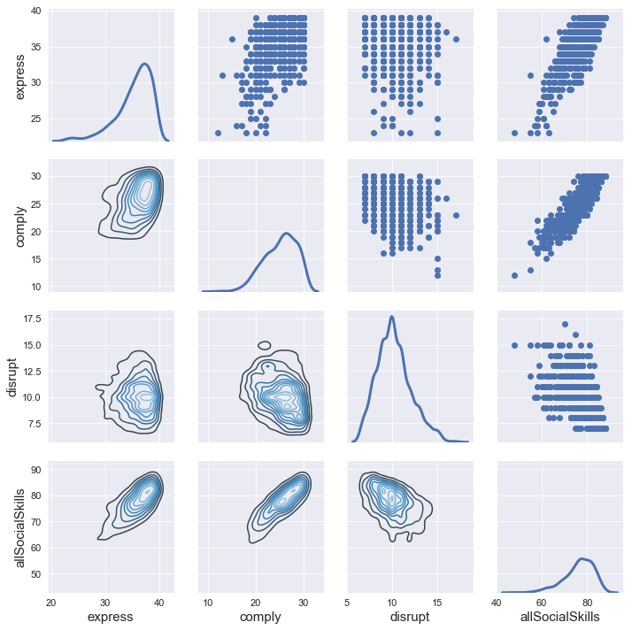
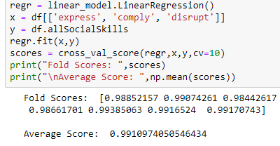
allSocialSkills relationship to its parameters

Slide 22
