Slide 1
Phone Usage: Supervised Learning with inconvenient data

Slide 2
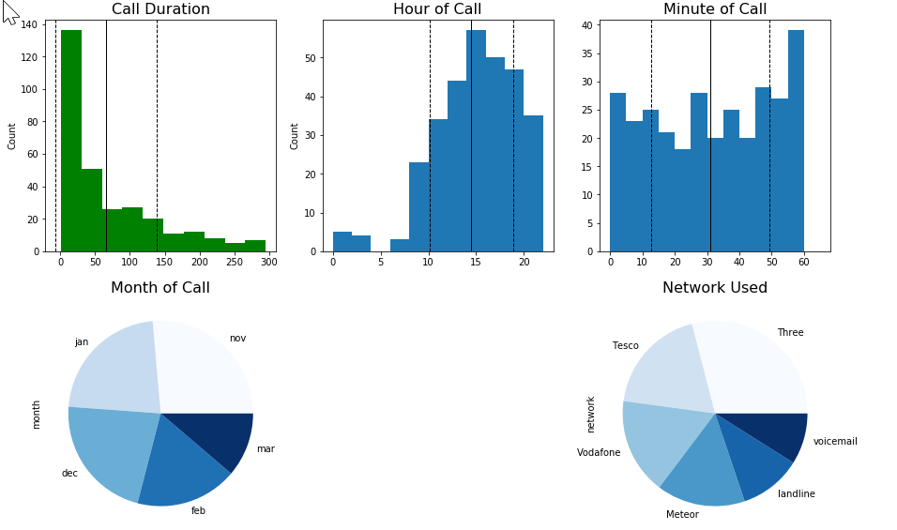
Initial Dataset: Phone Call Durations
Estimate the Poisson lambda/mean of call duration?
More about the linear models and quantifying the error of the estimate
https://www.kaggle.com/thansnet/phone-datas

Slide 3
PCA/dimension reduction
Show model tuning from underfit to overfit, “Parameter sweeping”
Review the rubric
Always plot mean/std lines onto histograms
Logistic Regression
Multicollinearity issues – create section for this

Slide 4
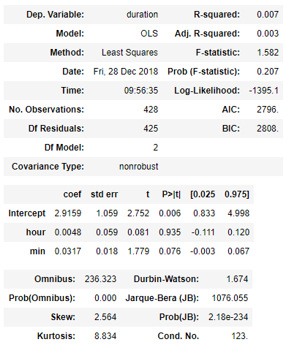

Can we predict time spent on the phone using time of day?
Statsmodels output:
Poor R-squared score
Insufficient confidence that these results didn’t just happen by chance
Why has this happened?
Sparse Data
Non-normally distributed data

Slide 5
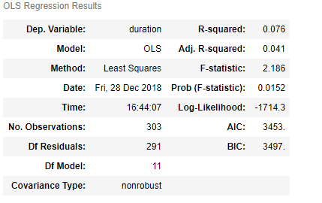
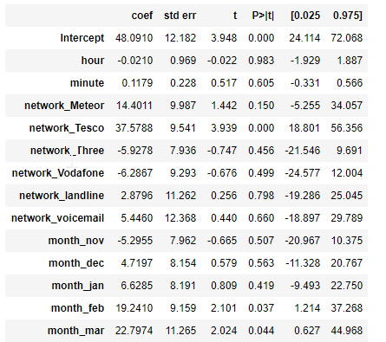
10x better, but still terrible
Only 3 of these features contain meaningful information

Slide 6
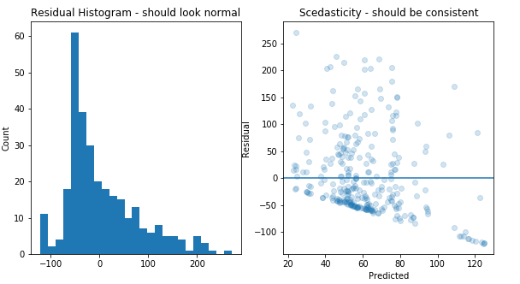
Other Cross-validated scores:
KNN: -.09
Random Forest: -.08
Gradient Boosted Regressor: -.21

Slide 7
Supervised Learning with inconvenient data
Overview: Generate a dataset with inconvenient properties to use in the following scenarios:
Linear Regression of a normally distributed dependent variable
Law of Large Numbers
Using normally distributed features (baseline)
Using skewed features
Using Poisson features
Using Bernoulli and Categorical features
Linear Regression of a Skewed dependent variable
Central Limit Theorem demonstration
Regressing with Outliers

Slide 8
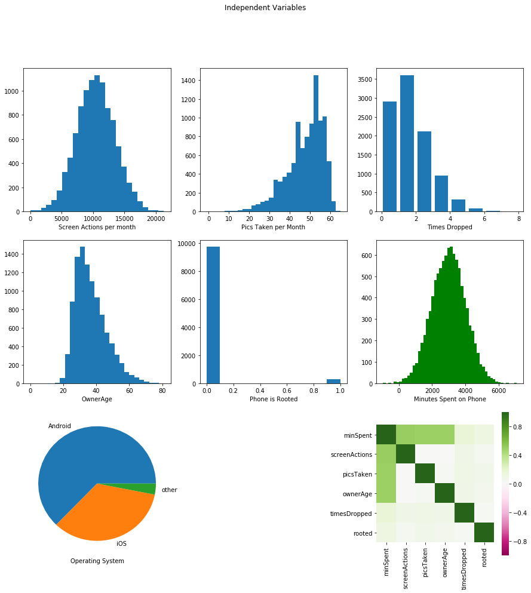
Overview of data generator output:

Slide 9
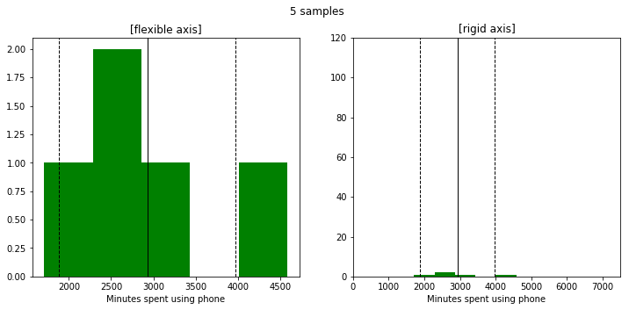
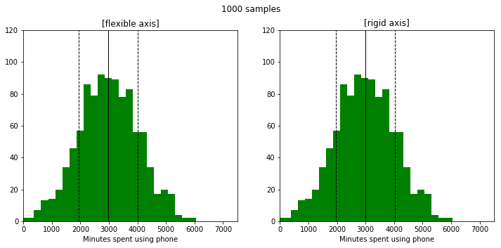
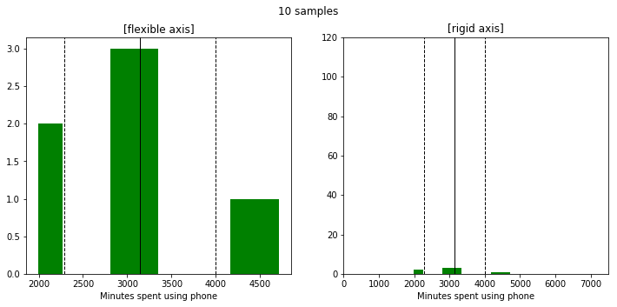
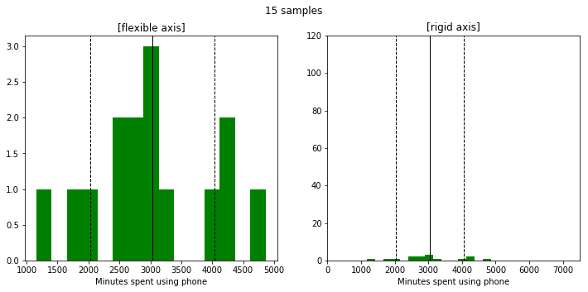
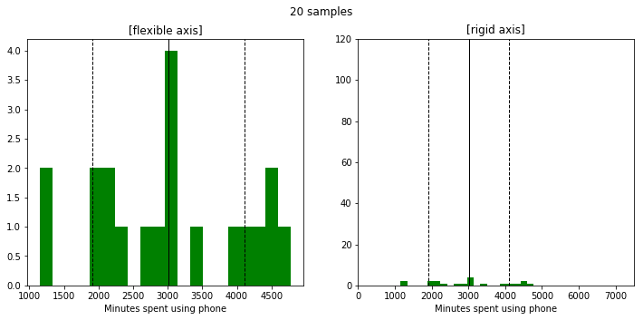
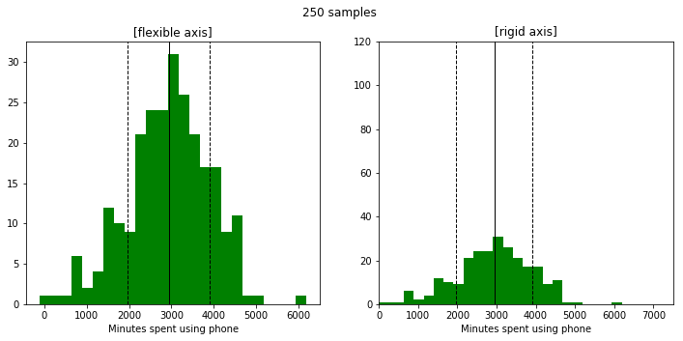
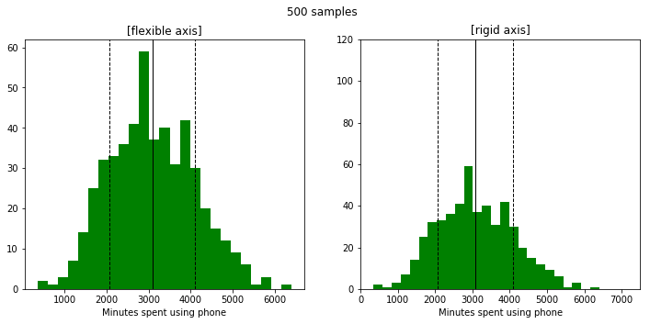
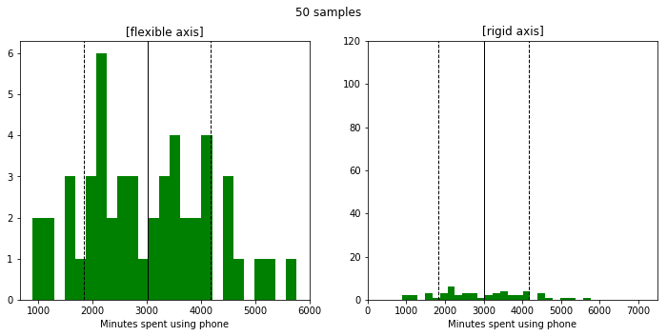
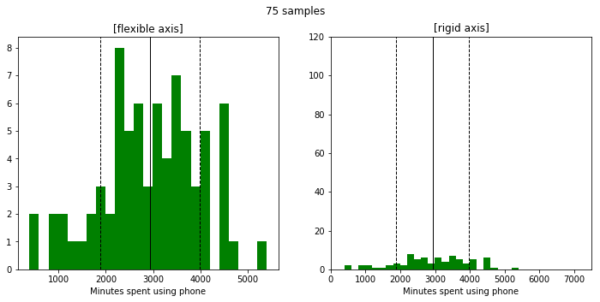
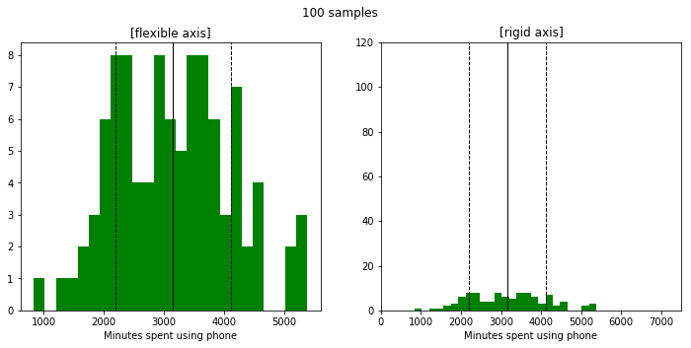
Law of Large Numbers:

Slide 10
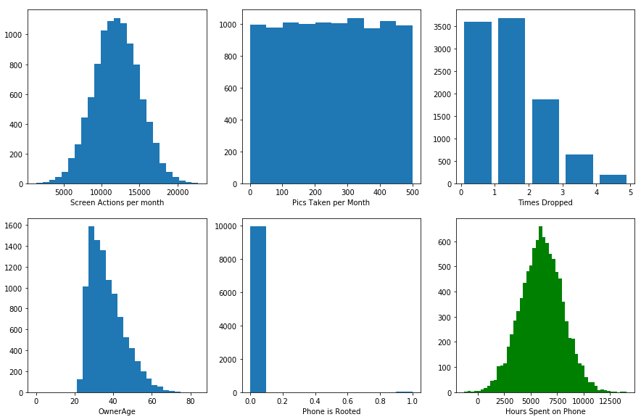
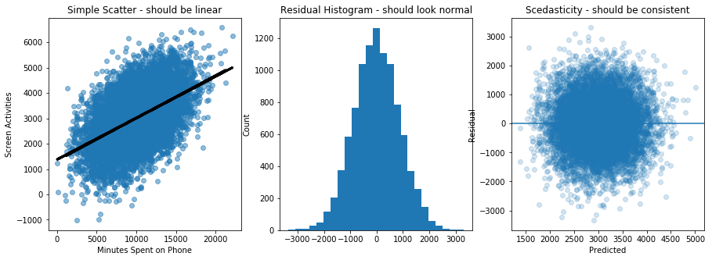
Baseline: Linear Regression with 1 normally distributed feature
Feature
Target Variable
SciKitLearn and statsmodels R-squared scores: .25 | Screen time increases .16 minutes for each incremental screen action

Slide 11
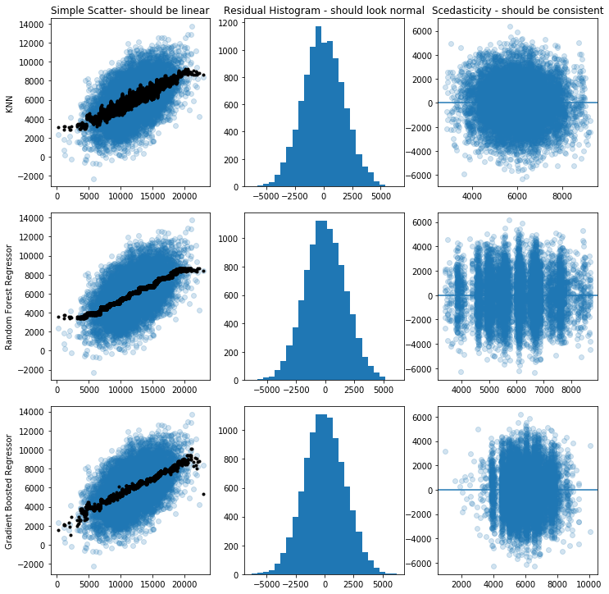
KNN Regressor: .224
Random Forest Regressor: .248
Gradient Boosted Regressor: .247

Slide 12
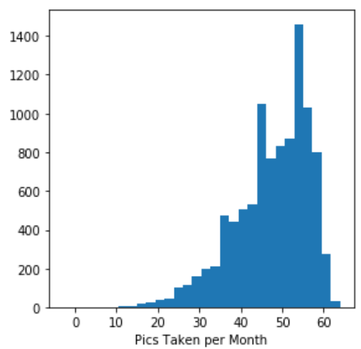
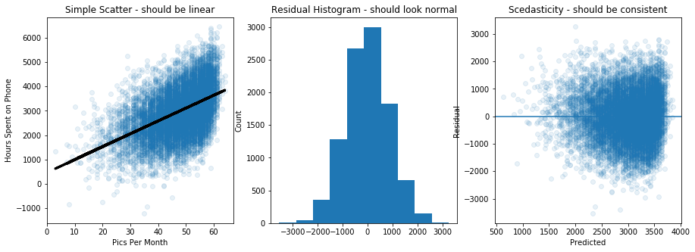
Baseline: Linear Regression with 1 skewed feature
Feature
Target Variable
SciKitLearn and statsmodels R-squared scores: .236 | Screen time increases 52.7 minutes for each incremental pic taken

Slide 13
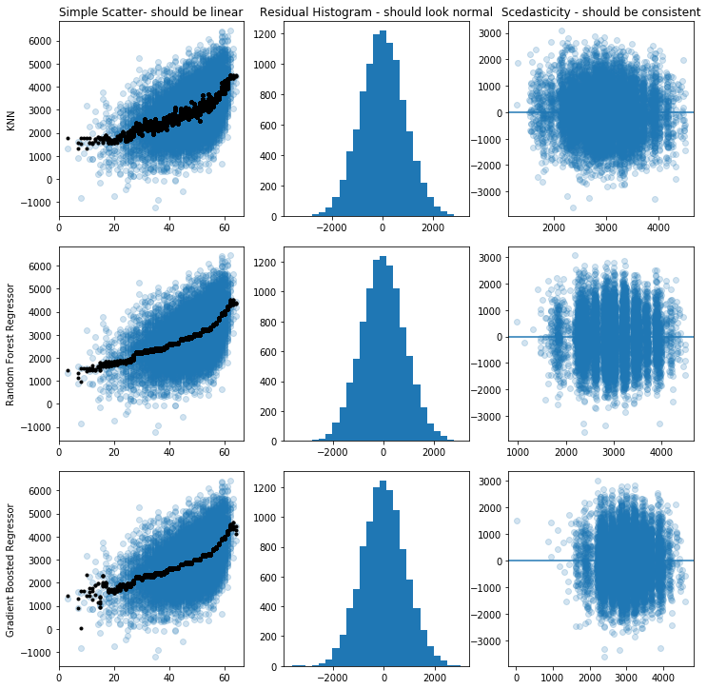
KNN Regressor: .234
Random Forest Regressor: .254
Gradient Boosted Regressor: .253

Slide 14
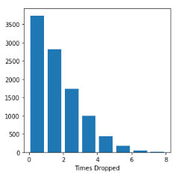
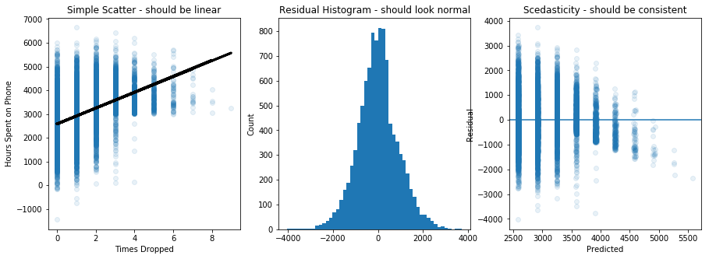
Baseline: Linear Regression with 1 Poisson feature
Feature
Target Variable
SciKitLearn and statsmodels R-squared scores: .196 | Screen time increases 332 minutes for each incremental drop

Slide 15
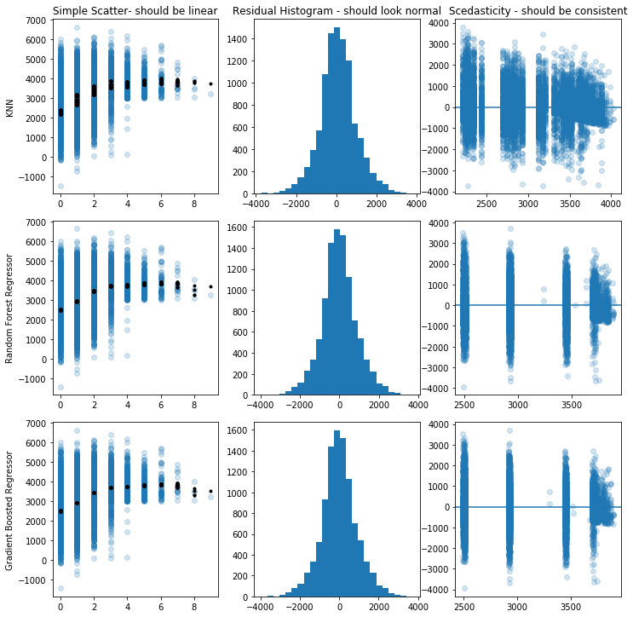
KNN Regressor: .193
Random Forest Regressor: .219
Gradient Boosted Regressor: .219

Slide 16
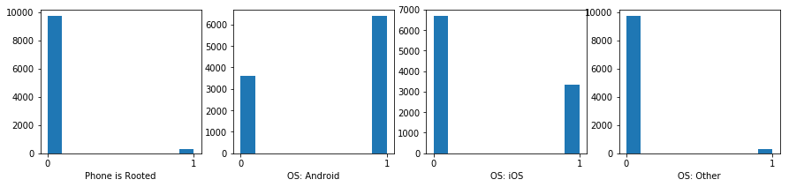
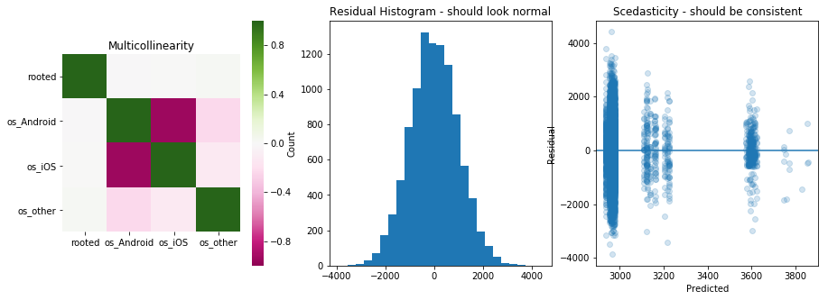
Baseline: Linear Regression with Boolean Features
Features
Target Variable
SciKitLearn and statsmodels R-squared scores: .011 | Screen time increase for Rooted phones: 637 min

Slide 17
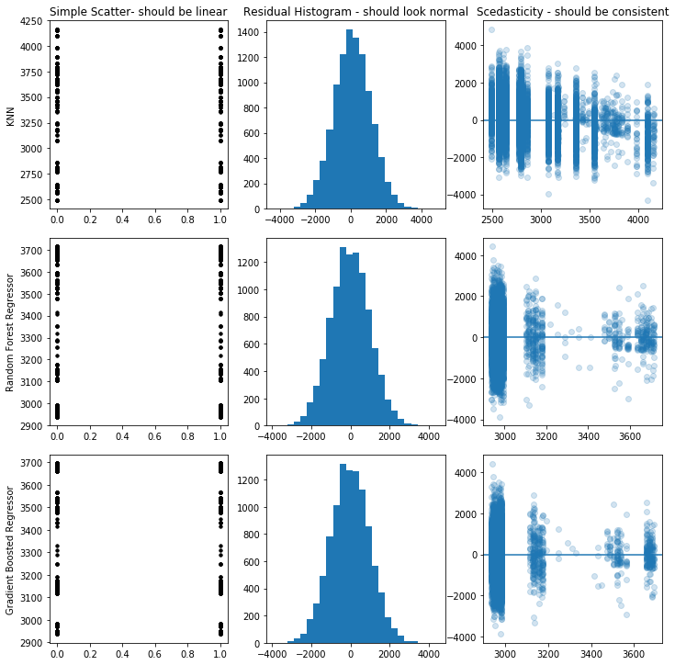
KNN Regressor: -0.9
How many neighbors
Random Forest Regressor: .011
Gradient Boosted Regressor: .011

Slide 18
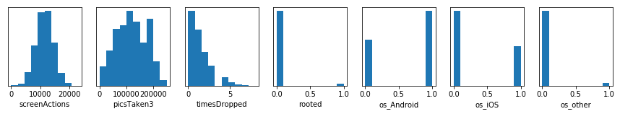
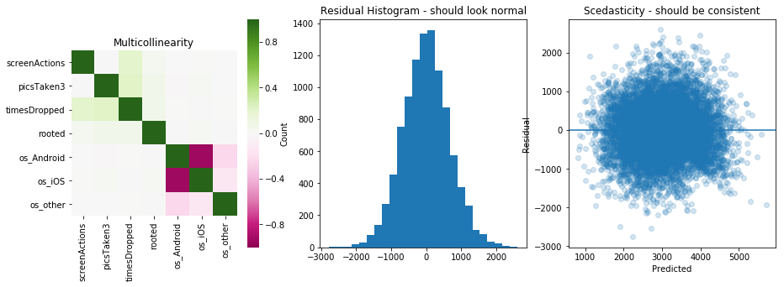
Baseline: Linear Regression with All the above Features
Features
Target Variable
SciKitLearn and statsmodels R-squared scores: .556

Slide 19
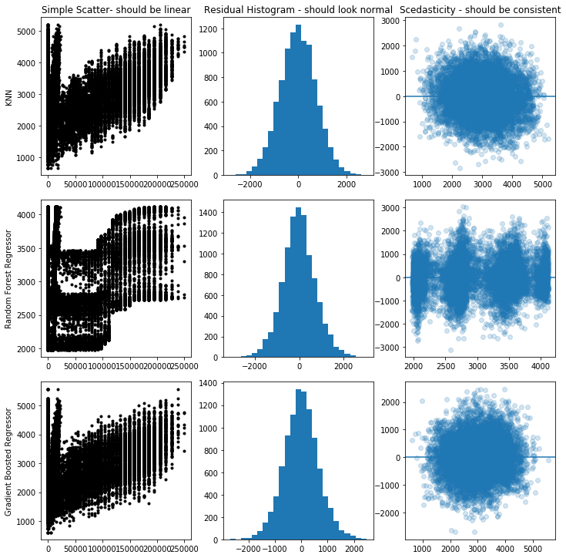
KNN Regressor: .439
Random Forest Regressor: .444
Gradient Boosted Regressor: .565

Slide 20
Supervised Learning with inconvenient data
Overview: Generate a dataset with inconvenient properties to use in the following scenarios:
Linear Regression of a normally distributed dependent variable
Law of Large Numbers
Using normally distributed features (baseline)
Using skewed features
Using Poisson features
Using Bernoulli and Categorical features
Linear Regression of a Skewed dependent variable
Central Limit Theorem demonstration
Regressing with Outliers
Transformation of

Slide 21
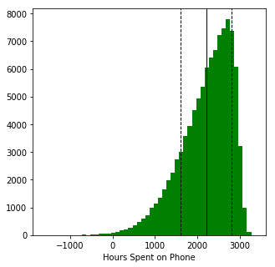
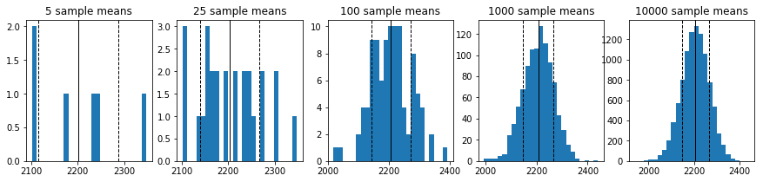
Central Limit Theorem
Make sure the means line up
Sigma, SE, degree
Lock xticks, and note movement of std dev
Remove yticks here
Include sample sizes

Slide 22
References

