Slide 1
Phone Usage: Supervised Learning with inconvenient data

Slide 2
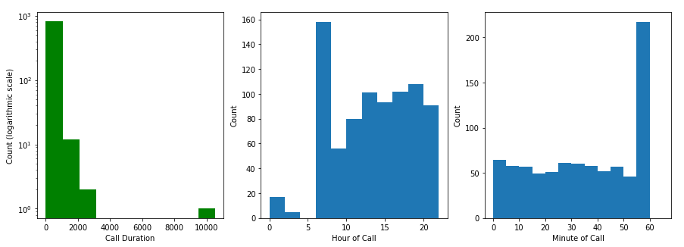
Initial Dataset: key attributes

Slide 3
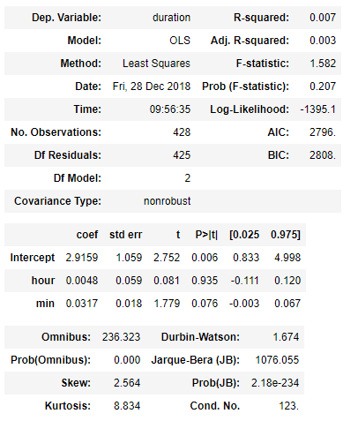

Can we predict time spent on the phone using time of day?
Statsmodels output:
Poor R-squared score
Insufficient confidence that these results didn’t just happen by chance
Why has this happened?
Sparse Data
Non-normally distributed data

Slide 4
Supervised Learning with inconvenient data
Overview: Generate a dataset with inconvenient properties to use in the following scenarios:
Linear Regression of a Normal Dependent Variable
Law of Large Numbers
Using normally distributed features (baseline)
Using skewed features
Using Poisson features
Using Bernoulli and Categorical features
Linear Regression of a Skewed dependent Variable
Central Limit Theorem demonstration
Regressing with Outliers

Slide 5
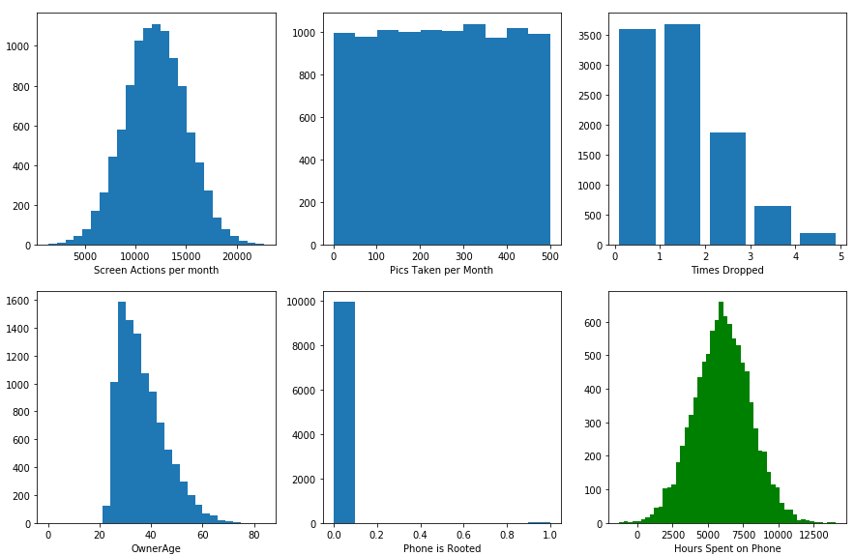
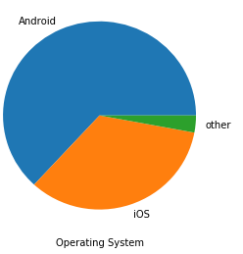
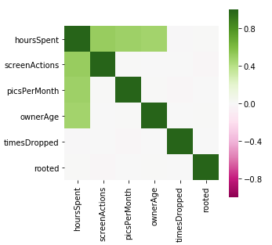
Overview of data generator output:

Slide 6
Linear Regression of a Normal Dependent Variable

