Slide 1
Phone Usage: Supervised Learning with inconvenient data

Slide 2
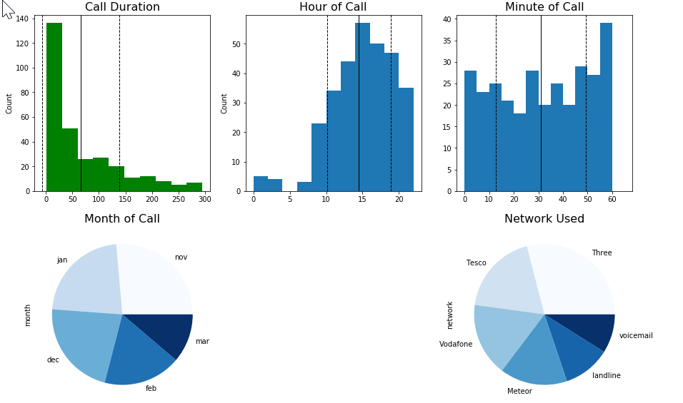
Initial Dataset: Phone Call Durations
https://www.kaggle.com/thansnet/phone-datas

Slide 3
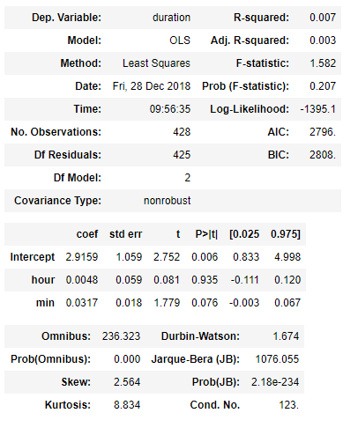

Can we predict time spent on the phone using time of day?
Statsmodels output:
Poor R-squared score
Insufficient confidence that these results didn’t just happen by chance
Why has this happened?
Sparse Data
Non-normally distributed data

Slide 4
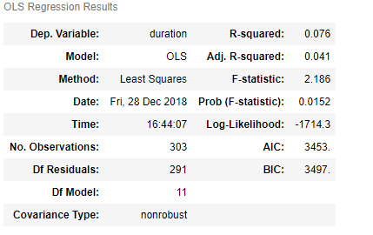
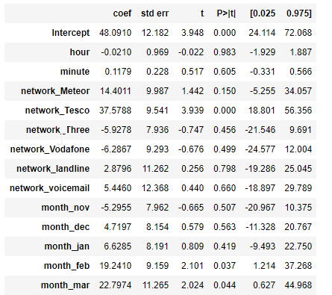
10x better, but still terrible
Only 3 of these features contain meaningful information

Slide 5
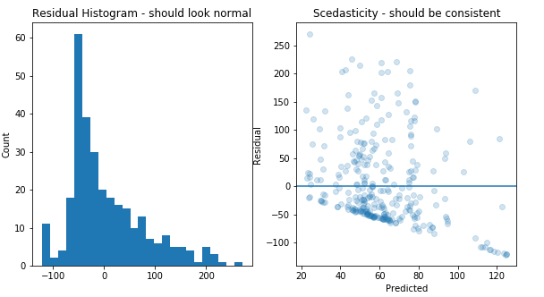
Other Cross-validated scores:
KNN: -.09
Random Forest: -.08
Gradient Boosted Regressor: -.21

Slide 6
Supervised Learning with inconvenient data
Overview: Generate a dataset with inconvenient properties to use in the following scenarios:
Linear Regression of a normally distributed dependent variable
Law of Large Numbers
Using normally distributed features (baseline)
Using skewed features
Using Poisson features
Using Bernoulli and Categorical features
Linear Regression of a Skewed dependent variable
Central Limit Theorem demonstration
Regressing with Outliers

Slide 7
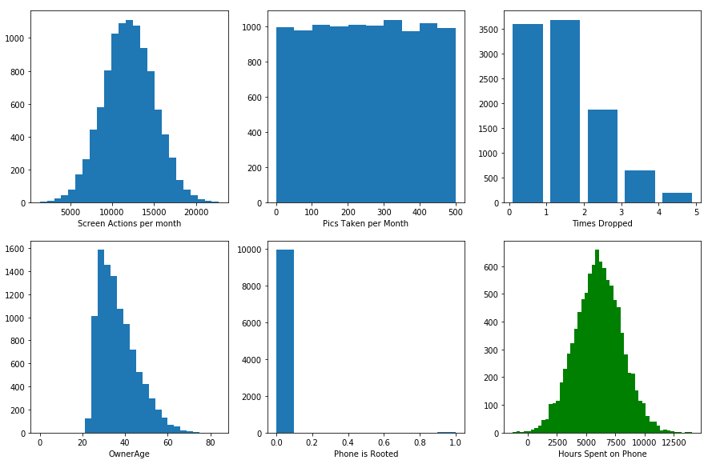
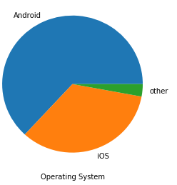
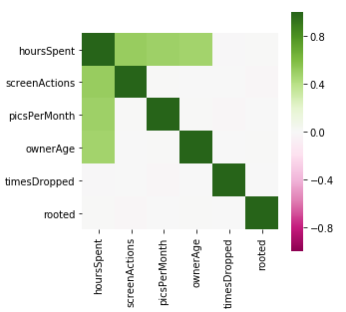
Overview of data generator output:

Slide 8
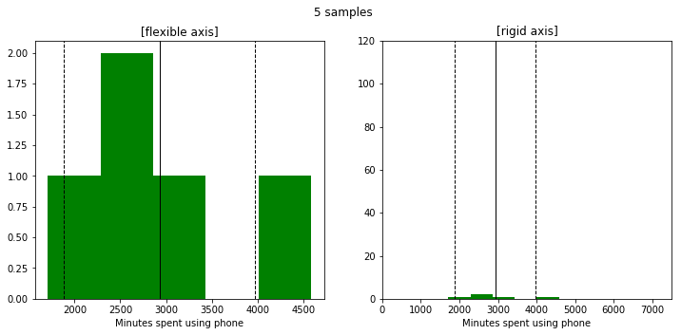
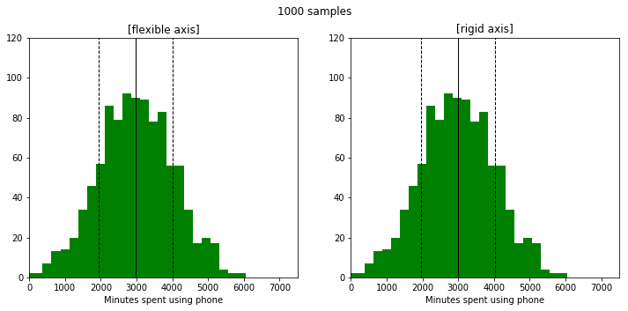
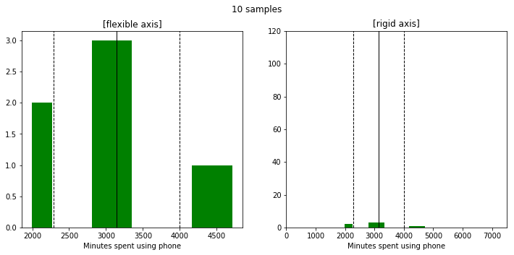
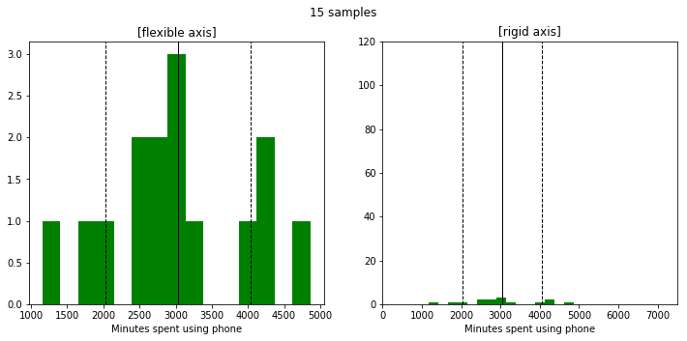
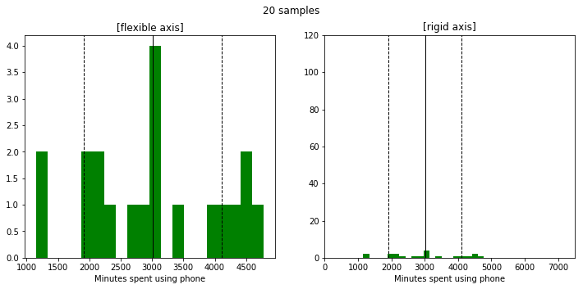
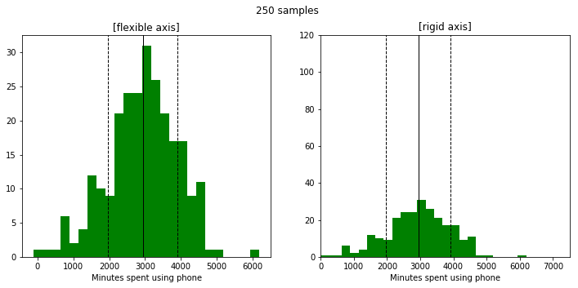
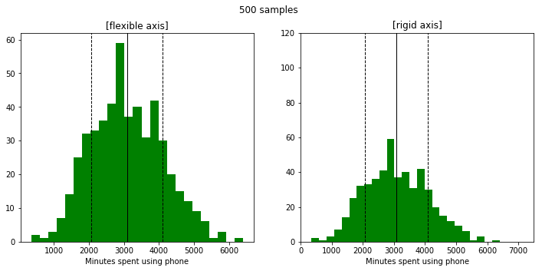
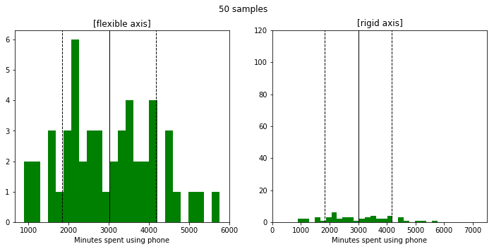
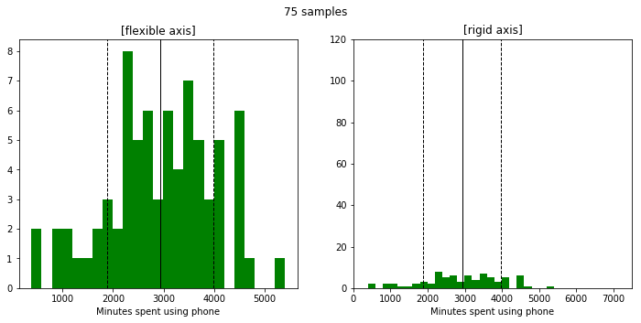
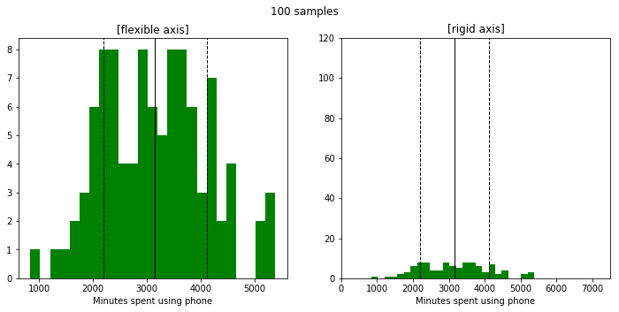
Law of Large Numbers:

Slide 9
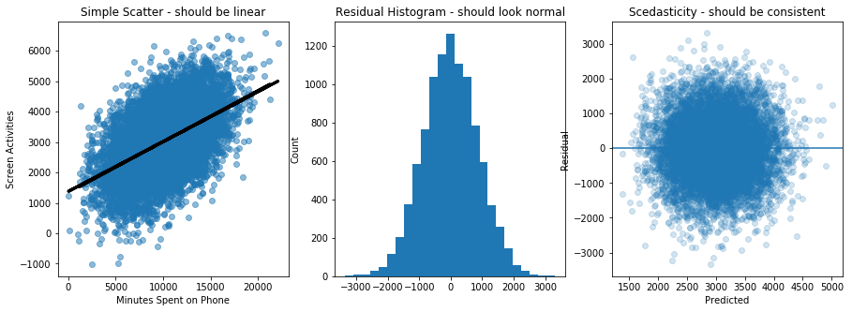
Baseline: Linear Regression with 1 normally distributed feature
Feature
Target Variable
SciKitLearn and statsmodels R-squared scores: .25 | Screen time increases .16 minutes for each incremental screen action

Slide 10
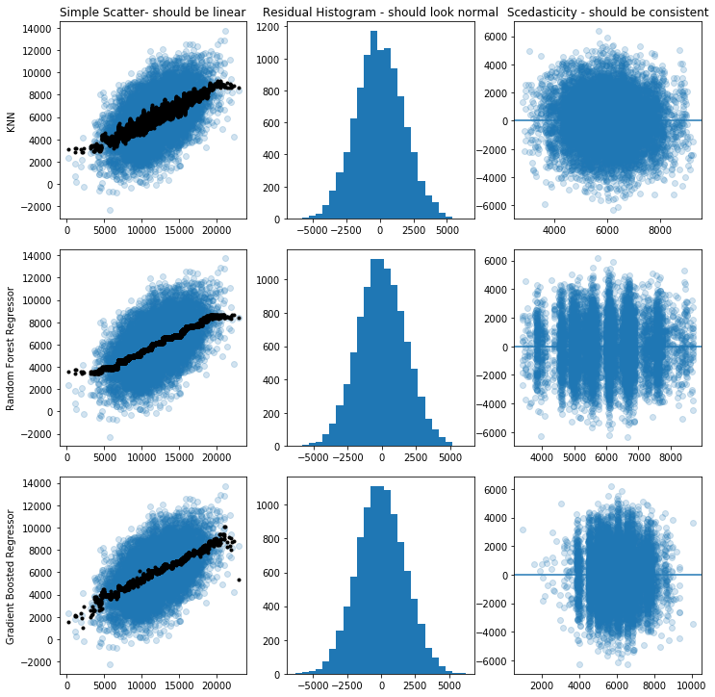
KNN Regressor: .224
Random Forest Regressor: .248
Gradient Boosted Regressor: .247

Slide 11
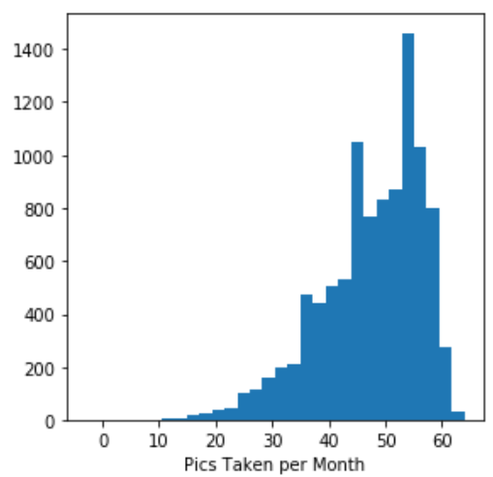
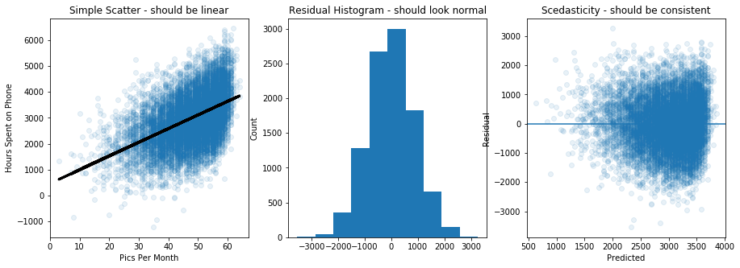
Baseline: Linear Regression with 1 skewed feature
Feature
Target Variable
SciKitLearn and statsmodels R-squared scores: .236 | Screen time increases 52.7 minutes for each incremental pic taken

Slide 12
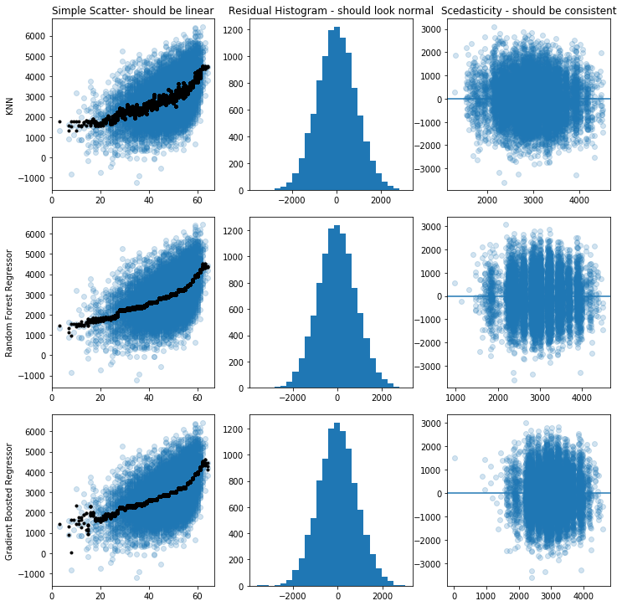
KNN Regressor: .234
Random Forest Regressor: .254
Gradient Boosted Regressor: .253

