Slide 1
Deng-AI: Predicting Disease Spread
Predicting the spread of Dengue Fever using Time Series Techniques
Greg Condit

Slide 2
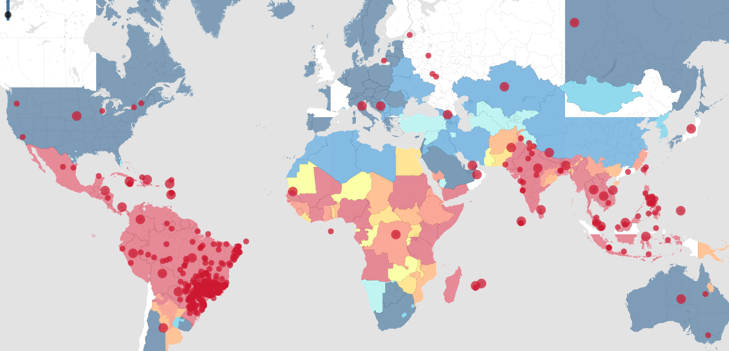
Problem Overview
Dengue Fever is a disease with severity ranging from flu-like symptoms to low blood pressure and death.
It is not contagious; Dengue Fever can only be spread by mosquitoes

Slide 3
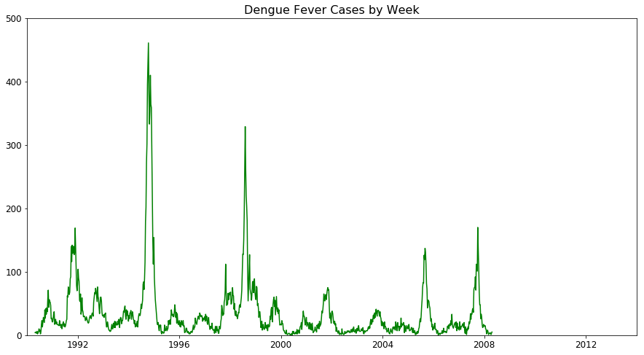
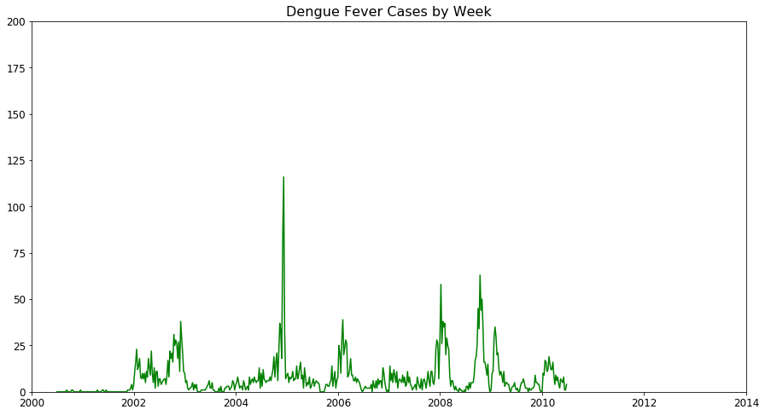
DrivenData.org Competition
DrivenData.org: “bring cutting-edge practices in data science and crowdsourcing to some of the world's biggest social challenges”
Deng-AI – Machine Learning Competition to predict outbreaks of Dengue Fever
San Juan, Puerto Rico
Iquitos, Peru
?
?
Notes:
Tone down the peach and/or add grid behind chart

Slide 4
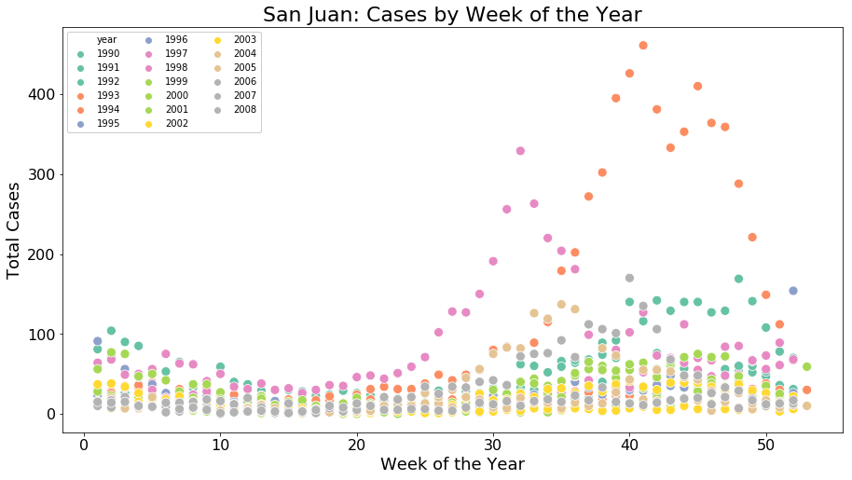
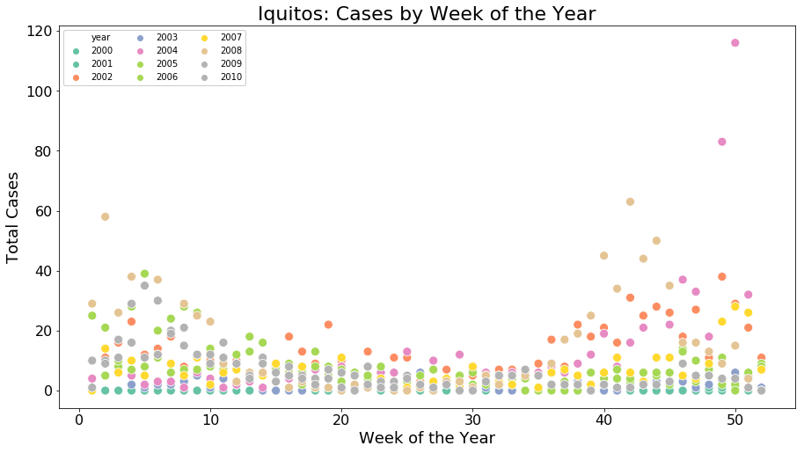
Hypothesis
Dengue is spread by Mosquitos, whose breeding patterns are related to weather patterns. Therefore, weather patterns can predict outbreaks.

Slide 5
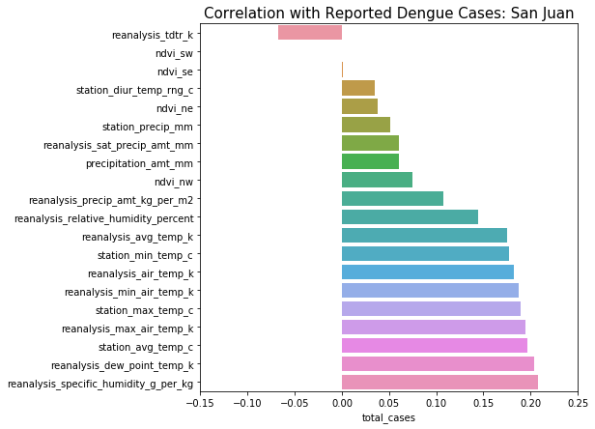
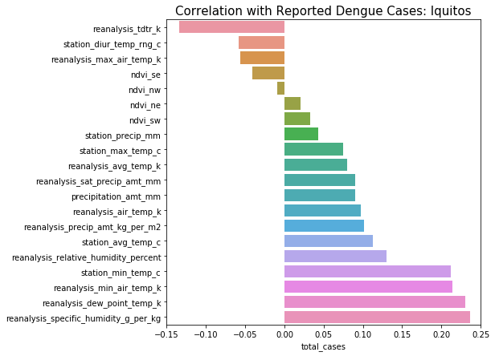
Features: Lots of weather data
Pearson correlations do not account for observation order
Notes:
Temperature
Humidity
Precipitation
Vegetation

Slide 6
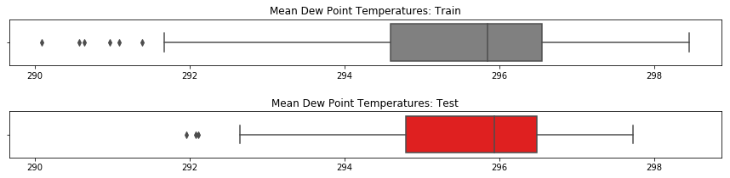
Feature Engineering: Degrading Training Data
Training minimums raises to Test minimums for each city
Training maximums raised to Test maximums for each city
Full scaling was avoided based on research that the specific temperature points matter and affect breeding patterns

Slide 7
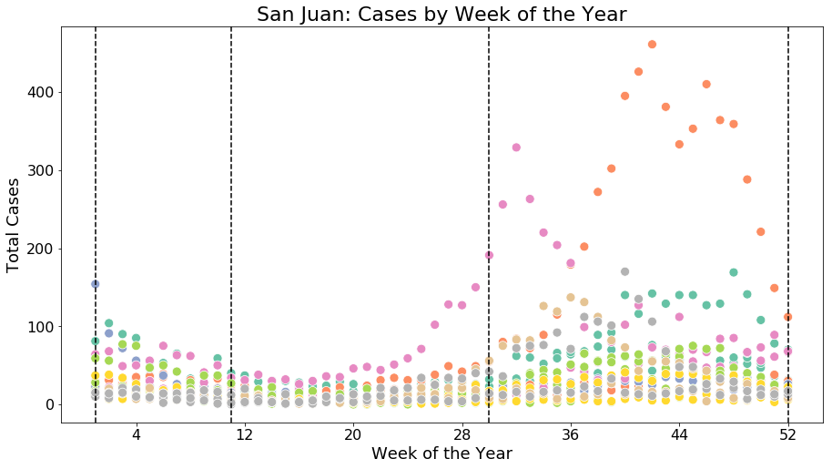
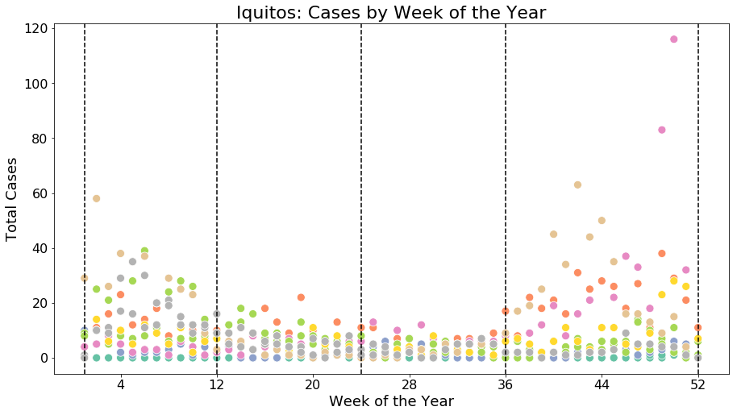
Feature Engineering: Seasons
Categorical features created for seasons based on outbreak patterns

Slide 8
How far back should a time series model “look”?
Following a “favorable” weather event, we’d expect to see reports of Dengue Fever in 2-3 weeks.

Slide 9
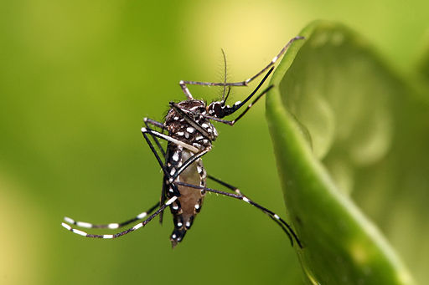
2 Time Series Techniques
Long short term memory neural network (LSTM)
Supervised Learning methods with lagged features

Slide 10
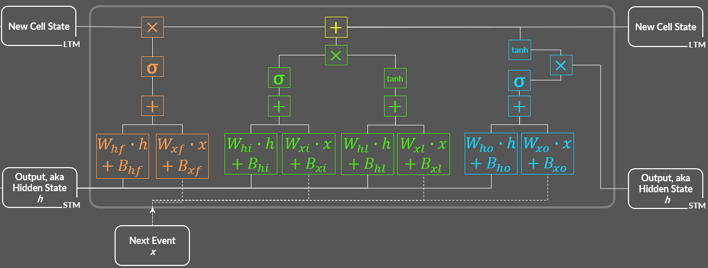
LSTM Architecture

Slide 11
























LSTM Logic, from the ground up
First Forward Pass
Subsequent Forward Passes
New Cell State
$$×$$
$$+$$
New Cell State
$$×$$
tanh
LTM
$$×$$
tanh
LTM
σ
$$×$$
$$×$$
σ
tanh
σ
σ
tanh
σ
$$+$$
$$+$$
$$+$$
$$+$$
$$W_{xi}∙x+B_{xi}$$
$$W_{xl}∙x+B_{xl}$$
$$W_{xo}∙x+B_{xo}$$
$$W_{hf}∙h+B_{hf}$$
$$W_{xf}∙x+B_{xf}$$
$$W_{hi}∙h+B_{hi}$$
$$W_{xi}∙x+B_{xi}$$
$$W_{hl}∙h+B_{hl}$$
$$W_{xl}∙x+B_{xl}$$
$$W_{ho}∙h+B_{ho}$$
$$W_{xo}∙x+B_{xo}$$
Output, aka
Hidden State
h
Output, aka
Hidden State
h
“learn” the data…
STM
“learn” the data…
STM
…and “ignore” some of it
…and “ignore” some of it
New Event
x
Next Event
x
LEGEND
Input Gate
Forget Gate
Output Gate
$$×$$
Element-wise multiplication
Size: (h,1)
Size: (h,x)
$$W_{h \{f,i,l,o\}}$$
Size: (h,h)
$$W_{x \{f,i,l,o\}}$$
Size: (h,x)
Assumes hidden and cell states are initialized with zeroes
Notes:
Consider flashing the whole chart first

Slide 12
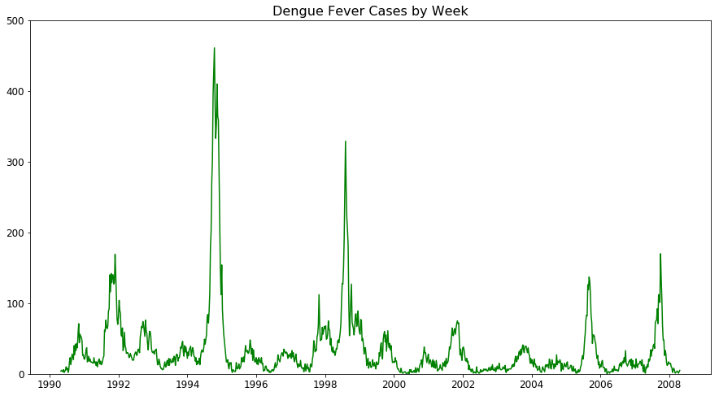
Challenge: Choosing Validation Data (San Juan)
No random sampling – order must be maintained for correct training
Split in red zone: Validation data has no big outbreak, so validation loss consistently lower than training loss
Split in blue zone: sparse training data, and risk of splitting up the leading indicators of the second outbreak

Slide 13
Walk Forward Validation
Pick the smallest viable training size n
Train with the first n samples, and predict sample(s) n+x
Increase n by x and repeat
By keeping the validation size constant (n+x regardless of training size), you can summarize loss across all points and know you are comparing apples to apples.
Training Data
Validation Data

Slide 14
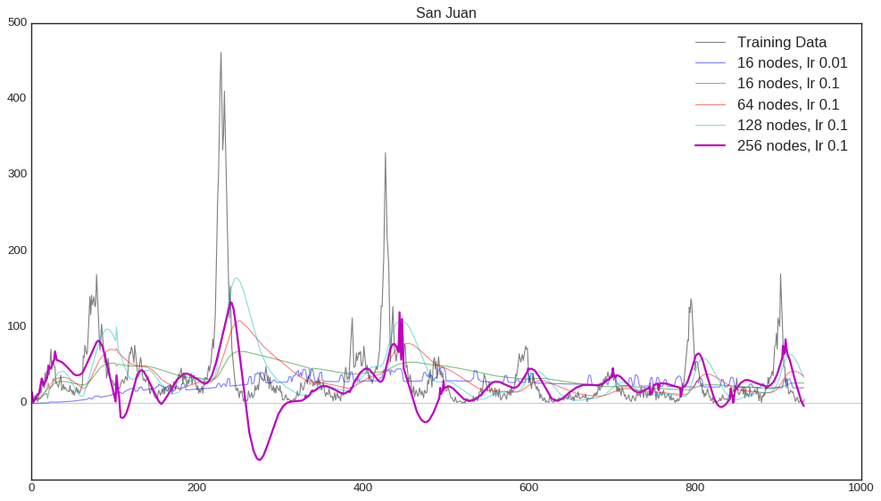
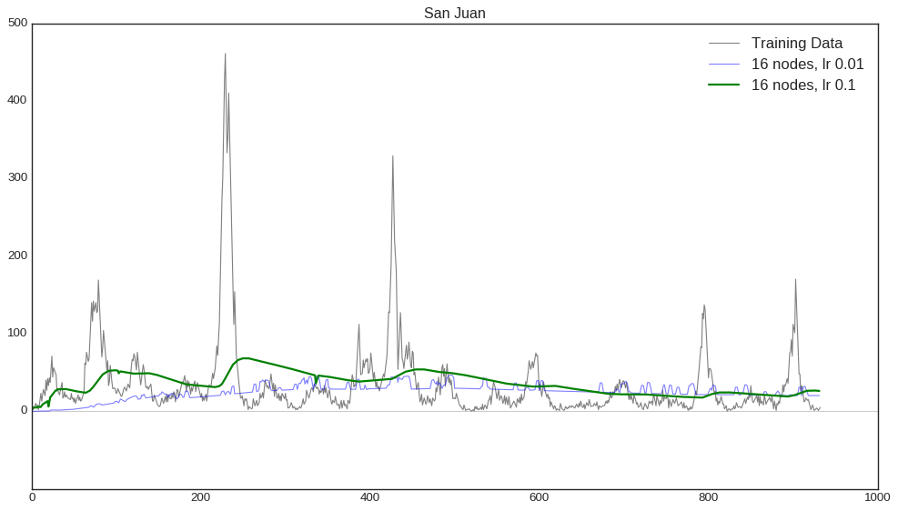
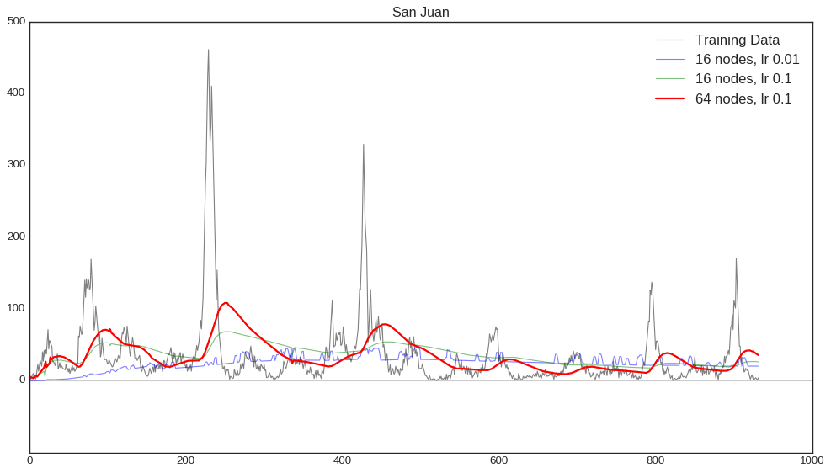
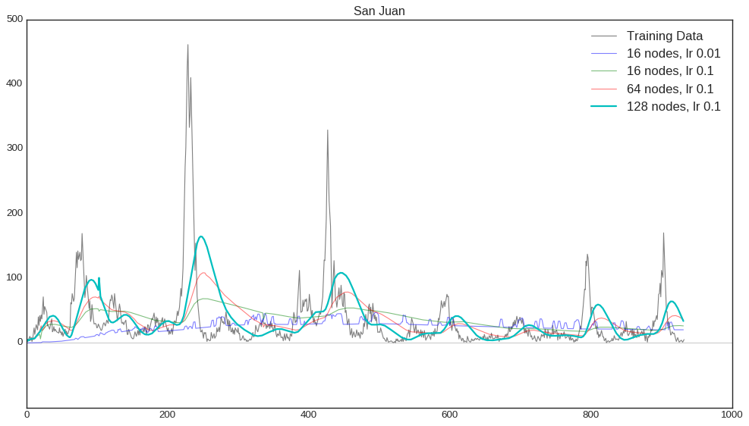
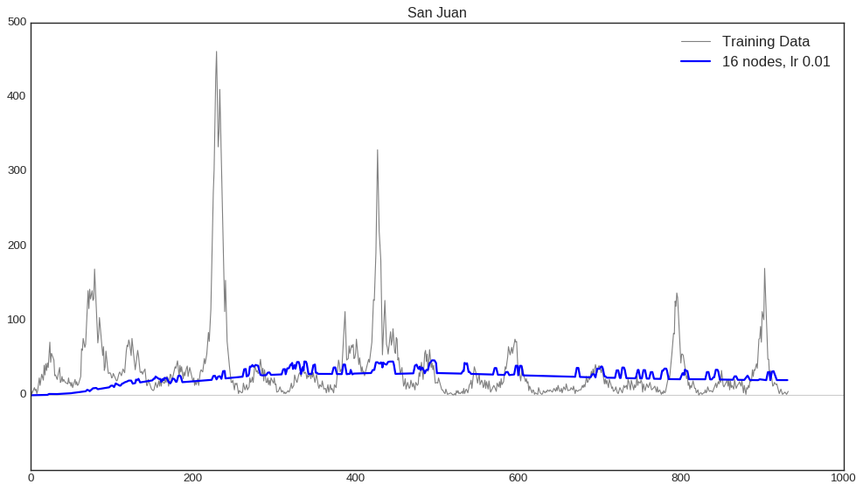
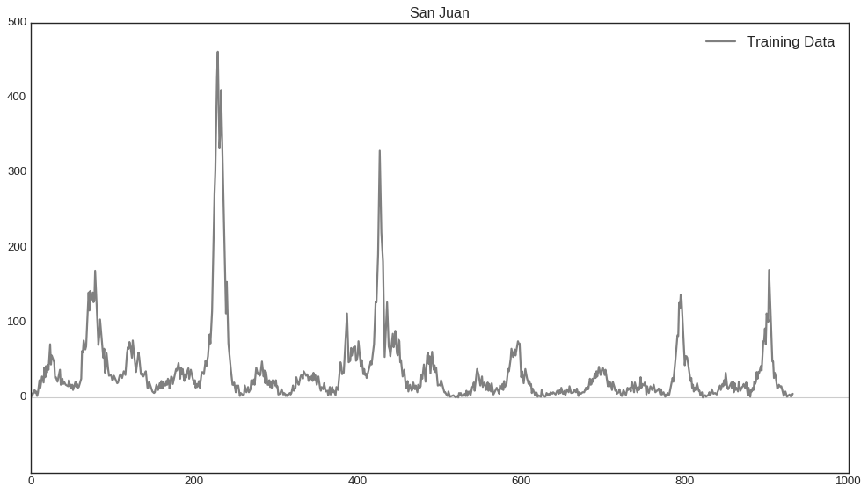
LSTM Training

Slide 15
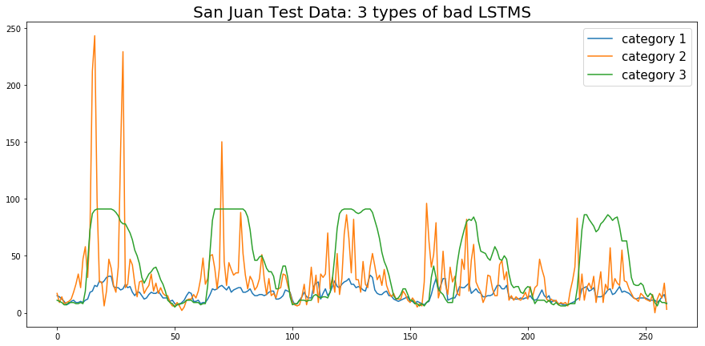
LSTM Performance
Ultimately, all the LSTM architectures I built fell into one of three categories:
Models that didn't predict any outbreaks (likely underfit)
Models that predicted nearly constant outbreaks (likely overfit)
Models that seemed to predict when an outbreak would happen, but continued predicting outbreak numbers for dozens of weeks after the fact. The error from these extended high predictions made these models unusable.
Best LSTM score: Mean Absolute Error of 26.8

Slide 16
Time Series Modelling using Lagged Features
Lag Features by n periods
Use with models that can ignore or penalize features (Random Forest, Lasso Regression, etc.)
ID | FeatureA | FeatureB | FeatureC
1 | A1 | B1 | C1
2 | A2 | B2 | C2
3 | A3 | B3 | C3
4 | A4 | B4 | C4
5 | A5 | B5 | C5
6 | A6 | B6 | C6
FeatureA_lag1 | FeatureB_lag1 | FeatureC_lag1
Need to impute | Need to impute | Need to impute
A1 | B1 | C1
A2 | B2 | C2
A3 | B3 | C3
A4 | B4 | C4
A5 | B5 | C5

Slide 17
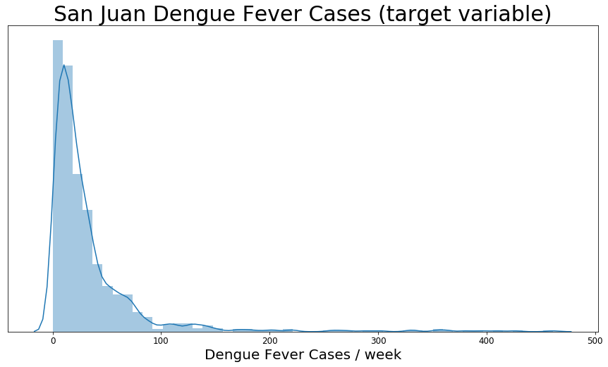
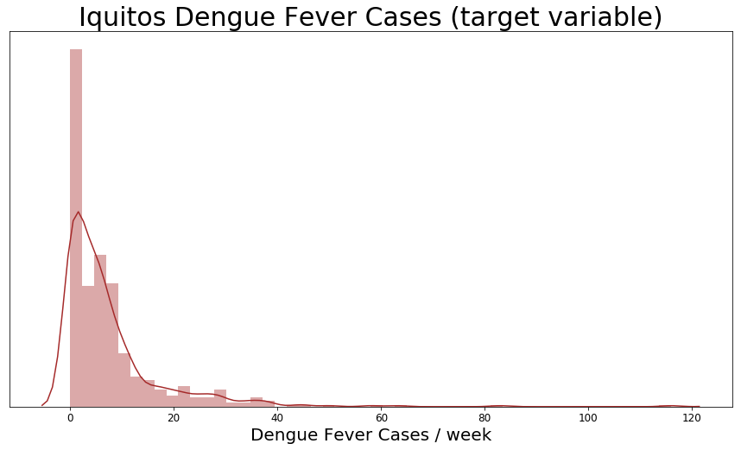
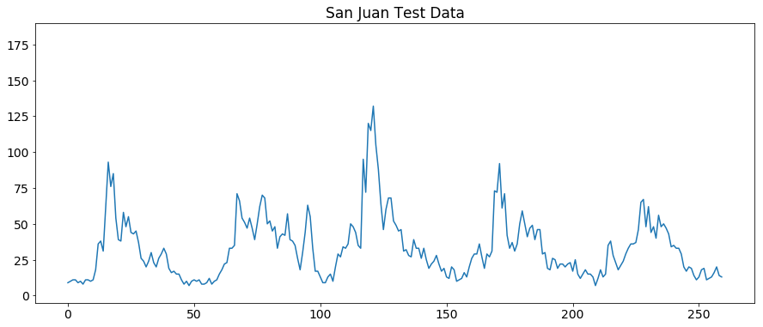
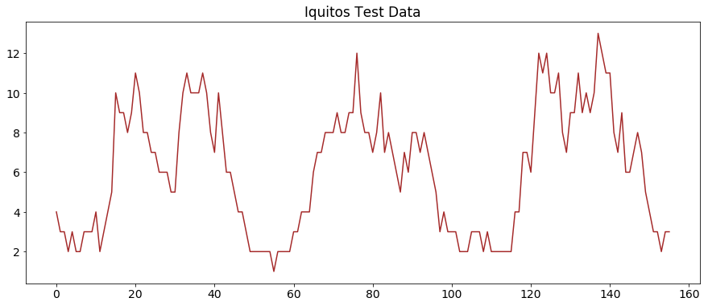
Random Forest Training
Model Choice: Random Forest Regressor:
No assumptions of linearity or normality, which would be problematic given the distribution of the target variable
Can “ignore” features that do not contribute to meaningful nodes in the trees. This is helpful since feature-lagging creates so many extra features
San Juan Random Forest Regressor via cross validated grid search | Maximum tree depth: 35 Maximum features considered per split: 5 Minimum samples to create a leaf: 3 Minimum samples to split a node: 2 Trees: 100
Iquitos Random Forest Regressor via cross validated grid search | Maximum tree depth: 10 Maximum features considered per split: 2 Minimum samples to create a leaf: 2 Minimum samples to split a node: 2 Trees: 300
Best LSTM score: Mean Absolute Error of 24.3

Slide 18
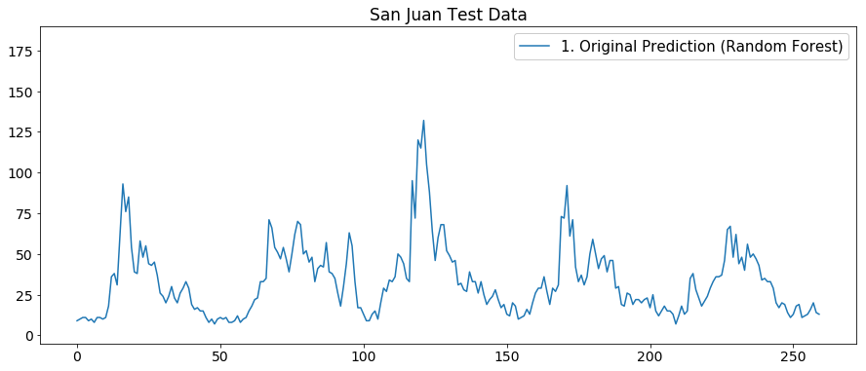
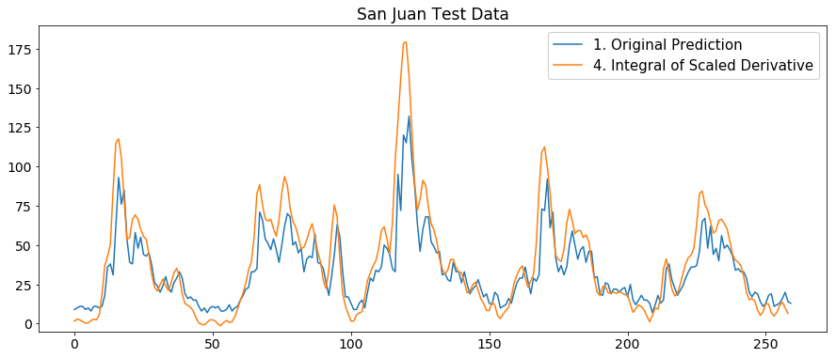
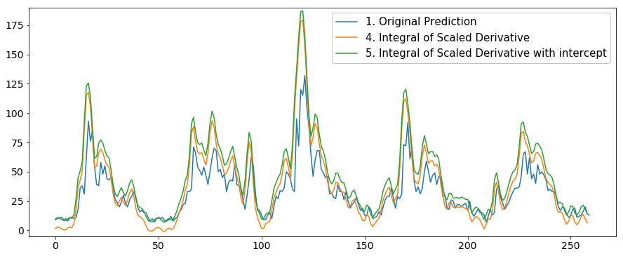
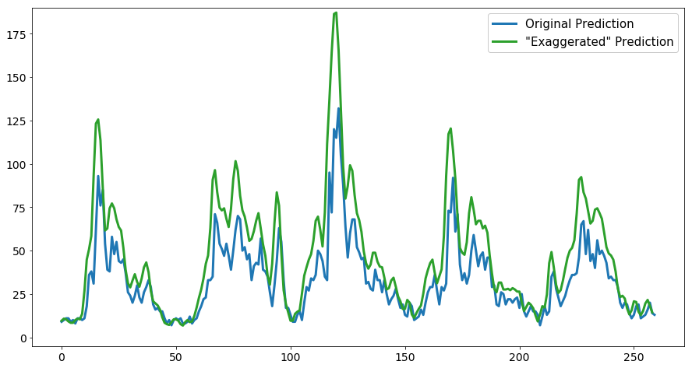

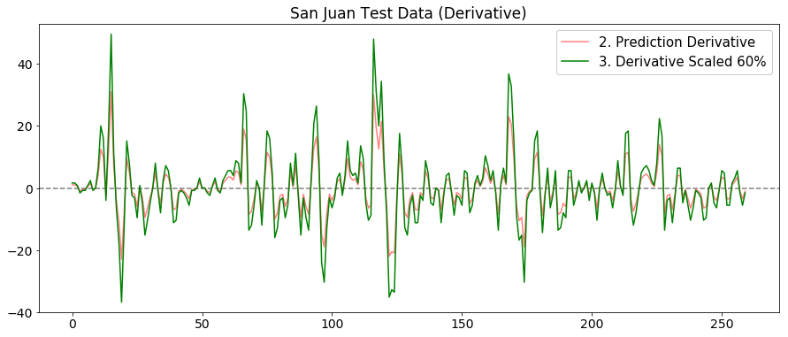
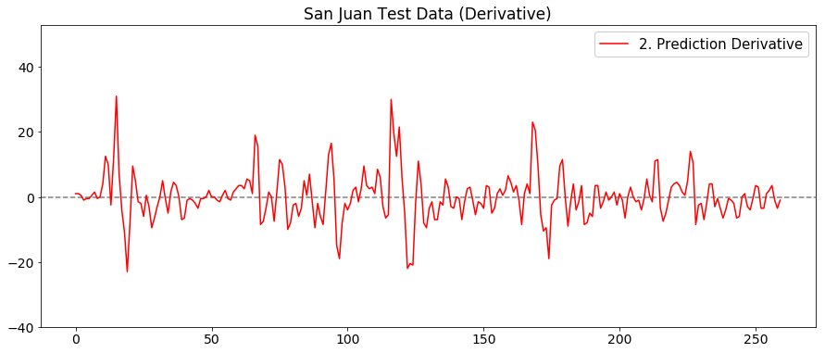
Peak Boosting
Reminder: the value of a disease outbreak predictor would be finding the outliers. Most models were unlikely to predict extreme values, so the following was done to boost the largest predictions:
Predict test data with model
Take derivative of the predictions
Scale derivative values
Take Integral of scaled derivative
Add “intercept” (the first predicted value)

Slide 19

Performance
San Juan Best Model:
Random Forest Regressor with 100 trees and maximum depth of 35
Prediction derivative scaled up by 60% to exaggerate predicted outbreaks
Iquitos Best Model:
Random Forest Regressor with 300 trees and a maximum depth of 10
Prediction derivative scaled up by 10% to exaggerate predicted outbreaks
Combined Mean Absolute Error of 24.0, good for 440th / 5910 competitors (93rd percentile)

Slide 20
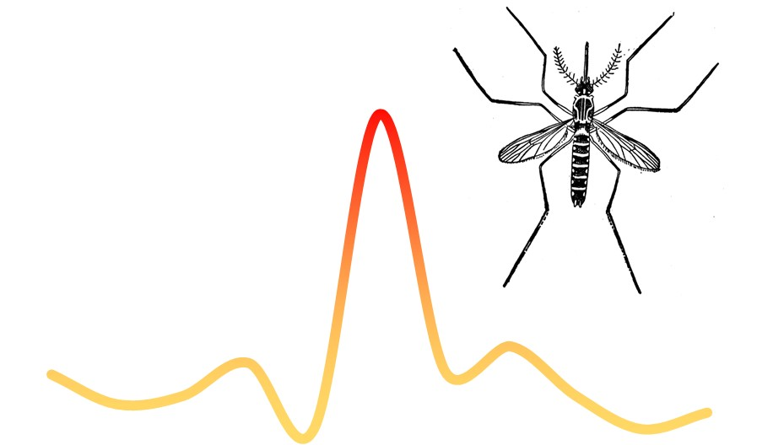
Resources
LSTMs:
Download The LSTM Reference Card and code an LSTM forward pass with just NumPy!
Free Udacity course on deep learning (including RNN’s) in pytorch
Helpful article on LSTM’s and GRU’s
Interesting podcast (TWiML&AI) suggesting you can trim an LSTM down to ONLY a forget gate
Walk Forward Validation guide by Dr. Brownlee (Machine Learning Mastery)
Dengue Fever and Aedes Aegypti mosquitoes:
Juliano, Steven A et al. “Desiccation and thermal tolerance of eggs and the coexistence of competing mosquitoes.” Oecologia vol. 130,3 (2002): 458-469. doi:10.1007/s004420100811
Yukiko Higa, Nguyen Thi Yen, Hitoshi Kawada, Tran Hai Son, Nguyen Thuy Hoa, Masahiro Takagi Journal of the American Mosquito Control Association (1 March 2010)
More about this project:
Full writeup: gregcondit.com/articles/dengue-fever
Github: /conditg/deng-ai

Slide 23


