Slide 1
TP VI
Investigation irregular 2D lattice with long-range
Yelizaveta
Kulynych

Slide 2
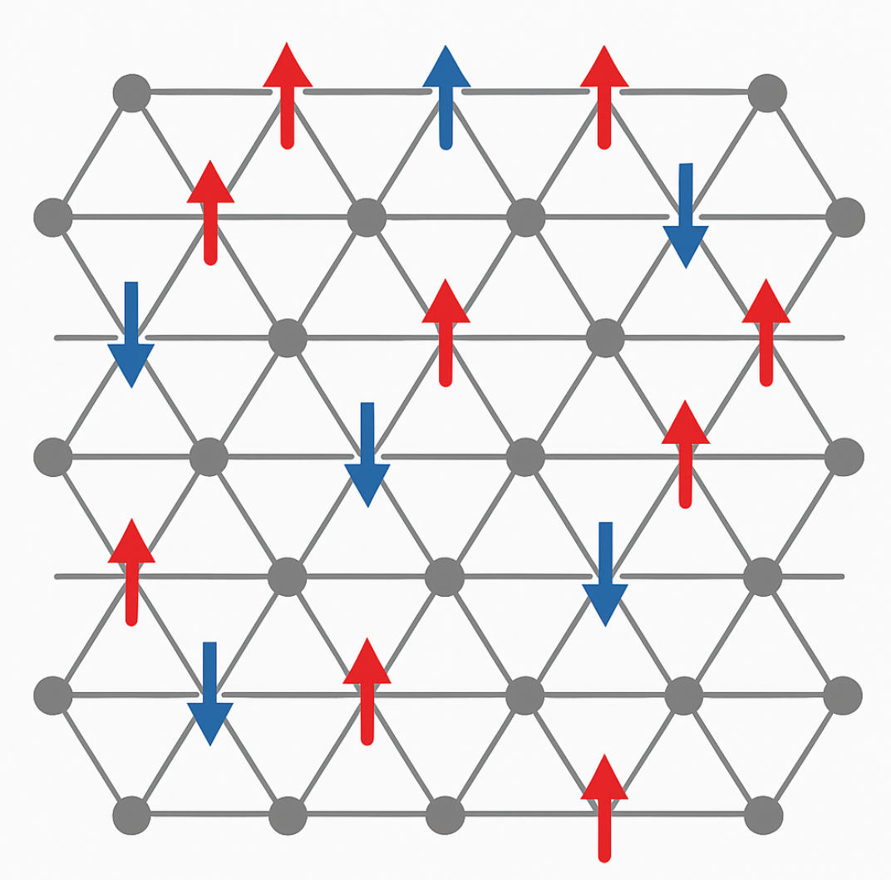
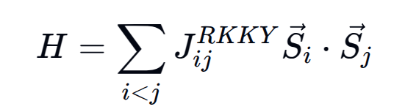
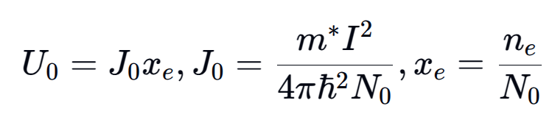
The model: triangular doped lattice
Hamiltonian is given by:
RKKY-interaction in 2D is given by:
.
TP VI
DOI: https://doi.org/10.1103/PhysRevB.58.3584

Slide 3
Plan of action:
Find the phase diagram for doped 2D triangular lattice:
Analytical approach: mean-field
Simulation
DFT:
Total Hamiltonian:
Yelizaveta Kulynych
TP VI

Slide 4
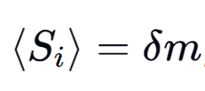
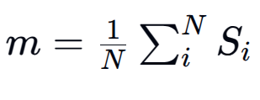
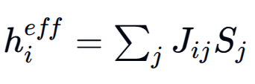
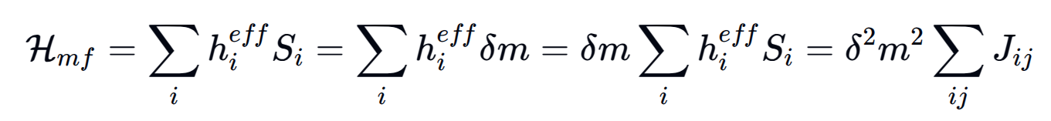
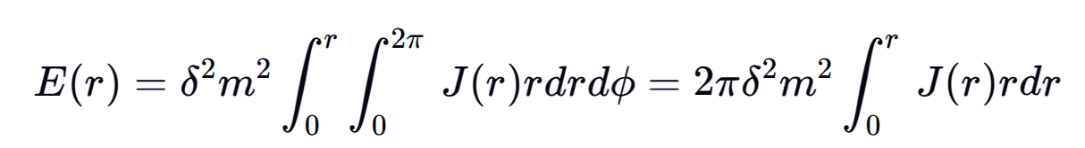
The analytical approach
Mean-field approach
Continuous model
/
TP VI
where

Slide 5
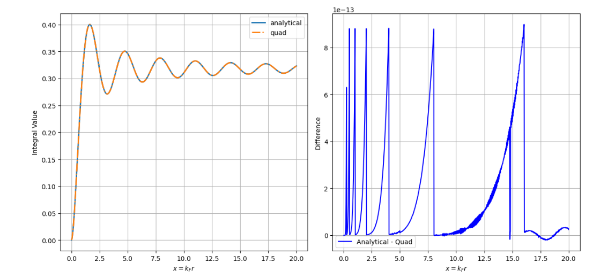
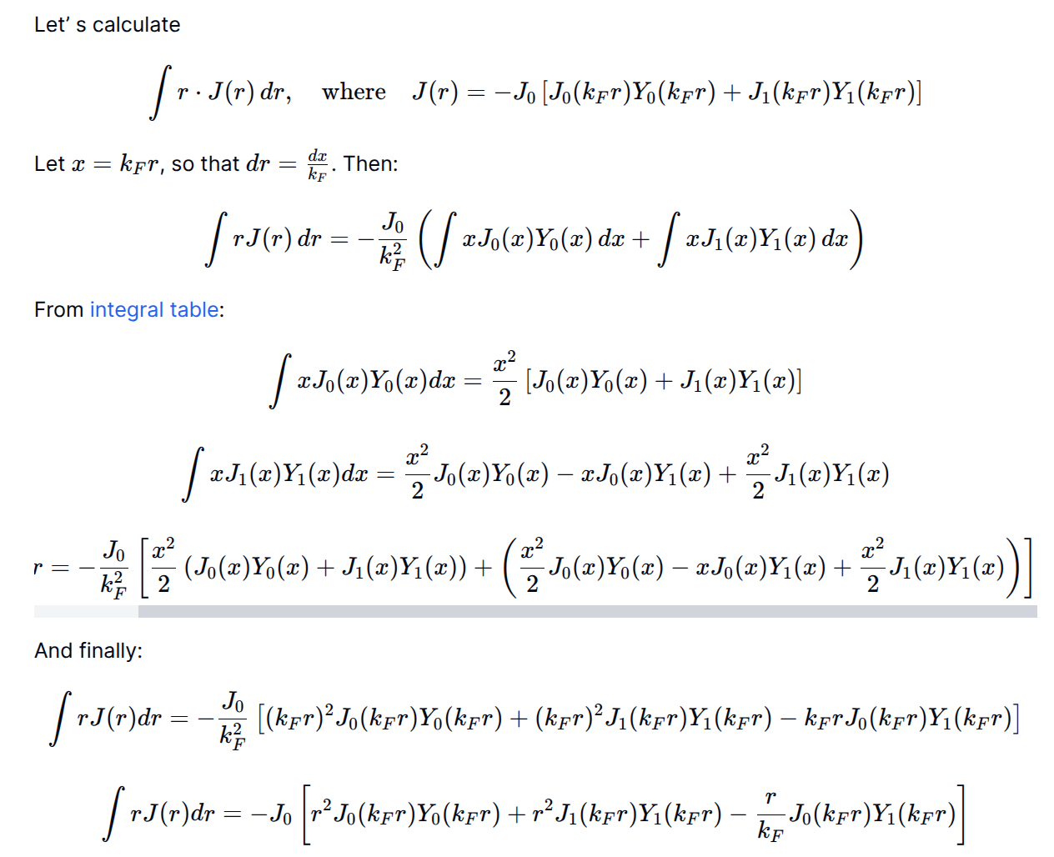
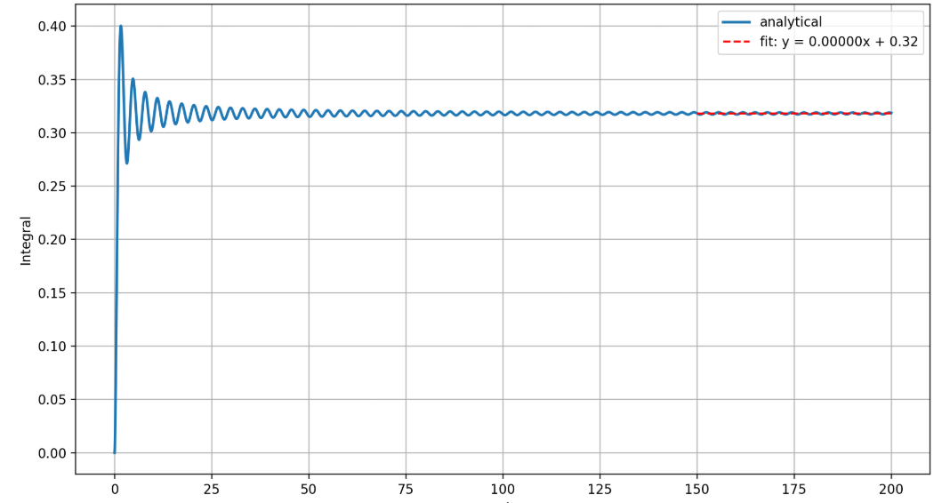
Calculations + sanity check
Yelizaveta Kulynych
TP VI

Slide 6
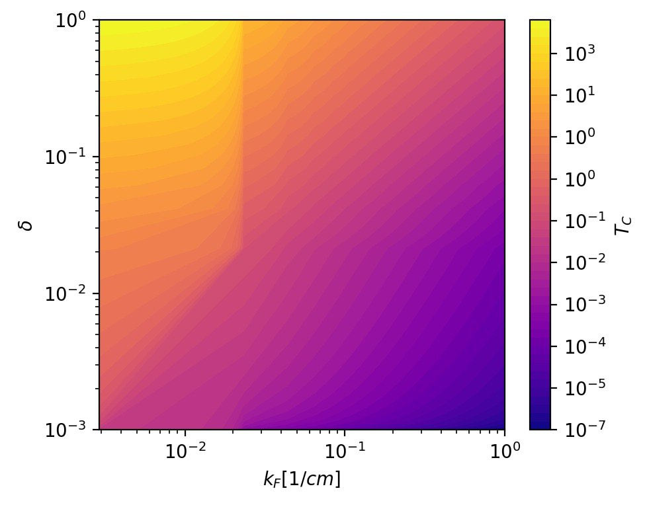
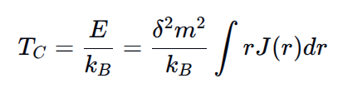
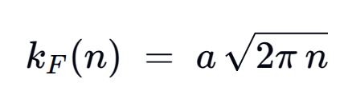

Phase diagram
We obtain the critical temperature:
where
Yelizaveta Kulynych
TP VI

Slide 7
Phase diagram
Create basis of recirpocal lattice vectors G:
Add to momentum k inside BZ:
Choose maximum for m,n: N
Create basis:
Total Hamiltonian:
Yelizaveta Kulynych
TP VI

Slide 8
Create basis of recirpocal lattice vectors G:
Add to momentum k inside BZ:
Choose maximum for m,n: N
Create basis:
Total Hamiltonian:
Yelizaveta Kulynych
TP VI

