Slide 1
ANNUAL GENERAL MEETING
AGM 2026
Kondominium Delima Emas
26th September 2026 · Community Hall
Prepared by the Joint Management / Management Committee
KONDOMINIUM DELIMA EMAS | AGM 2026
1

Slide 2
OVERVIEW
Meeting Agenda
1
Chairman's Address
6
Outstanding Arrears
2
Financial Overview
7
House Rules Update
3
Sinking Fund
8
Proposal / Suggestions / Amendments
4
Profit Summary
9
Community Highlights
5
Repair & Upgrade Works
10
Any Other Business
KONDOMINIUM DELIMA EMAS | AGM 2026
2

Slide 3
02 · FINANCIAL
CLOSING BALANCE
Maintenance Account Balance
RM 680,731.74
As at 31 December 2025
▼ RM 50,602 −6.9% vs 2024
KEY OBSERVATION
The maintenance account grew steadily from 2020 to 2024, reaching a high of RM 731,333.80, before declining by RM 50,602 (6.9%) in 2025.
HIGHEST BALANCE
RM 731,333.80 · 2024
YEAR-ON-YEAR MOVEMENT
2021
2022
2023
2024
2025
▲ +7.3%
▲ +4.8%
▲ +0.2%
▲ +6.8%
▼ −6.9%
Figure excludes fixed deposit savings of RM 300,000.00 (Maybank, placed 20 July 2019). Maintenance and Sinking Fund are held in separate accounts.
KONDOMINIUM DELIMA EMAS | AGM 2026
4

Slide 4
03 · FINANCIAL
SINKING FUND BALANCE
Sinking Fund
RM 354,884.02
as at 31 December 2025
RM135000 utilized for repair/replacement of building rooftop
Approved during EGM on May 2025
(RM 135,000.00)
KONDOMINIUM DELIMA EMAS | AGM 2026
5

Slide 5
03 · FINANCIAL
Profit Summary
Profit Breakdown by Source | 2025
Balance — Maintenance Fee | RM (76,720.37)
Access card & motor | RM 4,600.00
Interest on fixed deposit | RM 3,664.97
Penalty imposed | RM 2,565.00
Rental — parking | RM 9,375.00
Rental — equipment | RM 200.00
TOTAL | RM (55,850.06)
KONDOMINIUM DELIMA EMAS | AGM 2026
5

Slide 6
05 · SIGNIFICANT COST OF OPERATIONS
Repair & Upgrade Works — 2025
Rooftop repair / replacement of roof concrete
AUGUST
RM 178,200
TOTAL 2025 SPEND
RM 311,313
RM 34,408
Lift equipment major breakdown
NOVEMBER
across 6 major repair & upgrade items
Water tank repair
MAY-JUNE
RM 33,300
OVERALL
Depreciation of fixed assets (furniture, renovation, electrical)
RM 28,193
MAY
Swimming pool equipment repair
RM 18,850
Level 9 ceiling repair
RM 18,362
SEPTEMBER
KONDOMINIUM DELIMA EMAS | AGM 2026
7

Slide 7
06 · FINANCIAL
Outstanding Arrears
as at December 2025
5
5 units
Repaying via agreed payment arrangement
TOTAL OUTSTANDING
MAINTENANCE FEE
RM 36,232.45
1 unit
Referred to lawyer for legal proceedings
1
8 units involved
1
1 unit
Issued with 1st notice
1
1 unit
Issued with 2nd notice
KONDOMINIUM DELIMA EMAS | AGM 2026
8

Slide 8
06 · FINANCIAL
Outstanding Arrears
as at Aug2026
In progress proceed to tribunal court for selected case
TOTAL OUTSTANDING
MAINTENANCE FEE
5
RM 57,957.39
1
18 units involved
1
KONDOMINIUM DELIMA EMAS | AGM 2026
8

Slide 9
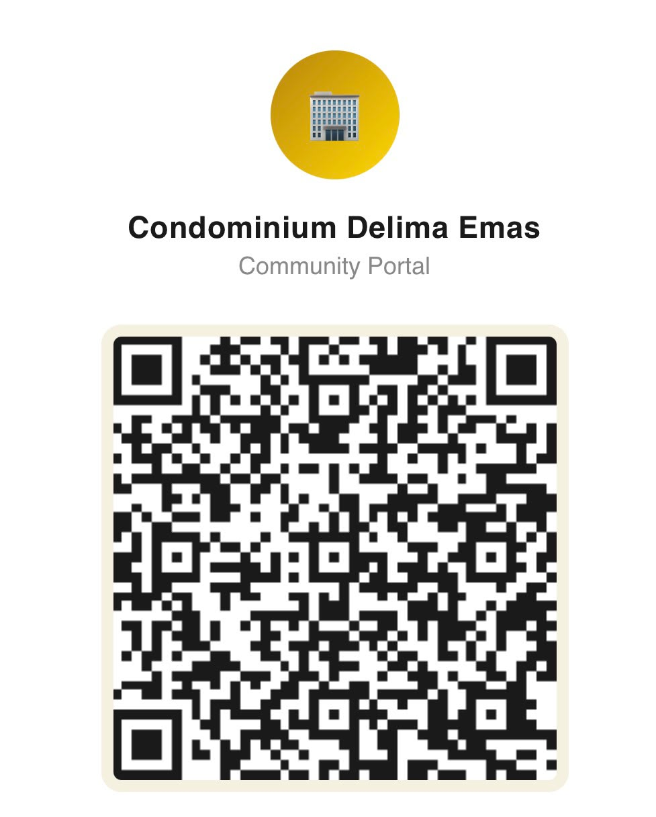
06 · Proposal/Suggestions/Ammendment
Previous House Rules/Bylaw Updates
https://condominiumdelimaemas.github.io/communityportal/
KONDOMINIUM DELIMA EMAS | AGM 2026
8

Slide 10
06 · Proposal/Suggestions/Amendment
2025 AGM Residents' Proposals — Recap
# | Resident Proposal (2025 AGM) | Proposed By | 2025 Vote Result | 2026 Status Update
1 | Allow foreign professionals to rent units, subject to compliance with by-laws and house rules; revoke the blanket restriction on foreign tenants. | MC 3-19 | 48 for / 18 against (Approved) | Approved. Subject to proper documentation and compliance with the applicable by-laws and House rules. The relevant requirements shall be referred to the House Rules, with confirmation to be obtained from management office
2 | Allow residents to install Invisible Grille at balconies, subject to MC-approved specifications (material, colour, design). | MC 7-19 | 54 for / 12 against (Approved) | Approved. The installation of invisible grille at balconies is subject to the specification approved by the MC and will be incorporated into the House Rules / By law updates.
3 | Allow residents to install Bamboo Roller Blinds (or similar sunshade material) at balconies, subject to MC-approved specifications. | MC 7-19 | 54 for / 12 against (Approved) | Approved. Residents are allowed to install bamboo roller blinds subject to specifications approved by the MC. The approved requirements will be incorporated into the House Rules/By-laws updates.
4 | Install Electric Vehicle (EV) charging facility within the condominium premises. | MC 3A-19 | 49 for / 17 against (Approved) | At present, the installation of an EV charger is not considered an immediate necessity due to the limited avaibility of suitable space within the condominium premises and the high installation and maintenance cost.
5 | Utilise available profit in the Maintenance Account to cover the upcoming 3 months of 2025 maintenance expenses, due to insufficient fund balance. | MC 2-11 | 59 for / 7 against (Approved) | Approved with total expenses for the three month period with amount RM144,000 based on average month maintenance expenditure of RM48,000
Proposals raised and voted on by residents at the 2025 AGM (27 September 2025) — carried forward for a 2026 status update
KONDOMINIUM DELIMA EMAS | AGM 2026
9

Slide 11
08 · PROPOSAL / SUGGESTIONS / AMENDMENTS
5% Discount for One-Year Advance Payment
Proposal: The Management Committee proposes a 5% discount on maintenance fees for parcel owners who pay one full year in advance, to be implemented for a one-year trial period.
PROPOSED TERMS
PURPOSE
Discount: 5% on maintenance fees, only applies to maintenance fee.
Encourage early and timely payment
Payment: full one-year maintenance fee paid in advance (From January to December)
Reduce outstanding maintenance fee arrears
Duration: one-year trial period
Improve the Management Corporation's cash flow
Sinking fund and other charges are not included in the discount
Owners with outstanding arrears must settle them before qualifying
Reward owners who make advance payment
The scheme will be reviewed after one year
KONDOMINIUM DELIMA EMAS | AGM 2026
10

Slide 12
08 · PROPOSAL / SUGGESTIONS / AMENDMENTS
Motorcycle park at car park area
The Management Committee proposes to allow motorcycles with an engine capacity of 600cc and above, owned by residents with a valid B Full motorcycle licence, to be parked at the resident's allocated car park bay, subject to Management approval.
KONDOMINIUM DELIMA EMAS | AGM 2026
10

Slide 13
08 · PROPOSAL / SUGGESTIONS / AMENDMENTS
Motorcycle park at car park area
The Management Committee proposes to allow motorcycles with an engine capacity of 600cc and above, owned by residents with a valid B Full motorcycle licence, to be parked at the resident's allocated car park bay, subject to Management approval.
Proposed Conditions
The motorcycle owner must hold a valid B Full motorcycle licence.
The motorcycle must be legally registered and road-legal.
Only 1 motorcycle shall be parked within the owner's existing allocated car park bay.
The motorcycle must not be parked in visitor parking, common areas, emergency access areas, pedestrian walkways or other unauthorised locations.
The arrangement is subject to prior approval from the Management.
The Management may impose reasonable conditions or withdraw approval if the parking causes obstruction, safety concerns or nuisance.
KONDOMINIUM DELIMA EMAS | AGM 2026
10

Slide 14
09 · COMMUNITY
Community Highlights
Galeri & Aktiviti Delima Emas
1
Festive Celebrations
2
Community Gotong-Royong
Photo highlights to be added by the Management Committee.
Photo highlights to be added by the Management Committee.
3
Sports & Recreation
4
Committee Engagement
Photo highlights to be added by the Management Committee.
Photo highlights to be added by the Management Committee.
KONDOMINIUM DELIMA EMAS | AGM 2026
12

Slide 15
TERIMA KASIH
Thank You
Kondominium Delima Emas · Management Committee
KONDOMINIUM DELIMA EMAS | AGM 2026
13

Slide 16
?
10 · Any Other Business
Hal-Hal Berbangkit
Any Other Business
KONDOMINIUM DELIMA EMAS | AGM 2026
14

