Slide 1
Lesson 1 Case 1
Node FileSystem - csv

Slide 2

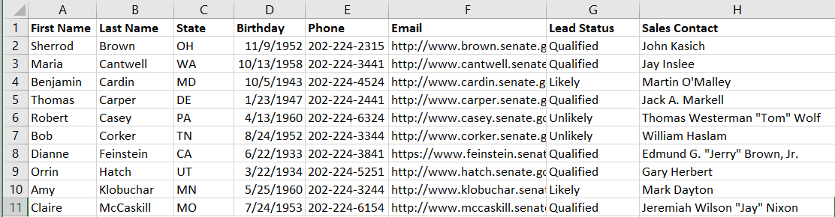
Defining what we want
Inputs
Outputs
Texas
Consolidated List of Leads
New York
Process
California
Colorado
… + 46

Slide 3
Process Flow

Slide 4
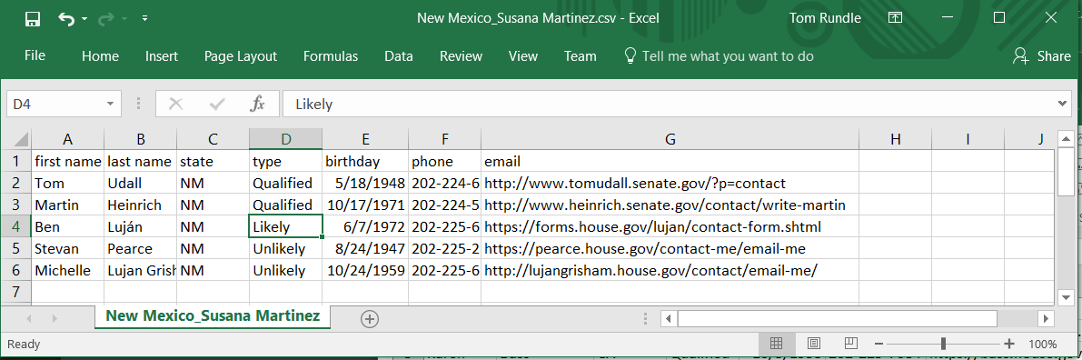
Case 1
We’ll start by taking files that are already formatted the way we want and consolidating them into one file. There’s a couple of things we’ll need to know about to do this:
Reading a directory with fs.readdir
Reading a file with fs.readFile
Writing a file with fs.writeFile
When we complete this case, we’ll have the bulk of automation handled as long as all team members give us the information we want in exactly the format we want it in. The solution is scalable for any number of files. This can save you a lot of time or would be a necessity depending on the scale you are working with, especially if you wanted to consolidate say 1,000 files or 10,000 for that matter.

Slide 5
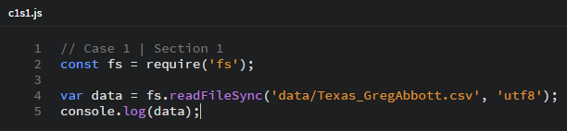
Section 1 | Listing
Require the fs module
Define constants

Slide 6
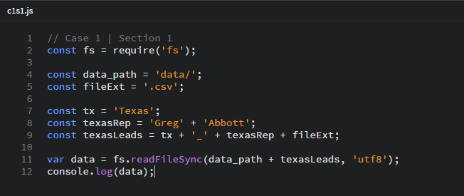
Section 1 | Sidebar – naming convention, using variables, string concatenation
These include our the path to our files, and the file extension we are expecting. And the file name. It’s important that our input files use filenames that follow a convention.
I’ve broken up the file name across constants to illustrate the naming convention I’ve chosen for this exercise.
stored value is “Texas_GregAbbot.csv”
argument passed: “data/Texas_GregAbbot.csv”

Slide 7
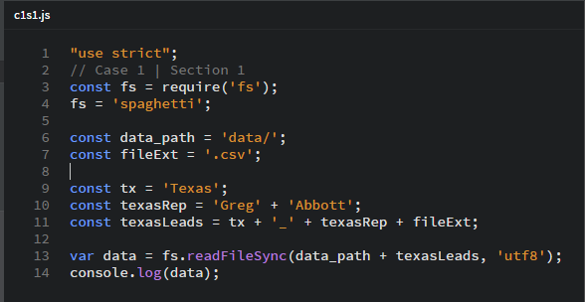
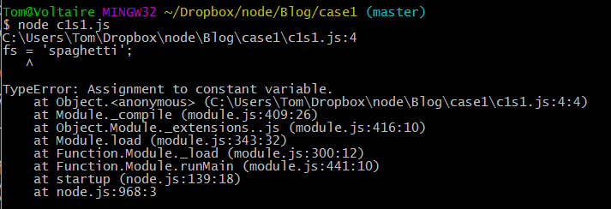
Section 1 | Sidebar
enable strict mode
in strict mode, an attempt to reassign a constant throws an error
If strict mode isn’t enabled, the program will just ignore the reassignment.

Slide 8
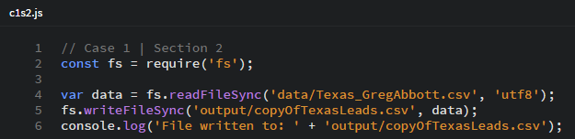
Section 2 | Listing

Slide 9
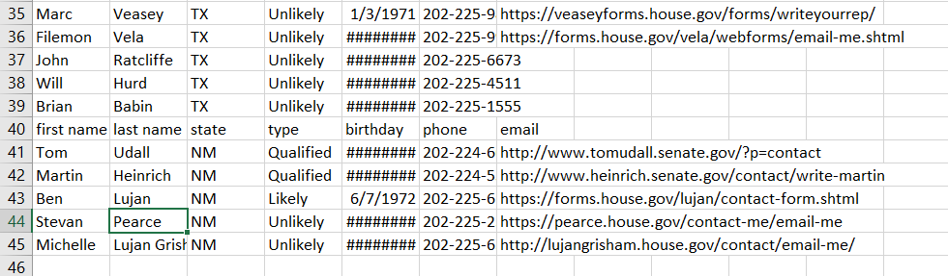
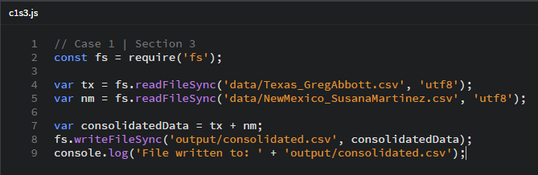
Section 3 | Listing
Output
We read each file separately, storing it to a variable. Then, we concatenate the data into our consolidatedData . Lastly, we write the new file.
We’ve accomplished the task but this doesn’t really save us much in terms of effort. Importantly, we now know how to read and write individual files.
Looking at our output, we see that we’ve concatenated the files. To make this output useable, we’d still have to remove the extra header rows tacked on when each file is joined.

Slide 10
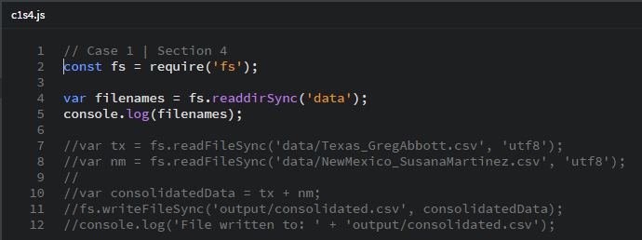

Section 4 | Listing
I’ve added the synchronous read directory method. I commented out the rest of the code so that we can focus on looking at how this method works.
Console output
Array of file names

Slide 11


fs.readdirSync
Node.js v6.2.2 Documentation
fs.readdirSync(path[, options])
Added in: v0.1.21
path <String> | <Buffer>
options <String> | <Object>
encoding <String> default = 'utf8'
Synchronous readdir(3). Returns an array of filenames excluding '.' and '..'.
Inputs
Outputs
fs.readdirSync
[ ‘file1.csv’, ‘file2.csv’, ‘file3.csv’ ]

Slide 12
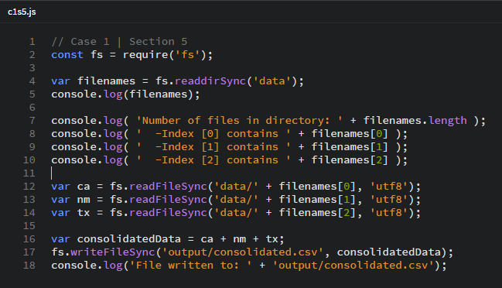
Section 5 | Listing
Here I explain how arrays work. The code is organized the way it is to illustrate the concept

Slide 13
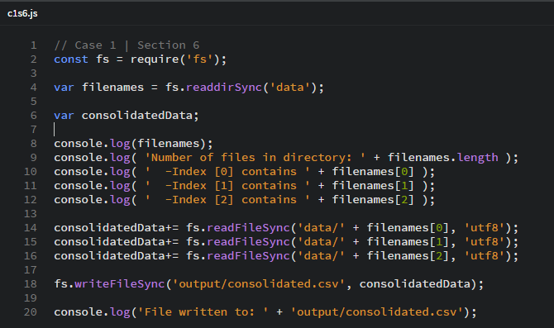
Section 6 | Listing
Introduce the += operator
See how it simplifies the code

Slide 14
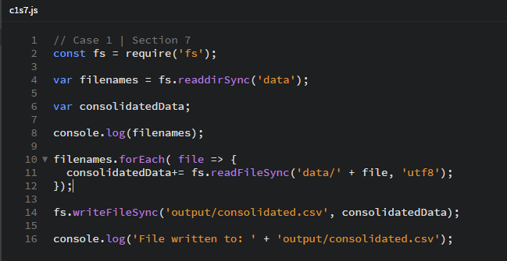
Section 7 | Listing
Introduce looping
Now we’re really getting the program to work for us.

Slide 15
Section 8 | Listing
I like having the program tell us what it is doing while it’s doing it. Let’s add our logging back in.

Slide 16
Section 9 | Listing
For an acceptable finished product, we still have to manually remove the extra headers from each file added to the consolidated report .

Slide 17
INDEX:
0
1
2
[ “California_JerryBrown.csv”, “NewMexico…”, “Texas…” ]
variable:
filenames
type: Array

