Slide 1
Lesson 1 Case 2
Node FileSystem - csv

Slide 2
Expanded data set
Logging matches
writing a report
Writing remediation msg to input user
Defer this one
Node modules
Fixing another
Defer this one
Validate API
Fixing one type of format
Defer this one
Normalization
Defer this one
Logging API

Slide 3
c2listing1
This is exactly the same as where we left off with c1l8 except that the path now points us to the data set for case 2. Run the script and notice that that it does indeed scale to handle the 10 files that are in this data set.
Objective:
Log discrepancies
Normalize file formatting

Slide 4
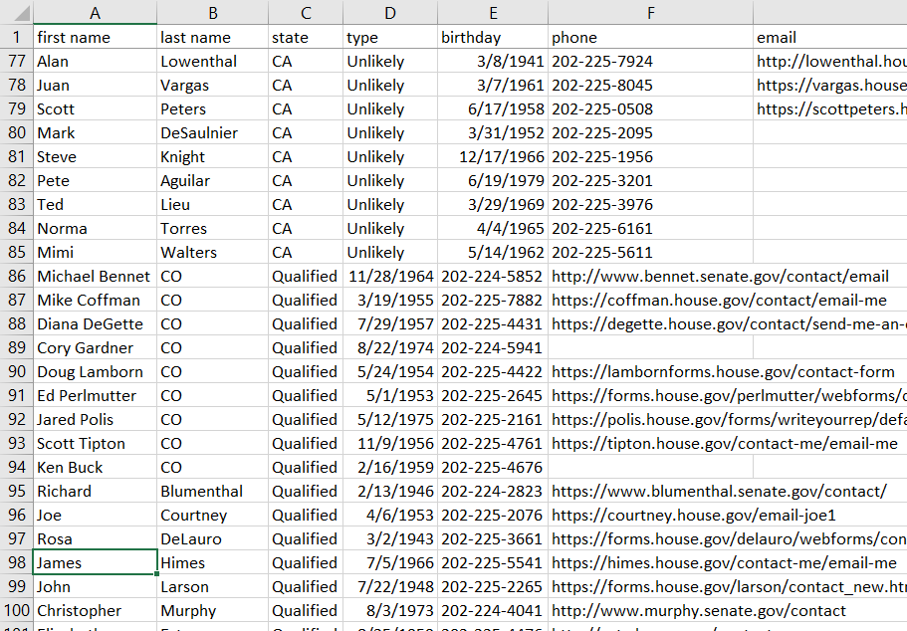
c2listing1 output
The script scales nicely to handle the additional files. It requires no modification whatsoever to do so. Looking closer, you’ll see some discrepancies with the consolidated data. We’ve made an automation tool that works perfectly as long as our sales team members give us exactly the input we want— but what opens if they don’t?
If you visually inspect the output of c2-listing1.js, you’ll see that we have some issues with our report.
expected last name here
expected state here

Slide 5
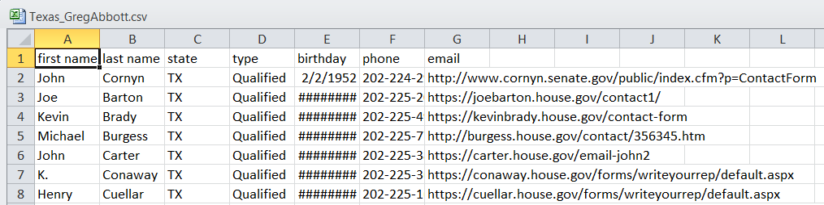
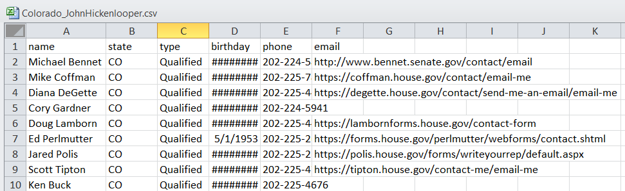
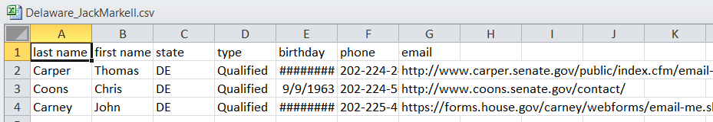
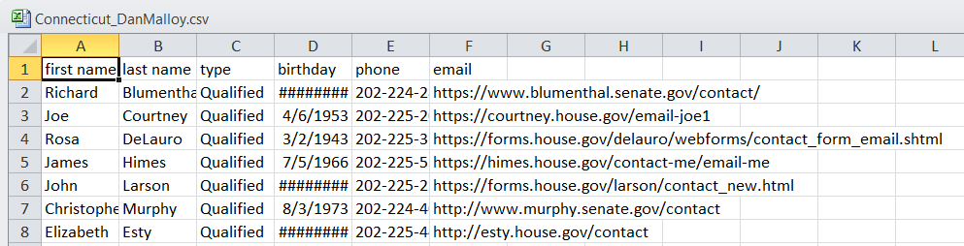
Inspecting our inputs
Model input
first and last name contained in single column
first and last name in reverse order
state column not included
Looking at the inputs from the sales team, we see where the issues are coming from. However, what if we could have our script warn us when we don’t get the input we expected so don’t have to search for it ourselves?....

Slide 6
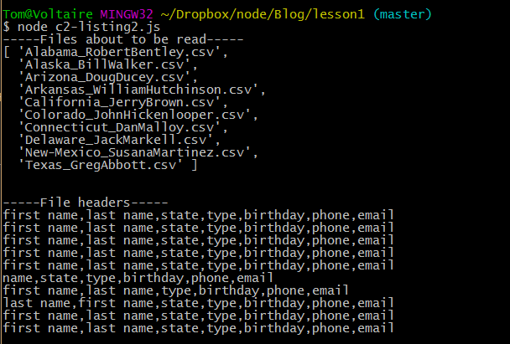
c2-listing2 checking our data and creating a log

Slide 7
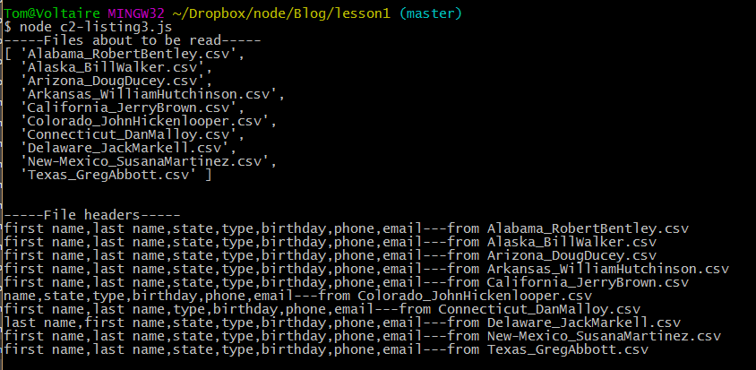
c2-listing3 – naming the guilty

Slide 8
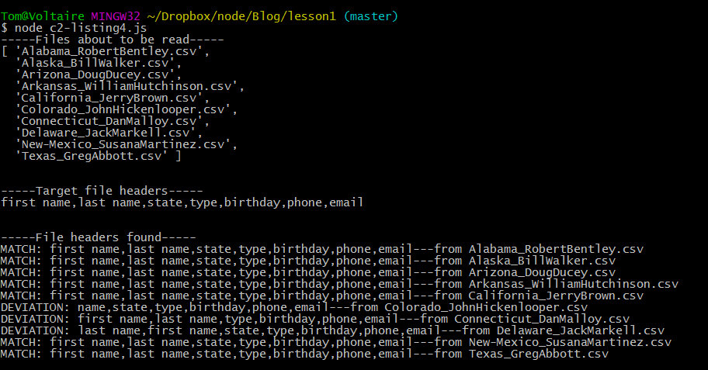
c2-listing4 – having the system tell us there’s a problem rather than relying on us coming to our own conclusion

Slide 9
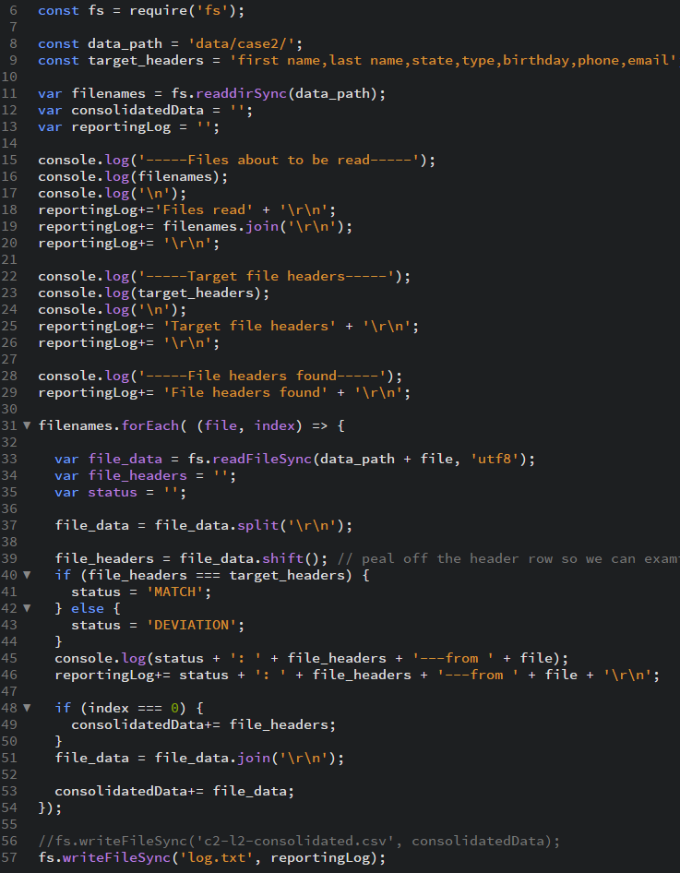
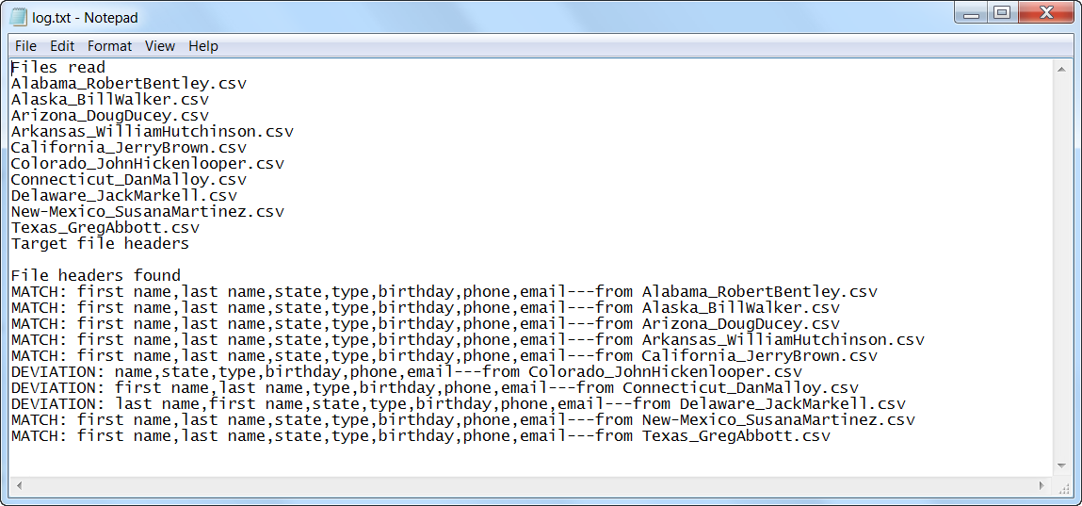
c2-listing5 – writing a log file
We want to have the same information that we’re printing to the console to be stored in a file. In this listing, we’ll do that.
The program now barely fits on the screen– of course many complex programs will be hundreds or thousands of lines long, but in this case, we can accomplish the same result in a more concise and more readable way. Let’s take a look at how to do that.

Slide 10
c2-listing6 – housekeeping
We’ll move all of our logging capabilities into a function.

Slide 11
c2-listing7 – housekeeping part 2
We’ll move all of our logging capabilities into a function.

Slide 12
c2-listing8 – a little extra – log formatting utility
We’ll move all of our logging capabilities into a function.

Slide 13
c2-listing9 – modularize

Slide 14
c2-listing? – avoid false reports
Trimming excess whitespace
Handle variations of column names – “first name”, “firstname”, “First Name”, “FIRST NAME”, “first_name”

Slide 15
c2s20.js

