Slide 1
Roadmap
Node FileSystem - csv

Slide 2
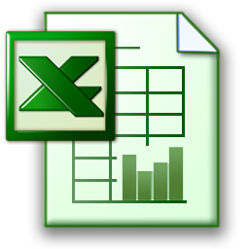


Consolidate multiple files into a single file
Make comparisons of files and report on deviations
Logging
Validation

