Slide 1
Lesson 1 Case 3
Node FileSystem - csv

Slide 2
c3listing1
There are no modifications to the code in this listing from the last one in the previous case. However, like last time, note that our data set has changed. Go ahead and run it and see.
Objective:
Log discrepancies
Normalize file formatting

Slide 3
c3 listing2 – Separation of powers

Slide 4
c3 listing3 – Normalize the headers

Slide 5
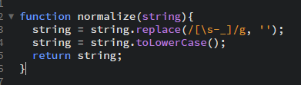
c3-listing5.js | c3l5-validate.js
c3l5-validate.js
We’ve used a regular expression that will match any whitespace ( \s ), hyphen ( - ), or underscore ( _ ).
This regular expression is plugged in the replace method as the first argument and we define our replacement as an empty string ( ‘’) in the second argument.

Slide 6
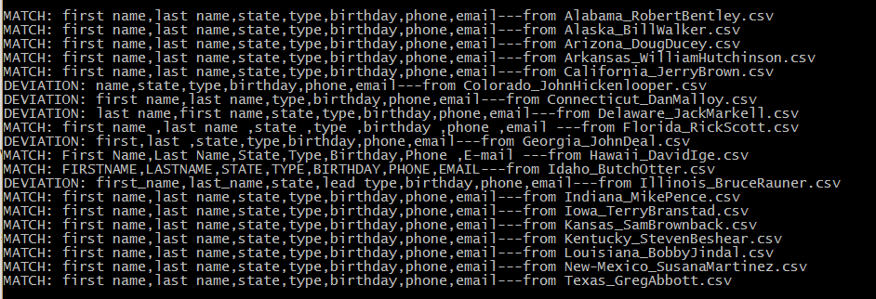
c3-listing6.js | c3l6-validate.js | c3l6-log.js

Slide 7
c3-listing6.js | c3l6-validate.js | c3l6-log.js (cont’d)
Implement Log class
Write tests for Log class and class methods
Let’s update our validate.js utility to use log.js in order to give us a report of how the comparisons are being made. This will give us a better idea of how close the validate utility is to working the way we want it to.
This is going to be harder than I thought because a need a new log instance for every module that calls it.

Slide 8
It’d be a good idea to show what happens when you don’t implement the constructor function. Trying to scale the old version of the log module you find that you are unable to write to more than one log file.
You could work around it by copying the log.js file and then adding another require to the program, basically using two modules instead of one. However, this won’t scale well. If you were a customer of this application then you would have to put in a request every time you wanted a new type of log file created. Part of the purpose of this blog / lesson is to illustrate how learning about code can help you become a better customer of IT services… this is extremely important– I’ve worked for companies who waste millions of dollar every year on poor code that isn’t scalable. I can make the containerization analogy– companies like Maersk transformed the logistics industry by using standard containers. The IT analogy of many companies today is that they are like the guy carrying multiple bricks on their head (this is the IT guy with the shitty code base)– it’s an impressive feat but we have better methods available. Using something like npm is the software development analog to the container revolution in the logistics industry.
In a sense, this article inspired me on this line of thought: https://medium.com/@loorinm/coding-is-over-6d653abe8da8#.lpplu7ca3 . And the reason we keep writing the same tired old code is because we haven’t innovated the business models– we don’t know how to pay people to think, dream and imagine. We don’t know how to charge for it. We bill by the hour– building another REST API is the ability to bill a lot of hours.

Slide 9
Tests
1) Make sure the damn thing runs
2) Test to see if it runs with default parameters
3) Test to see if it runs with supplied arguments
4) Test that it returns expected values

Slide 10
c3-listing7.js | c3l7-validate.js | c3l7-log.js implement logging in util/validate.js
This one took a lot of work as well – at least in terms of troubleshooting. Hopefully I’ll remember some of the pitfalls so I can explain them or show examples. The key was that I need to export the instance of the log from the validate.js module. I was calling the log.create() method within the module, which of course during execution was called when the module was loaded– not after all the files were written, which was what I intended.
I’m really happy with the way this is coming together. I feel like it’s written quite elegantly, especially for a rookie. With these fundamentals in place, it will get really exciting when I start working with the frameworks.

Slide 11
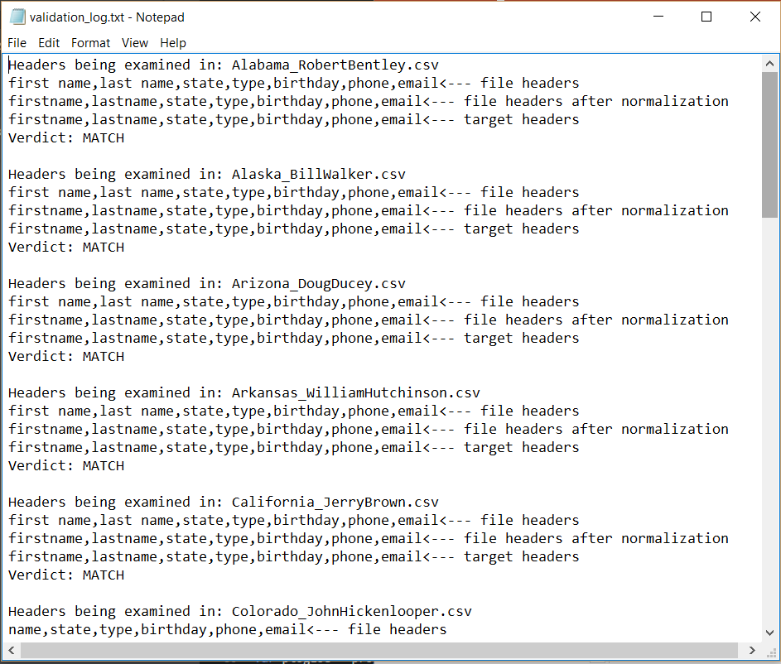
c3-listing8.js | c3l8-validate.js | c3l8-log.js implement logging in util/validate.js
OK now that I’ve figured out how exactly the fuck to make an instance of the Log class in validate.js, I need to actually make use of it. Let’s design our log file.

Slide 12
c3-listing9.js | c3l9-validate.js | c3l9-log.js verbose() method in log.js

Slide 13
c3-listing10.js | c3l10-validate.js | c3l10-log.js report() method in validate.js && log.js
The objective is to have the program tell me at the bottom of the log what the deviations were and show the comparisons so that I don’t have to look through the whole list myself.

