Slide 1
Lesson 1 Case 1
Node FileSystem - csv

Slide 2

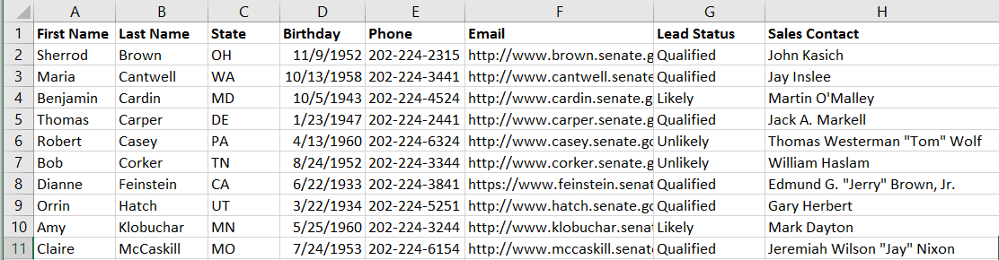
Inputs
Outputs
Texas
Consolidated List of Leads
New York
Process
California
Colorado
… + 46

Slide 3
Process Flow

Slide 4
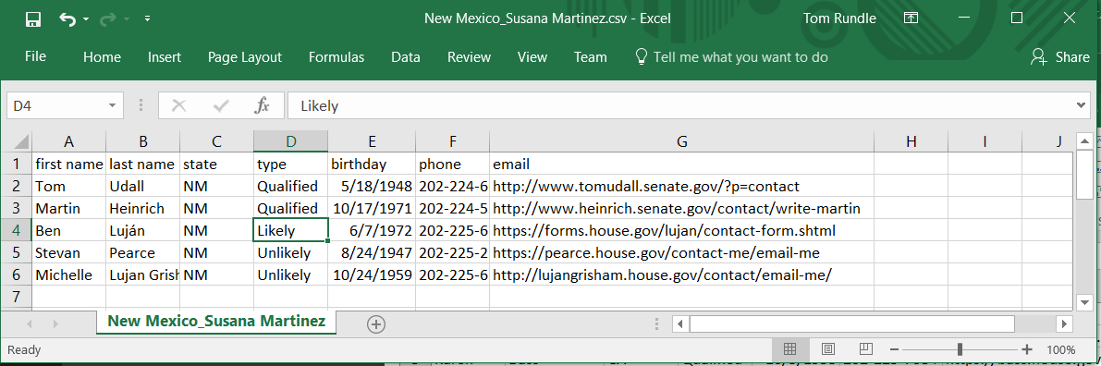
L1 – Case 1
We’ll start by taking files that are already formatted the way we want and consolidating them into one file. There’s a couple of things we’ll need to know about to do this:
Reading a directory with fs.readdir
Reading a file with fs.readFile
Writing a file with fs.writeFile
When we complete this case, we’ll have the bulk of automation handled provided all team members give us the information we want in exactly the format we want it in. The solution is scalable for any number of files. This can save you a lot of time or would be a necessity depending on the scale you are working with, especially if you wanted to consolidate say 1,000 files or 10,000 for that matter.

Slide 5
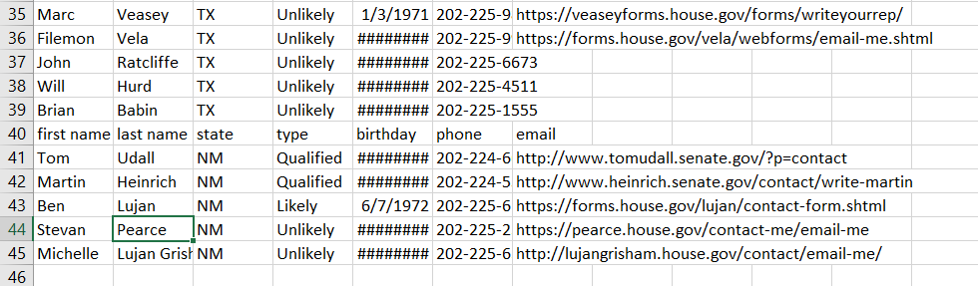
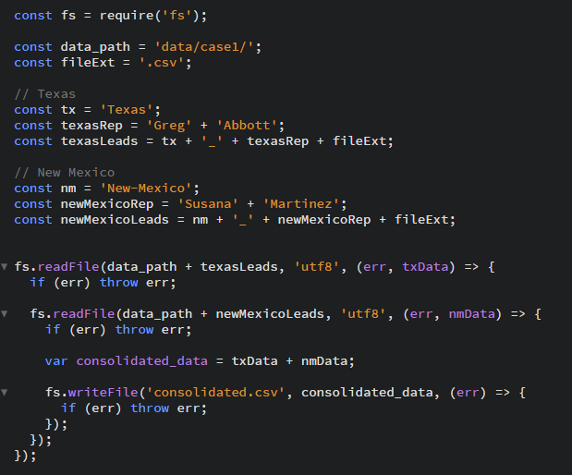
Listing 3
Output
We’ve accomplished the task but this doesn’t really save us much in terms of effort. Importantly, we now know how to read and write individual files.
Looking at our output, we see that we’ve concatenated the files. To make this output useable, we’d still have to remove the extra header rows tacked on when each file is joined.
Also, the code is hard to maintain. It’s in this structure because node executes asynchronously. It’s out of scope for this lesson to explain the asynchronous nature of node. To simplify our code, we will introduce you to synchronous read/write methods in the next listing.

Slide 6
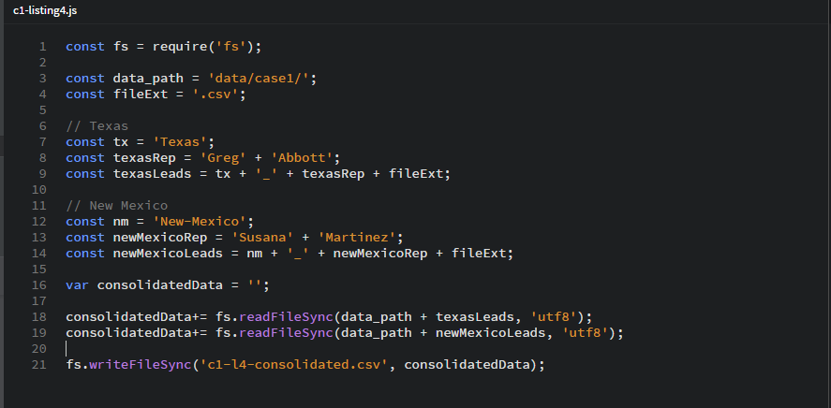
Listing 4
Now the code is refactored to use synchronous fs methods. It’s much more concise and readable.

Slide 7
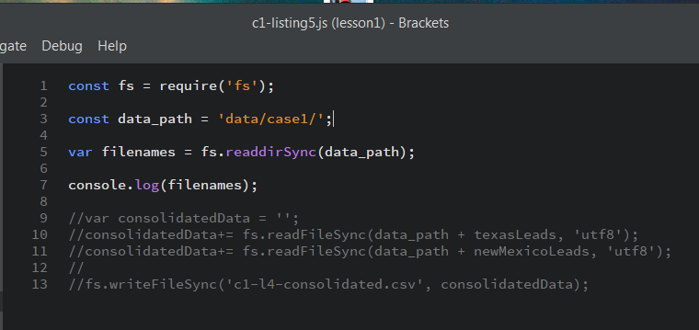

Listing 5 – Introducing readdir
I’ve added the synchronous read directory method. I commented out the rest of the code so that we can focus on looking at how this method works.
Console output
Array of file names

Slide 8


fs.readdirSync
Node.js v6.2.2 Documentation
fs.readdirSync(path[, options])
Added in: v0.1.21
path <String> | <Buffer>
options <String> | <Object>
encoding <String> default = 'utf8'
Synchronous readdir(3). Returns an array of filenames excluding '.' and '..'.
Inputs
Outputs
fs.readdirSync
[ ‘file1.csv’, ‘file2.csv’, ‘file3.csv’ ]

