Slide 1
Creating an Express project

Slide 2
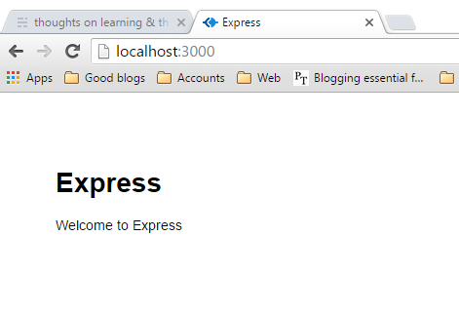
Initialize project
$ express
this will create the folder structure and package.json, but will not install the node modules.
npm install
Test the installation – npm start

Slide 3
Folder structure (Getting MEAN – Manning Publications)
app_server
controllers
models
routes
index.js
users.js
views
error.jade
index.jade
layout.jade
bin
node_modules
public
app.js
package.json
update paths in app.js to include app_server

