Slide 1
WineClubReviews.net
Exploratory Data Analysis Project

Slide 2
Summary of data
635,000 click data observations, including 77 variables
832 club observations, including 66 variables
27,704 sales
Most of the data analysis is centered around the following variables:
Club group (clubgroup_id.x)
Commission (total)
Revenue by club group (revenue)
Conversion date (cdate)
Club group offerings, including color selection and number of bottles (selcolor.name, bottles)
Average price per bottle (price_per_bottle) for within each club group

Slide 3
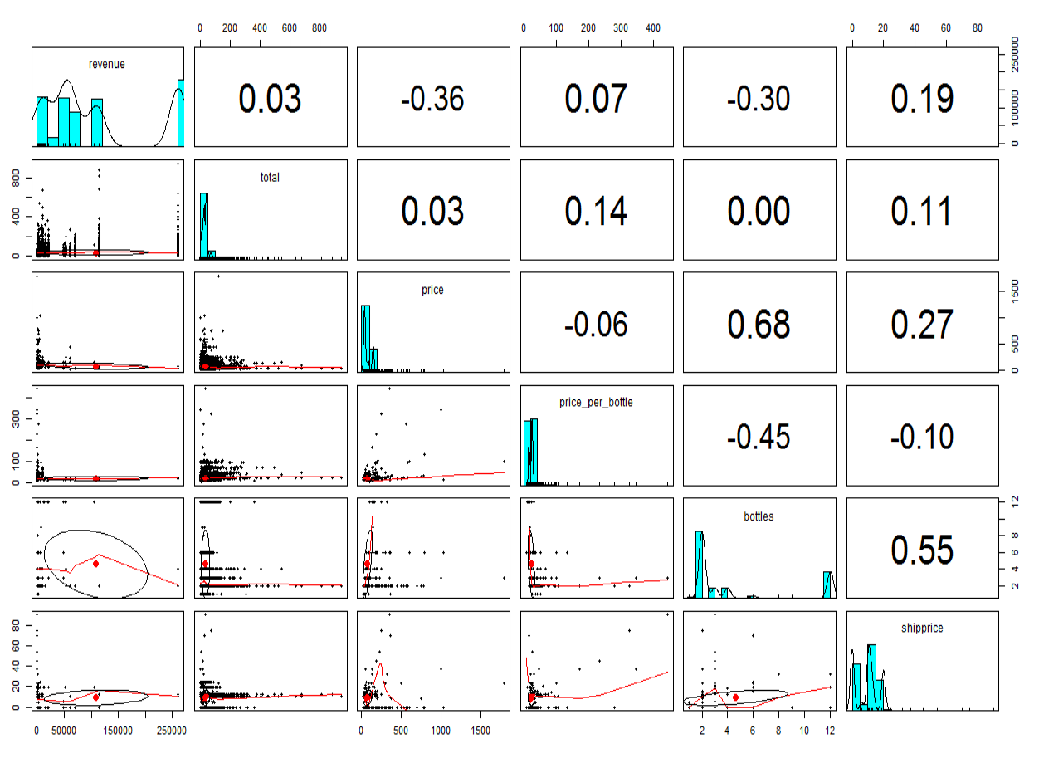
Variable correlations

Slide 4
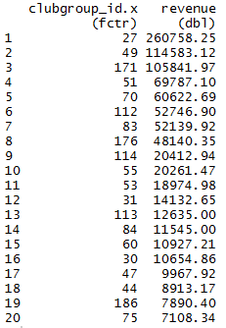
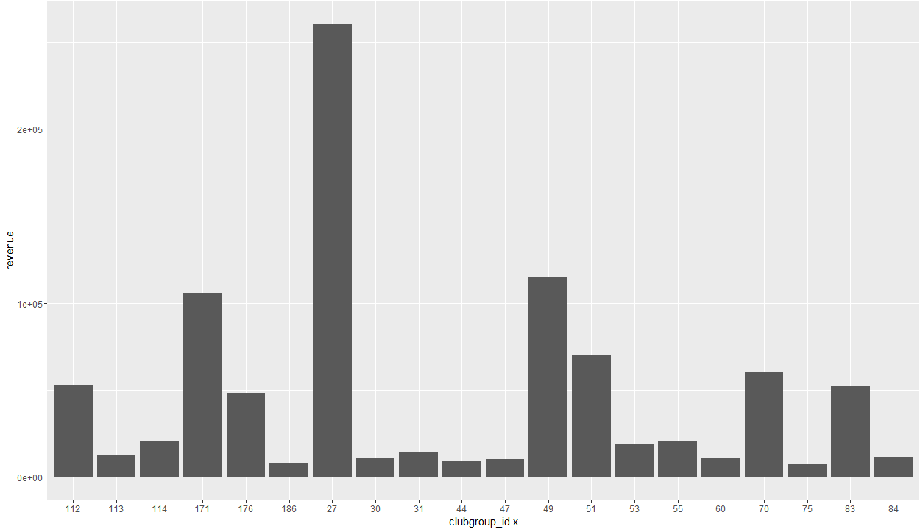
Top 20 club groups by revenue

Slide 5
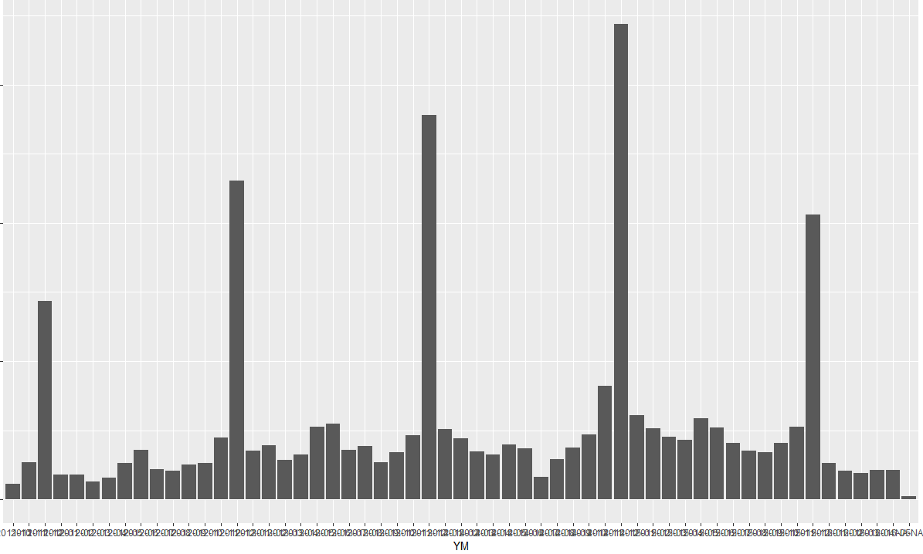
Total revenue by month

Slide 6
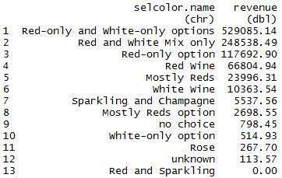
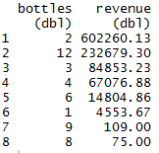
Other revenue breakdowns
Revenue by club wine color choices
Customers prefer clubs that offer choices including red wine by over 48:1
Revenue by number of bottles per shipment
2 bottle shipments account for more than 2x the next highest shipment quantity, and 2 and 12 bottle shipments combined account for over 80% of revenue over the past 4.5 years

Slide 7
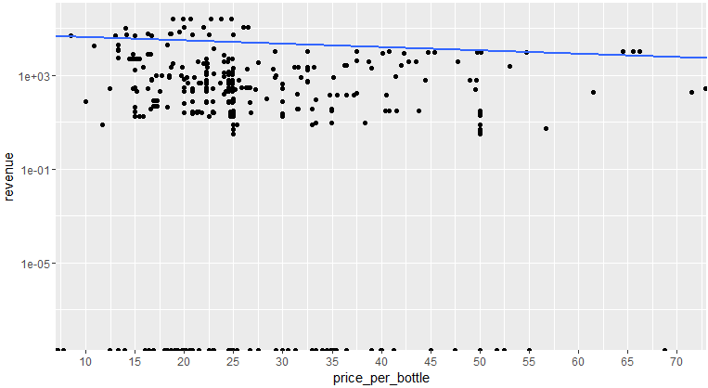
Scatterplot of Revenue by Avg Price/Bottle
Notice the cluster around $22-25/bottle

Slide 8
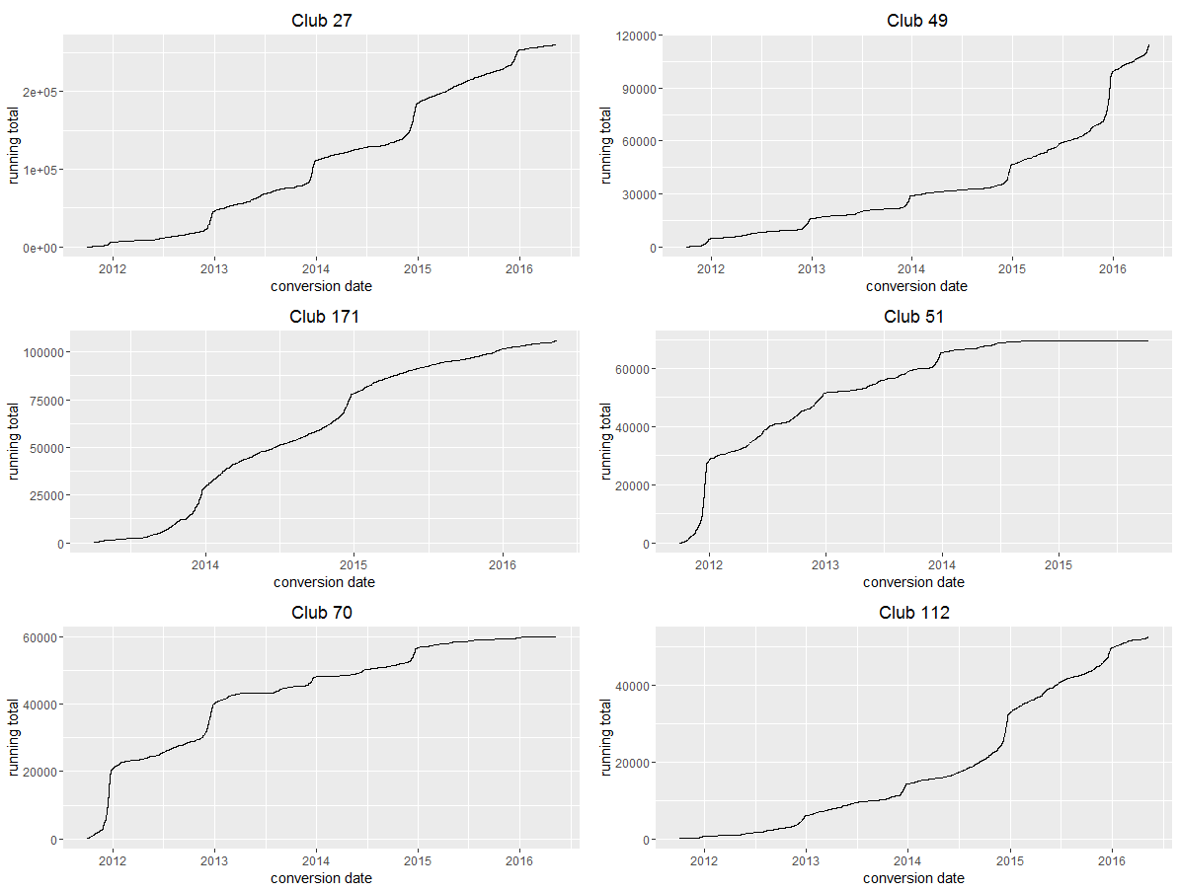
Plots of cumulative revenue for top 6 clubs

Slide 9
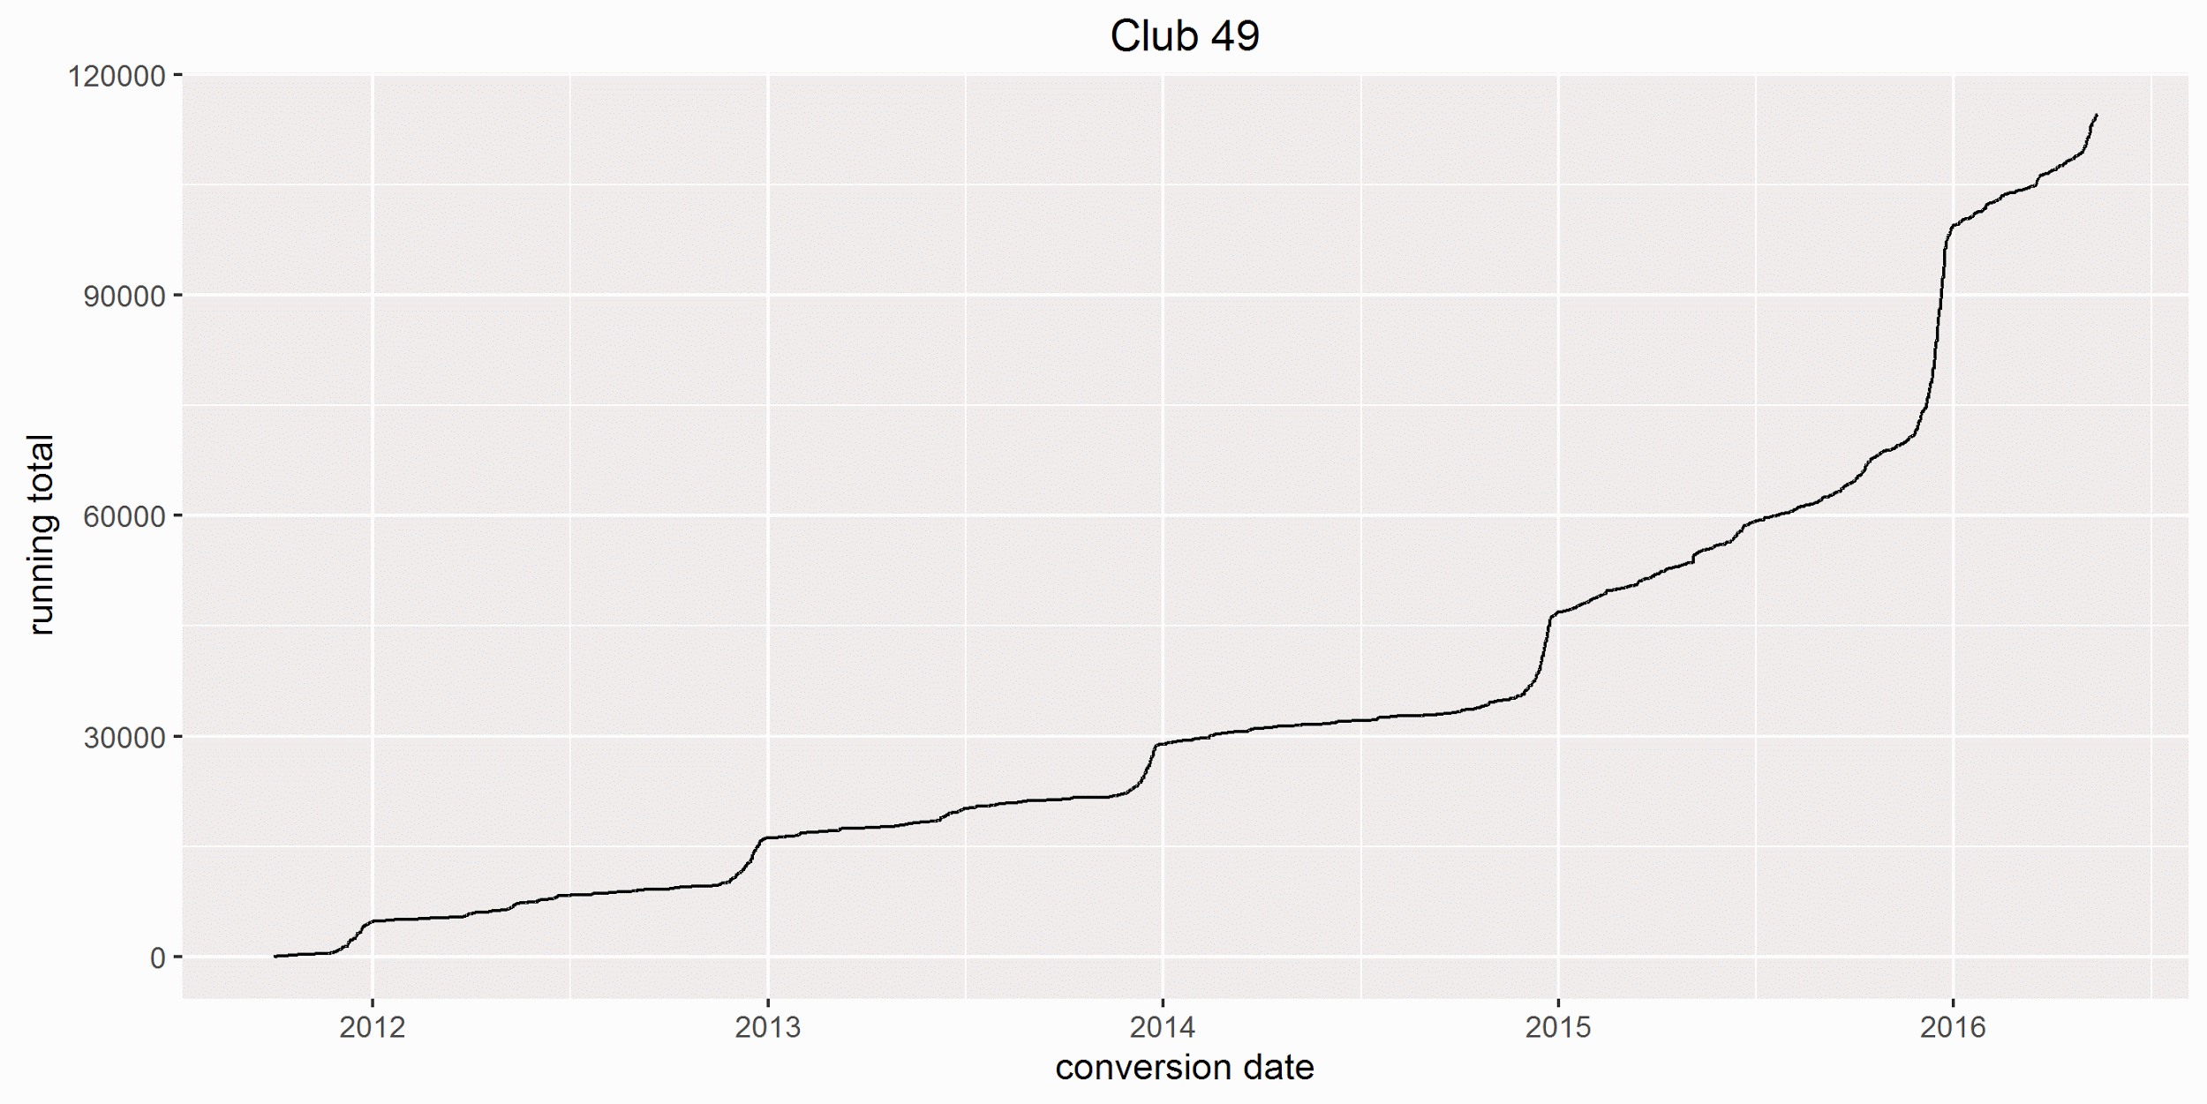
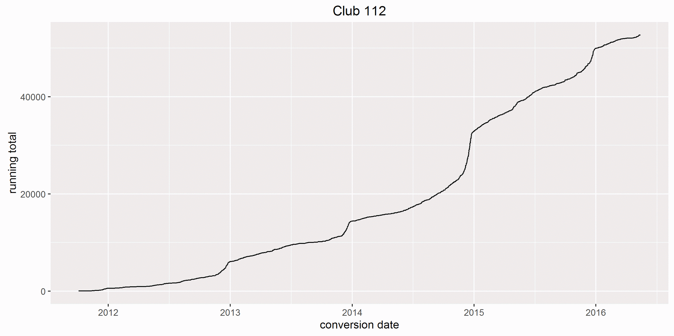
Observations of revenue over time
These two clubs can be seen having accelerated growth, including having their most successful periods at the end of 2014 (for club 112) and end of 2015 (for club 49).
Many clubs had a significant spike in December 2014, including club 112, so it is interesting to see the largest spike for club 49 in December 2015.
The slope of the line for for club 49 in 2016 is still going up, which means this is tracking to be a successful year.

Slide 10
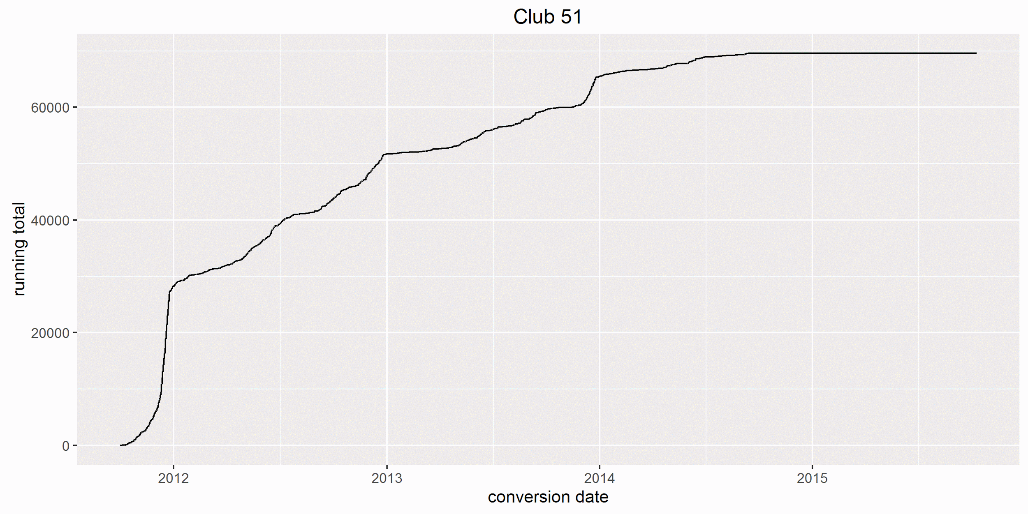
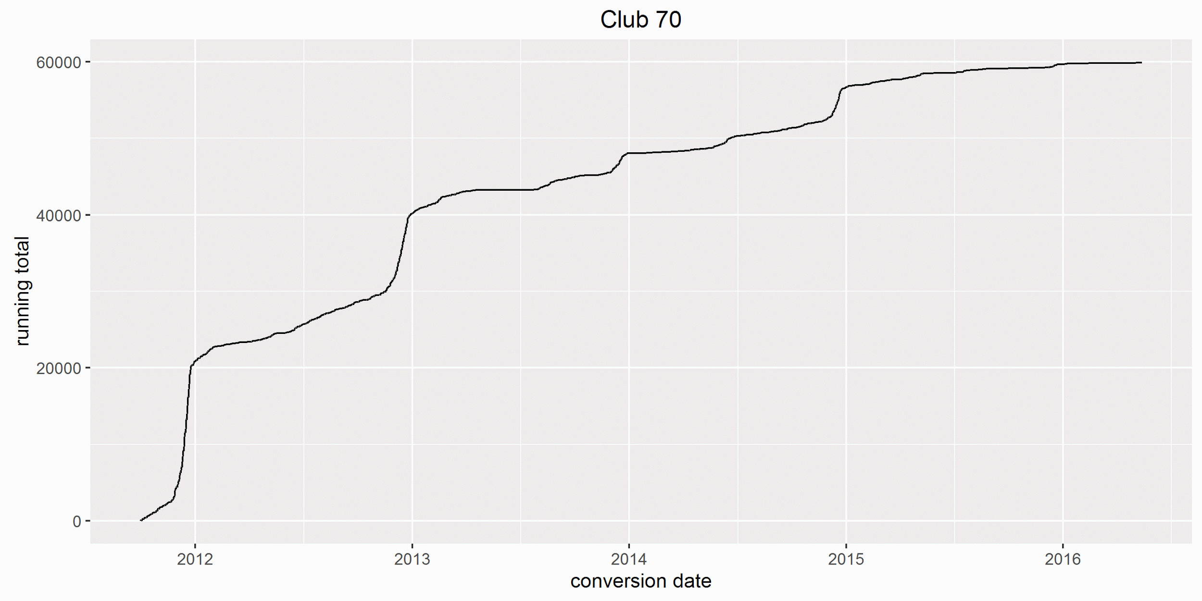
Observations of revenue over time, continued
Conversely, these two clubs have had their revenue curves basically flatten out, with little to no sales in the past two years.
Club 51 has made $203 since July 2014
Club 70 made ⅓ of its total revenue in the first 2 months, and 95% of it before the end of 2014. There have been very few sales since the beginning of 2015, despite this being the 6th highest club group in revenue in the past 4.5 years.

Slide 11
Recommendations
Try to understand why clubs 49 and 112 have had significant upticks in revenue since the beginning of 2015, and see if there is any way to influence the same factors for other clubs.
Focus marketing efforts on clubs that offer red wine in their offerings, as they outsell white only or even champagne or rosé clubs by 48:1.
Focus efforts on clubs that offer smaller shipment sizes, as these outsell even the next most common shipment size (albeit those are shipments with 12 bottles) by 2:1. Or more likely, recommend to the wine clubs themselves that 2 bottle and 12 bottle shipments are the most purchased, outselling all others by 5:1.
Focus efforts on clubs offering a price per bottle of around $25, as there is a distinct grouping there.
Don’t worry too much about shipping costs impacting sales, though shipping costs should stay around $10-15 for clubs in the $38-72 range. Above that point the data doesn’t indicate what the preferred shipping price limit might be.

