Slide 1
Introduction To GTest
C++ Unit Testing

Slide 2
Unit Testing
With Google Test

Slide 3
Why Google Test
Google Test is designed to be portable
You can decide which tests to run using name patterns
Google Test can generate XML test result reports
Easy to write assertions that generate informative messages
Google Test automatically detects your tests and doesn't require you to enumerate them in order to run them
Simple things are easy in Google Test, while hard things are possible

Slide 4
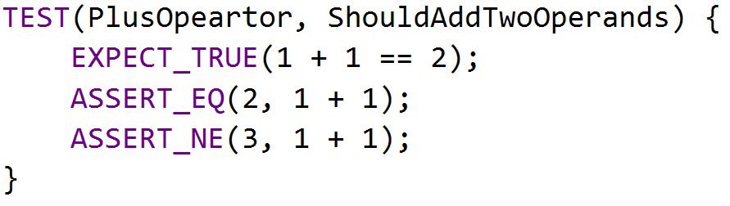
BASIC CONCEPTS
Start by writing assertions. An assertion's result can be success, nonfatal failure, or fatal failure

Slide 5
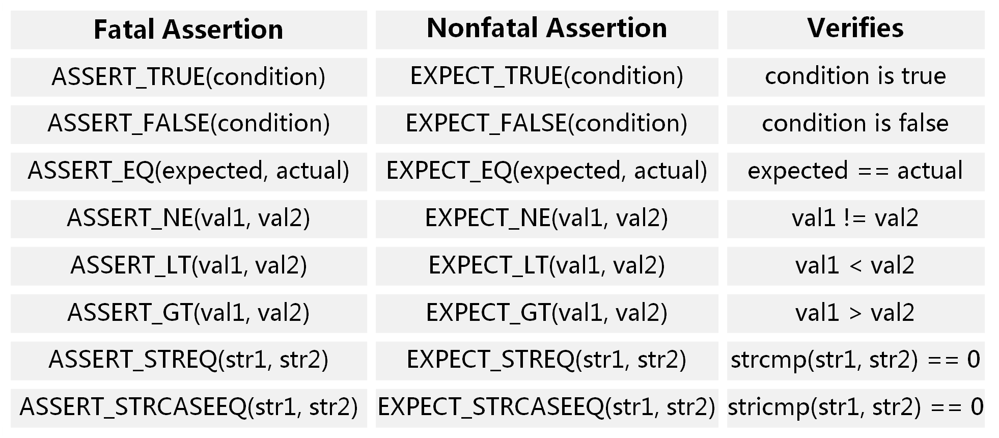
ASSERTIONS
EXPECT_* generate nonfatal failures, which don't abort the current function
ASSERT_* generate fatal failures when they fail, and abort the current function

Slide 6
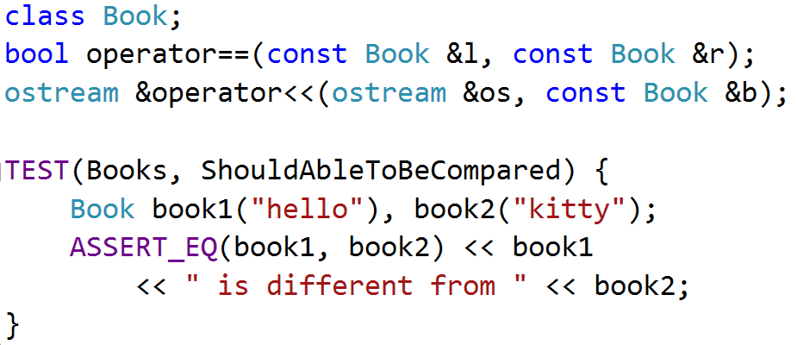
Requirement
Value arguments must be comparable by the assertion's comparison operator
Values must support the << operator for streaming to an std::ostream

Slide 7
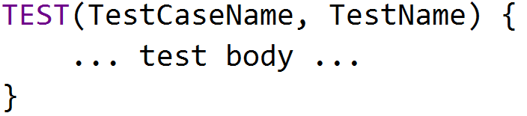
TEST STRUCTURE
Test Program
Test Case
Test Case
Test
Test
Test
Test
Test
Test
Test

Slide 8
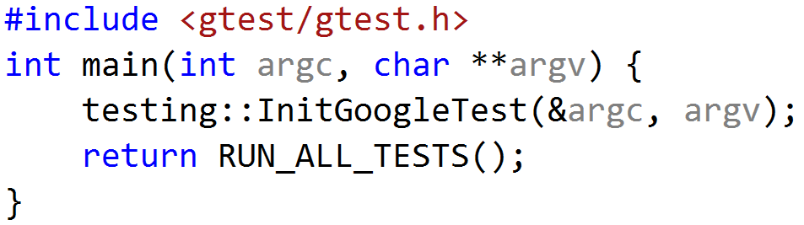
USING GTEST
include <gtest/gtest.h>
write your tests in any source files
initialize gtest by InitGoogleTest()
call RUN_ALL_TESTS() in main() function
compile and run

Slide 9

EXERCISE
图书馆有一名图书管理员(Librarian), 他能够帮助图书馆存书(Store), 并且向我们提供借书服务(borrow):
当管理员存书后, 他会告诉我们当前图书馆的现存图书数量
当向管理员借书后, 他会告诉我们当前图书馆的剩余图书数量
当向管理员借书时, 如果馆内没有这本书, 则会收到一个无法借书的消息

Slide 10
To DO
Fork http:// github /DT
Clone代码到本地, 打开工程01-Gtest.sln
阅读代码逻辑, 完成练习题目的需求
将代码push到code club上

Slide 11
Test-Driven Development

Slide 12
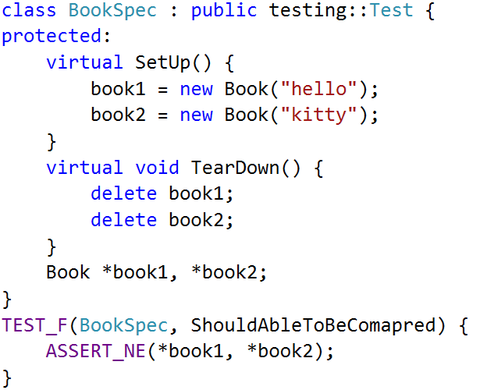
TEST Fixture
A test fixture allows you to reuse the same configuration of objects for several different tests

Slide 13
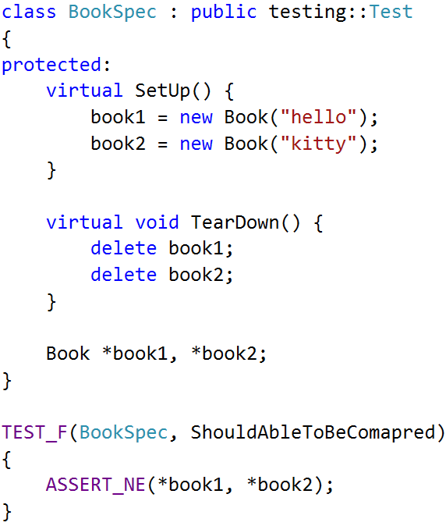
TEST FIXTURE Internals
Google Test constructs a BookSpec object (let's call it t1 ).
t1.SetUp() initializes t1 .
the test(ShouldAbleToBeCompared) runs on t1.
t1.TearDown() cleans up after the test finishes.
t1 is destructed.

Slide 14
TO DO
使用Test Fixture对测试代码重构, 提取公共逻辑
将代码push到github上

Slide 15
Reference
https://code.google.com/p/googletest/wiki/Primer
https://code.google.com/p/googletest/wiki/AdvancedGuide
https://code.google.com/p/googletest/wiki/FAQ
《测试驱动开发》

Slide 16
Q & A

Slide 17
THANK YOU
For questions or suggestions:
Wu Kun
kunwu@thoughtworks.com

