Slide 1
Advanced Mocking
C++ Unit Testing

Slide 2
Painless Refactoring
Make Less Changes

Slide 3
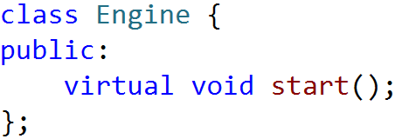
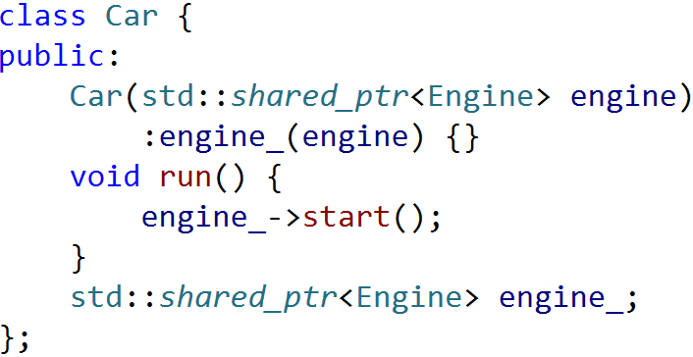
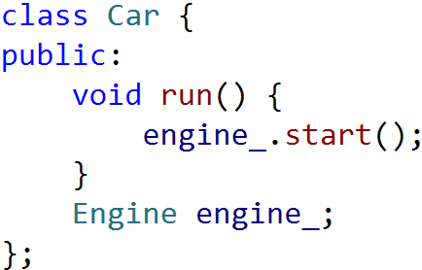
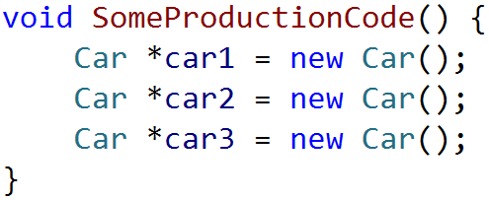
Side Effect OF Dependency Injection

Slide 4
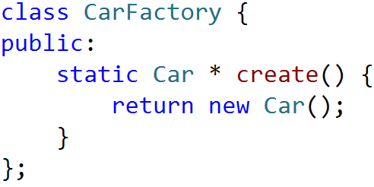
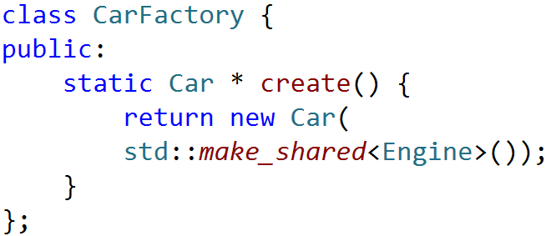
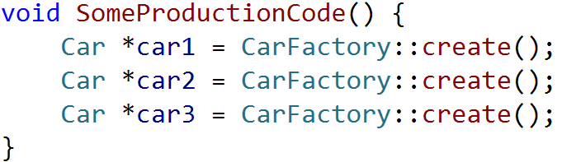
Factory Method

Slide 5
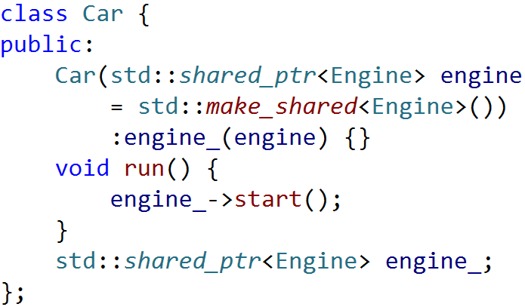
Constructor Default Parameters
Default parameters

Slide 6
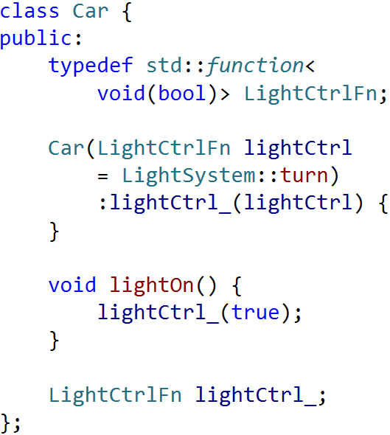
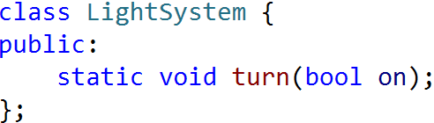
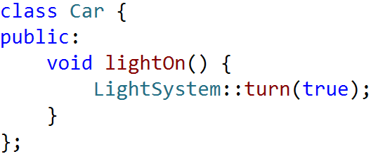
MOCK STATIC Function With Std::Function
std::function

Slide 7
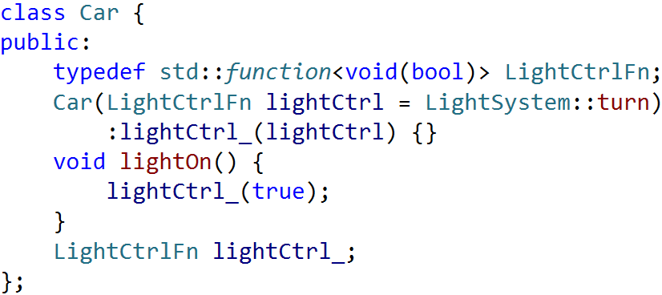
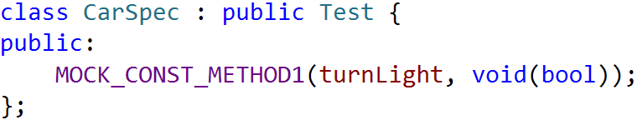
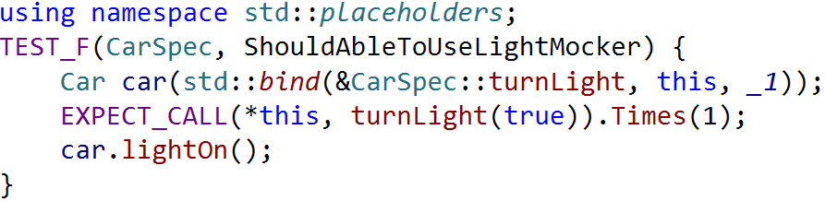
Pass Mocked Function With std::bind
create a new mock function
bind mock function

Slide 8
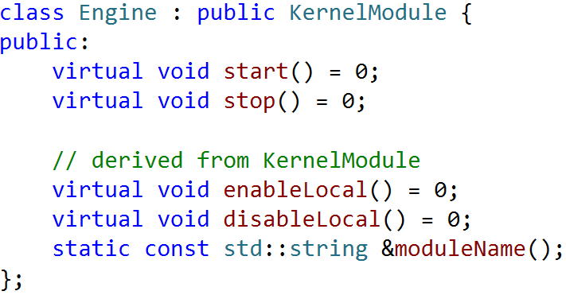
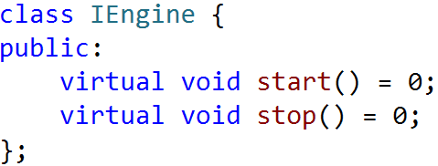
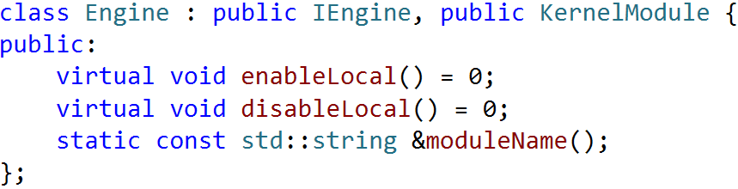
Extract Interface
Using this interface for
programming and mocking

Slide 9

EXERCISE
为了更好的服务读者, 图书馆引进了图书查询(SearchEngine)和推荐系统(RecommendEngine):
管理员会使用查询和推荐系统根据读者提供的关键字推荐一本书
查询系统会查询并返回所有包含指定关键字的书籍
推荐系统会选择并返回查询结果中最流行的一本书
Notes:
介绍新需求

Slide 10
EXERCISE
从原始Repo上更新代码
git remote add source http://github/DT.git
git pull source master
Mock RecommendEngine, 完善Librarian::recommend()的测试
Mock SearchEngine::Search, 完善Librarian::recommend()的测试(通过function & bind)
要求: Librarian::recommend()的集成测试代码不能修改并且要保证运行通过

Slide 11
Advanced Mocking
Deep Into Google Mock

Slide 12
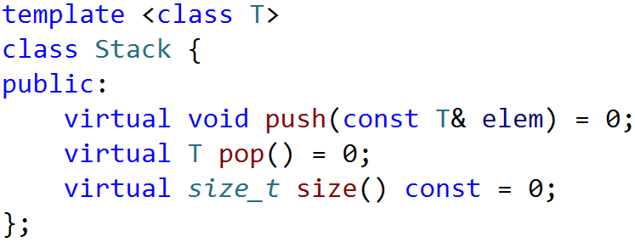
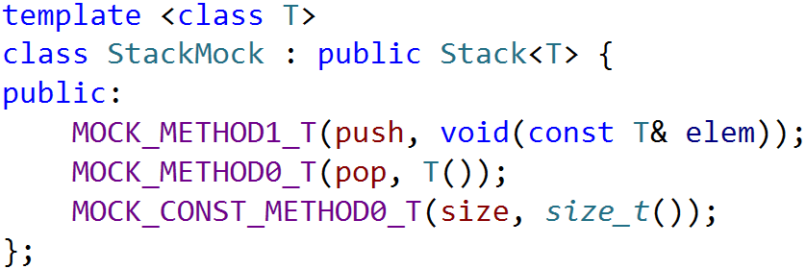
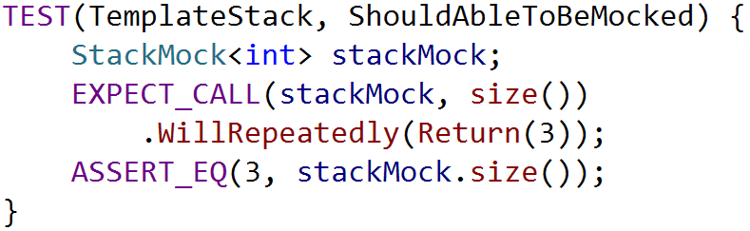
Mocking Template Class
Mock with MOCK_METHODn_T
Initialize with template arguments

Slide 13
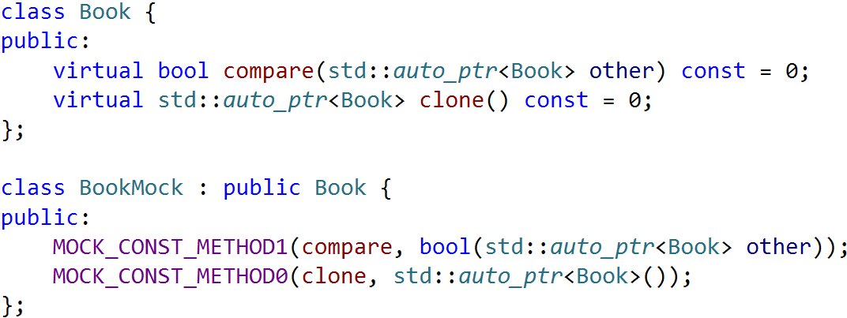
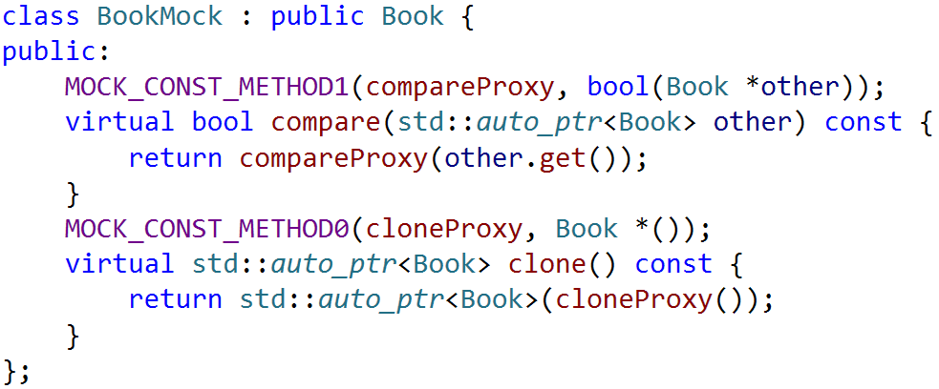
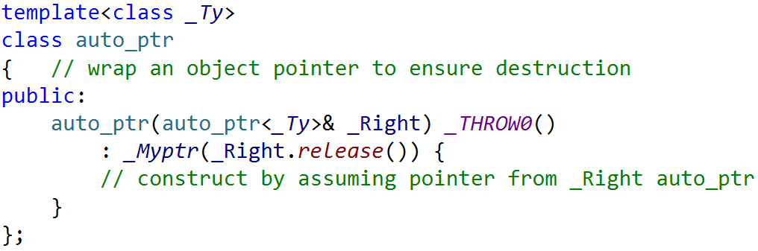
MOCKING AUTO_PTR
Compilation Error!
Proxy method with raw-pointer
Non-const Copy Constructor

Slide 14
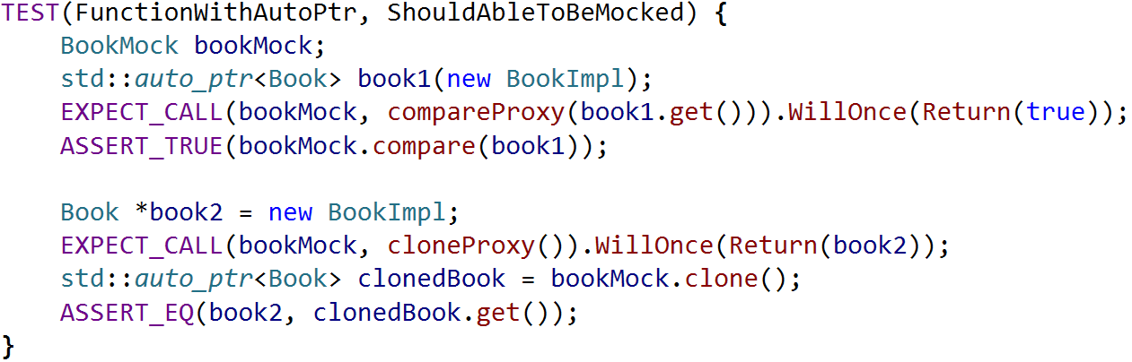
MOCKING AUTO_PTR
Set expectations on proxy method

Slide 15
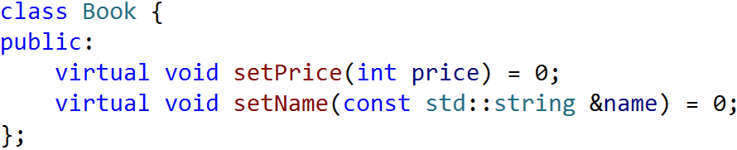
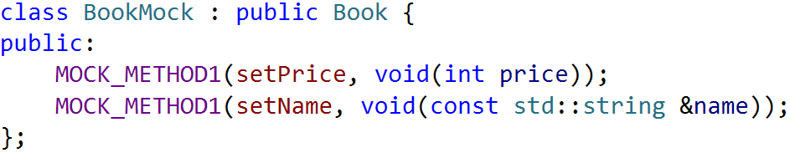
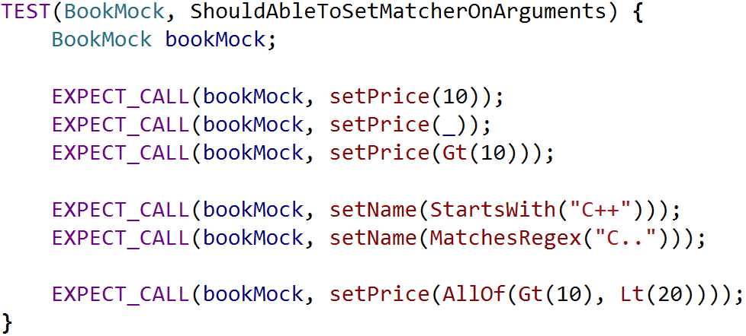
Advanced Mathers

Slide 16
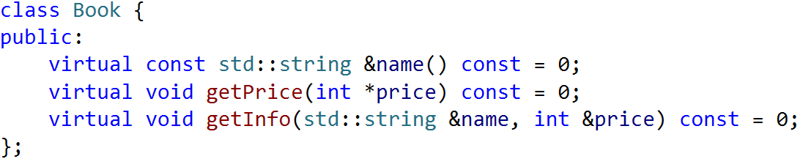
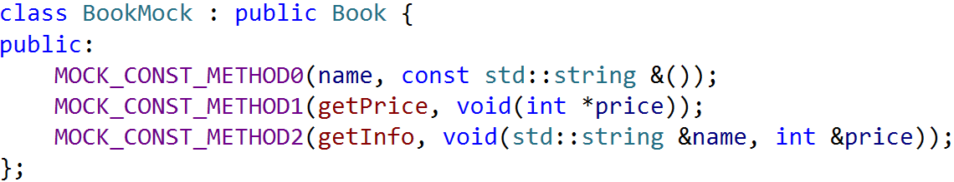
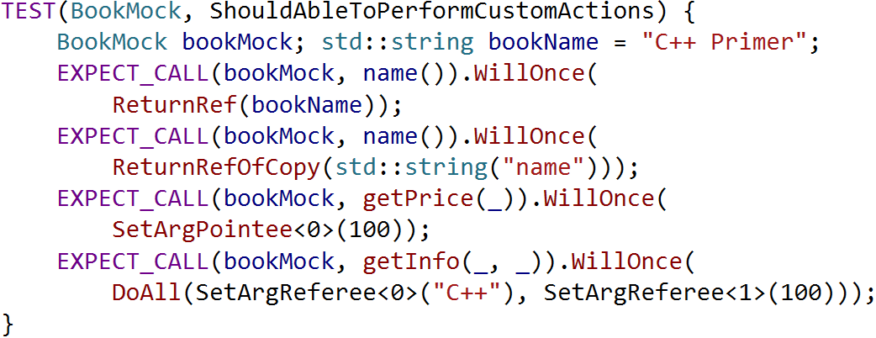
Advanced Actions

Slide 17
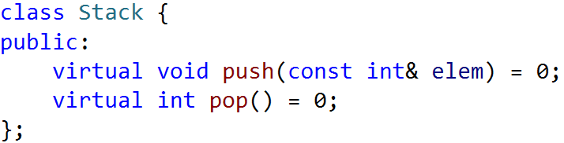
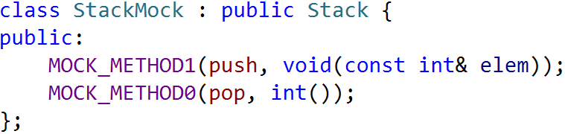
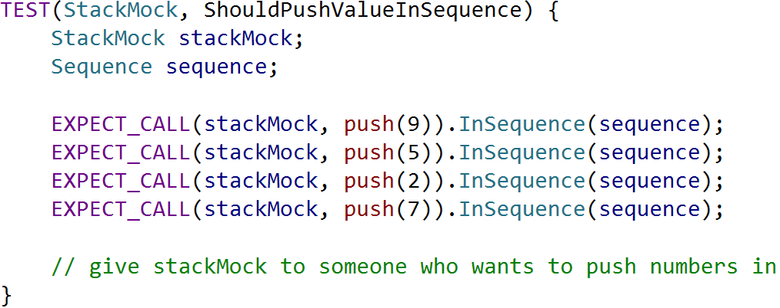
Expectation Order

Slide 18
Reference
Google Mock Cheat Sheet
https://code.google.com/p/googlemock/wiki/CheatSheet
Google Mock Cook Book
https://code.google.com/p/googlemock/wiki/CookBook

Slide 19
THANK YOU
For questions or suggestions:
Wu Kun
kunwu@thoughtworks.com

