Slide 1
Dom0
DomU
(ScaleWorks)
DomU
(Guest OS)
DomU
(Guest OS)
Dom0
Local
Storage
Shared Strorage
Local
Storage
USB Disk
HDD
USB Disk
VM Host1
VM Host2

Slide 2
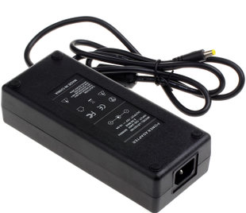
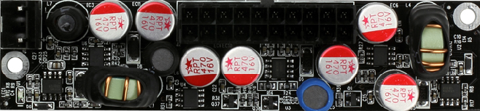
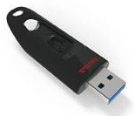
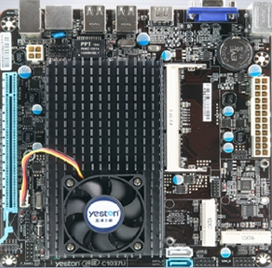
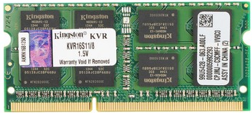
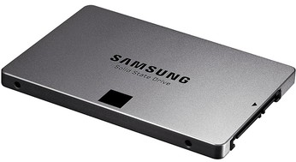
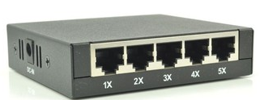
Power
Adapter
220V AC
Power
Module
USB Disk
MotherBoard
Memory
RJ45 Cable
SSD
Switch

