Slide 1
Introduction To GTest
C++ Unit Testing

Slide 2
Unit Testing
With Google Test

Slide 3
Why Google Test
Google Test is designed to be portable
Google Test automatically detects your tests and doesn't require you to enumerate them in order to run them
Simple things are easy in Google Test, while hard things are possible
Easy to write assertions that generate informative messages
You can decide which tests to run using name patterns
Google Test can generate XML test result reports

Slide 4
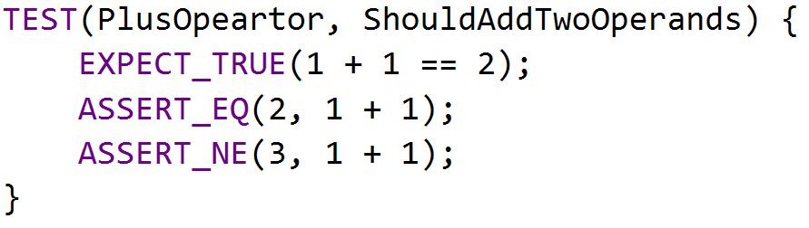
BASIC CONCEPTS
Start by writing assertions. An assertion's result can be success, nonfatal failure, or fatal failure

Slide 5
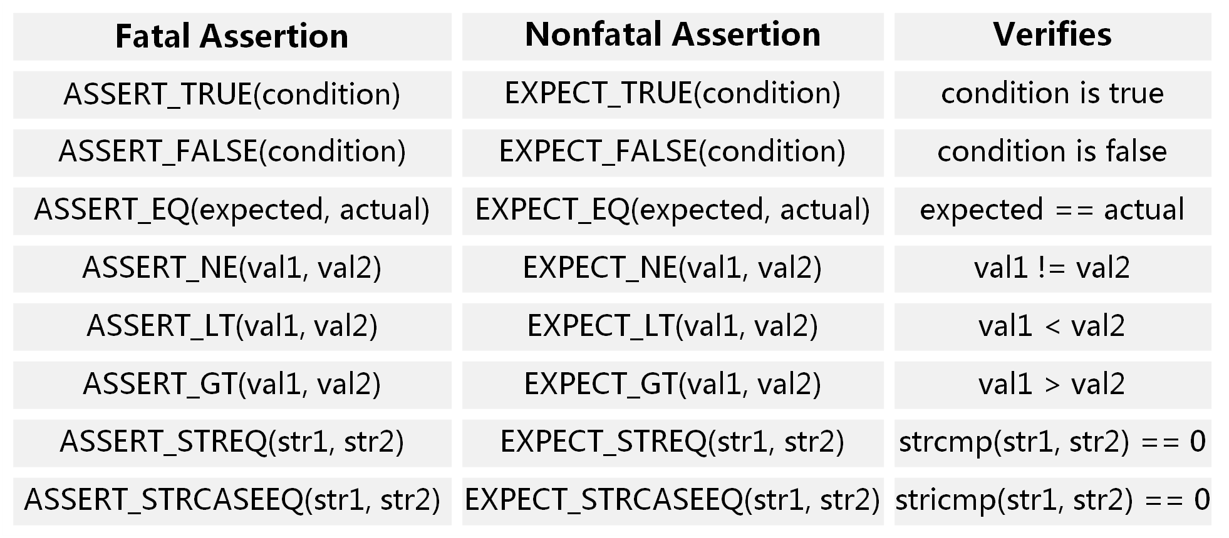
ASSERTIONS
EXPECT_* generate nonfatal failures, which don't abort the current function
ASSERT_* generate fatal failures when they fail, and abort the current function

Slide 6
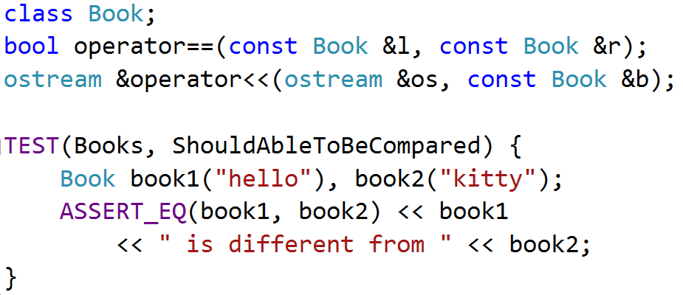
Requirement
Value arguments must be comparable by the assertion's comparison operator
Values must support the << operator for streaming to an std::ostream

Slide 7
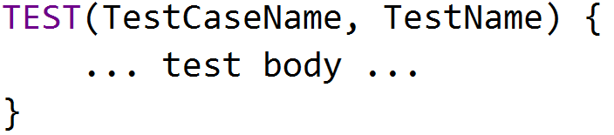
TEST STRUCTURE
Test Program
Test Case
Test Case
Test
Test
Test
Test
Test
Test
Test

Slide 8
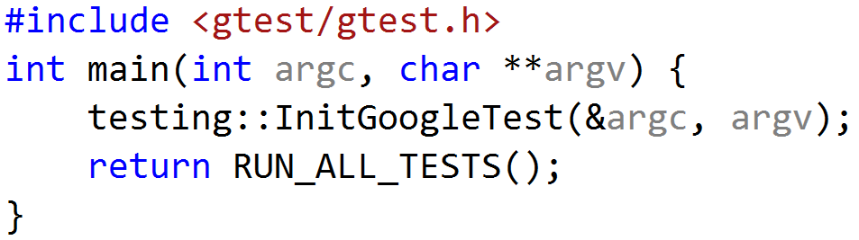
USING GTEST
include <gtest/gtest.h>
write your tests in any source files
initialize gtest by InitGoogleTest()
call RUN_ALL_TESTS() in main() function
compile and run

Slide 9

EXERCISE
Open gtest_sample, Compile and run
SalesMan should answer “see you” to “bye”
SalesMan should throw an exception if question is empty

Slide 10
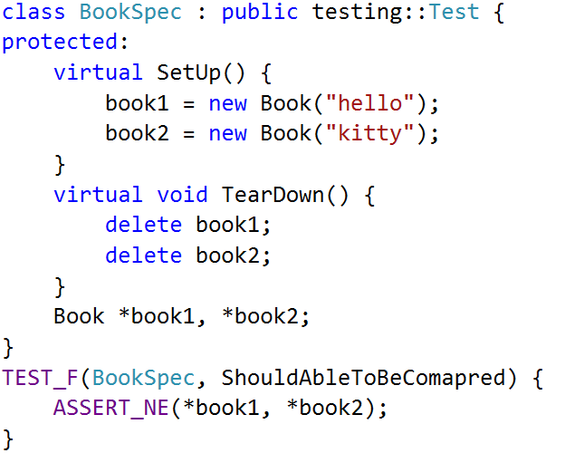
TEST Fixture
A test fixture allows you to reuse the same configuration of objects for several different tests

Slide 11
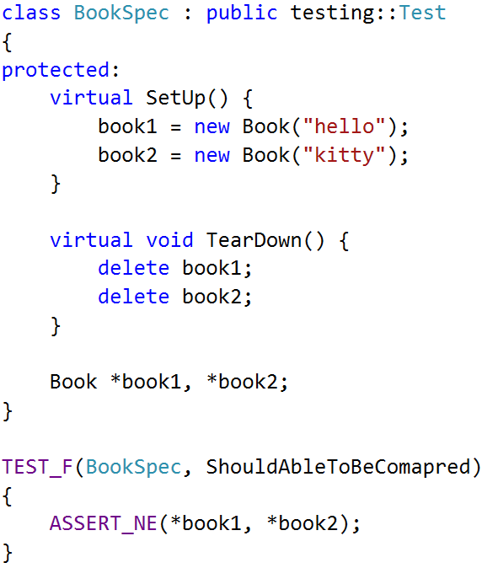
TEST FIXTURE Internals
Google Test constructs a BookSpec object (let's call it t1 ).
t1.SetUp() initializes t1 .
the test(ShouldAbleToBeCompared) runs on t1.
t1.TearDown() cleans up after the test finishes.
t1 is destructed.

Slide 12
EXERCISE
Open gtest_sample, Compile and run
SalesMan should answer “see you” to “bye”
SalesMan should throw an exception if question is empty

Slide 13
THANK YOU
For questions or suggestions:
Wu Kun
kunwu@thoughtworks.com

