Slide 1
Stubs & Mocks
C++ Unit Testing

Slide 2

EXERCISE
图书馆管理员(Librarian)会定期向书商(BookVendor)购买一些书籍来充实图书馆:
书商能够提供多种图书(附有价格)供管理员进行选择
管理员仅会挑选当前图书馆中不存在的书籍进行购买
管理员选好图书后, 会向书商支付所选书籍的总金额
Notes:
介绍新需求

Slide 3
EXERCISE
从原始Repo上更新代码
git remote add source https://github.com/coney/cpp-unit-testing.git
git pull source master
重构Librarian, 使管理员可以通过store方法存入一个Book对象
思考如何编写Librarian::store(vendor)的测试
Notes:
更新代码, 后续课程均需进行此步
重构使Librarian对象支持新的Book依赖, 测试可以通过Book真实对象实现
Librarian::store(vendor)需要构造一个`假`的vendor

Slide 4
Mocking
With Google Mock

Slide 5
WHY GOOGLE MOCK
You want to "mock out" your dependencies.
Your tests are slow as they depend on too many libraries or use expensive resources (e.g. a database).
Your tests are brittle as some resources they use are unreliable (e.g. the network, current time).
You want to test how your code handles a failure which is not easy to trigger.
You need to make sure that your module interacts with other modules in the right way.
Dependent Interface Does not yet exist or may change behavior.

Slide 6
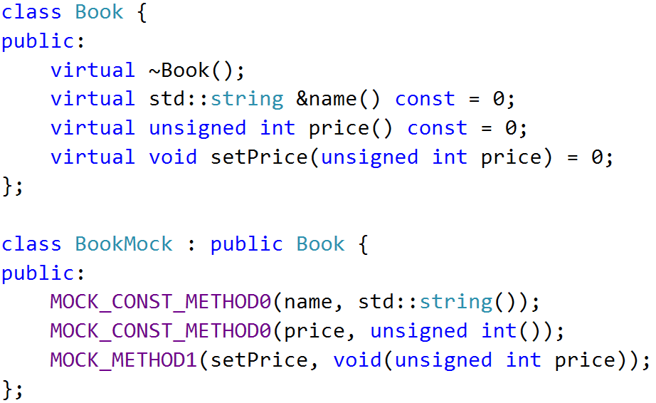


MOCK Object
A mock object implements the same interface as a real object (so it can be used as one), but lets you specify at run time how it will be used and what it should do

Slide 7
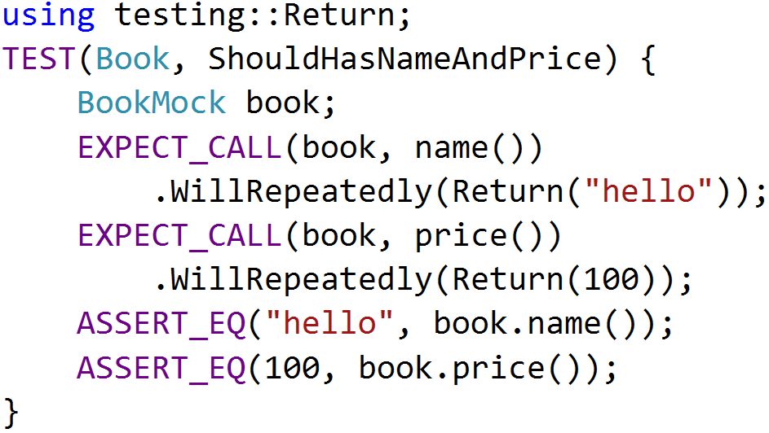
EXPECTATIONS
Use the EXPECT_CALL() macro to set an expectation on a mock method

Slide 8
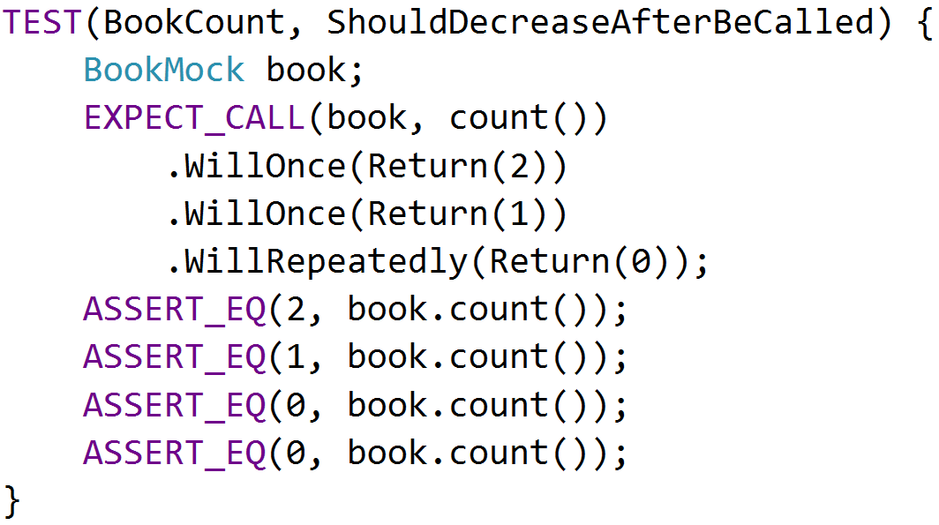
ACTIONS
The return value of mock functions can be specified by Will and Return Statement

Slide 9
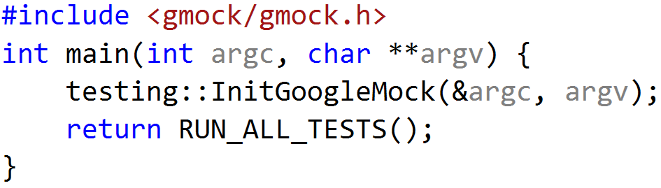
USING GMOCK
include <gmock/gmock.h>
write your mocks and tests
initialize gmock by InitGoogleMock()
call RUN_ALL_TESTS() in main() function
compile and run
InitGoogleMock() will automatically initialize Google Test

Slide 10
EXERCISE
图书馆管理员(Librarian)会定期向书商(BookVendor)购买一些书籍来充实图书馆:
书商能够提供多种图书(附有价格)供管理员进行选择
管理员仅会挑选当前图书馆中不存在的书籍进行购买
管理员选好图书后, 会向书商支付所选书籍的总金额

Slide 11
Stubs Vs Mocks
Behavior Based Verification

Slide 12
Test Doubles
Dummy objects are passed around but never actually used. Usually they are just used to fill parameter lists
Fake objects actually have working implementations, but usually take some shortcut which makes them not suitable for production
Stubs provide canned answers to calls made during the test, usually not responding at all to anything outside what's programmed in for the test
Mocks are objects pre-programmed with expectations which form a specification of the calls they are expected to receive

Slide 13
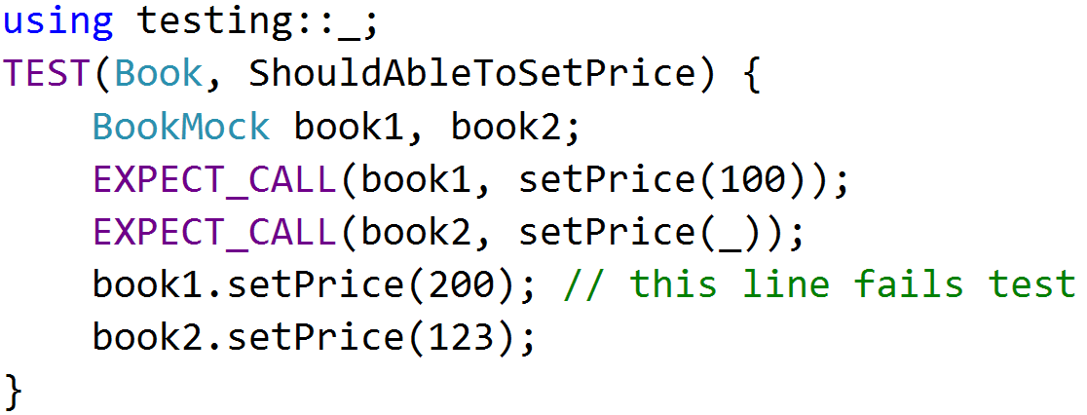
MATCHERS
When a mock function takes arguments, we can specify the expected arguments value
testing::_ will match any input arguments

Slide 14
Cardinalities
Use the Times() to specify the cardinality as it tells how many times the call should occur

Slide 15
EXERCISE
图书馆管理员(Librarian)会定期向书商(BookVendor)购买一些书籍来充实图书馆:
书商能够提供多种图书(附有价格)供管理员进行选择
管理员仅会挑选当前图书馆中不存在的书籍进行购买
管理员选好图书后, 会向书商支付所选书籍的总金额
Notes:
通过EXPECT对传入参数设置期望
通过Times限制付款次数

Slide 16
Reference
https://github.com/coney/cpp-unit-testing/tree/master/02-GMock
https://code.google.com/p/googlemock/wiki/ForDummies
https://code.google.com/p/googlemock/wiki/CheatSheet
https://code.google.com/p/googlemock/wiki/CookBook
https://code.google.com/p/googlemock/wiki/FrequentlyAskedQuestions

Slide 17
THANK YOU
For questions or suggestions:
Wu Kun
kunwu@thoughtworks.com

