Slide 1
Gtest & Gmock
Unit Testing With

Slide 2
Unit Testing
With Google Test

Slide 3
Why Google Test
Google Test is designed to be portable
Google Test automatically detects your tests and doesn't require you to enumerate them in order to run them
Simple things are easy in Google Test, while hard things are possible
Easy to write assertions that generate informative messages
You can decide which tests to run using name patterns
Google Test can generate XML test result reports

Slide 4
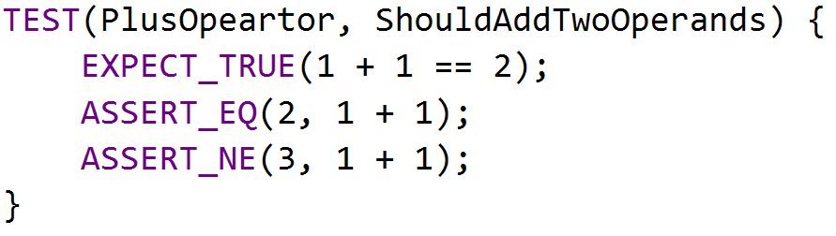
BASIC CONCEPTS
Start by writing assertions. An assertion's result can be success, nonfatal failure, or fatal failure

Slide 5
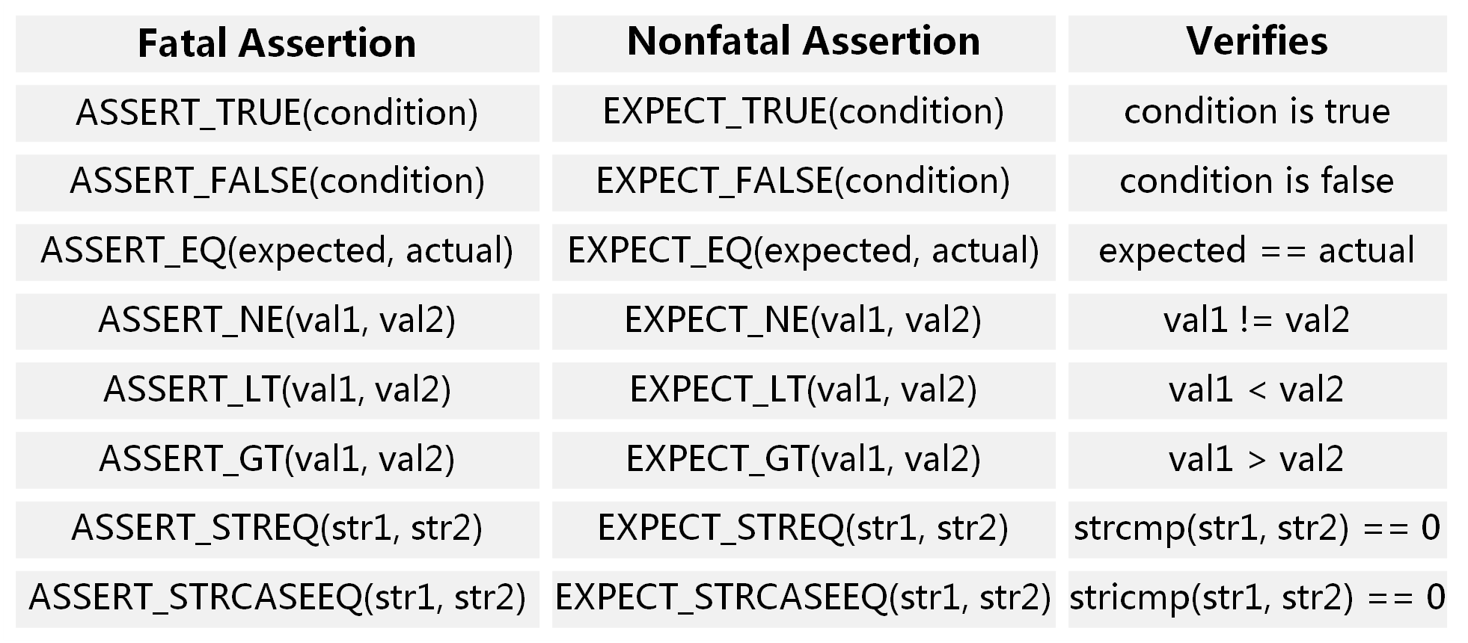
ASSERTIONS
EXPECT_* generate nonfatal failures, which don't abort the current function
ASSERT_* generate fatal failures when they fail, and abort the current function

Slide 6
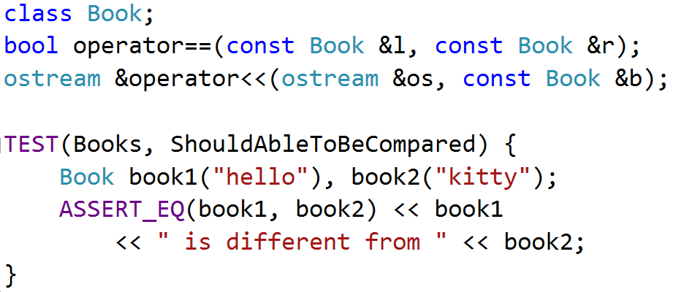
Requirement
Value arguments must be comparable by the assertion's comparison operator
Values must support the << operator for streaming to an std::ostream

Slide 7
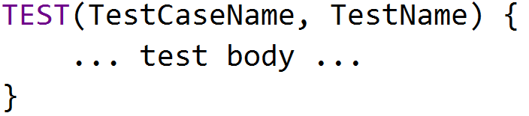
TEST STRUCTURE
Test Program
Test Case
Test Case
Test
Test
Test
Test
Test
Test
Test

Slide 8
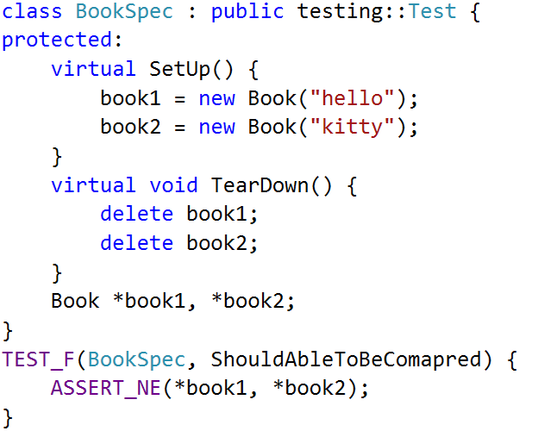
TEST Fixture
A test fixture allows you to reuse the same configuration of objects for several different tests

Slide 9
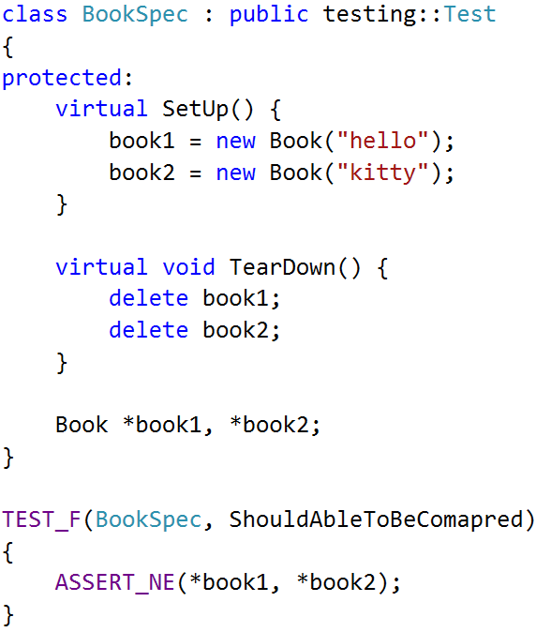
TEST FIXTURE Internals
Google Test constructs a BookSpec object (let's call it t1 ).
t1.SetUp() initializes t1 .
the test(ShouldAbleToBeCompared) runs on t1.
t1.TearDown() cleans up after the test finishes.
t1 is destructed.

Slide 10
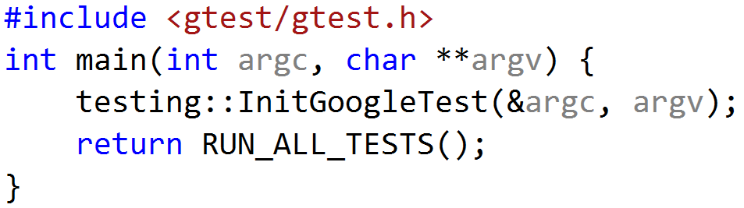
USING GTEST
include <gtest/gtest.h>
write your tests in any source files
initialize gtest by InitGoogleTest()
call RUN_ALL_TESTS() in main() function
compile and run

Slide 11

EXERCISE
Open gtest_sample, Compile and run
SalesMan should answer “see you” to “bye”
SalesMan should throw an exception if question is empty

Slide 12
MOCKING
With Google Mock

Slide 13
WHY GOOGLE MOCK
You want to "mock out" your dependencies.
Your tests are slow as they depend on too many libraries or use expensive resources (e.g. a database).
Your tests are brittle as some resources they use are unreliable (e.g. the network, current time).
You want to test how your code handles a failure which is not easy to trigger.
You need to make sure that your module interacts with other modules in the right way.
Dependent Interface Does not yet exist or may change behavior.

Slide 14
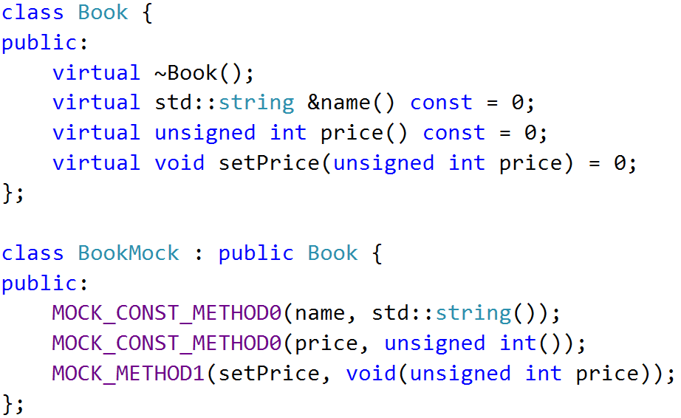
MOCK Object
A mock object implements the same interface as a real object (so it can be used as one), but lets you specify at run time how it will be used and what it should do

Slide 15
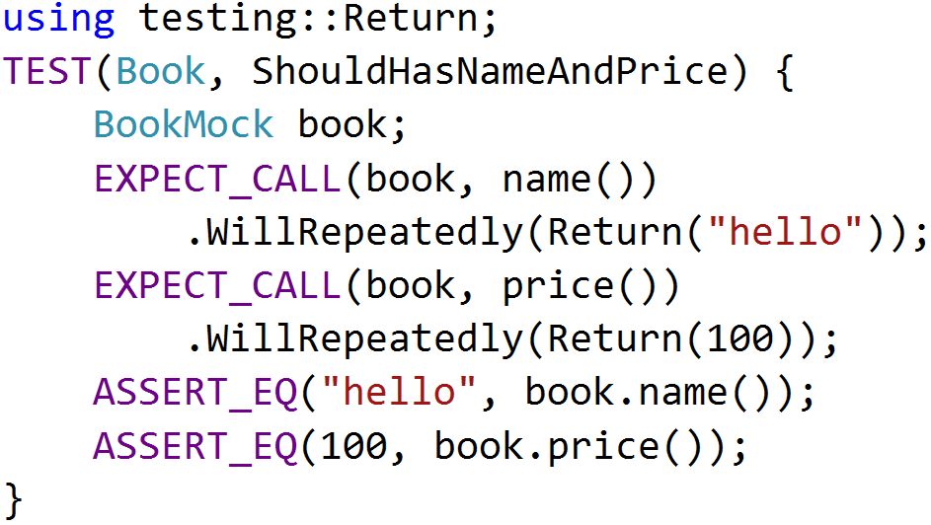
EXPECTATIONS
use the EXPECT_CALL() macro to set an expectation on a mock method

Slide 16
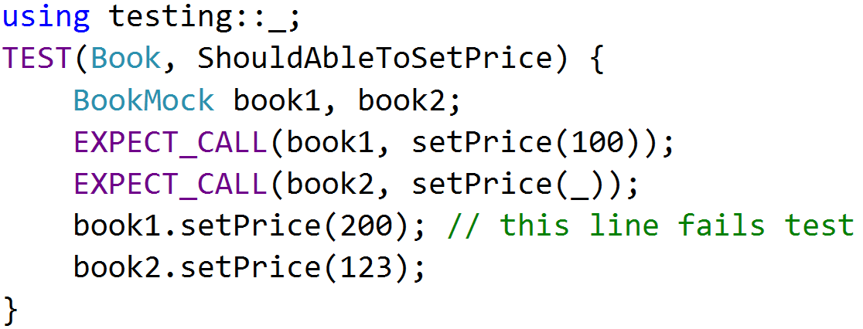
MATCHERS
When a mock function takes arguments, we must specify the expected arguments value
testing::_ will match any input arguments

Slide 17
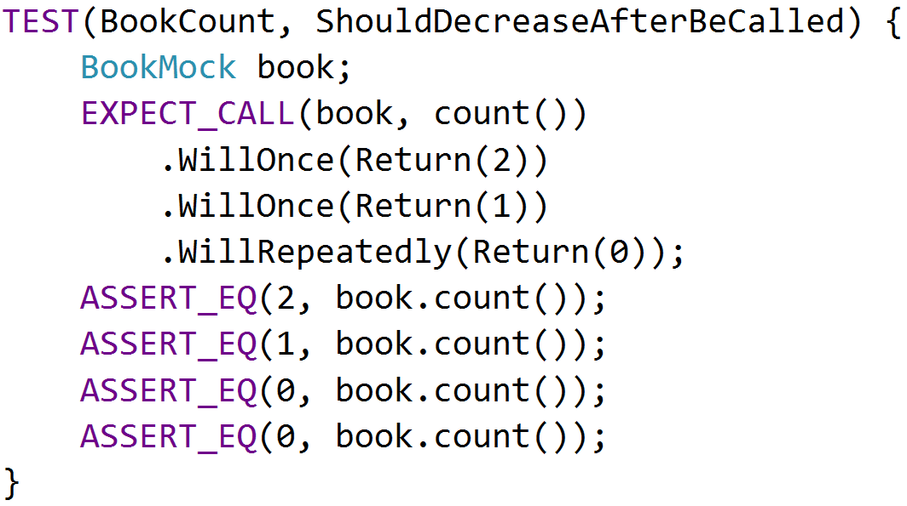
ACTIONS
The return value of mock functions can be specified by Will and Return Statement

Slide 18
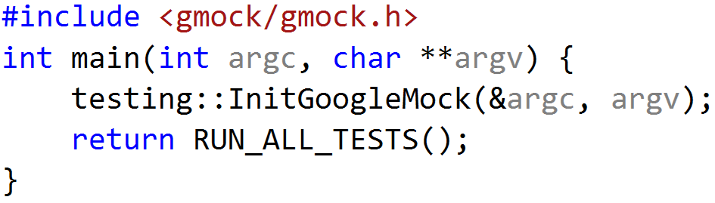
USING GMOCK
include <gmock/gmock.h>
write your mocks and tests
initialize gmock by InitGoogleMock()
call RUN_ALL_TESTS() in main() function
compile and run
InitGoogleMock() will automatically initialize Google Test

Slide 19
EXERCISE
Create a StoreMock class which implements IStore
Set expectations on StoreMock object
Verify SalesMan::findCheapest() via StoreMock Object

Slide 20
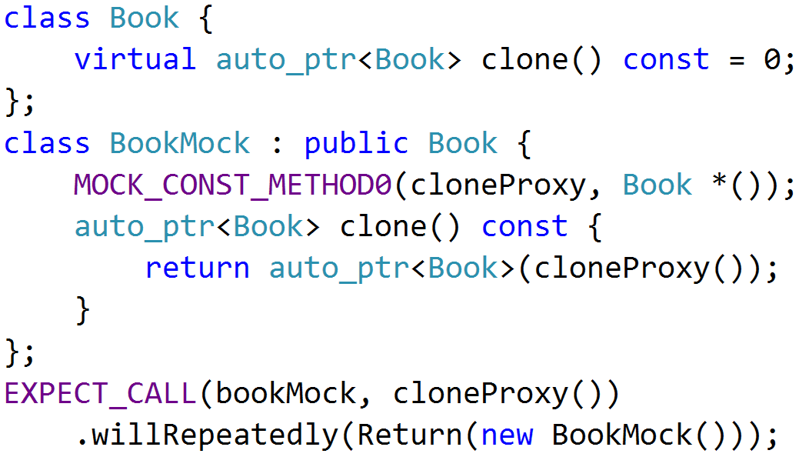
MOCKING WITH AUTO_PTR
If mock function has auto_ptr as arguments or return value, we need to setup the proxy.

Slide 21
THANK YOU
For questions or suggestions:
Wu Kun
kunwu@thoughtworks.com

