Slide 1
MS Excel 2007
Beginner Training

Slide 2
Course Goals
This material is to provide you with a realistic perspective of how we use Excel effectively during a project.
Course Goals:
Teach skills that are immediately useful
Share experiences
Provide helpful "tricks of the trade"
This Course Will Not:
Provide a definitive understanding of Microsoft Excel
Discuss complex analytical modelling methods
Make you an expert at analysis

Slide 3
Agenda
Understanding Basic Excel – the 2007 look
Importing Data
Data Analysis
Sort
Auto Filter
Sub-Totals
Pivot Tables
Output Display
Charts
Conditional Formatting
Commonly Used Functions
Macros
New features in Excel 2007
Final Thoughts

Slide 4
I. Understanding Basic Excel
This module will familiarize you with the new look and feel of the Excel2007 as compared to the earlier versions. A brief overview will be provided about the new groupings of the functions and where to find the most commonly used shortcuts.
This module will also help you with the frequently used features in Excel.
It is, however, not designed to be comprehensive, and if additional help is needed, manuals, books, and Excel's online help facility are available to you.
Understanding the Design
Working with Cells
Shortcuts in Excel

Slide 5
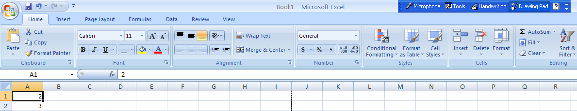
Understanding the Design
New User Interface
Office button
Tabs
Ribbon
Auto Sum
Quick access toolbar
Fill Handle
Groups
More Options
Select All cells
Formula Bar
Auto Calculate

Slide 6
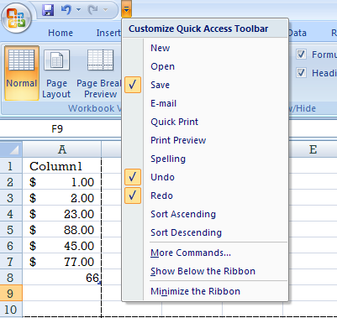
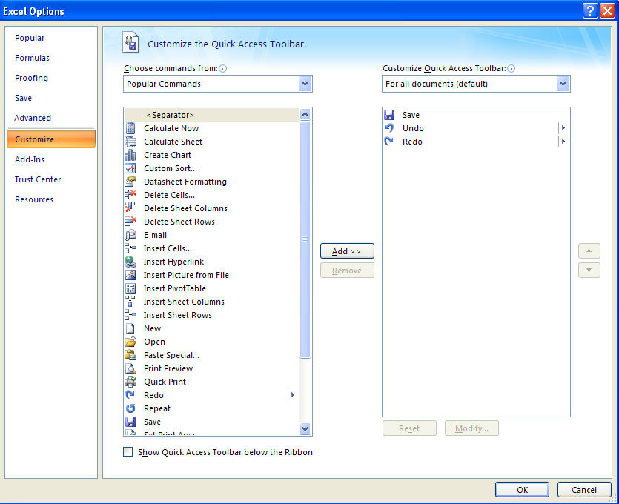

Understanding the Design – contd…
Customize Quick Access Toolbar
Select ‘More Commands’ option
Underneath "Choose commands from:” pick “Popular Commands" or “All Commands”.
We can also add a particular command to the Quick Access toolbar by right click on that command and select “Add to Quick Access Toolbar”

Slide 7
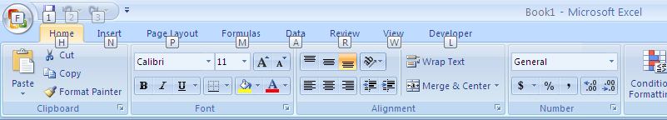
Understanding the Design – contd…
Shortcut to access any command with a few strokes:
Press Alt and the KeyTips are displayed over each feature that is available in the current view.
Press the letter shown in the KeyTip over the feature that you want to use.
What about the old keyboard shortcuts?
Keyboard shortcuts of old that begin with CTRL and ALT are still intact, and you can use them the same way you always have.
For example, the shortcut CTRL+C still copies something to the clipboard, and the shortcut CTRL+V still pastes something from the clipboard.
Other shortcuts like ALT+D+F+F and ALT+D+S also work ☺

Slide 8
Working with Cells
There are also a number of features that simplify selecting, moving and copying cells within a spreadsheet. Excel wizards aids you in performing more advanced functions.
Selected Basic Excel Features
Feature | Description | Directions
Selecting a Cell | Highlights the cell into which data will be entered | A cell can be selected using the mouse or arrow keys
Selecting Ranges | Highlights a group of cells | A range of cells can be selected by clicking and dragging the mouse or using the arrow keys while holding the shift key
AutoSum | Enters a summation formula into a selected cell by anticipating the range to sum | Select the cell for the sum Click the AutoSum button on the toolbar
AutoFill | Copies an initial cell value into adjacent, highlighted cells using the fill handle | Select the initial cell to be copied Using the cell handle drag contents over adjacent cells Value from initial cell will be copied into the highlighted cells Note that formulas will adjust to reference new cells
AutoFill Series | Extends a series in a row or column by anticipating the next values in the series | Enter the initial two values of the series into adjoining cells Using the cell handle (a small box at the lower-right corner of the active cell), drag over adjacent cells The series will be incremented as it is copied
Function Wizard | Uses dialogs to guide you through the process of creating formulas in a cell | Click on function wizard toolbar button Follow dialog instructions
Naming Cells and Ranges | Allows cells to be referenced in formulas using customized names | Select the cell/range to be named From the menu, select Insert/Name/Define and follow dialog instructions or enter name directly into name box

Slide 9
Shortcuts in Excel
As your use of Excel increases, shortcuts will become more valuable. Some of our favourites are listed below. To view the full list of shortcuts, search on "shortcut keys" under the help facility in Excel.
Selected Key Stroke Shortcuts in Excel
Key Strokes |  | Result |  | Key Strokes |  | Result
Alt E, S, V |  | Paste only values |  | Ctrl + B |  | Inserts or deletes bold formatting
Alt E, S, T |  | Paste only formats |  | Ctrl + D |  | AutoFill down – copies topmost cells down in highlighted range
Alt + Arrow |  | Active menus from keyboard |  | Ctrl + ] |  | Select only cells with formulas that refer directly to the active cell
Alt + Enter |  | Insert a hard break in the same cell |  | Ctrl + R |  | AutoFill right – copies left most cells to the right in highlighted range
Shift + Arrow |  | Highlights range using arrow keys instead of mouse |  | Crtl + Y |  | Repeat the last action
Shift + Tab |  | Move from right to left within the selection |  | Ctrl + Z |  | Undo the last action
Shift + Spacebar |  | Select the entire row |  | Ctrl + Arrow |  | Moves to the next break in the line
Shift + End, Arrow |  | Highlights all cells to the last empty/used cell in the direction of the arrow |  | Crtl + Home |  | Moves to the beginning of the worksheet
Shift + Ctrl + 8 |  | Highlights a contiguous data range |  | Ctrl + End |  | Moves to the end of the worksheet
Shift + Ctrl + → |  | Selects a contiguous row or column of data |  | Ctrl + Page Down |  | Move to the next sheet in the workbook
End, Arrow |  | Activates last empty/used cell in the direction of the arrow |  | Ctrl + Page Up |  | Move to the previous sheet in the workbook
Esc |  | Deactivate menus from keyboard |  | Ctrl + - |  | Delete cell
Alt D, F, F |  | Puts the auto filter |  | Alt D, S |  | Sort the selected range

Slide 10
Shortcuts in Excel
Selected Key Stroke Shortcuts in Excel
Key Strokes |  | Result |  | Key Strokes |  | Result
CTRL SHFT ~ |  | Applies the General number format in Microsoft Excel. |  | Ctrl + F |  | Displays the Find and Replace dialog box, with the Find tab selected.
CTRL+SHFT+$ |  | Applies the Currency format with two decimal places (negative numbers in parentheses). |  | Ctrl + G |  | Displays the Go To dialog box.
CTRL+SHFT+% |  | Applies the Percentage format with no decimal places |  | CTRL+H |  | Displays the Find and Replace dialog box, with the Replace tab selected.
CTRL+SHFT+^ |  | Applies the Exponential number format with two decimal places. |  | Ctrl + N |  | Creates a new, blank workbook.
CTRL+SHFT+# |  | Applies the Date format with the day, month, and year. |  | Crtl + O |  | Displays the Open dialog box to open or find a file.
CTRL+SHFT+@ |  | Applies the Time format with the hour and minute, and AM or PM. |  | Ctrl + P |  | Displays the Print dialog box.
CTRL+SHFT+: |  | Enters the current time. |  | Ctrl + Spacebar |  | Select the entire column
CTRL+SHFT+ |  | Copies the value from the cell above the active cell into the cell or the Formula Bar. |  | Ctrl + + |  | Inserts a cell in the worksheet
CTRL+1 |  | Displays the Format Cells dialog box.
CTRL+2 |  | Applies or removes bold formatting.
CTRL+3 |  | Applies or removes italic formatting.
CTRL+ 4 |  | Applies or removes underlining.

Slide 11
II. Importing Data
Often the first hurdle of a study is identifying and collecting the data needed for analysis. Imposing a structure on the process up front can facilitate your efforts, resulting in more accurate and timely results.
Importing Data
Exercise 1

Slide 12
Importing Data
Excel has the ability to import data from various applications, which is an efficient way to gain access to information.
Certain types of files can be directly imported into Excel
Analysis Services
SQL Server
Microsoft Office Access
other OLAP and relational databases
Spreadsheets
text files.
Many programs can export Excel-ready files:
Access
SAS

Slide 13
File Content
Prior to importing, it is important to understand what information is being provided and how it is formatted.
What information is contained in the file?
What dates are included?
What regions/divisions/products are included?
What does each field (column) represent?
Are the variables named in the file?
Are field formats included in the file?
What do the observations (rows) represent?
How many are included?
What types of observations have been excluded?
Is this a complete record or a sample?

Slide 14
Text Files
Often, electronic data obtained from the client will be in text format. Learning to quickly and correctly manipulate incoming text files can be invaluable.
There are three types of text files to consider:
Fixed-length fields
Delimited fields
Text that could be converted to delimited or fixed length
Accounting reports
Tables
The files must be organised as follows:
Fields into columns
Observations into rows
If included, headers should be in the first row

Slide 15
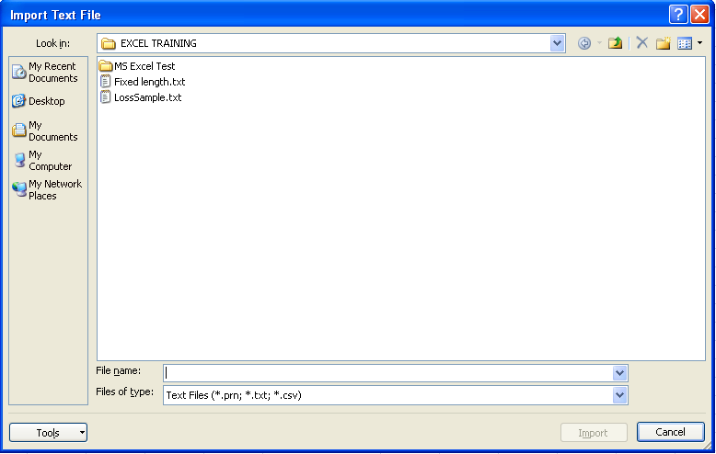
Text Import Wizard
A text file can be opened through the same commands and dialog box as an Excel file.
On the Data tab, in the Get External Data group, click From Text. The Text Import Wizard examines the text file that you are importing and helps you ensure that the data is imported in the way that you want.
Complete the Open dialog box by changing "Files of type" drop-down to text and selecting the file "LossSample.txt"
Excel will determine the file format and invoke the Text Import Wizard

Slide 16
Text Import Wizard
The wizard allows text files to be imported into Excel in three steps. Dialog boxes guide you through the available options at each stage.
Step 1: Import Data file type
Step 2: Delimited/Fixed width file
Step 3: Format import data

Slide 17
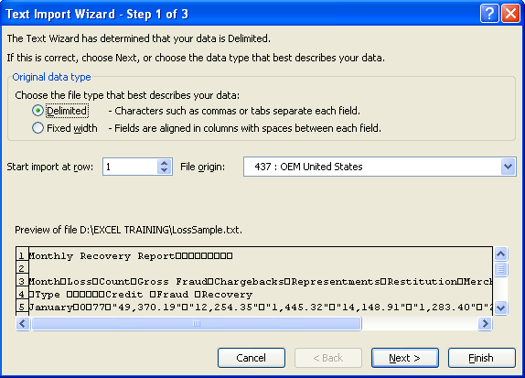
Importing Data: Step 1
Indicate Import Data type
The first screen allows the user to identify the type of column separation and to specify on which row to begin the import.

Slide 18
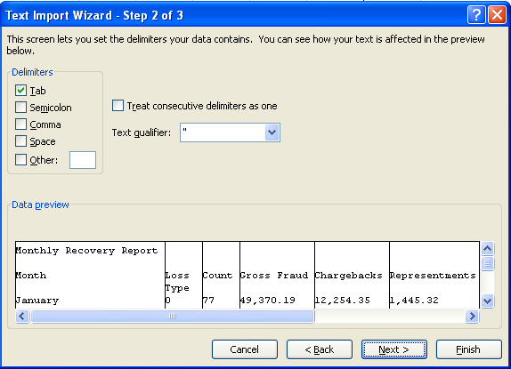
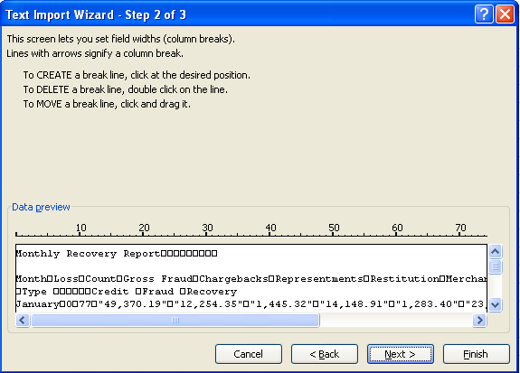
Importing Data: Step 2
Different dialogs will appear depending on whether the delimited or fixed-length box was checked during Step 1 of the text import.
Step 2: Delimited File
Step 2: Fixed Length File
Note: Once the correct delimiter is selected, lines will appear to indicate column breaks
Note: Column Breaks are set manually, each arrow denoting a new column

Slide 19
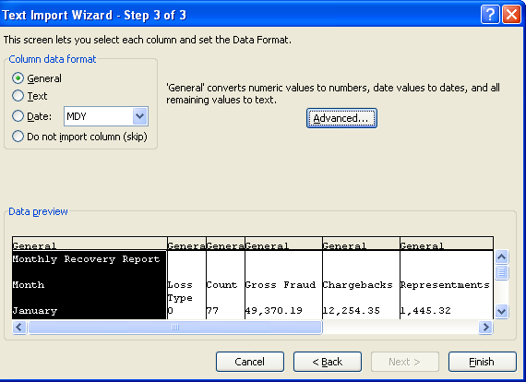
Importing Data: Step 3
Format Import data
This allows the user to specify a format for each column. Note that date fields can be imported in multiple formats. Data integrity can initially be checked by scrolling through the rows and columns in the import dialog box to find obvious errors.

Slide 20
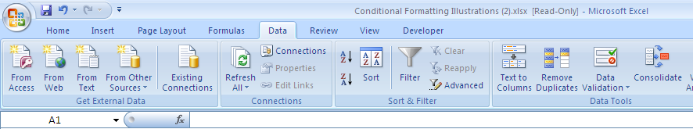
Converting Text to Columns
If data is copied from a program and pasted onto Microsoft Excel, Excel may condense several columns of data to a single column.
To put each record in a separate column, Data > Text To Columns command can be used.
This will open the ‘Text Import’ wizard and the data can then be separated based on ‘Fixed Width’ or ‘Delimited’ criterion.
The range to be converted may contain many rows, but only one column of data can be converted at a time.

Slide 21
Exercise 1
The organization has been hired by a large credit card issuer to help reduce credit losses. You have been given data for the previous year. The data has been provided in a file with an unknown format. Your objective in the exercise will be to import this data and convert it to a format useful for analysis.
Import the file "LossSample.txt" into Excel
Use the Text Import Window to determine the type of file
Change any of the field formats as required
Save this file on your hard drive as an Excel spreadsheet named "LossSample.xls"
Note how "#" signs appear in cells where the column width is not sufficient to display the data
Note how some of the headers have been split into two rows

Slide 22
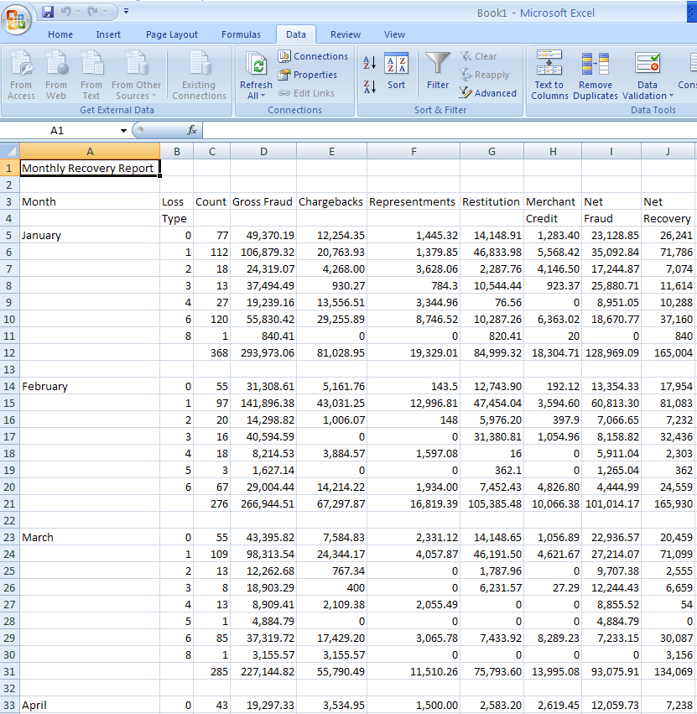
Exercise 1: Output
After completing the exercise, the resulting spreadsheet should look like the following.

Slide 23
III. Data Analysis
We will cover
Preparing Data
Analyzing Data in Excel
Exercise 2

Slide 24
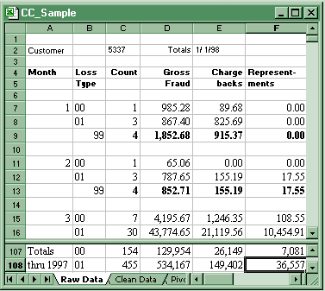
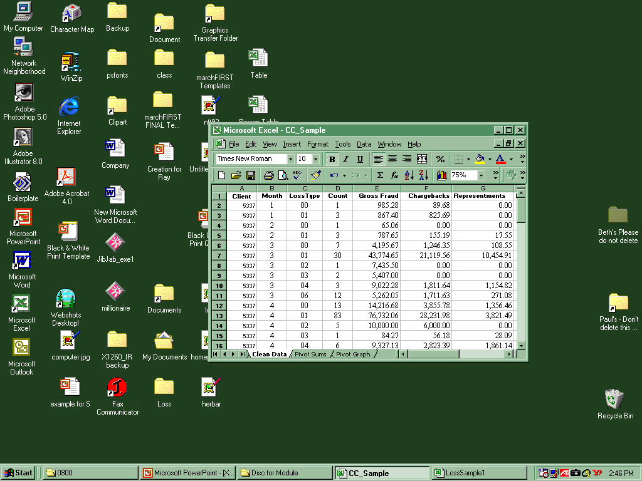
Preparing Data for Analysis
Prior to performing analysis, data should be formatted such that each row represents a complete observation. It may be necessary to eliminate headers and footers, add columns, or modify variable names as shown in example below:
Formatting Data for Analysis
Header info not
usable
Variable names on
1 and 2 lines
ID info not complete
Missing
values
included
Footer info not
needed

Slide 25
Analyzing Data: Key Functions
Excel contains several useful functions that facilitate general data analysis. These features can be used to quickly organise, scan, or calculate data.
Selected Data Management Features
Feature | Description | Directions
Sort | Sorts observations using selected variables (numbers/text/dates or time) | Highlight entire data range to be sorted Select Sort in the Sort & Filter group in the Data tab Follow instructions in the dialog box
AutoFilter | Controls which observations (rows) are visible by hiding rows that do not meet specified criteria | Select Filter in the Sort & Filter group in the Data tab Use pull down boxes to select filter criteria. Select Data/Filter/AutoFilter to end filtering.
Subtotals | Calculates and inserts subtotals in a list of data | Select a single cell in your list of data. Select Subtotal in the Outline group in the Data tab. Follow instructions in the dialogue box
PivotTable | Creates cross tabulations from a list of data providing statistics by discrete category | Select Insert tab, Pivot Table in the Tables group. Follow the wizard directions
Note: An extensive overview of each of these functions is available in the Microsoft Excel help facility

Slide 26
Sort Function
You can sort text, numbers, and dates and times in one or more columns. Excel 2007 also offers the feature to sort by a custom list or by format, including cell color, font color, or icon set. Most sort operations are column sorts, but you can also sort by rows.
Sort Text
Select a column of alphanumeric data in a range of cells, or make sure that the active cell is in a table column containing alphanumeric data.
On the Data tab, in the Sort & Filter group, do one of the following:
To sort in ascending alphanumeric order, click Sort A to Z.
To sort in descending alphanumeric order, click Sort Z to A.
Optionally, you can do a case-sensitive sort. (In the Sort dialog box, click Options then select Case Sensitive In the Sort Options dialog box)
On the Data tab, in the Sort & Filter group, click Sort.
To reapply a sort after you change the data, click a cell in the range or table, and then on the Data tab, in the Sort & Filter group, click Reapply.
Similarly we can sort numbers, dates and times. You can sort by up to 64 columns/rows.
Keyboard Shortcut: Alt + D + S

Slide 27
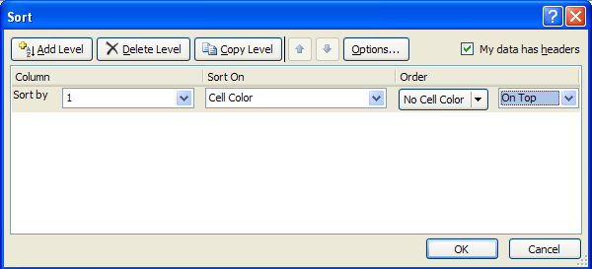
Sort by cell color, font color, or icon
On the Data tab, in the Sort & Filter group, click Sort. The Sort dialog box is displayed.
Under Column, in the Sort by box, select the column that you want to sort.
Under Sort On, select the type of sort i.e. cell /font color or cell icon.
Under Order, depending on the type of format, select a cell color, font color, or cell icon.
To move the cell color, font color, or icon to the top or left, select On Top for a column sort, and On Left for a row sort.
To move the cell color, font color, or icon to the bottom or right, select On Bottom for a column sort, and On Right for a row sort.
Click Add Level to specify another sort level
Note:
There is no default cell color, font color, or icon sort order.
To reapply a sort after you change the data, click a cell in the range or table, and then on the Data tab, in the Sort & Filter group, click Reapply.

Slide 28
Sort by a Custom List
Create the custom list:
In a range of cells, enter the values that you want to sort by, in the order that you want them, from top to bottom.
Select the range that you just typed. In the example above, you would select cells A1:A3.
Click the Microsoft Office Button , click Excel Options, click the Popular category, and then under Top options for working with Excel, click Edit Custom Lists.
In the Custom Lists dialog box, click Import.
Then Sort the list based on the custom list formed.
Note:
You can only create a custom list based on a value (text, number, and date or time). You cannot create a custom list based on a format (cell color, font color, and icon).
The maximum length for a custom list is 255 characters, and the first character must not begin with a number.

Slide 29
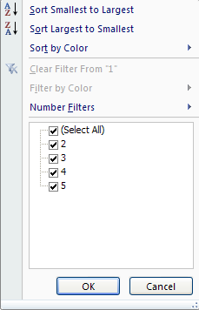
Auto Filter Function
Using AutoFilter, you can create three types of filters:
By List Values
By Format
By Criteria
We can filter Numbers, Text, Dates or times. We can also filter for top or bottom numbers, above or below average numbers, blanks or nonblanks.
On the Data tab, in the Sort & Filter group, click Filter and choose the condition of Filter.
Keyboard Shortcut: Alt + D + F + F

Slide 30
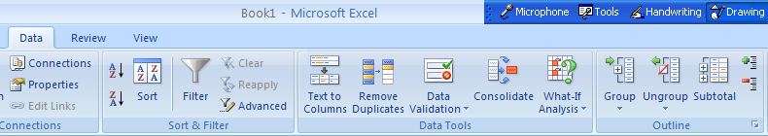
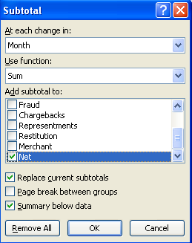
Subtotals Function
Subtotals are a quick way of summarising data that can be grouped into a small number of categories (i.e., months). In addition to subtotals, you can summarise your data using averages, counts, etc.

Slide 31
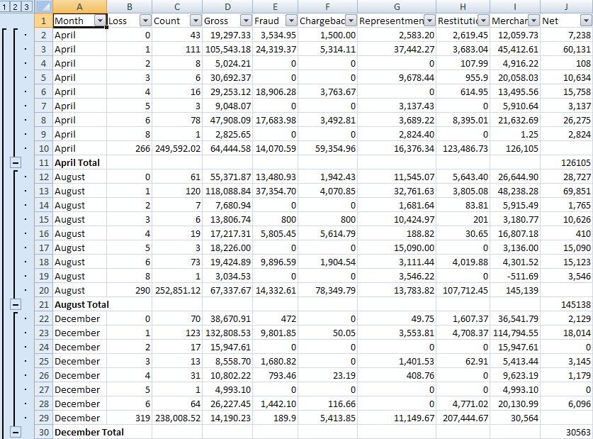
Subtotals Function contd…
The level of detail in a sorted data set can be controlled by using the +/- boxes. Clicking on one will toggle the switch to hide or display the relevant data.
Controls level of data displayed
Subtotals can also show average, etc.
Grand total
Monthly totals
All data
Shows range of data summarized in subtotal

Slide 32
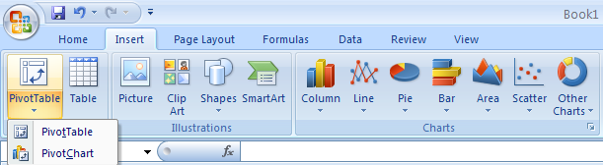
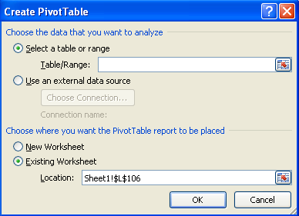
Analyzing Data: PivotTable Function
Pivot tables are useful tools with which to quickly summarise data and perform preliminary analysis.
Invoke the PivotTable Wizard by going to Pivot Table in the Insert tab.
Select the Table/Range for which the Pivot Table is to be created.
Select the Location where the Pivot Table needs to be created
Keyboard Shortcut: Alt + D + P

Slide 33
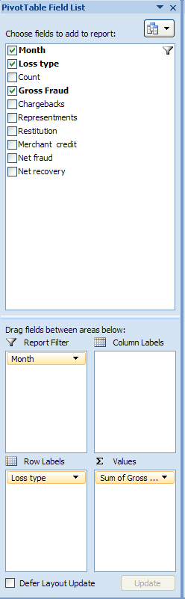
PivotTable Function
Drag the names of the fields to be summarised into the Value box located at the bottom right.
If the text field in the top of the pivot table field list is checked, it will automatically jump to the Row Labels. If you checkmark a numeric field, it will automatically jump to the Σ Values section.
Column Labels and Row Labels determine how many columns and rows will be present in the pivot table.
To analyze the data by a particular field, drag that field in the Report Filter area. The filter at the top of the page can then be used to select the desired field.
Filters can also be applied to the fields in the Row and column area.

Slide 34
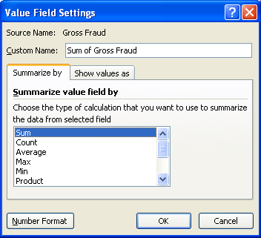
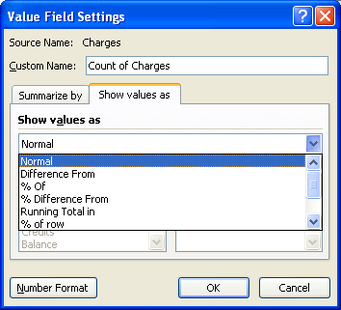
PivotTable Function
Right click on the field name and choose “Field Value Settings” to make changes to its attributes. The data set will be organised into a table which will summarise all instances of Gross Fraud by Month.

Slide 35
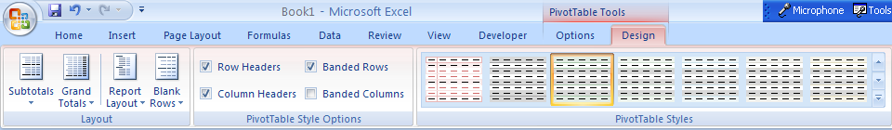
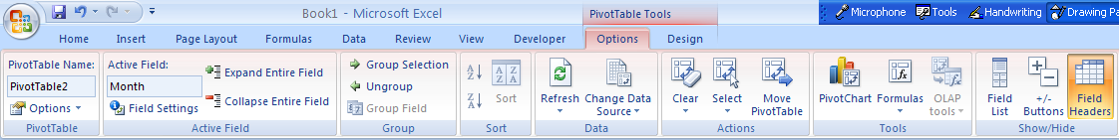
PivotTable Function - Formatting
Excel 2007 offers lots of formatting options on the pivot table.
When your cell pointer is inside the pivot table, you will have two new tabs under the PivotTable Tools heading - Options and Design.
On the Design tab, the PivotTable Styles gallery offers 85 built-in formats for pivot tables which changes the look of the pivot table.
On the Options tab, we can manipulate the data to be displayed in the pivot

Slide 36
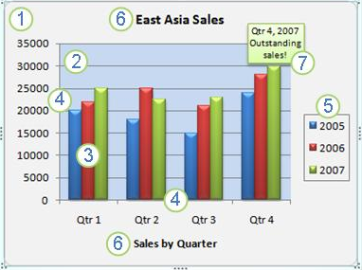
IV. Output Display - Charts
Key Elements of the Chart
The chart area of the chart.
The plot area of the chart.
The data points of the data series that are plotted in the chart
The horizontal (category) and vertical (value) axis along which the data is plotted in the chart .
The legend of the chart
A chart and axis title that you can use in the chart.
A data label that you can use to identify the details of a data point in a data series.

Slide 37
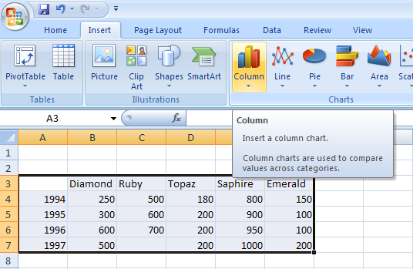
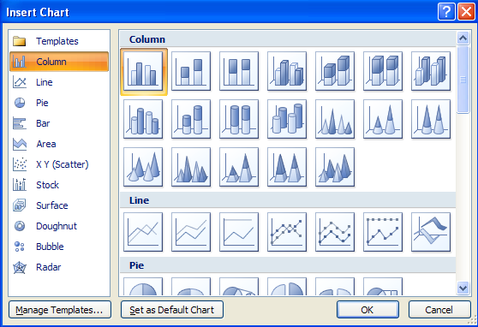
Charts
Select the data that needs to be represented in the chart.
To insert a new chart, select Chart in the Insert tab.
A Chart Wizard will open that creates graphs that portray the selected data.
The challenge is to select the chart type that best highlights the conclusions of the analysis.
Select the data which has to be represented in chart
Select the type of chart which best represents the data

Slide 38
Charts – Changing Chart/Series Type
Select the chart that needs to be changed.
Right-click on the chart area and select Change Chart type or select Change Chart Type option in the Design tab on the Chart tools.
To change the Series Chart Type
Select the series in the chart that needs to be changed.
Right-click on the chart and select Change Series Chart type or select Change Chart Type option in the Design tab on the Chart tools
The same data presented in two different chart types

Slide 39
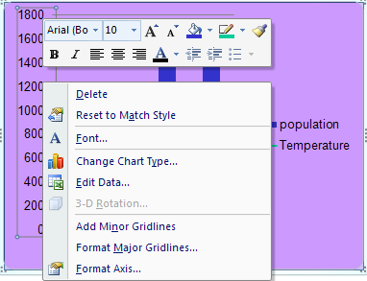
Charts – Editing Fonts and Resizing
Select X-axis and right-click to edit; change fonts and font size so text looks presentable
Similarly for Y-axis and legend fonts
Resize the chart by extending the chart from the corners

Slide 40
Charts – Other Chart Options
Right click on Gridline and click on Delete to remove gridlines.
Right click on legend, select “Format Legend", on ‘Legend Option’ tab, change the legend position as required.
Right click on the axis, select “Format axis” to change the axis style
Right click a series by clicking on any bar (all the bars in that series are selected); under ‘Format Data Labels’ tab, under “Label options” click on Value
Edit fonts and sizes of data-labels if required by selecting the data-labels that appear for the series

Slide 41
Charts – Using a Secondary Axis
To plot a data series against a secondary axis, right-click on it and select the “Format data series”.
Under “Series Options “ choose Plot on “Secondary Axis” .
By default, the same chart type will be used for the data series now plotted against the secondary axis. In the illustration below, temperature series is plotted on the secondary axis and its bar appears larger now.

Slide 42
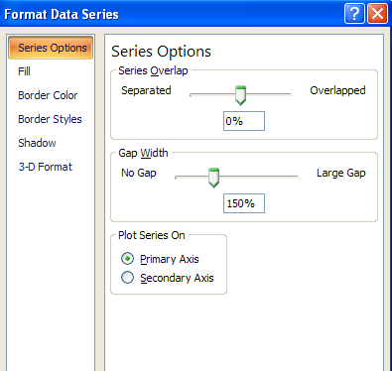
Charts – Gap Width and Overlap
You can control the amount of space between bars with the Gap Width and Series Overlap options in the Format Data Series – Series Options dialog window. Gap Width is the amount of space between categories on your chart. You can set it from 0 (zero) to 500. The larger the number, the more the space.
Use Overlap if the bars on your chart become so narrow that you can’t distinguish their fill patterns.

Slide 43
Charts – Useful Information
Each graph element can be treated as a separate shape. So, all the editing that can be applied on the shapes can be used on individual graph elements. Thus, each bar in the bar-graph can be worked on individually.
Any element of the chart that is not desired can be simply removed using the delete key.
Make sure that the units are always mentioned in the graph
The size of the graph should be such that all the data represented is clearly visible.
Try to utilize as much space available as possible, never leave a lot of empty space on the slide.
If required, highlight the key areas in the graph using an outline.
Colors can be used for providing additional information like red for bad, green for good etc.
If the file is in older format, convert the chart to the new format first before editing if all the new features of the 2007 format need to be used. For converting the chart to the newest format, Right click on the chart, then ‘Chart Object’ and select ‘Convert’. Select ‘Microsoft Graph Chart’ in the options provided. It might take some time depending upon the chart size. Then, again double click the chart and select ‘Convert All’ to finally convert the chart to the 2007 format.

Slide 44
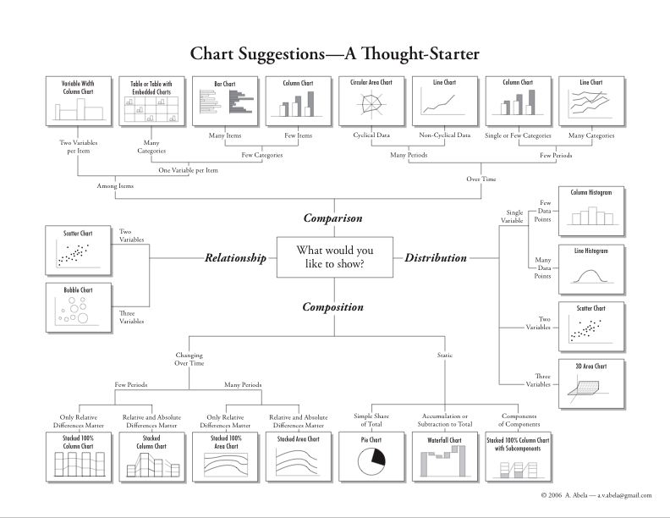
Charts – Which to use When

Slide 45
Exercise 2
Analyze the file "LossSample1.xls", using the steps below. Determine the extent of the issuer's losses in 1997, and indicate if there are any patterns or trends.
Convert the file to a usable format
Check headers and footers
Add any necessary columns
Create variable names in header
Check the file for sensible values and identify any data that appear suspect
Sort the data to find minimum and maximum observations for each variable
Use the AutoFilter to view data categories and ensure data integrity for each category
Invoke Descriptive Statistics and Histogram features from the Data Analysis Toolpack
Note: These procedures only work with continuous variables
Use the Subtotal function to perform a preliminary analysis
Conclude preliminary analysis
Use a PivotTable to determine the total Gross Fraud for each Month
Graph Gross Fraud over time
Document your initial conclusions

Slide 46
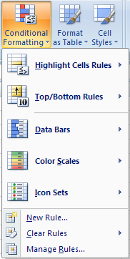
Output Display – Conditional Formatting
Conditional formatting allows you to set rules for cell formatting. If the rules(conditions) are met, then the formatting is applied. Excel 2007 offers a variety of new conditional formatting.
In Excel 2003, only 3 rules could be set but in Excel 2007, a lot more can be added.
Select the cells to be formatted Choose Home tab > Conditional Formatting
From the first drop-down list, choose the type of formatting
Applications:
Hiding Errors & Duplicate Values, Highlighting Duplicates in Column, Highlighting Items in a List, Highlighting

Slide 47
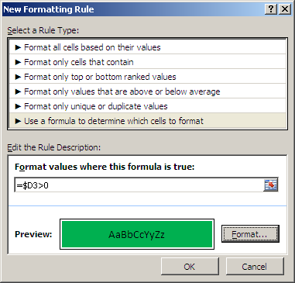
Output Display – Conditional Formatting
Formula based formatting
Select the cells to be formatted and select the ‘Conditional Formatting’ under the ‘Home Tab’.
Create a new rule by selecting ‘Use a formula to determine which cells to format’
In the text box, enter a formula that refers to an absolute reference to a column (for example, $D), to ensure that the conditional formatting in all columns refers to the value in column D. Otherwise, the formula will be adjusted in each column.
Select to apply conditional formatting based on formula
Enter the condition
Apply the requisite format

Slide 48
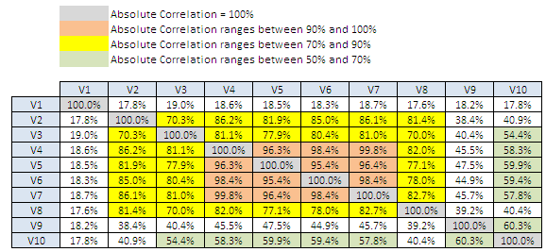
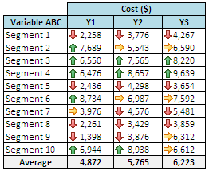
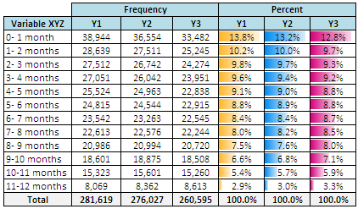
Output Display – Conditional Formatting

Slide 49
V. Excel Functions
Functions are designed to perform complex and frequently used calculations. These predefined formulas make it easier to enter arguments and follow the correct syntax when programming your model.
Components of a Function
Selected Excel Functions
 | Function |  | Description
 | = SUM(Range) |  | Adds the value or cells in the argument
 | = AVERAGE(Range) |  | Provides arithmetic mean for the values or cells in the argument
 | = COUNT(Range) |  | Counts the numbers in the argument
 | = COUNTIF(Range, Criteria) |  | Counts all the cells that meets the test condition
 | = IF(logical test, Value if True, Value if False) |  | Provides either value (if true or false), depending on the result of the logical test
 | = SUMIF(Range, Criteria, Sum, Range) |  | Adds the value in the argument that meets the test condition
 | = VLOOKUP(Lookup value, Range, Column index, Range lookup |  | Returns a value from table by cross- indexing a specified column with the row of the lookup value
 | = SUMPRODUCT(Range 1, Range2, etc.) |  | Multiplies the corresponding numbers in a range and sums the products
Equals sign signals the beginning of a formula or function
Function name
Arguments
=SUM(A1,B2:B10,Taxes,100)
Parentheses enclose arguments
Colons indicate ranges
Commas separate arguments
Note: In office 2007, the ‘Intellisense’ property will display all the possible formulae as a dropdown list based on the typed characters

Slide 50
IF Function And Logical Operators
The If function returns one value if a specified condition evaluates to TRUE, or another value if it evaluates to FALSE.
The syntax for the If function is:
If( condition, value_if_true, value_if_false )
condition is the value that you want to test.
value_if_true is the value that is returned if condition evaluates to TRUE.
value_if_false is the value that is return if condition evaluates to FALSE.
The syntax for the nesting the IF function is:
IF( condition1, value_if_true1, IF(condition2, value_if_true2, value_if_false2 ))
This would be equivalent to the following IF THEN ELSE statement:
IF condition1 THEN value_if_true1
ELSEIF condition2 THEN value_if_true2
ELSE value_if_false2
END IF
Using IF with Logical Operators
=IF(AND(C11>=620, OR(C10="F",C10="S"), C4<=1000000), 1, 2)

Slide 51
VLOOKUP Function
It may sometimes happen that partial information has been entered or calculated on another worksheet, which may have been created from scratch by a user, or based on a list spreadsheet obtained from another source. In this case, there is a requirement to be able to easily transfer information between the sheets. It is possible to simply copy and paste - however, unless the lists are a perfect match, both in terms of total records and exact order, then this is extremely dangerous!
Syntax = VLOOKUP(lookup_value, table_array, col_index_num, range_lookup)
lookup_value Required. The value to search in the first column of the table or range. The lookup_value argument can be a value or a reference. If the value you supply for the lookup_value argument is smaller than the smallest value in the first column of the table_array argument, VLOOKUP returns the #N/A error value.
table_array Required. The range of cells that contains the data.
col_index_num Required. The column number in the table_array argument from which the matching value must be returned.
range_lookup Optional. A logical value that specifies whether you want VLOOKUP to find an exact match or an approximate match:
HLOOKUP works in a similar manner for data with a horizontal layout.

Slide 52
CONCATENATE and TRIM Functions
CONCATENATE
The Concatenate function allows you to join 2 or more strings together.
Syntax = CONCATENATE( text1, text2, ... text_n )
CONCATENATE(“This”, A1, A8, “Test”)
Another way of concatenating the strings is using the ‘&’ operator
Syntax = A1 & B1
There can be up to 255 strings that can be joined together.
TRIM
The Trim function returns a text value with the leading and trailing spaces removed.
Syntax = Trim( text )
TIP: To remove all the spaces, even in between the text, replace the space with a null value!!!

Slide 53
Other String Functions
Function | Description | Syntax | Example
LEFT | Selects specified characters starting from the left of the string. | LEFT( text, no_of_chars) | LEFT(“Hello”, 3) LEFT(A6, 4)
RIGHT | Selects specified characters starting from the right of the string. | RIGHT( text, no_of_chars) | RIGHT(“Hello”, 4) RIGHT(B10, 2)
MID | Returns a specific number of characters from a text, starting at the specified position , till the specified number of characters | MID(text, start_num, num_chars) | MID(“Hello”, 2, 2) MID(A13, 3,2)
LEN | Returns the number of characters in a text string | LEN(text) | LEN(“Hello”) LEN(B24)
FIND (Case Sensitive) | Locates one text string within a second text string, and return the number of the starting position of the first text string from the first character of the second text string. | FIND(find_text, within_text, start_num) | FIND(“is”, “This is a test”)
SEARCH (Non Case Sensitive) | Locates one text string within a second text string, and return the number of the starting position of the first text string from the first character of the second text string. | SEARCH(find_text, within_text, start_num) | SEARCH(“IS”, “This is a test”)
REPLACE | Replaces part of a text string, based on the number of characters specified, with a different text string. | REPLACE(old_text,start_num,num_chars,new_text) | REPLACE(“Hello”, 2, 1, “*”)

Slide 54
SUMPRODUCT Function
The SUMPRODUCT function multiplies corresponding components in the given arrays, and returns the sum of those products.
Syntax = SUMPRODUCT( Array 1, Array2, ...)
The array arguments must have the same dimensions. If they do not, SUMPRODUCT returns the #VALUE! error value.
SUMPRODUCT treats array entries that are not numeric as if they were zeros.
Logical conditions can be used to validate the arrays before a particular value is evaluated
Syntax = SUMPRODUCT(Array1 = “Value1”, Array2 = “Value2”, Array3)
The resultant of the above function will be the value of ‘Array3’ in that row where the value of ‘Array1’ equals ‘Value1’ and that of ‘Array3’ equals ‘Value2’

Slide 55
OFFSET Function
The OFFSET function returns a reference to a range that is a specified number of rows and columns from a cell or range of cells.
Syntax = OFFSET(reference, rows, cols, height, width)
Reference is the reference from which you want to base the offset.
Rows is the number of rows, up or down, that you want the upper-left cell to refer to. Using 5 as the rows argument specifies that the upper-left cell in the reference is five rows below reference
Cols is the number of columns, to the left or right, that you want the upper-left cell of the result to refer to. Using 5 as the cols argument specifies that the upper-left cell in the reference is five columns to the right of reference.
Height is the height, in number of rows, that you want the returned reference to be. Height must be a positive number.
Width is the width, in number of columns, that you want the returned reference to be. Width must be a positive number.
OFFSET(B5, 3, 2, 1, 1) will give the value in the cell ‘D8’

Slide 56
INDEX Function
The INDEX function returns a value or the reference to a value from within a table or range.
Syntax = INDEX(reference, row_num, column_num, area_num)
Reference is a reference to one or more cell ranges.
Row_num is the number of the row in reference from which to return a reference.
Column_num is the number of the column in reference from which to return a reference.
Area_num selects a range in reference from which to return the intersection of row_num and column_num. The first area selected or entered is numbered 1, the second is 2, and so on. If area_num is omitted, INDEX uses area 1.
INDEX(A1:B2,1,2) will return the value in the cell ‘A2’

Slide 57
MATCH Function
The MATCH function searches for a specified item in a range of cells, and then returns the relative position of that item in the range.
Syntax = MATCH(lookup_value, lookup_array, match_type)
lookup_value is the value that needs to be matched in lookup_array..
lookup_array is the range of cells being searched
match_type specifies how Excel matches lookup_value with values in lookup_array. The default value for this argument is 1.
‘1’ or omitted searches largest value that is less than or equal to lookup value (the values must be in ascending order),
‘0’ searches for the first value that is exactly equal to lookup value
‘-1’ searches the smallest value that is greater than or equal to lookup value (the values must be in descending order)
MATCH(30, A1:A20,1) will return the position of the ‘30’ in the range ‘A1:A20’
Wildcard characters - the question mark (?) and asterisk (*)
A question mark matches any single character; an asterisk matches any sequence of characters. If you want to find an actual question mark or asterisk, type a tilde (~) before the character.

Slide 58
Other Functions
Inbuilt Functions without arguments:
Row()
Column()
Date()
Today()
ERROR Related
NA()
ISNA()
ISBLANK()
ISERROR()
ISNUMBER()

Slide 59
Commonly used Financial Functions
FUNCTION | DESCRIPTION
DISC | Returns the discount rate for a security
DURATION | Returns the annual duration of a security with periodic interest payments
FV | Returns the future value of an investment
IRR | Returns the internal rate of return for a series of cash flows
NPV | Returns the net present value of an investment based on a series of periodic cash flows and a discount rate
PMT | Returns the periodic payment for an annuity
PRICE | Returns the price per $100 face value of a security that pays periodic interest
PV | Returns the present value of an investment
SLN | Returns the straight-line depreciation of an asset for one period
YIELD | Returns the yield on a security that pays periodic interest

Slide 60
Error Values
If a formula cannot properly evaluate a result, Excel will display one of several error values, each of which has a different meaning.
 | Function |  | Description
 | #VALUE! |  | Wrong type of argument or operation is used The formula may require a numerical value but refers to text or the dimensions of a matrix are wrong
 | #DIV/0! |  | A formula contains a division by zero argument The formula may refer to a blank cell in the denominator
 | #NAME? |  | Excel does not recognize text in a formula The formula may contain a misspelled range name or function, or contain text that should be in quotes
 | #NA |  | A necessary value is not available for a formula or function The function cannot find a value in a lookup function or may be missing arguments
 | #REF! |  | An invalid cell reference Cells referenced in a formula may have been moved, deleted, or copied with an invalid reference
 | #NUM |  | A problem with a number in a formula or function An argument requires a number (not text) or the result is too big or small for Excel
 | #NULL! |  | Using an incorrect range separator.

Slide 61
Commonly used Formatting Tips
Wrap Text
Borders
Removing Gridlines
Cells Formatting
Freezing the panes
Row and Column Width
Shading/Colouring Cells/Range
Hyperlink
Merging Cells
Indentation
Grouping the Rows/Columns

Slide 62
VI. Macros
Macros are VBA (Visual Basic for Applications) instructions which can be used to automate tasks in Excel. Macros are also called Procedures.
It is possible to record Macros using the Excel Macro Recorder – this eliminates the need to know VBA for constructing simple macros. The Macro Recorder records the actions step by step.
Using the Macro record feature has a lot of advantages, especially if you would like to learn the appropriate VBA code or command, but it is of only limited use when trying to develop more complex program – such as a program than can take conditional actions, or that repeat an action for a specific (or even conditional) number of times.
Macros can be stored in
This Workbook (only available within the particular workbook)
New Workbook
Personal Workbook (available with all workbooks on your PC)
What will we cover:
Recording & Running a macro
Examples

Slide 63
Recording Macro
Microsoft Excel has a build-in macro recorder that translates your actions into VBA macro commands. Every action taken during the recording will be captured including the corrections. After the macro is recorded, the syntax and the layout can be seen.
Pre-requisites:
Developer Tab: Developer tab holds the VBA tools. If the tab is not available, then:
Click the Microsoft Office Button , and then click Excel Options.
In the Popular category, under Top options for working with Excel, select the Show Developer tab in the Ribbon check box, and then click OK.
To set the security level temporarily to enable all macros, do the following:
On the Developer tab, in the Code group, click Macro Security.
Under Macro Settings, click Enable all macros (not recommended, potentially dangerous code can run), and then click OK.

Slide 64
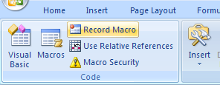
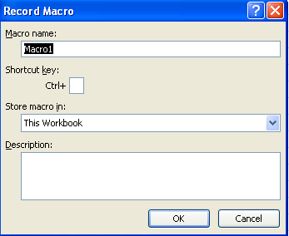
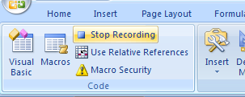
Macro - Example
On the Developer tab, in the Code group, click Record Macro.
Record Macro Wizard will open.
In the Macro name box, enter a name for the macro.
In the Store macro in list, select the workbook where you want to store the macro.
In the Description box, type a description of the macro.
Click OK to start recording.
Perform the actions that you want to record.
On the Developer tab, in the Code group, click Stop Recording.
Perform the actions that you want to capture

Slide 65
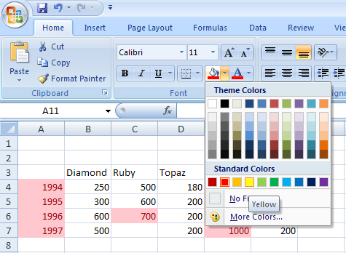
Macro – Example to set the Background Color to Yellow
On the Developer tab, in the Code group, click ‘Record Macro’.
Enter the requisite details in the Record Macro Wizard and press OK.
In the Background Color Panel, select the Light Yellow color box. This action will set the background of the current cell (A1) in light yellow color.
Once finished, click ‘Stop Recording’ on the Developer tab.

Slide 66
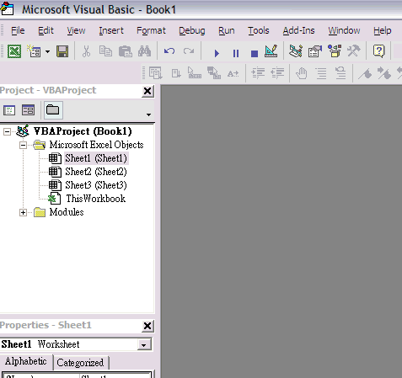
View the Recorded Macro
The recorded macro is ready for use. Before we run the Marco, let's look into the syntax.
To load the Visual Basic Editor, press [Alt] and [F11] at the same time. The Visual Basic Editor comes up.

Slide 67
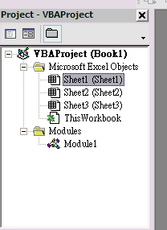
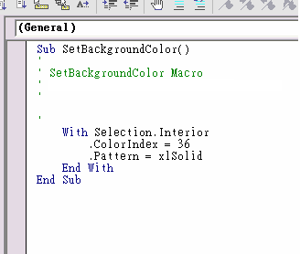
View the Recorded Macro
Expand the Modules folder in the Project Explorer by clicking on the plus (+) sign
Double click the Module1 folder to see the sub routine (macro).
As the figure shows, the name of the sub routine is "SetBackgroundColor". The color index for the light yellow is 36. The background pattern is solid.

Slide 68
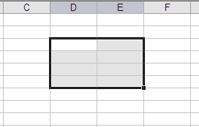
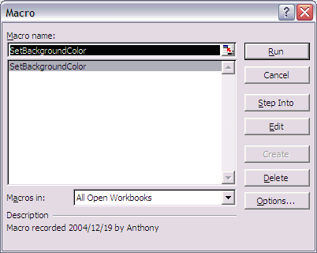
Run the Recorded Macro
In our prior example, we created the “SetBackgroundColor" macro. Now, we will run the recorded macro in the worksheet.
On any worksheet, select from D3 to E6
To run the recorded macro
On the Developer tab, in the Code group, click Macros.
In the Macro name box, click the macro that you want to run and click Run .
The Macro dialogue box displayed. Since there is only one macro in the module, by default the only macro SetBackgroundColor is selected. Click the Run button to run the macro.
Note: If you automatically get the message that the macros are disabled you must change the security level in excel.

Slide 69
Assign a Recorded Macro to VBA Object
Assigning and Running a macro by clicking a VBA object – Button / Checkbox / Option Button
Record the desired Macro and assign it an appropriate name.
Add a VBA object into the sheet by selecting Insert in the Controls Group from the Developer tab.
Chose from a list of objects under the ‘Form Controls’ option as they can refer to the macro directly.
Draw the selected object into the excel sheet.
Assign Macro dialogue box will open. Double-click the macro or enter its name in the Assign Macro dialogue box.
The macro can be assigned or modified later by right clicking and then selecting Assign Macro on the shortcut menu.

Slide 70
Assign a Recorded Macro to Graphic Object
Assigning and Running a macro by clicking an area on a graphic object
In the worksheet, select an existing graphic object, such as a picture, clip art, shape, or SmartArt.
To create a hot spot on the existing object, on the Insert tab, in the Illustrations group, click Shapes, select the shape that you want to use, and then draw that shape on the existing object.
Right-click the hot spot that you created, and then click Assign Macro on the shortcut menu .
Do one of the following:
To assign an existing macro to the graphic object, double-click the macro or enter its name in the Macro name box.
To record a new macro to assign to the selected graphic object, click Record. When you finish recording the macro, click Stop Recording on the Developer tab in the Code group.
To edit an existing macro, click the name of the macro in the Macro name box, and then click Edit.

Slide 71
Assign a Recorded Macro on Quick Access Toolbar
Assigning and Running a macro by clicking a button on the Quick Access Toolbar
Click the Microsoft Office Button , and then click Excel Options.
Click Customize, and then in the Choose commands from list, select Macros.
In the list, click the macro that you created, and then click Add.
To change the button image of the macro, select the macro in the box where it was added, and then click Modify.
Under Symbol, click the button image that you want to use.
To change the name of the macro that is displayed when you rest the pointer on the button, in the Display name box, type the name that you want to use.
Click OK to add the macro button to the Quick Access Toolbar.

Slide 72
Exercise (Tab 1)
Run the formatting macro on Tab “Macro”. and see the output. Try to generate a similar macro

Slide 73
VII. New Features in Excel 2007
More rows and columns, and other new limits
To enable you to explore massive amounts of data in worksheets, Excel 2007 supports up to 1 million rows and 16 thousand columns per worksheet.
Office themes and Excel styles
In Office Excel 2007, you can quickly format the data in your worksheet by applying a theme and by using a specific style. Themes can be shared across other 2007 Office release programs, such as Microsoft Office Word and Microsoft Office PowerPoint.
Easy formula writing
Resizable formula bar: The formula bar automatically resizes to accommodate long, complex formulas, which prevents the formulas from covering other data in your worksheet. You can also write longer formulas with more levels of nesting than you could in earlier versions of Excel.
Function AutoComplete: With Function AutoComplete, you can quickly write the proper formula syntax. From easily detecting the functions that you want to use to getting help completing the formula arguments, you will be able to get formulas right the first time and every time.
Improved Structured references: In addition to cell references, such as A1 and R1C1, Office Excel 2007 provides structured references that reference named ranges and tables in a formula.
Easy access to named ranges: By using the Office Excel 2007 Name Manager, you can organize, update, and manage multiple named ranges in a central location, which helps anyone who needs to work on your worksheet interpret its formulas and data.

Slide 74
New Features in Excel 2007
Sorting and Filtering
In Office Excel 2007, you can quickly arrange your worksheet data to find the answers that you need by using enhanced filtering and sorting. For example, you can now sort data by color and by more than 3 (and up to 64) levels. You can also filter data by color or by dates, display more than 1000 items in the AutoFilter drop-down list, select multiple items to filter, and filter data in PivotTables.
Quick connections to external data
In Office Excel 2007, you no longer need to know the server or database names of corporate data sources.
Instead, you can use Quicklaunch to select from a list of data sources that your administrator or workgroup expert has made available for you. A connection manager in Excel allows you to view all connections in a workbook and makes it easier to reuse a connection or to substitute a connection with another one.
Saving to PDF and XPS format
You can save as a PDF or XPS file from a 2007 Microsoft Office system program after installing an add-in.
Range of new Cell Styles
Excel 2007 offers than more than 40 colorful readymade styles which we can preview in the worksheet with Live Preview
Zoom Slider
The Zoom Slider makes it easy to zoom in and out by sliding the zoom control. It is located on the bottom right.

Slide 75
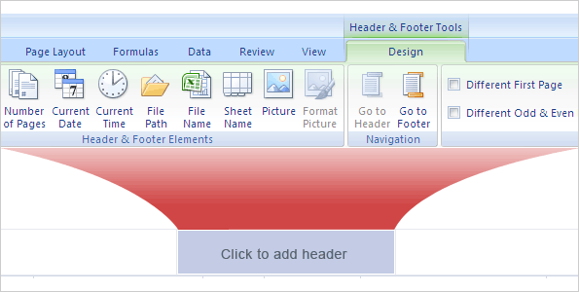
New Features in Excel 2007
Better printing experience
In addition to the Normal view and Page Break Preview view, Page Layout View is also provided.
In this view, you can work with page headers, footers, and margin settings right in the worksheet, and place objects, such as charts or shapes, exactly where you want them.
You also have easy access to all page setup options on the Page Layout tab in the new user interface so that you can quickly specify options, such as page orientation.
New File Extensions:
.xlsx Excel Workbook: Use when there are no macros or VBA code.
.xlsm Excel Macro-Enabled Workbook: Use when there are macros or VBA code.
.xltx Excel Template: Use when you need a template.
.xltm Excel Macro-Enabled Template: Use when you need a template and macros or VBA.
.xlsb Excel Binary Workbook: Use with an especially large workbook.
New Header/Footer Controls

Slide 76
New Features in Excel 2007
Excel table enhancements
In Office Excel 2007, you can use the new user interface to quickly create, format, and expand an Excel table to organize the data on your worksheet so that it's much easier to work with. New or improved functionality for tables includes the following features.
Table header rows: Table header rows can be turned on or off. When table headers are displayed, they stay visible with the data in the table columns by replacing the worksheet headers when you move around in a long table.
Calculated columns: A calculated column uses a single formula that adjusts for each row. It automatically expands to include additional rows so that the formula is immediately extended to those rows. All that you have to do is enter a formula once—you don't need to use the Fill or Copy commands.
Automatic AutoFiltering: AutoFilter is turned on by default in a table to enable powerful sorting and filtering of table data.
Structured references: This type of reference allows you to use table column header names in formulas instead of cell references, such as A1 or R1C1.
Total rows: In a total row, you can now use custom formulas and text entries.
Table styles: You can apply a table style to quickly add designer-quality, professional formatting to tables. By formatting a table of data with one of the many table styles available on the Table Styles drop-down gallery, you are assured that all new entries made to the table are going to be formatted in the same manner as others in similar positions in the table.

Slide 77
New Features in Excel 2007
Easy-to-use PivotTables
By using the new PivotTable user interface, the information that you want to view about your data is just a few clicks away—you no longer have to drag data to drop zones that aren't always an easy target. Instead, you can simply select the fields that you want to see in a new PivotTable field list.
Using Undo in PivotTables: You can now undo most actions that you take to create or rearrange a PivotTable.
Plus and minus drill-down indicators: These indicators are used to indicate whether you can expand or collapse parts of the PivotTable to see more or less information.
Sorting and filtering: Sorting is now as simple as selecting an item in the column that you want to sort and using sort buttons. You can filter data by using PivotTable filters, such as date filters, label filters, value filters, or manual filters.
Conditional formatting: You can apply conditional formatting to an Office Excel 2007 Pivot Table by cell or by intersection of cells.
PivotCharts: Like PivotTables, PivotCharts are much easier to create in the new user interface. All of the filtering improvements are also available for PivotCharts. When you create a PivotChart, specific PivotChart tools and context menus are available so that you can analyze the data in the chart. You can also change the layout, style, and format of the chart or its elements the same way that you can for a regular chart. In Office Excel 2007, the chart formatting that you apply is preserved when you make changes to the PivotChart, which is an improvement over the way it worked in earlier versions of Excel.

Slide 78
VIII. Final Thoughts
Because of the nature of this course, there were several subjects that were not covered in this training.
Excel can be made more functional through the use of:
Customising Macros
Modules
Visual Basic
However, Excel is not the right tool for solving all problems
Huge volumes of data
Very advanced statistics
Complex linkages between data
Other programs may need to be considered
Access, Oracle, Sybase
SAS
Programming languages
Visual Basic
SQL

