Slide 1

Taming the Complexity of Artifact Reproducibility
Matthias Flittner¹, Robert Bauer¹, Amr Rizk², Stefan Geißler³, Thomas Zinner³, Martina Zitterbart¹ ¹Karlsruhe Institute of Technology, ²Technische Universität Darmstadt, ³University of Würzburg

Slide 2
A typical paper
Design
Related Work
Evaluation
Problem
Should be reproducible!

Slide 3
Reproducibility by Design
General idea

Slide 4
Methodology
Selected five of 2016‘s top SDN conferences
CoNext, NSDI, OSDI, SIGCOMM, SOSR
Identified a sample of 34 SDN papers
Focused on evaluation of research artifacts
Analysis of basic requirements for reproducibility
Type of evaluation
Tools
Topologies
Traffic
Environment
Documentation

Slide 5

Observation 1

Slide 6
Observation 1
Proper documentation is difficult
Version | Version of mininet
HW-OS | Operation System
HW-spec | Hardware Specs (CPU, Memory, …)
HW-dim | Dimensioning of the hardware (#servers, …)
HW-vswitch | Virtual Switch (OVS, bmv2, …)
HW-nic/net | Network Setup (NIC, Latency)
Topo | Topology used with mininet
Topo-size | Dimensioning of the topology
Traffic-tools | Tool(s) used for traffic generation
Traffic-param | Parameters / Workflow of traffic generation
Metrics | What is evaluated?
Iterations | #experiments
Example from paper study:
6 of 34 investigated papers make use of the tool „mininet“
→ What documentation is required for reproducibility?

Slide 7
Observation 1
Proper documentation is difficult
 | Example 1 | Example 2 | Example 3 | Example 4 | Example 5 | Example 6
Version | No | No | No | No | Yes | Yes
HW-OS | Yes | No | Yes | No | Yes | No
HW-spec | Yes | No | Yes | No | Yes | Yes
HW-dim | Yes | No | Yes | No | No | Yes
HW-vswitch | No | Yes | Yes | Yes | Yes | No
HW-nic/net | Yes | No | No | No | No | Yes
Topo | Yes | Yes | Yes | Yes | Yes | Yes
Topo-size | Yes | Yes | Yes | Yes | Yes | Yes
Traffic-tools | Yes | Yes | Yes | Yes | Yes | Yes
Traffic-param | Yes | Partial | Yes | Yes | Partial | Yes
Metrics | Yes | Yes | Yes | Yes | Yes | Yes
Iterations | No | No | Yes | No | No | Yes

Slide 8
Observation 1
Proper documentation is difficult
 | Example 1 | Example 2 | Example 3 | Example 4 | Example 5 | Example 6
Version | No | No | No | No | Yes | Yes
HW-OS | Yes | No | Yes | No | Yes | No
HW-spec | Yes | No | Yes | No | Yes | Yes
HW-dim | Yes | No | Yes | No | No | Yes
HW-vswitch | No | Yes | Yes | Yes | Yes | No
HW-nic/net | Yes | No | No | No | No | Yes
Topo | Yes | Yes | Yes | Yes | Yes | Yes
Topo-size | Yes | Yes | Yes | Yes | Yes | Yes
Traffic-tools | Yes | Yes | Yes | Yes | Yes | Yes
Traffic-param | Yes | Partial | Yes | Yes | Partial | Yes
Metrics | Yes | Yes | Yes | Yes | Yes | Yes
Iterations | No | No | Yes | No | No | Yes

Slide 9
Proposal: Meta-Artifacts
Common way of describing well-known aspects of the evaluation
Select the tool
Fill out a domain-specific template
Provide access to Meta-Artifacts
Paper author
Portal / Publisher

Slide 10
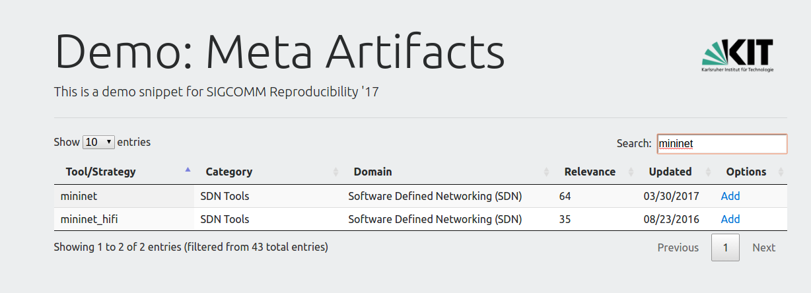
Example
Step 1: select the tools

Slide 11
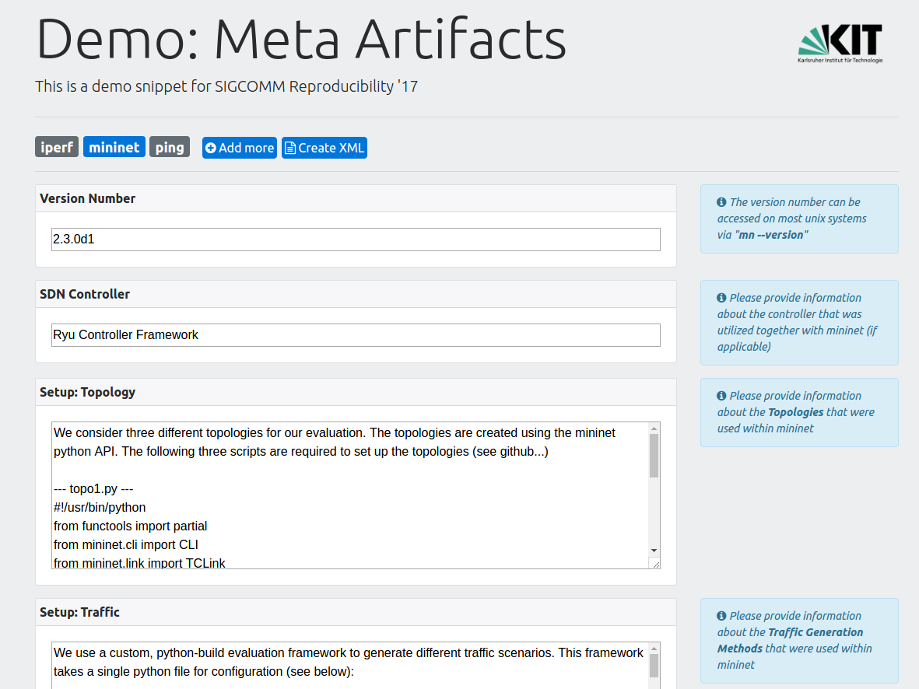
Example
Step 2: fill out the templates

Slide 12
Example
Benefits?
Automatic / easy access
Checklist for documentation
Sources for inspiration

Slide 13
Observation 2

Slide 14
Observation 2
Similar terms but different realizations

Slide 15

Observation 2
Similar terms but different realizations
Some similarities, but different traffic, topologies, configurations, implementations …

Slide 16
Proposal: Shared Evaluation Environment
Separation of scenario, application and evaluation environment
Allows reuse, comparability and reproducibility

Slide 17
Example
@KIT: one-year research project of three students
Based upon a shared simulative environment
Elaboration of common tools, traffic, topologies, and implementations
➔ Results
Support for NS3, OMNeT++ and Mininet
Unified data format for traffic and topologies
SDN app integration (POX)
Exchange / Share of apps, scenarios, and simulator
Other examples
Portable workflow framework (CK), http://cknowledge.org/
Pantheon of Congestion Control, http://pantheon.stanford.edu/overview/

Slide 18
Example
@KIT: one-year research project of three students
Based upon a shared simulative environment
Elaboration of common tools, traffic, topologies, and implementations
➔ Results
Support for NS3, OMNeT++ and Mininet
Unified data format for traffic and topologies
SDN app integration (POX)
Exchange / Share of apps, scenarios, and simulator
Other examples
Portable workflow framework (CK), http://cknowledge.org/
Pantheon of Congestion Control, http://pantheon.stanford.edu/overview/
Benefits?
Comparability
Advanced review
Test with other scenarios

Slide 19
Observation 3

Slide 20
Observation 3
Individual complex evaluation parts are hard to reproduce
35%
use “complex” setups, e.g., multiple approaches
52%
provide a direct link to the code
~0%
No step-by-step documentations for reproducibility

Slide 21



Proposal: Provisioning of the Evaluation Setup
Provide self-deploying evaluation environments
$ git clone <paper repository> myFolder
$ cd myFolder
$ vagrant up
$ … wait …
$ vagrant ssh
$ ./run_all_experiments.sh
$ cd /results

Slide 22
Proposal: Provisioning of the Evaluation Setup
Provide self-deploying evaluation environments
$ git clone <paper repository> myFolder
$ cd myFolder
$ vagrant up
$ … wait …
$ vagrant ssh
$ ./run_all_experiments.sh
$ cd /results
Benefits?
Original experiment
One click reproducibility

Slide 23
Challenges

Slide 24
Challenges
Paradigm shift
How to get started?
Conflicting priorities
high
Every researcher has to fulfill the standard
Overhead to establish BCPs
Every researcher can do whatever he wants
high
Overhead for Reproducibility

Slide 25
Scope

Slide 26
Reproducibility Landscape
Get Incentives
Get BCPs
- Badges - Contest
- Fast Track
- Traffic Features - Testbeds
- Environments
Change Paper
Change Portals
Change Review
- More Details - Considerations
- Upload - Meta-Artifacts
- Artifacts - Questions
Notes:
Change the paper
Reproducibility considerations
More details
Enhance portals
Artifact upload
Change review
Questions about reproducibility
Review of artifacts
New incentives
Highlight reproducible papers (e.g. badges)
Reproducibility challenge/ networking contest in reproducibility
Requirement for submission
Journal fast tracking
Best current practice
Recommended traffic features
Testbeds (Responsebility, Load, Standardization)

Slide 27
Summary
Sharing Environment
Set up Provision
Docu- mentation
Reproducibility by Design

Slide 28
QuestioNS?

Slide 29
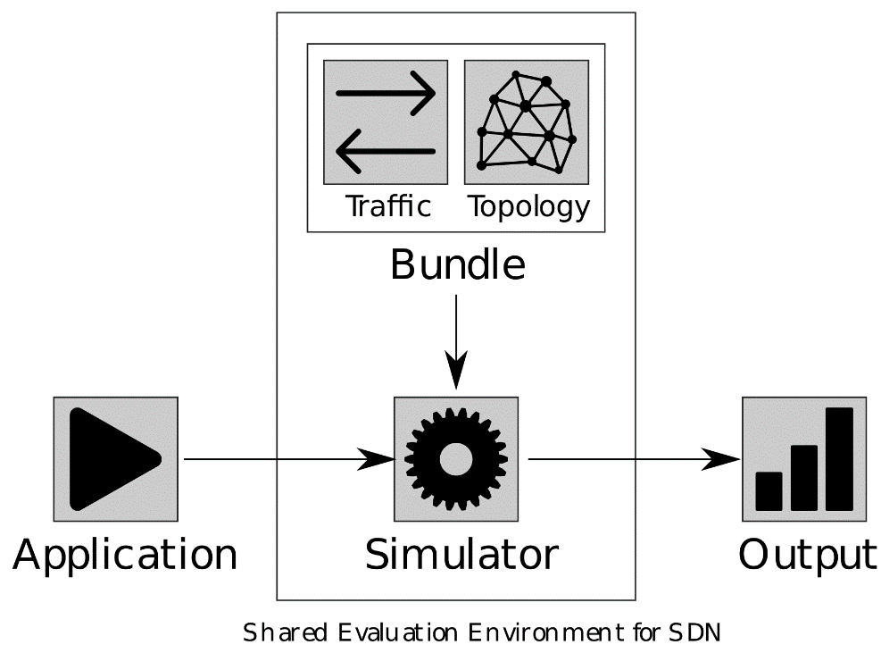
Proposal: Shared Evaluation Environment
Separation of scenario, application and evaluation environment
Allows reuse, comparability and reproducibility
Traffic
Topology
Scenario
Artifact
Environment
Results

