Slide 1

Learning Networking by Reproducing Network Results
Lisa Yan and Nick McKeown
Stanford University
With help from Keith Winstein, Sachin Katti,
Nikhil Handigol, Brandon Heller, and Bob Lantz
Notes:
A bit more background before I start my talk – I started my PhD doing networking, but over the past few years I’ve transitioned to researching education in computer science. My advisor Nick generously allowed me to use Stanford as my research test bed, and I’ve been working specifically on networking education at Stanford, where we have two classes, undergraduate and graduate networking.
So today, instead of spending 13 minutes talking to you about networking research, I’m going to talk about networking education, instead, and what we learned from our experience offering a particular type of assignment at the graduate networking level. This project is done with lots of help…

Slide 2
Teach…
Introduction to Networking
Graduate Networking
Notes:
Let’s first start out with a scenario.
Envision yourself as a fledgling networking professor at Stanford, just starting out in your career. Wouldn’t that be great?
The department of computer science has tasked you with

Slide 3
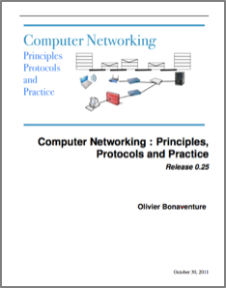

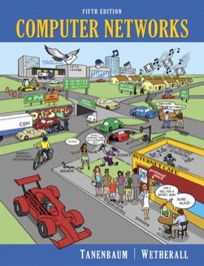
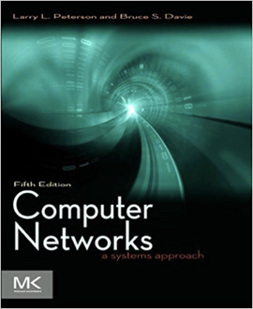
Introduction to Networking
Application
Transport
Network
Link
Notes:
The first of these seems pretty straightforward: take a textbook, we happen to choose Kurose and Ross, give the introductory material, teach the four layer model, and that’s about it.

Slide 4
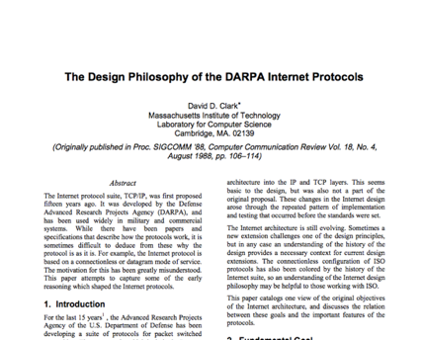
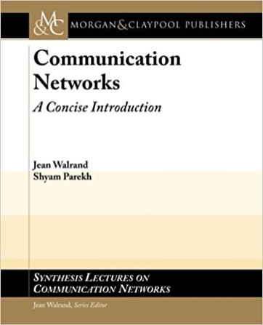
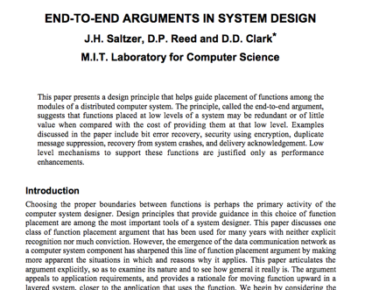
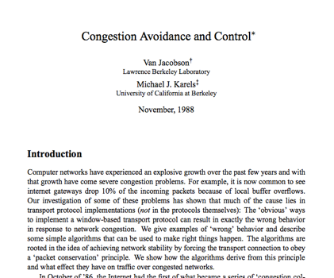
Graduate Networking
Notes:
But there seems to be much more variation in the way the second class, graduate networking, is taught. You might take a more advanced textbook, maybe this one, or a bunch of papers, or some combination of the two, and teach this material in the classroom.

Slide 5
Graduate Networking
Train and build experience in order to become a future networking researcher or networking engineer.
Notes:
But in most of these classes, what are you training these people for? You are training them and building their experience *read slide*

Slide 6
What kinds of systems should advanced students build?
Give them all the same project
Have them create their own project
or
A bit boring
Too risky
Notes:
Which begs the question –
We tried two options. Are we trying to get them all to do the same thing? We could … as an assignment.
They’re likely to improve their programming skills, but the educational outcome of that is quite limited. We’ve found that this got a bit boring for us. Maybe we weren’t being creative enough with the assignments we were giving them.
So since these are more advanced networking students, it seemed very compelling to instead …. The problem with this is that the ten-week quarter system at Stanford was very short, and there wasn’t enough time to finish anything meaningful.
It was also too risky -- Too many students failed to produce a novel system that worked, and they get a bad experience out of this.

Slide 7
What kinds of systems should advanced students build?
Assignment goals
build a system
think critically about a system
Around 2012: the beginning of Mininet
N.Handigol, B. Heller, V. Jeyakumar, B. Lantz, N. McKeown. Reproducible network experiments using container-based emulation. CoNEXT 2012.
Notes:
So we found ourselves looking for an assignment that achieved two goals:
Give them the experience of building a system,
But also give them the feeling of thinking critically about a system.
This was back in 2012, when we were also concurrently developing and testing Mininet, and showing that Mininet could create an environment where emulating networked systems becomes easy.
And when we abstracted the assignment goals like this, and combined it with our research on Mininet-Hifi, we struck on the idea of…

Slide 8
Reproduce someone else’s research.*
*our sole novel contribution
Notes:
asks students to ...
And our experience with offering this type of assignment is the … of this work.

Slide 9
CS 244 Reproducibility Project
Week 1, Day 1 Project proposal
Pick a paper and a key result to reproduce.
Contact the original researchers
Preliminary work
TA-student meeting to discuss next steps
Blog post
Public source code and steps for reproducing
In-class presentations
Peer validation of another group’s project
Week 2, Day 14 Intermediate report
Week 4, Day 23 Final report
reproducingnetworkresearch.wordpress.com
Week 5, Days 29-31 Peer discussion
Notes:
And so, as part of CS 244, Stanford’s graduate networking class, we proposed the reproducibility project, which happens in a little over four weeks.
Usually a graph or a table that they can validate.
If they got different results, how and why they were different, show that they understood what the paper was trying to tell them with this result.
And in the last week, …. Since we are counting on the students to reproduce someone else’s work, it naturally follows that they should be accountable to have their own work reproduced as well. If your fellow students can look at your blog post and get all the resources they need to reproduce your graphs, then we incorporate this success into the project grade.

Slide 10
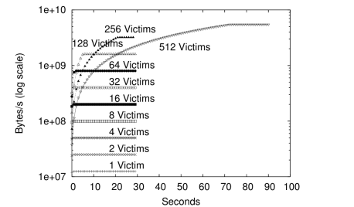
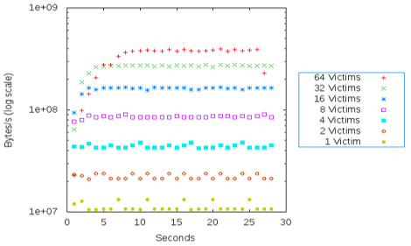
Reproduced TCP opt-ack attack
Original result from paper
Alexander and Trey’s reproduced result (blog post)
R. Sherwood, B. Bhattacharjee, and R. Braud. Misbehaving TCP receivers can cause internet-wide congestion collapse. CCS 2005.
Notes:
I’ll give you an example of a successful reproduction. Two students in 2016 tried recreating a TCP opt-ack attack, where a misbehaving receiver sends optimistic acknowledgements to multiple victim senders, who in turn generate an overwhelming amount of traffic. On the left is a graph from the original paper – the researchers show that for up to 512 victims, the amount of traffic increases exponentially over time.
The student reproduced result is pretty close – the curves match closely for up to 16 victims, whereas the curves for 32 and 64 struggle a bit. While the original researchers simulated their results in ns2, the students emulated the traffic pattern in Mininet, and therefore they hit the performance limit sooner. However, the overall results match quite closely, and we count this as a successful reproduction.

Slide 11
What kinds of reproductions?
40+ papers
Congestion control
Topologies
Security attacks
Applications
Publication | # student reproductions
TCP opt-ack attack | 8
Increasing TCP init cwnd | 7
TCP Fast Open | 7
MPTCP | 6
DCTCP | 5
Hedera | 4
pFabric | 3
Sprout | 3
(24 other papers) | 30
Notes:
Since we started out using Mininet as our emulator of choice, we didn’t expect students to be able to reproduce research on wireless, or localization, or mass user experiments. Instead, we encouraged them to look at papers covering …, datacenter topologies, …, like video streaming, and so on.
Here is a list of the top papers that our students have looked at, to give you an idea. As you can see, the top reproduction is the TCP opt-ack attack I just discussed. And we have a long tail of papers that were attempted once or twice.

Slide 12
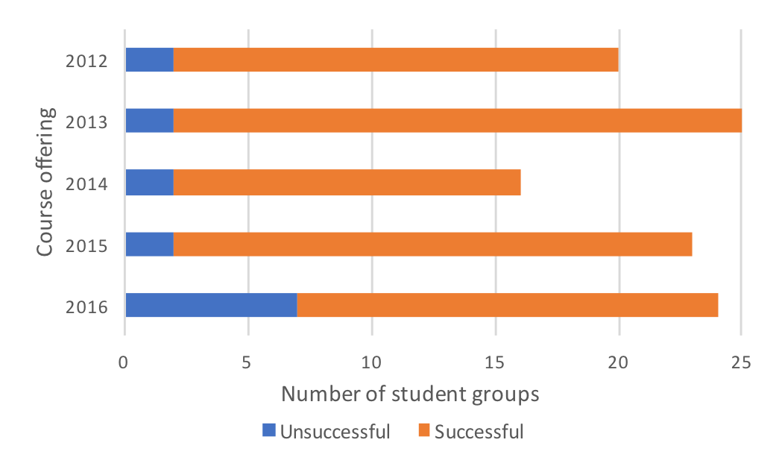
5 years of student projects
40+ papers
200+ students
Publication | # student reproductions
TCP opt-ack attack | 8
Increasing TCP init cwnd | 7
TCP Fast Open | 7
MPTCP | 6
DCTCP | 5
Hedera | 4
pFabric | 3
Sprout | 3
(24 other papers) | 30
Notes:
We’ve offered this reproducibility project for the past five years. Over 40 papers have been reproduced by students – some more than others.
Since each project is done in pairs, we have had over 200 students go through this exercise. The large majority of projects have been successful, seen here in orange, and the blue bars show the students that have not. So what makes an unsuccessful reproduction?

Slide 13
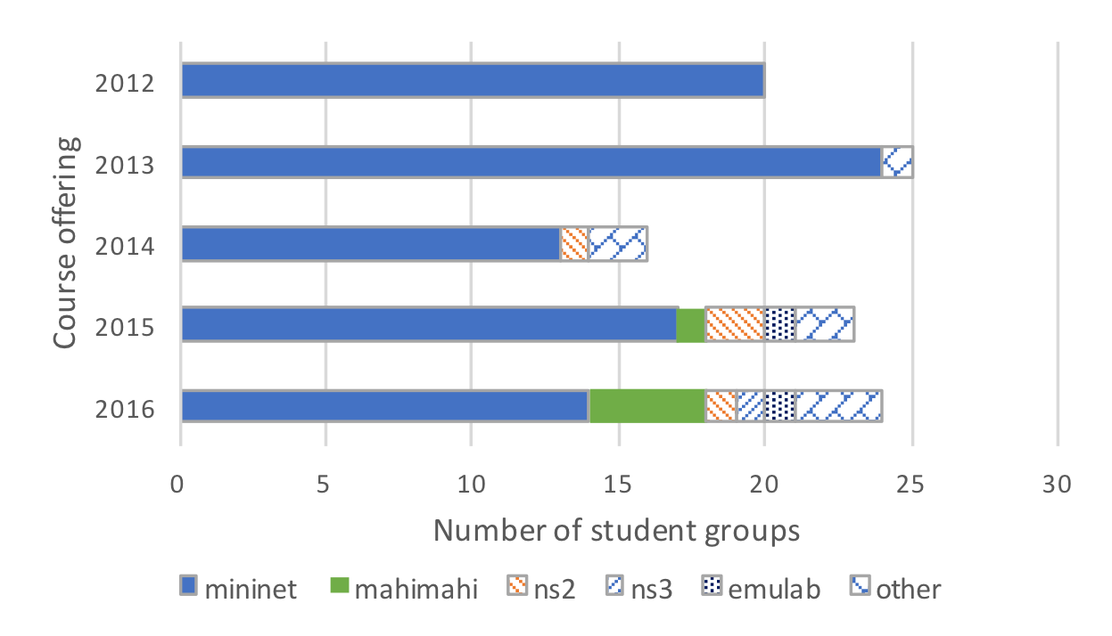
Emulators/simulators used by students
Python

Slide 14
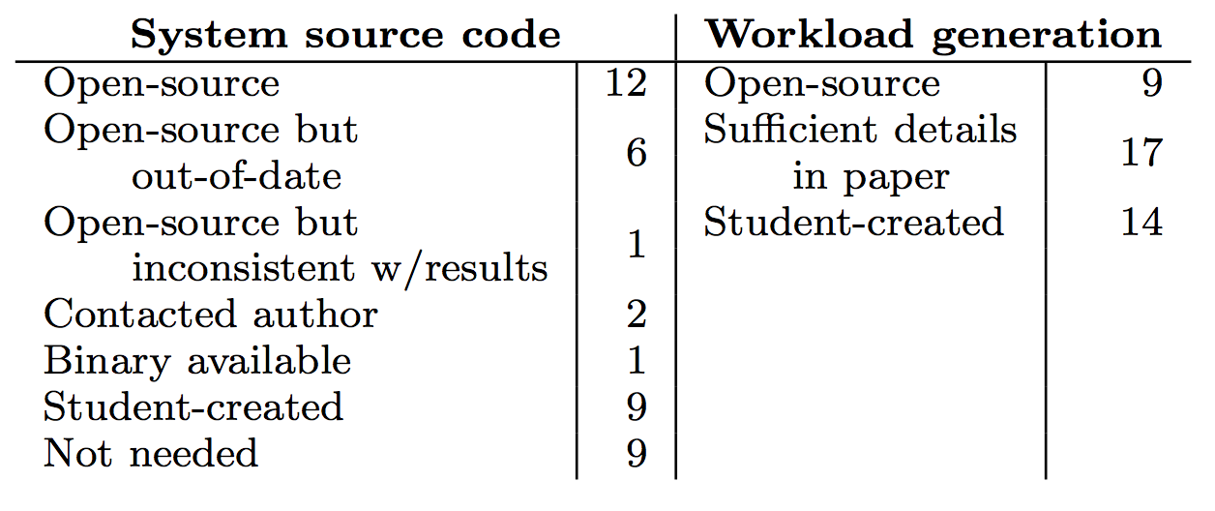
Availability of research code

Slide 15
Reproducing in different environments

Slide 16
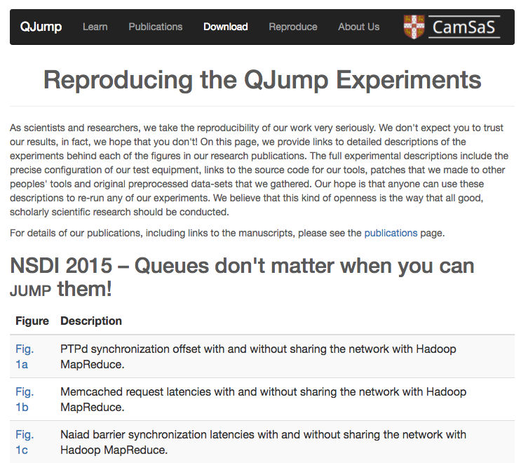
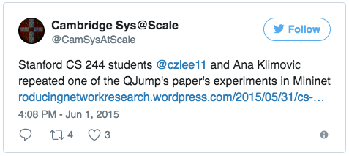
QJump (NSDI 2015, Students 2015)
“Their assumption was that [people] would reproduce the results in an actual datacenter, whereas we did the emulation in Mininet.”
“In the end, we did not use their scripts directly, but it was nice to see that the authors were enthusiastic to have their work reproduced.”
http://www.cl.cam.ac.uk/research/srg/netos/qjump/pubs.html
https://reproducingnetworkresearch.wordpress.com/2015/05/31/cs-244-15-qjump-delay-guarantees-in-datacenter-networks
Notes:
Ana and CZ
This pair of students contacted the authors throughout the project to reconcile scaling and timing differences that arose from using an emulated environment in place of a datacenter and were finally successful in recreating the experiments in Mininet. The other student commented that the original authors even
“tweeted about [our final blog post], actually.

Slide 17
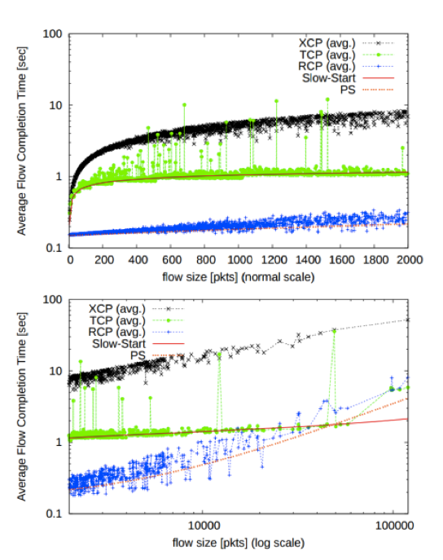
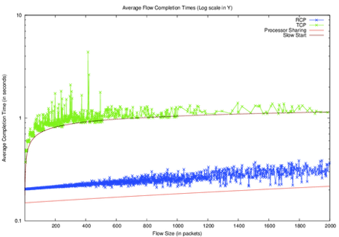
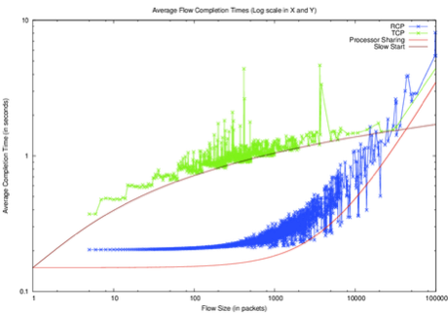
RCP (SIGCOMM 2006, Students 2015)
SIGCOMM 2006, ns-2
Students 2015, ns-2
Students 2015, mahimahi
Goal: emulate the experiment
Add new RCP header
RCP sends at right rate
RCP router rate stamping fails – possibly higher-level checksum dropping packet
Left for future work
FCT, Fig. 6
Processor Sharing inaccurate because Pareto params in code != Pareto params in paper
http://yuba.stanford.edu/techreports/TR05-HPNG-112102.pdf
https://reproducingnetworkresearch.wordpress.com/2016/05/30/cs244-16-why-flow-completion-time-is-the-right-metric-for-congestion-control-rate-control-protocol/
Notes:
Philip and Victor

Slide 18
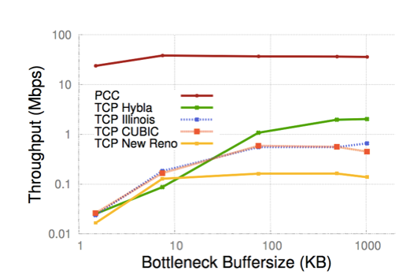
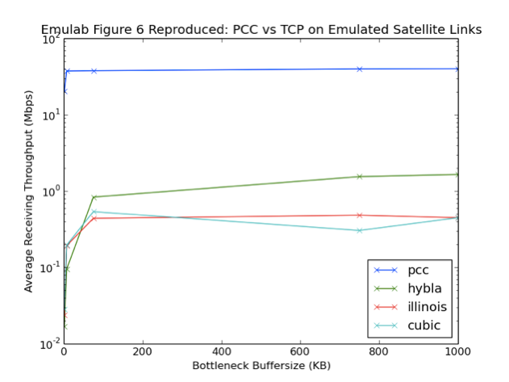
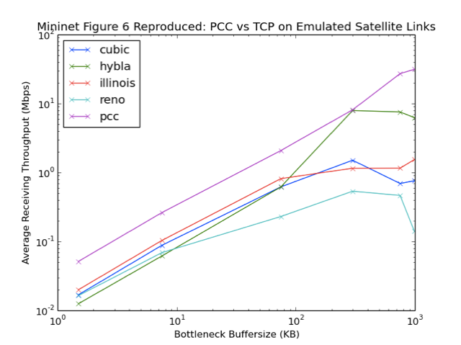
PCC (NSDI 2015, Students 2015)
NSDI 2015, Emulab
Students 2015, Emulab
Students 2015, Mininet
Satellite links, Fig. 6
“After discussion with [the author] directly, we believe it is likely that the virtualized environment of AWS containers degraded PCC performance. PCC relies on [sending] packets at precise times.”
(no explanation for why TCP also follows a degraded performance in Mininet)
https://github.com/modong/pcc
https://reproducingnetworkresearch.wordpress.com/2015/05/29/cs244-15-evaluating-pcc-re-architecting-congestion-control-for-high-performance/
Notes:
Kevin and Omer
PCC: Alternative congestion control which has fine-tuned adjustment of rates to provide better flexibility and higher throughput than TCP, even on long links like satellite links
Figure 6: PCC outperforms special TCP modifications on emulated satellite links
Figure 7: PCC is highly resilient to random loss compared to specially engineered TCPs
PCC is an interesting protocol to analyze because it claims to produce dramatically higher throughput than TCP under the varied network conditions that compose modern links today, while at the same time improving flexibility. TCP, for instance, penalizes flows that have long RTTs because it takes longer for the congestion control algorithm to observe packet losses and transmissions, forcing it to slow down the entire TCP cycle. Additionally, TCP penalizes links with high packet loss rates by causing cwnd to enter congestion avoidance more frequently than those with lower packet loss rates. In both cases the authors argue that PCC exhibits far more efficient use of network equipment and offers greater fairness for servicing different flows over the network that experience complex, different network conditions.
The virtual machine, however, may be interrupted by the host OS, causing packets PCC would send to get delayed and sent all at once later. For small router buffer sizes, we observe that PCC exhibits poor performance because packets that ordinarily would succeed instead get dropped, causing PCC to throttle its packet sending rates frequently. This will consistently affect PCC’s collected statistics to lower sending rate, thus lowering throughput.

Slide 19
Reproducing older experiments

Slide 20
DCTCP (SIGCOMM 2010, students 2016)
Original paper graphs simulated in ns-2
2012 Mininet: Kernel patch for Linux 3.2 (Ubuntu 12.04)
2016: (Ubuntu 16.04 LTS, Mininet 2.3)
Installed old Ubuntu
Downgraded to Mininet 2.0
Future project: port patch to more recent kernel versions
https://github.com/mininet/mininet-tests/tree/master/dctcp
https://reproducingnetworkresearch.wordpress.com/2016/05/30/cs244-16-dctcp

Slide 21


TCP Fast Open (CoNEXT 2011, Students 2015)
 | Page | RTT (ms) | PLT: non-TFO (s) | PLT: TFO (s) | Improve-ment:
CoNEXT 2011 | Amazon | 20 | 1.54 | 1.48 | 4%
 |  | 100 | 2.60 | 2.34 | 10%
 |  | 200 | 4.10 | 3.66 | 11%
 | NYTimes | 20 | 3.70 | 3.56 | 4%
 |  | 100 | 4.59 | 4.30 | 6%
 |  | 200 | 6.73 | 5.55 | 18%
Students 2015 | Amazon | 20 | 11.30 | 10.43 | 8%
 |  | 100 | 15.92 | 12.55 | 21%
 |  | 200 | 26.70 | 19.42 | 27%
 | NYTimes | 20 | 3.33 | 2.89 | 13%
 |  | 100 | 5.37 | 4.03 | 25%
 |  | 200 | 9.02 | 6.46 | 28%
Page Load Time (PLT) much higher in recent years
Emulator: Dummynet
Change to actual table instead of that ^
Notes:
Sudarsh and Romil

Slide 22
What did we learn?

Slide 23
What did we learn?
These projects…
Spark discussions between researchers and students.
Give students more tools to use in their own research.
Jumpstart careers in networking.
Help future researchers by providing a fully reproducible project in the public domain.
Other researchers can build upon it
Eases technology transfer
Notes:
And so what did we really learn from this? There were a number of things.
The first is that these projects really help to spark discussions between original researchers and students.
Think about it from the students’ perspective. They recreate something from your results, and they get to talk to you, too.
We just had a few examples of where the students contacted the original researchers at length to understand the differences in reproduced results, and each of these cases has been really interesting and different. It’s a dilemma for the students, and navigating that journey with the original researchers is really fun.
These projects also give students more tools to use in their own research.
Ana and CZ, two students successfully reproduced a key figure in Qjump, and this was a different project group from the one on the previous slide, Ana, a PhD student researching remote flash memory, said that because of her experience with the project, she was able to quickly implement a similar scheduler for her own systems research.
We’ve also seen cases where these projects jumpstart careers in networking. Priya was a student trying to reproduce DCTCP. Her project required her to patch the linux Kernel and dig deep into Mininet, and she really struggled a lot with debugging. But a few months later after her graduation, her new career as a systems engineer coincidentally had her working with a network emulator! So hit the ground running.
Finally, we think these.... We’ve had cases where other researchers come upon our class blog, build upon the code that students built, and ask the students in-depth questions. We’ve found that this process of publicly posting the reproduction steps can ease technology transfer; students become familiar with the original research, and can in turn aid the research process.
An example of this is the first year we offered it: two Grad students just embarking on their career found an error in a fairly well-known paper, so what did they do?
So they tackled the researchers on this
Everybody took it very well
Took some tracking down
Some a little resistant, code was hard to find
But in the end everyone benefited from it

Slide 24
Easing technology transfer

Slide 25
Experiments for the future
A/B testing of choosing to contact the author
What is missing from the paper that increases the difficulty of reproducibility?
Reproducibility on different platforms
How much work is required to update kernel patches?
How much work is required to port from simulator to emulator?

Slide 26
Thank you!
cs244.stanford.edu/reproducibility
L. Yan and N. McKeown. Learning Networking by Reproducing Research Results. CCR April 2017.
https://ccronline.sigcomm.org/2017/learning-networking-by-reproducing-research-results/
Notes:
Maybe it will be good for you too.
We haven’t found a paper that was wrong, we have found some graphs that were mistaken, or that the prior work was misconfigured.
Hedera story
One of the graphs – one of the early graphs. They had no doubt that the core result of the papers were correct
Everyone came to the conclusion that there was an error in the graph, but it didn’t change
the overall paper.
The really interesting thing was not that the results were right or not, it was the journey and of the students.
The researchers found it really interesting too.
Put paper reference at the end of this

Slide 27
Extra slides

Slide 28
Reproducing research
Educational benefit:
Systems engineering skills
Critical thinking
Different results
Student incorrectly reproduce the experiment
Experiment had other assumptions
Side benefit:
Reproducible form of the system can be put into the public domain for others to use
Notes:
Why good? Well, it strengthens their…. They gain a better understanding of how to design, program, and configure a real system, and how to compare it to existing benchmarks.
It also builds …. How do I set up the experiment environment so that it is as close as possible to the original? What are inherent limitations or benefits of using an emulator to reproduce research that was collected in a real datacenter? And so on.
Finally, what if the students get different results from the original? We’ve all been there. You try out someone else’s work, you run it, and it doesn’t match what you’re expecting. There can be two reasons for this: either you incorrectly reproduced the experiment, or the original one had some assumptions or restrictions that were not clear from the paper. And deciding which one of these is the case is an exploratory, analytical, and critical learning component of the student’s experience.
Then get this additional side benefit, which is that once students are successful in reproducing the research, we now have …. I’ll talk a bit about this later.

Slide 29
Unsuccessful reproductions
Usually due to students’ overambitious engineering
“We spent our last week trying to find a mixed LP optimizer.” (reproduction of FastMPC, SIGCOMM 2015)
Sometimes due to emulator restrictions
"We scaled down all load generation parameters, but we still couldn’t achieve target latencies when emulating on a single machine.” (reproduction of QJump, NSDI 2015)
Notes:
Most of the unsuccessful ...
While the reproducibility project significantly reduces the chance of failure, students still. On one final report, a group mentioned a great deal about their successes finding the dataset for a particular video streaming algorithm
which was essential for the algorithm. In hindsight, this could have been resolved had they contacted the TAs early
Sometimes, there are just restrictions on the emulator side.
When reproducing the experiment on an emulator, it’s often necessary to scale down the workload, say from 1 Gbps links to 100 Mbps links. However, one group said that even when they scaled down all load generation parameters, they still couldn’t achieve target latencies when emulating on a single machine.

Slide 30
Why are we telling you this?
We thought you might like to try this in your class, too.
We’ve made this assignment reproducible:
cs244.stanford.edu/reproducibility
Notes:
Alright. now why are we telling you this? Why are we saying all this stuff about how assigning this project to some grad students worked? Well, we thought you might like to try this type of assignment in your class too.
And so, in the spirit of reproducibility, we’ve made this assignment reproducible. We've posted online all of the resources we found along the way that helped make this assignment a success, and give graduate networking students what we feel is a valuable, educational experience in network engineering and research.

Slide 31
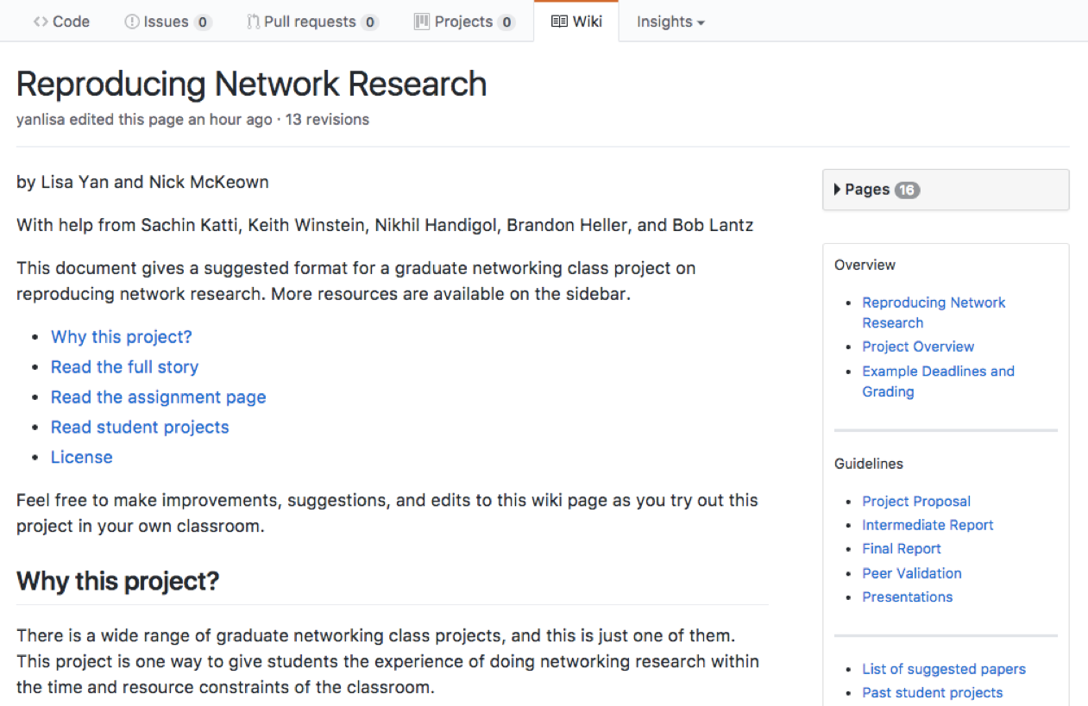
Open sourcing the assignment
Improve on it, reproduce it, give back to the community.
Notes:
We’ve posted a github wiki
We've posted online all of the resources we found along the way that helped make this assignment a success, and give graduate networking students what we feel is a valuable, educational experience in network engineering and research.
a starting list of papers to look at for reproducing, as well as guidelines for structuring the final report and blog posts. So please, since it’s out in the open, improve upon it, reproduce it, and give back to the community.
And finally, we’re not saying that this is the best way to teach graduate networking, but this is one way that’s worked for us. Maybe it’ll work for you, too.

