Slide 1
Handling blockage and mobility

Slide 2
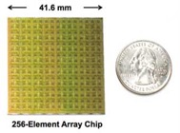



Grand Challenges for mmWave Networking
Shorter wavelengths, higher attenuation
~1000x higher attenuation than WiFi or LTE
Use highly directional, electronically steerable phased-arrays to overcome propagation loss
Introduces new challenges: blockage, mobility
Phased-array antenna
$$<{10}^{°}$$

Slide 3



Grand Challenges for mmWave Networking
Mobility
Tx and Rx beams must keep aligned
Tx
Rx
Blockage
Needs environment reflection to overcome blockage
Tx
Rx

Slide 4
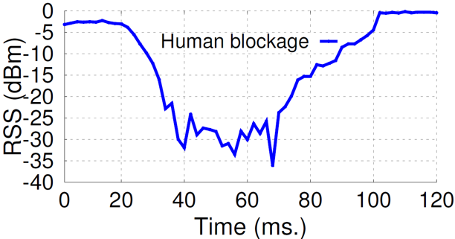


How severe is the blockage/mobility problem?
Signal attenuation of a directional link
The body absorbs majority of the energy from a directional transmitter
Tx
> 30 dB!
Complete link outage
Rx

Slide 5
How severe is the blockage/mobility problem?
Throughput drop due to signal attenuation and blockage
Experimental setup
* S. Sur et. al., ACM MobiCom’17

Slide 6
How severe is the blockage/mobility problem?
Throughput drop due to signal attenuation and blockage
Results

Slide 7
How severe is the blockage/mobility problem?
Theoretical recovery time (from triggering to completion)
Phased-array size | 1 client | 4 clients
8 | 0.51 ms | 1.27 ms
16 | 1.01 ms | 2.53 ms
64 | 4.04 ms | 304.04 ms
128 | 106.07 ms | 706.07 ms
256 | 310.11 ms | 1501.11 ms
* Hassanieh et. al., arXiv 1706.069335v1
Non-trivial protocol level operations and decision making
Beam searching overhead grows with the number of beams
When to trigger the beam searching? (Tradeoff: overhead vs. responsiveness)
There is no guarantee that beam searching can result in a usable pair of TX-RX beams

Slide 8
How severe is the blockage/mobility problem?
Measurement of recovery time
Qualcomm 802.11ad radios, 32 element phased-array, 128 beams
Measure time to converge to best beam after blockage
CDF over 50 trials
Link outage effect is amplified at higher layer (TCP results later)
* S. Sur et. al., ACM MobiCom’17
Notes:
CDF over 50 blocking scenarios

Slide 9
Design principles to handle mobility/blockage
Fast beam realignment protocols
Predictive and proactive beam switching Example: BeamSpy (S. Sur et al., NSDI’17)
Sensor assisted beam searching Example: Pia (T. Wei et al., MobiCom’17)
New network architectures
Multi-node coordination Example: Pia (T. Wei et al., MobiCom’17)
Multi-band cooperation Example: MUST (S. Sur et al., MobiCom’17)

Slide 10
BeamSpy: predictive link recovery under blockage
Working conditions
Quasi-stationary TX and RX
Working principles
Measure the channel of current TX/RX beams
Predict the channel of other beams, without beam scanning overhead!
* “BeamSpy: Enabling Robust 60 GHz Links Under Blockage”, Sanjib Sur, Xinyu Zhang, Parameswaran Ramanathan, Ranveer Chandra, USENIX NSDI’16

Slide 11
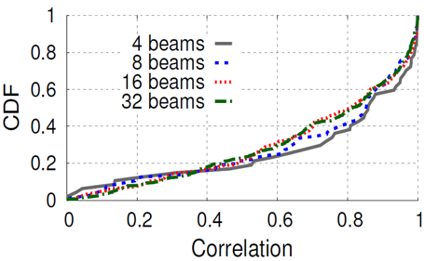

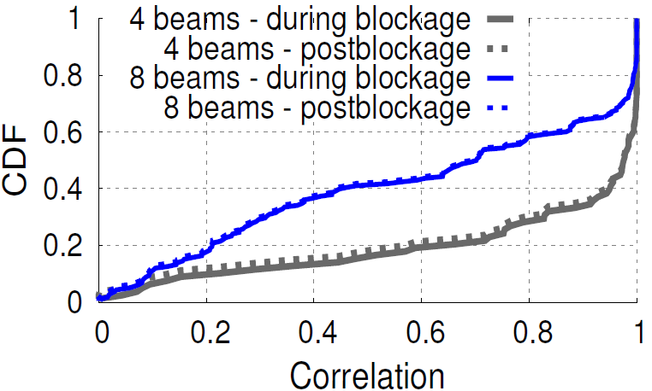
Key insights: correlation between beams
Blockage in a beam drops performance of other beams
~14 dB
Tx
median > 0.8!
~22 dB
Rx
RSS drop correlation of other beams w.r.t. strongest beam
Correlation remain unchanged irrespective of blockage!
11

Slide 12
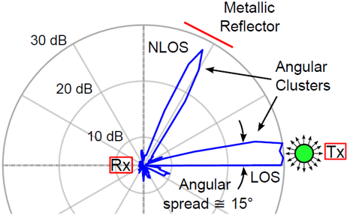
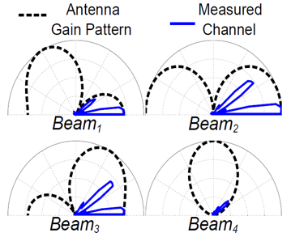
Key insights: correlation between beams
Why does correlation exist?
Signal arrival
paths
X
X
X
X
X
Sparse signal arrival paths are shared between beams, thus blockage causes correlated RSS drop in all beams!

Slide 13
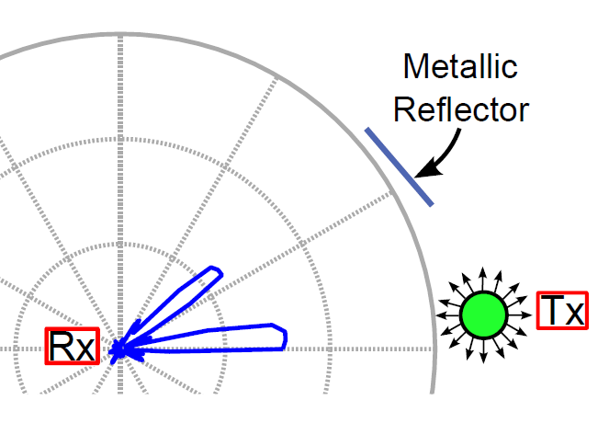
Modeling the correlation through a sparse channel model
Signal arrival
paths

Slide 14
Modeling the correlation through a sparse channel model
Path Skeleton

Slide 15
Modeling the correlation through a sparse channel model

Slide 16
Modeling the correlation through a sparse channel model

Slide 17
Modeling the correlation through a sparse channel model

Slide 18
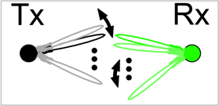
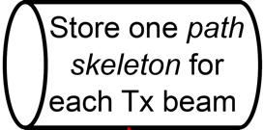

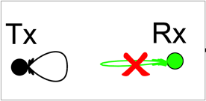
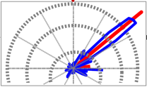
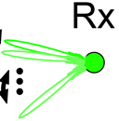
BeamSpy workflow
At deployment time
Discrete coarse beam-steering
Model Sparse Clusters
Track Path Skeleton
At run time
Beam is blocked
Identify state of Path Skeleton
Predict RSS of other beams from new state

Slide 19
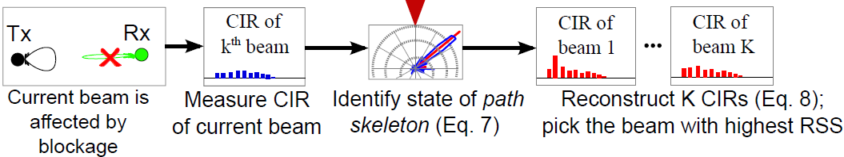
Modeling the correlation through a sparse channel model
How does the prediction work
Look at current beams condition under blockage → Identify the state of sparse cluster → Virtually reconstruct performance of rest of the beams and pick the best one.

Slide 20
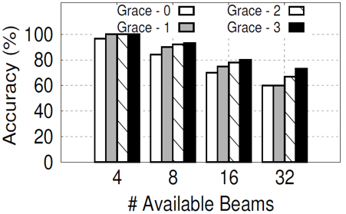
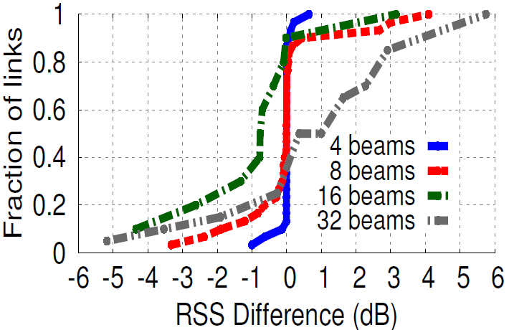
BeamSpy performance
Accuracy of best beam direction prediction under blockage
Close to 70% even with 32 beams!
Predicting RSS of the best beam under blockage
Prediction error (90%-ile) is within ±3 dB for 32 beam

Slide 21
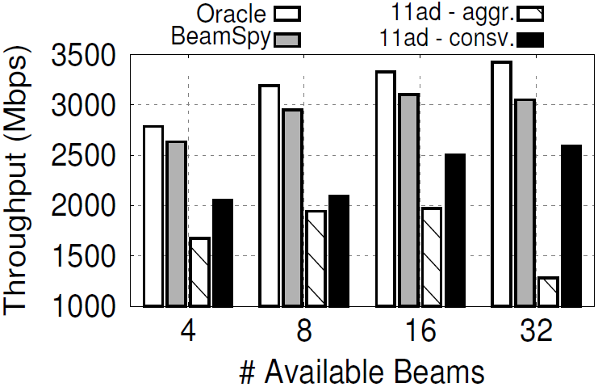
BeamSpy performance
Link performance gain under blockage
Throughput performance close to oracle.

Slide 22
Towards seamless coverage and mobility support
BeamSpy works for quasi-stationary TX/RX
Can we make mmWave networks as mobile and ubiquitous as WiFi?
Non-trivial! Even for room-level mobility/coverage
Limited TX/RX coverage due to directionality and lack of multipath
Blockage, mobility, and even minor orientation change can cause beam misalignment

Slide 23
Pia: Pose information assisted 60 GHz networks
Design principles
Cooperation between APs to ensure coverage
Leverage mobile client’s pose information (x,y,z coordinate and elevation/azimuth angle) to select the best AP
Leverage pose information to select the best beams to maximize spatial reuse
* “Pose Information Assisted 60 GHz Networks: Towards Seamless Mobility and Coverage”, Teng Wei, Xinyu Zhang, ACM MobiCom’17

Slide 24
How does pose change affect link performance
Vary relative angle between TX and RX
Throughput almost constant with an 160 degree field-of-view (FoV)
Throughput drops dramatically when out of FoV

Slide 25
How does pose change affect link performance
Vary relative angle between TX and RX
For room level coverage, in/out of FoV matters more than distance

Slide 26
Pia work flow

Slide 27
Pia: AP selection
Proactive AP switching instead of reacting to link outage
Predict pose: simple kinematic model
Predict in/out of FoV based on relative pose between client and AP
Switching before outage

Slide 28
Pia: AP selection
How does a client know the APs‘ pose?
One-time initial training, to obtain APs’ global pose info
Statistical estimation

Slide 29
Pia: beam selection for spatial sharing
Non-trivial due to imperfect directionality of phased-arrays
Strongest beam is not necessarily the throughput-optimal one
Measured beam patterns from a commercial 802.11ad device.

Slide 30
Pia: beam selection for spatial sharing
Joint beam and AP selection problem.
Beam strength map (BSM) as a basic data structure
Objective: maximize SIR
A(i): AP assignment for client i; B(i): beam assignment for client i;
INFmax(j,i): max interference from AP i to client j
Computational cost too high. Approximate using signal to leakage ratio (SIR).
Example BSM between 3 APs and 3 clients.

Slide 31
Pia: testbed verification
Experimental setup

Slide 32
Pia: performance overview
Link stability
(a) Link availability: percentage
of time that throughput exceeds a threshold (1.8 Gbps).
(b) Hazard times: number of occurrences that link throughput drops below the threshold in a 5-minute test.

Slide 33
Pia: performance overview
Spatial sharing
Why is 802.11ad interference mapping ineffective?
Lack optimal mechanism to schedule concurrent transmissions
Large overhead esp. in mobile scenarios

Slide 34
Pia: performance overview
Resilience of AP selection under pose errors
Only need meter level location precision, and 10+ degrees of orientation precision

Slide 35
MUST: WiFi assisted 60 GHz networks
Design principle: WiFi as a backup to make 60 GHz network stable
Leveraging commodity tri-band 802.11ac/ad radois
Predict 60 GHz channel (under mobility) using WiFi CSI
Under high risk of low-RSS, proactively switch to WiFi
Why use WiFi CSI to estimate 60 GHz channel?
Much less likely to be blocked
MIMO array, instead of phased-array, can estimate channel profile instantaneously (instead of trying all beam directions)
* “WiFi-Assisted 60 GHz Networks”, Sanjib Sur, Ioannis Pefkianakis, Xinyu Zhang, Kyu-Han Kim, ACM MobiCom’17

Slide 36
MUST: alternative design choices
Why not turn on both 60 GHz and 5 GHz radios?
Performance is even worse due to TCP artifacts
TCP throughput performance.
TCP congestion window size.

Slide 37
MUST: alternative design choices
Why not react (switch to WiFi) after link outage occurs?
Switching latency is long, and amplified at TCP level
Non-trivial to determine “when” to switch; non-trivial protocol overhead
(a) CDF of switching latency on a commodity 802.11ad device.
(b) Latency amplified at higher layer.

Slide 38
MUST: predicting 60 GHz channel using WiFi CSI
MUST work flow

Slide 39
MUST: predicting 60 GHz channel using WiFi CSI
Identify the angular shift of the 60 GHz dominating path from the successive time-domain spatial snapshots of the WiFi channel

Slide 40
MUST: predicting 60 GHz channel using WiFi CSI
Denote W1 as WiFi angular profile at t1, and similarly W2. Then the device’s angular shift (equivalent to shift of 60 GHz dominating path)
Besides angular change, we need to estimate gain change
Straightforward to predict the best beam based on channel prediction (cf. BeamSpy)

Slide 41
MUST: detecting risk of blockage
Use SNR difference between WiFi and 60 GHz interface as hint to detect potential blockage
LOS: constant link budget difference of 27 dB
Blocked: large variance of SNR difference

Slide 42
MUST: efficient interface switching
Implementation and architecture on a tri-band 802.11ad device
Optimized software: prioritize FST in kernel; remove unnecessary queuing
Balanced core affinity: serve 60 GHz and WiFi at different cores, while assigning both IRQ/packet processing of an interface in the same core.
Notes:
While the entire FST protocol to switch from 60 GHz to WiFi (including coordination and handshake) can finish within 1.5-2 ms, our measurements show that the platform requires approximately 180 ms (c.f. Section 3.4.2) for such operation. This is for two reasons: (1) On disconnection from 60 GHz RF front-end, current under-optimized firmware-kernel implementation still takes additional median 120 ms for message exchanges, hardware and software queuing delays and trigger FST daemon; (2) On trigger and completion of FST protocol, the daemon takes additional 60 ms to complete the virtual MAC switch at the Linux bonding driver, and reroute the packets to WiFi interface.
We optimize the FST daemon and bonding driver to overcome this latency. Specifically, we generate software interrupt to the FST
daemon, when Algorithm 1 detects the signature of blockage without waiting for RF disconnection from 60 GHz firmware. We further modified the bonding driver and use WiFi as backup slave instead of rehauling the virtual MAC of the active slave (i.e. 60 GHz).

Slide 43
MUST: performance overview
Link level throughput
*
* “Steering with Eyes Closed: mm-Wave Beam Steering without in-Band Measurement”, San Thomas Nitsche, Adriana B. Flores, Edward W. Knightly, and Joerg Widmer, IEEE INFOCOM’16
Notes:
In working NLOS cases (where 60 GHz is still the best interface), MUST performs similar to BBS and 802.11ad, and achieves within
20% from the Oracle. This is because in such scenarios, the existence of multiple dominating paths may lead to inaccurate beam and rate prediction, and thus MUST will frequently fallback to 802.11ad. In all NLOS, including where 60 GHz links are blocked, all algorithms will eventually switch to WiFi. MUST can almost instantaneously switch to WiFi achieving 34% and 39% throughput gains over BBS and 802.11ad, respectively.

Slide 44
MUST: performance overview
TCP end to end latency
Orders of magnitude reduction

Slide 45
MUST: performance overview
Field trials with mobile users
~50% gain over 802.11ad and 45% over BBS.
Higher gain with more mobility.

Slide 46
References
* “BeamSpy: Enabling Robust 60 GHz Links Under Blockage”, Sanjib Sur, Xinyu Zhang, Parameswaran Ramanathan, Ranveer Chandra, USENIX NSDI’16
* “Pose Information Assisted 60 GHz Networks: Towards Seamless Mobility and Coverage”, Teng Wei, Xinyu Zhang, ACM MobiCom’17
* “WiFi-Assisted 60 GHz Networks”, Sanjib Sur, Ioannis Pefkianakis, Xinyu Zhang, Kyu-Han Kim, ACM MobiCom’17
* “Steering with Eyes Closed: mm-Wave Beam Steering without in-Band Measurement”, San Thomas Nitsche, Adriana B. Flores, Edward W. Knightly, and Joerg Widmer, IEEE INFOCOM’16
* “Blockage and Directivity in 60 GHz Wireless Personal Area Networks,” S. Singh, F. Ziliotto, U. Madhow, E. M. Belding, and M. Rodwell, IEEE JSAC, vol. 27, no. 8, 2009.
* “Beam-forecast: Facilitating Mobile 60 GHz Networks via Model-driven Beam Steering,” Anfu Zhou, Xinyu Zhang, Huadong Ma, IEEE INFOCOM, vol. 27, no. 8, 2017.
* “Enabling High-Quality Untethered Virtual Reality,” Omid Abari, Dinesh Bharadia, Austin Duffield, and Dina Katabi, USENIX NSDI, 2017.

