Slide 1
LoS MIMO
Upamanyu Madhow
ECE Department
University of California, Santa Barbara

Slide 2






Collaborators
Prof. Mark Rodwell
Bharath A.
Eric Torkildson
(now at Nokia)
Colin Sheldon
Prof. Amin Arbabian
(Stanford)
Babak Mamandipoor
Mahmoud Sawaby (Stanford)

Slide 3
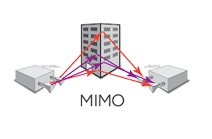
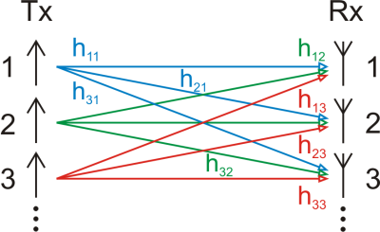
MIMO spatial multiplexing
“Rich scattering” environment
(more prevalent indoors)
--many paths from TX to RX
--direct, multiple bounce reflection,
diffraction, scattering)
Number of independent data streams that can be sent: DoF
Mathematical model
--Vector response to TX1 linearly
independent of response to TX2
--Data streams from different TXs
can be separated out at RX

Slide 4
But mm wave channels are sparse
(the opposite of “rich scattering”)
Can we get spatial multiplexing gains?

Slide 5
But mm wave channels are sparse
(the opposite of “rich scattering”)
Can we get spatial multiplexing gains?
Yes we can.
Spatial multiplexing can happen even in LoS settings
But the antenna separations must scale with wavelength
➔ Can do it with compact form factors at tiny wavelengths

Slide 6
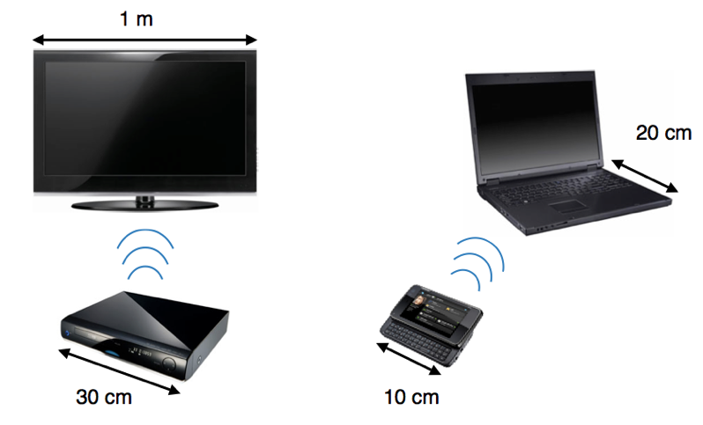
How many degrees of freedom are available?

Slide 7
As usual, we need a geometric approach

Slide 8
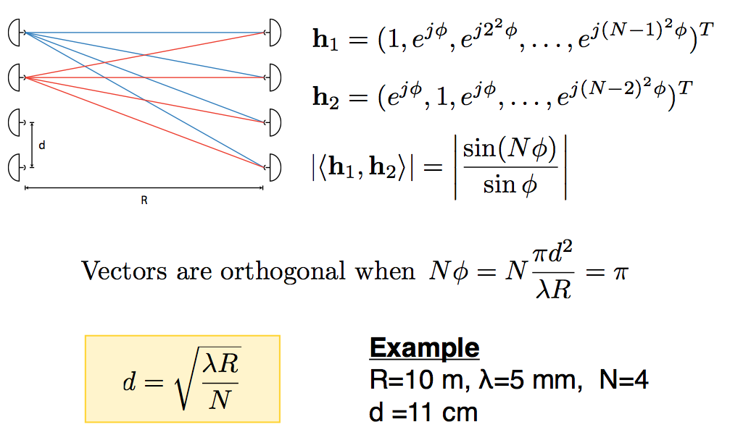
The Geometry of LoS MIMO Rayleigh criterion

Slide 9
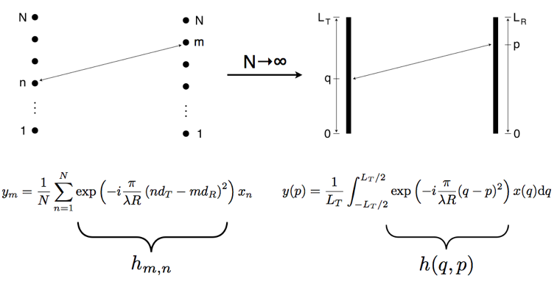
Information-theoretic analysis
➔
DoF depends on form factor
Rayleigh spaced antennas near-optimal for DoF
Packing in more antenna elements does not increase DoF
But provides beamforming (SNR) gain

Slide 10
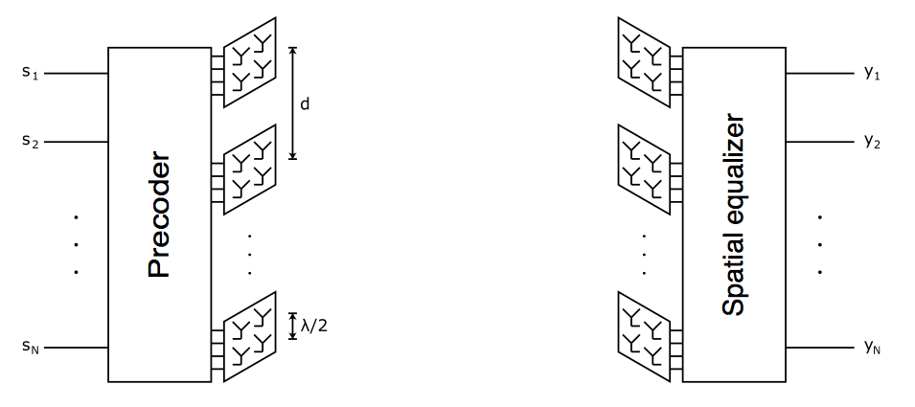
Array of subarrays architecture
Rayleigh-spaced arrays: spatial multiplexing
Each array is a sub-wavelength spaced subarray: beamforming

Slide 11
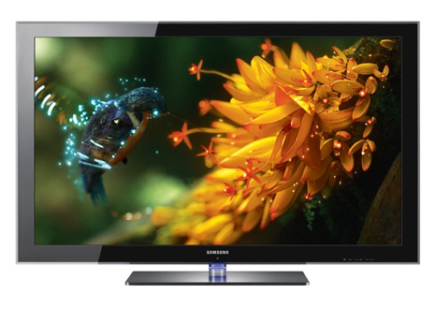


Implications for WiGig
28 Gbps on a
WiGig channel
10m
5m
14 Gbps
on a WiGig
channel

Slide 12
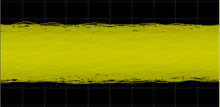
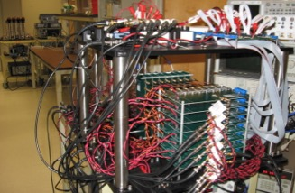
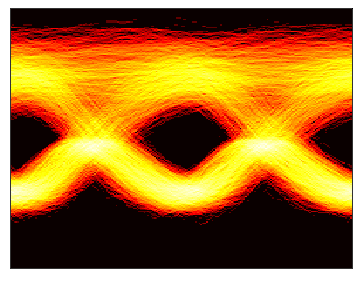
Demos in indoor & outdoor settings
Received
superposition
After separation

Slide 13
Far more ambitious goal today
4 x 4 MIMO
130 GHz carrier frequency
40 Gbps per stream
160 Gbps!
Significant challenges
--Even slight misalignment changes the channel
--”Mostly analog” processing needed because of ADC bottleneck

Slide 14
Take-aways
LoS MIMO enables multiplicative increase in data rates
For fixed form factor, DoF increases with frequency, decreases with link distance
For typical consumer device form factors, 2-4X increase possible at 60 GHz
802.11ad → 802.11ay
For outdoor links, need to go beyond 60 GHz
“Wireless fiber:” 100 Gbps @ 100 m using 130 GHz

Slide 15
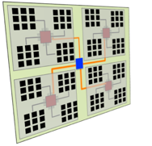
LoS MIMO is severely constrained by geometry
Can we manipulate the geometry to increase the # DoF?
(without requiring giant antenna arrays)

Slide 16
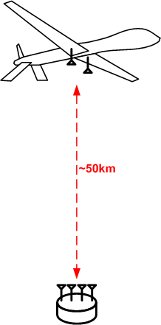
DARPA 100G program How to get 100 Gbps wireless over 50 km?
Must throw everything we know at it
Bandwidth ➔ mm wave band or higher
Power ➔ not THz or optics
Directivity ➔ mm wave band or higher
Spatial multiplexing ➔ geometry must support full rank MIMO matrix
Polarimetric multiplexing ➔ no conceptual hurdles, modulo hardware/signal processing design

Slide 17
Recall the Rayleigh criterion
Perfect for
short-range
indoor 60 GHz
comms
Generalizes to different spacing at TX and RX
Achieves the spatial degrees of freedom promised by continuous Shannon limit

Slide 18
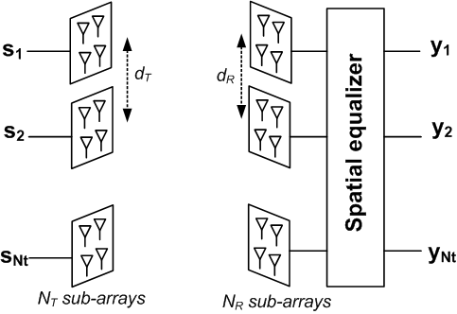
Array of subarrays architecture
Discrete array suffices to attain Shannon limit on degrees of freedom
Each element in the array can be a subarray providing beamforming gain
➔ Array of subarrays architecture providing spatial multiplexing + beamforming

Slide 19


Back to 100 Gbps long-range link
Andrew Irish
Francois Quitin
(now at ULB, Belgium)

Slide 20
We have a problem
Example
75 GHz carrier frequency, 50 km range
Two-fold spatial multiplexing

Slide 21
A dealbreaker?
Example
75 GHz carrier frequency, 50 km range
Two-fold spatial multiplexing
Subarrays 1 m apart on aircraft
➔ Need subarrays 100 m apart on the ground!
This picture does not work!

Slide 22
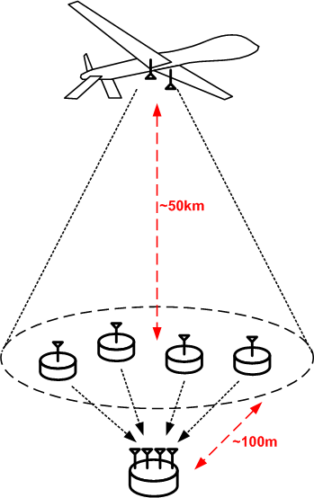
Distributed MIMO to the rescue
Synthesize full rank channel by spreading the receiver out

Slide 23
Anatomy of full rank DMIMO
Very narrow beam
covers all relays
H₁ full-rank thanks
to spatial spread of relays
Composite channel full-rank
Moderately
narrow beam
between each
relay and receiver
H₂ diagonal => full-rank
How much do the relays need to be spread out?

Slide 24
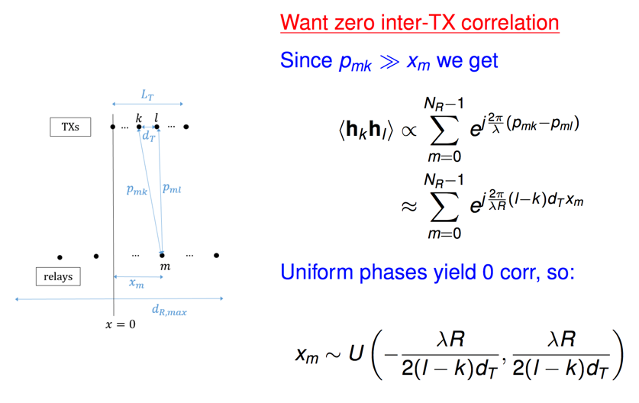
Relay spread design via geometry + statistics

Slide 25
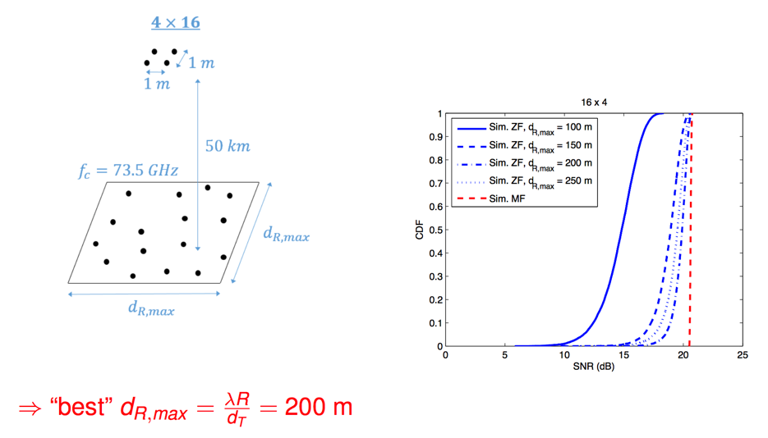
Design matches simulations

Slide 26
LoS MIMO take-aways
Potential for 2-4X increase for indoor 60 GHz links
Wireless fiber is within reach
Can get around form factor limitations using relays
Novel geometries ➔ novel system concepts
Explore via combination of geometry & statistics

