Slide 1
ADVENTIST UNIVERSITY OF CENTRAL AFRICA
Faculty of Information Technology · Software Engineering
AUCA Student
Mentorship Portal
Best Programming Practices and Design Patterns
Confiance UFITAMAHORO · Student ID: 27185
Instructor: RUTARINDWA JEAN PIERRE · Academic Year 2025–2026
"As iron sharpens iron, so one person sharpens another." — Proverbs 27:17

Slide 2
Presentation Outline
Phase 1
Phase 2
System Analysis & Design
Software Prototype
01
02
Case study, problem statement, OOP diagrams
Architecture, design patterns, tech stack
Phase 3
Phase 4
Docker & Version Control
Testing & Validation
03
04
Containerization, Git workflow, GitHub
Unit tests, integration tests, Postman API

Slide 3
Phase 1 · Case Study & Problem Statement
PHASE 1 — ANALYSIS
System Overview
Problems Identified at AUCA
The AUCA Student Mentorship Portal connects junior students (mentees) with senior students and lecturers (mentors) for academic and career guidance.
Users & Roles:
◆ Mentee — junior student seeking guidance
◆ Mentor — senior student or lecturer
◆ Admin — system manager with full control
Core Features:
◆ User registration & JWT authentication
◆ Mentor application & admin approval
◆ Session booking & status management
◆ Feedback & star rating system
◆ Admin monitoring & reporting
No structured mentorship system
Students relied on informal, untracked connections
No session scheduling tool
Meetings were arranged via WhatsApp with no record
No feedback mechanism
Quality of mentorship could not be measured
No admin oversight
No way to monitor mentorship activity or generate reports
Mentor availability unknown
Students had no way to see who was available

Slide 4
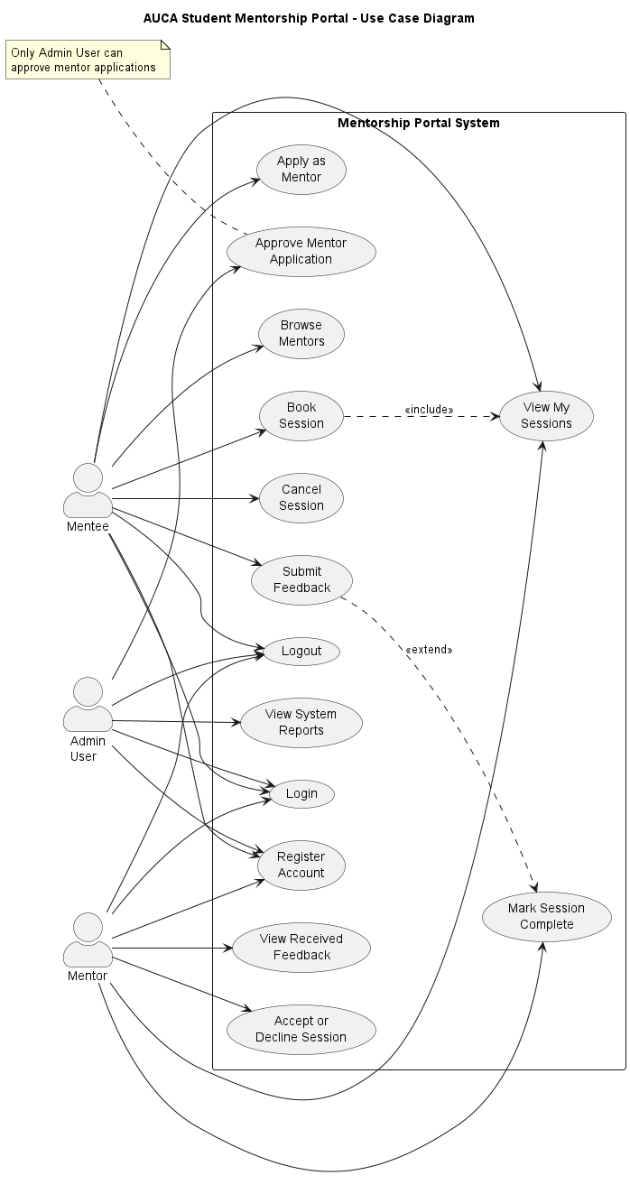
Phase 1 · Use Case Diagram
OBJECT-ORIENTED DESIGN

Slide 5
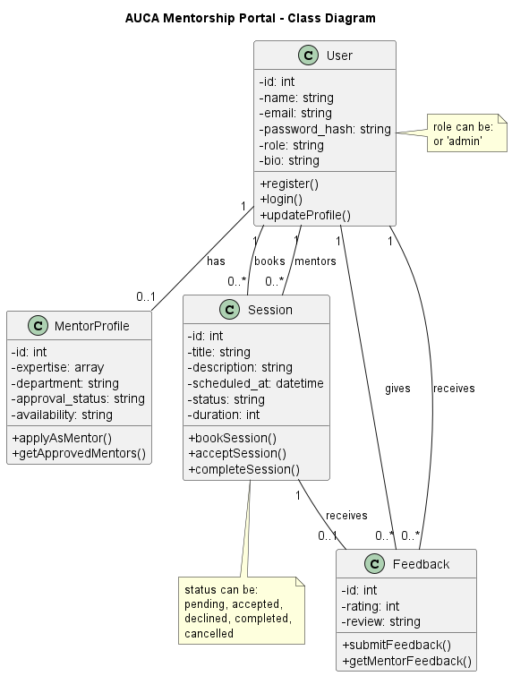
Phase 1 · Class Diagram
OBJECT-ORIENTED DESIGN

Slide 6
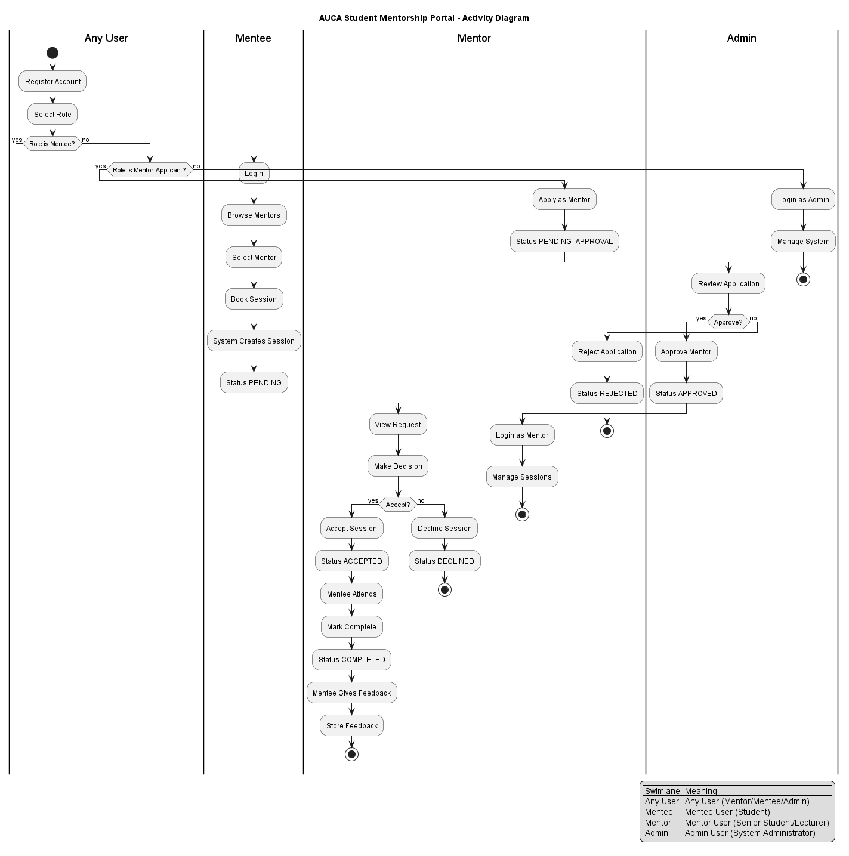
START
Phase 1 · Activity Diagram — Session Lifecycle

Slide 7
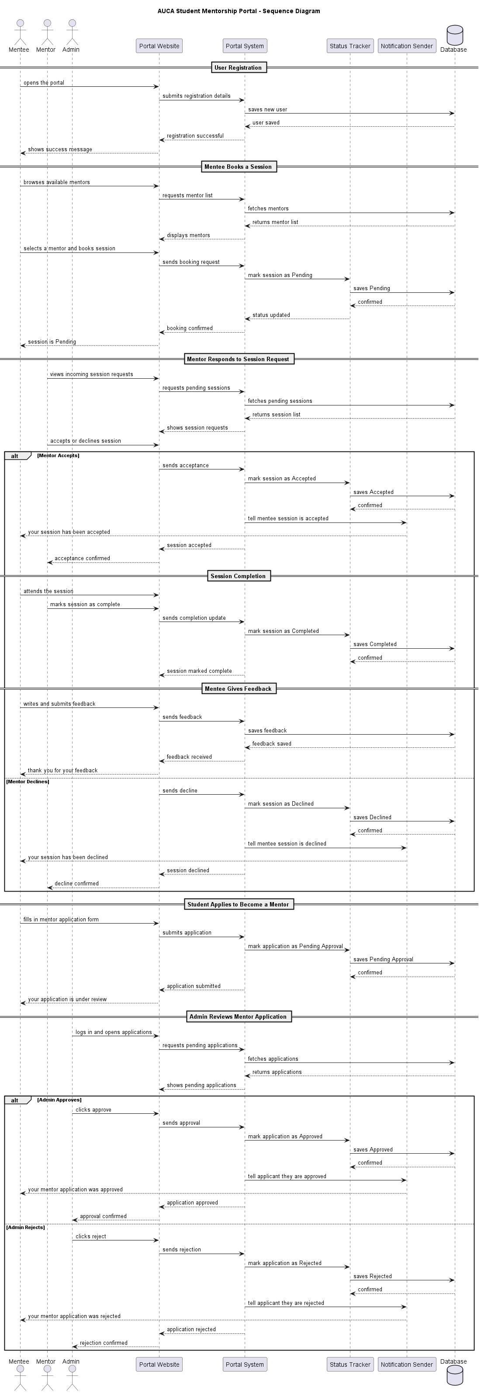
Phase 1 · Sequence Diagram — Session Booking Flow

Slide 8
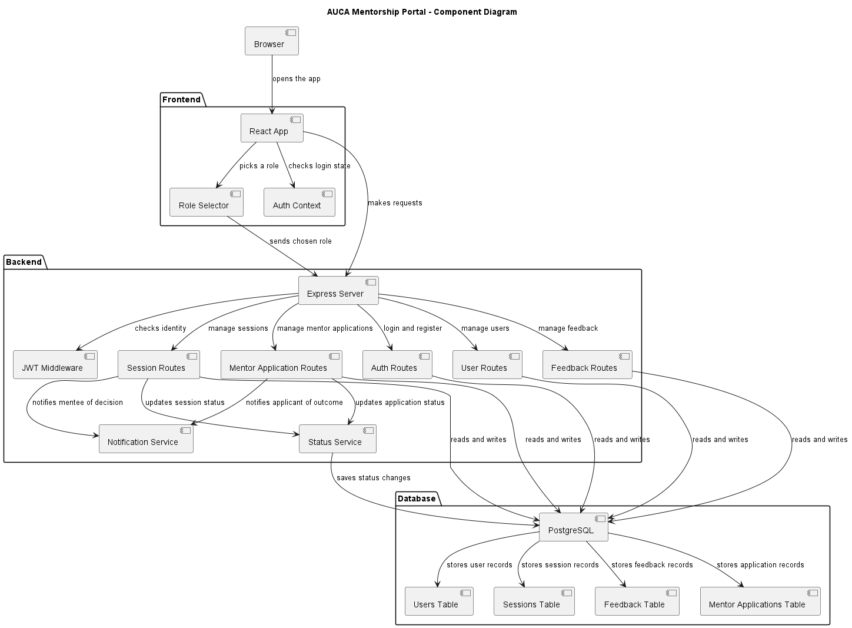
Phase 1 · Component Diagram — System Architecture

Slide 9
Phase 2 · Tech Stack & Design Patterns
PHASE 2 — PROTOTYPE
Frontend UI
Backend API
Database
React 18 + Vite
Node.js
PostgreSQL 15
Component-based SPA with React Router
RESTful API with MVC architecture
Relational DB with ACID compliance
Auth
DevOps
Testing
JWT + bcrypt
Docker + Compose
Jest + Supertest
Stateless auth with hashed passwords
Containerized multi-service deployment
Unit and integration test suites
Design Patterns Applied:
MVC Pattern
Singleton (DB Pool)
Repository Pattern
Middleware Chain
Context API (React)
Guard Clauses

Slide 10
Phase 3 · Docker & Version Control
PHASE 3 — DOCKER & GIT
Docker Configuration
Git Branching Strategy
Services:
mentorship_db — PostgreSQL 15-alpine
mentorship_api — Node.js 20-alpine
Key Commands:
docker-compose up --build
docker ps
docker-compose down
Health Check:
GET http://localhost:5000/health
→ { status: ok, project: AUCA Mentorship Portal }
Volume:
pgdata — persistent PostgreSQL data
main
Production-ready code
feature/auth-system
JWT auth & bcrypt
Mentor profiles
feature/session-management
Booking system
feature/feedback-system
Ratings & reviews
feature/frontend-ui
React pages
feature/docker-setup
Containerization
feature/tests
Jest test suites

Slide 11
Phase 4 · API Testing Postman Collection
Method
Endpoint
Auth
Description
POST
/api/auth/register
Public
Register mentee or mentor
POST
/api/auth/login
Public
Login — returns JWT token
GET
/api/auth/me
Any
Get current authenticated user
GET
/api/users/mentors
Any
List all approved mentors
GET
/api/users/pending
Admin
Pending mentor applications
PATCH
/api/users/:id/approve
Admin
Approve or reject a mentor
POST
/api/sessions
Mentee
Book a new session
GET
/api/sessions
Any
Get sessions for logged-in user
PATCH
/api/sessions/:id/status
Mentor/Admin
Update session status
POST
/api/feedback
Mentee
Submit feedback after session
GET
/api/feedback/mentor/:id
Any
Get feedback for a mentor
GET
/api/feedback
Admin
Get all feedback (admin)

Slide 12
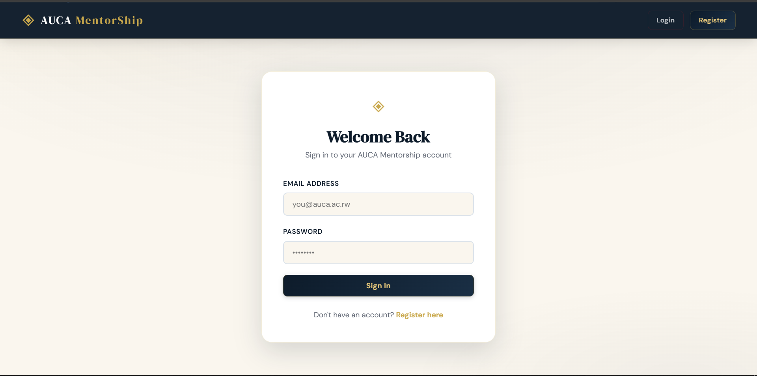
Phase 4 · Software Testing
PHASE 4 — TESTING

Slide 13
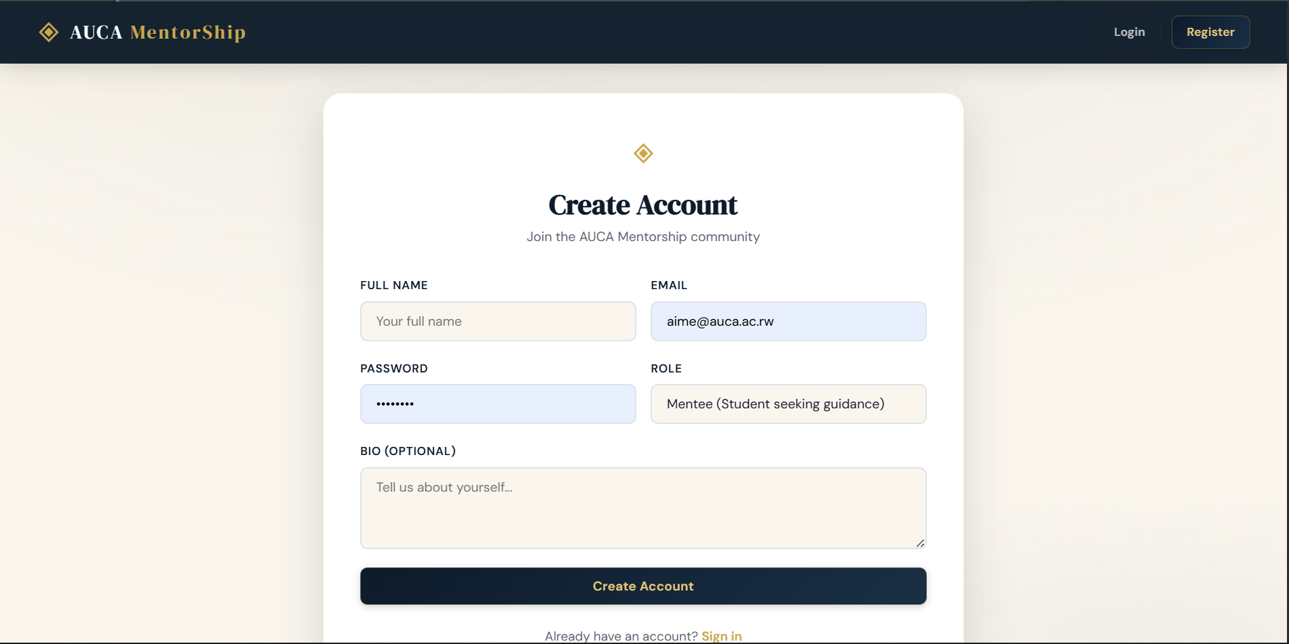
Phase 4 · Software Testing
PHASE 4 — TESTING

Slide 14
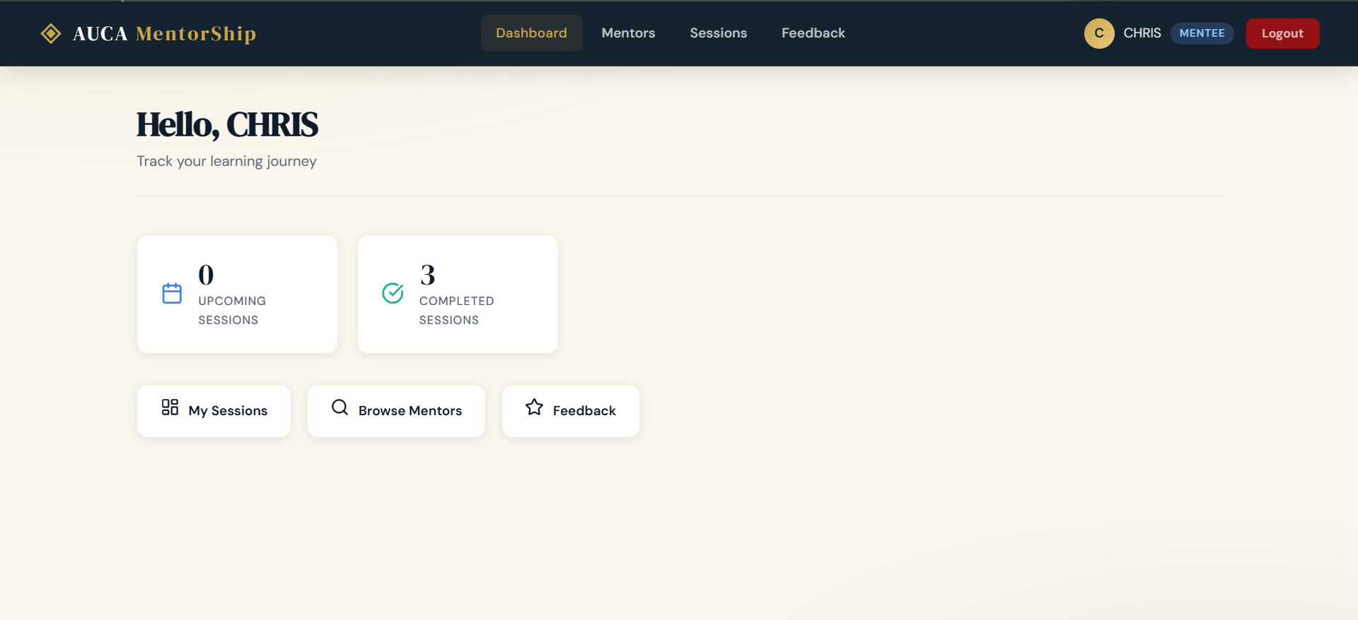
Phase 4 · Software Testing
PHASE 4 — TESTING

Slide 15
Project Summary
AUCA Student Mentorship Portal — Complete Full-Stack System
Phase 1
System analysis, UML diagrams (Use Case, Class, Activity, Sequence, Component)
Phase 2
Full-stack prototype — React frontend, Express API, PostgreSQL database
Phase 3
Dockerized with docker-compose, Git version control with feature branches
Phase 4
17 tests (100% pass rate) — unit, integration, Postman API validation
"Whatever you do, work at it with all your heart, as working for the Lord." — Colossians 3:23

