Slide 1

Data Analytics Project 1
Data Exploration Methods And Data Cleaning Process.

Slide 2

GROUP – 4 Members
Name: CONFIDENCE IKEMSINACHI AHUEKWE Student ID: 991714953
Name: DAVID GICHERU Student ID: 991665570
Name: IFIOK-OBONG SUNDAY IKPE Student ID: 991734876
Name: HENRY NNADOZIE ECHEJI Student: 991730116
Date: October 3rd, 2023.

Slide 3

INTRODUCTION
This project aims to serve as a practical learning opportunity for students in the field of data analytics. It focuses on two crucial aspects: data exploration and data cleaning processes. The foundation of the project lies in four datasets containing vital information on traffic accidents in Toronto spanning from 2015 to 2018.
These datasets are rich sources of real-world data that challenges and empowers students to apply their analytical skill. The project introduces the fundamental steps that Data Analysts and Scientists encounter before diving into any data analysis. These preliminary steps include data gathering, performing joins, merging columns, and creating new data. These tasks are the bedrock upon which data insights are built.

Slide 4

OBJECTIVE
This project delves into the principles and practices of data exploration, manipulation, and preprocessing using Python Programming Language and some Data Analytics Techniques such as correlation analysis, visualization (bar graph, pie charts and tables), understanding data distributions, and identifying outliers.

Slide 5
New Single Data Set That Outputs A Table
Highlights:
Extracted_df.head displays table of the new Data set listing the first five rows, and the extracted columns.
Extracted_df.tail displays table of the new Data set listing the last five rows, and the extracted columns.
Extracted_df.describe shows the summary statistics of numerical columns among the extracted columns of the new data set.

Slide 6
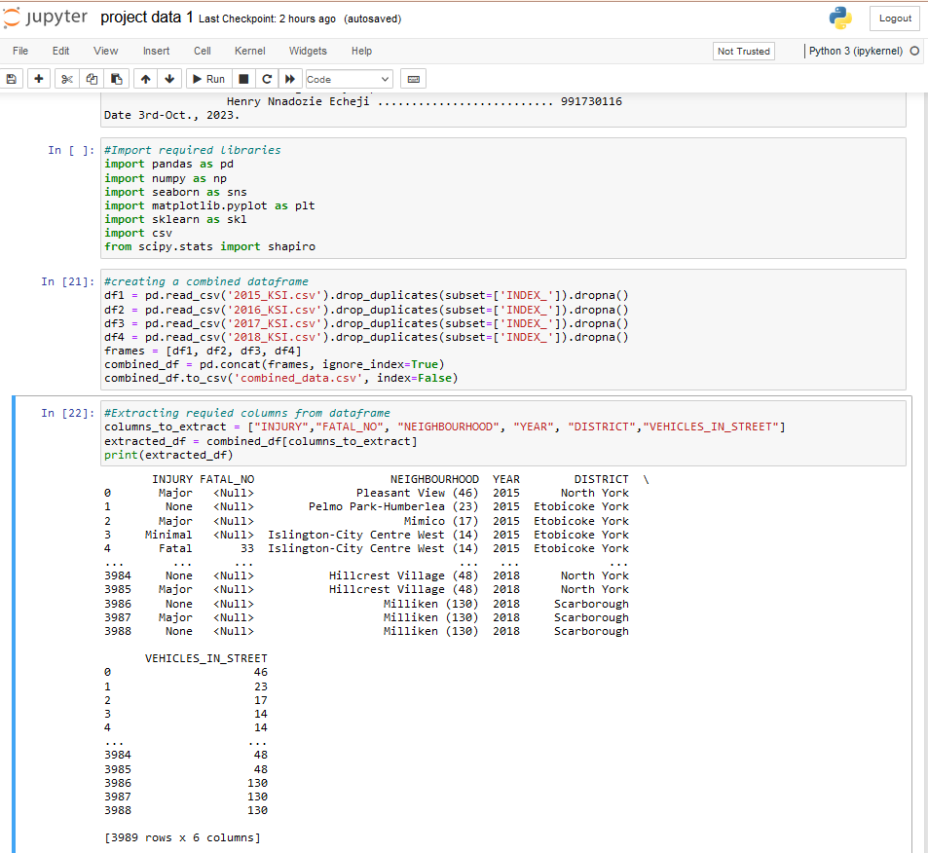
The Brain box:
Snapshot of code that powers the output seen in the previous slide

Slide 7
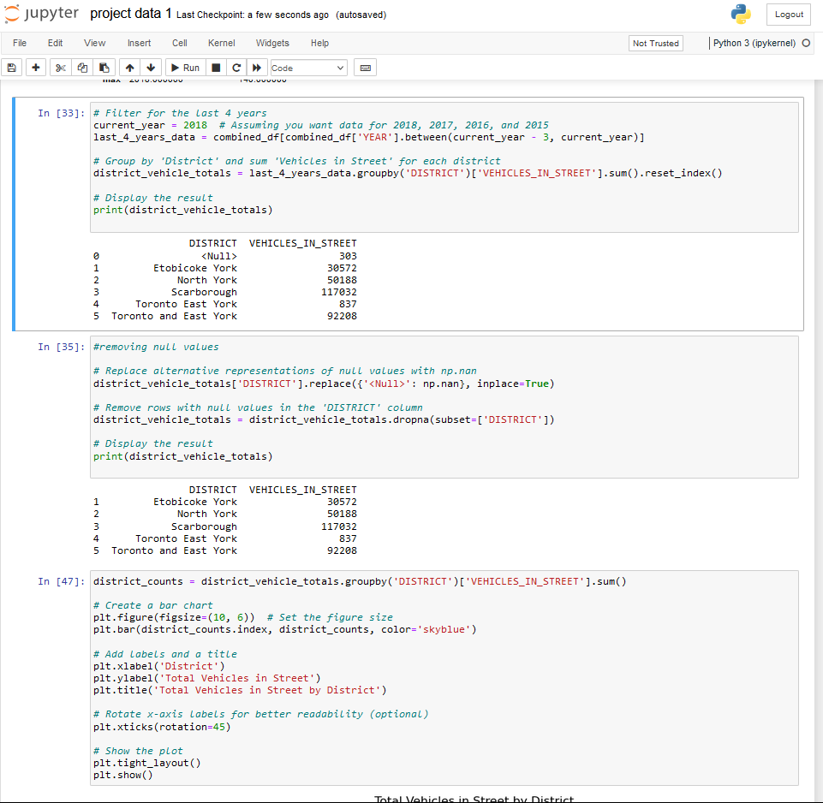
Sequence of Code:
that shows the total vehicles in the street for each district for the last 4 years
during the accidents.

Slide 8
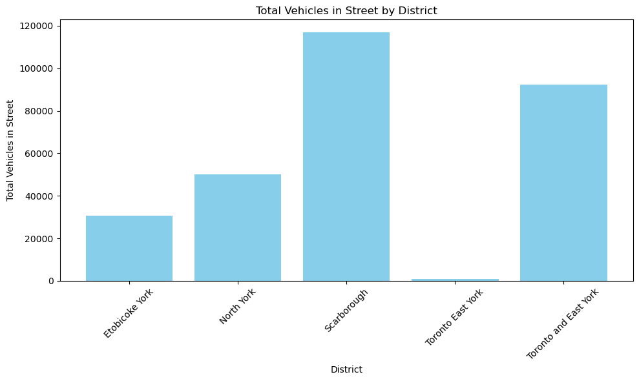

Visualisation
We visualize our data using bar graph because it is a categorical data.
While histogram is used to represent quantitative data, bar graph is best suited for categorical data.

Slide 9
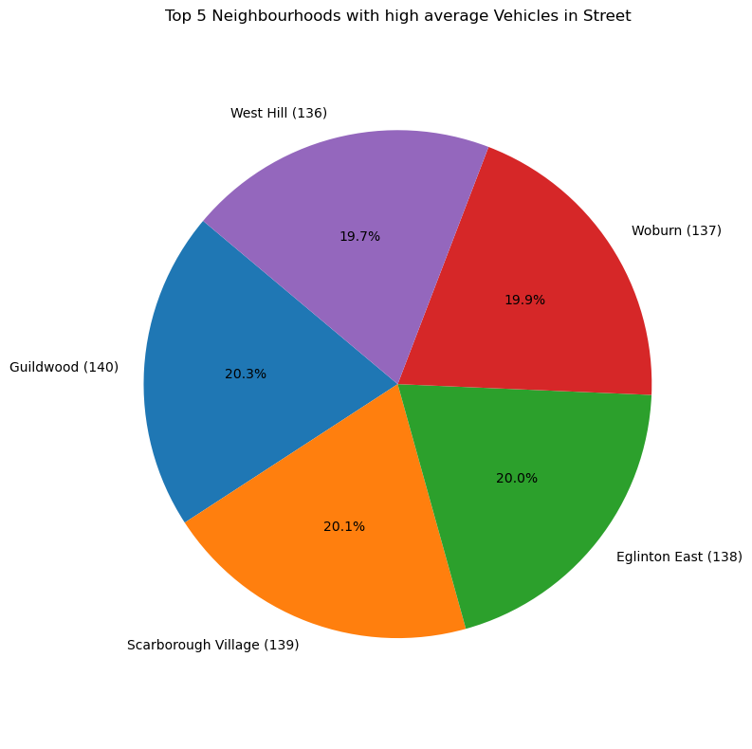
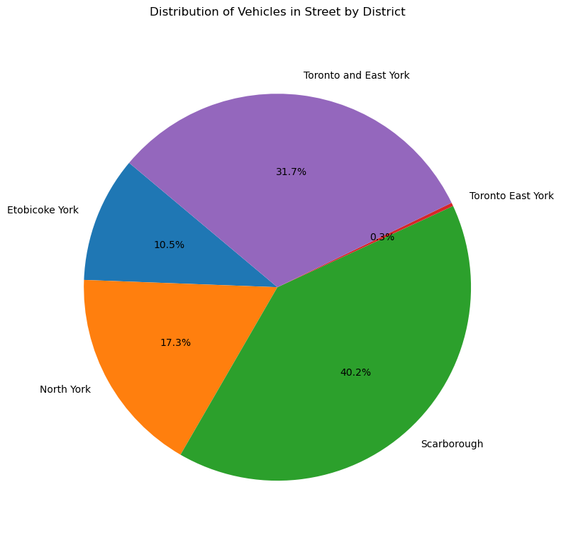
Conclusion
In conclusion, we observed that while cleaning the data set, some columns needed to be renamed to match with the data set from other years. We also used the dropna method to drop the data values that are Not a Number.

Slide 10
Thank You!
Question & Answer

