Slide 1

Gramine: Securing unmodified Linux Applications with Confidential Computing
Presenter: Mona Vij, Intel Labs

Slide 2
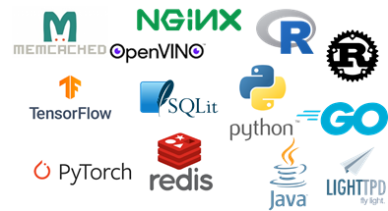
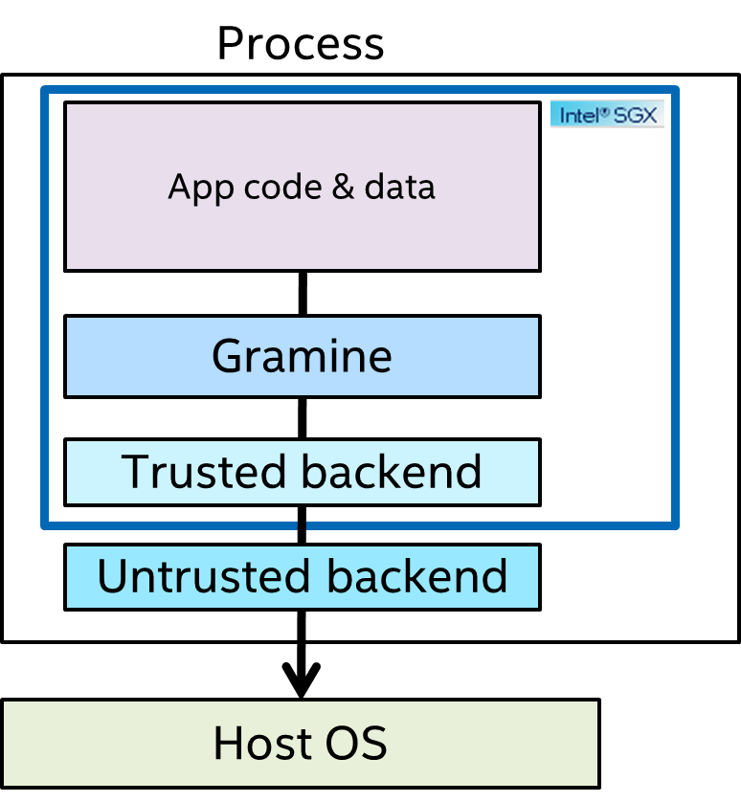


Gramine
Gramine is a multi-process Library OS and run unmodified Linux applications on SGX
Community-maintained open-source (LGPL) project hosted on GitHub
Joined CCC in Sep’21 and Graduation status in May’23
Provides several tools for SGX solutions; containerization, attestation
Latest production ready Gramine v1.8, released in Oct’24; under active development
Process
Customers
Deployed Use Cases
IBM
Cosmian
Edgeless Systems
JD Cloud
Tencent Cloud
Enclaive
Eder Labs
Acompany
IBM ePrescription
BigDL PPML
OpenVINO™ Security Add-on
OpenFL deep learning framework
CCZoo projects

Slide 3
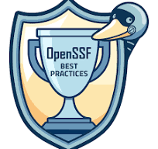
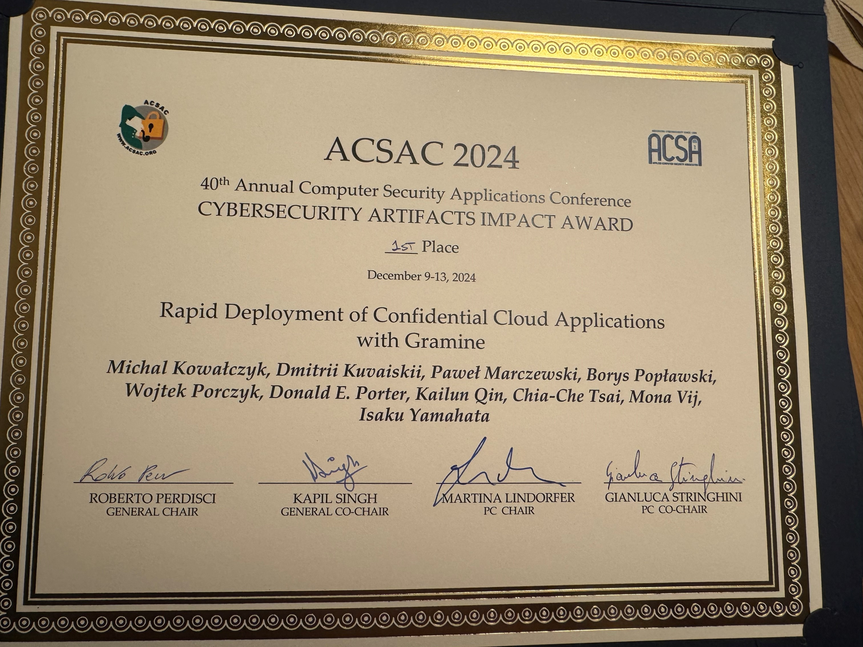
Highlights
Transitioned from CCC Incubation to Graduation in May’23
Received the OpenSSF Security Best Practices Badge in Feb’24
Won Cybersecurity Artifacts Impact Award at 40th ACSAC ‘24 (Annual Computer Security Applications Conference) in Dec’24

Slide 4
Research to Production
Oct 2024: v1.8 released; Experimental Gramine-TDX published at CCS’24
Sep 2020: Intel increases support towards productization
2017: Gramine with Intel SGX paper published
Apr 2019: Intel Labs, UNC, TAMU, and Golem/ITL create a Gramine community
Feb 2022: v1.1 released; quarterly releases planned; Several solutions are in development with Gramine
Jun 2018: Golem/ITL announce Gramine-ng
Oct 2021: Gramine is renamed to Gramine, joins CCC, Gramine v1.0 is released
Feb 2024: v1.6 released; Several production deployments; Graduation from CCC incubation
2011-2014: Gramine PoC at Stony Brook University
Sep 2019: Gramine v1.0 is released
Notes:
Gramine project started as a research prototype at Stony Brook University. The development started in 2011, and the very first open-source version of Gramine was published in 2014.

Slide 5
Gramine LibOS​
Mature confidential computing project
Active development for the last ~8 years
Modular design
Offloads functionalities to the host
Manifest file for security configuration
Process
Unmodified application
Gramine LibOS
Gramine manifest file
Gramine backend
Host
Network stack
Filesystem stack

Slide 6
Progress since last update (Feb ’23)
Gramine Releases
Four releases with latest 1.8 on Oct’24 and 1.9 expected shortly
Packaged for popular Linux distributions (Debian/Ubuntu and RHEL/CentOS)
Official Gramine Docker image
Active development
Continued enhancements of code with bug fixes and documentation improvements
Active github community with 106 open issues and 49 pull requests on 4/17/2025. ~10 P1 issues
New Tools
gramine-manifest-check tool that checks manifest for conformance with Schema
gramine-sgx-sigstruct-view tool for showing SGX metadata for quote verification
Scaffolding tool for containerization; complimentary to Gramine Shielded Container (GSC)
Enhanced Attestation
Updated RA-TLS to adhere to CCC attestation SIG defined Interoperable RA-TLS
Added external plugins for MAA (Microsoft Azure Attestation) and ITA (Intel® Tiber™ Trust Authority)

Slide 7
Progress since last update (Feb ’23)
Core Gramine changes
Enabled communication with HW accelerators (e.g GPU)
Flexible IOCTL
Support for untrusted shared memory support
Added secure implementation for eventfd
Several enhancements for robust encrypted files supported (arbitrary truncation, file recovery, unconditional deletion)
Support for musl C v1.2.5, Glibc v2.40, mbedTLS v3.6.3 and libcurl v.8.8.0 standard libraries to keep up with latest security fixes.
Implemented few new system calls as required by some new use cases e.g flock
Enhanced EDMM (Enclave Dynamic Memory Management)
Dynamic thread creation
lazy memory allocation
Developed Gramine-TDX as a new backed for supporting light weigh TDs with Gramine

Slide 8
Gramine-TDX
TDX-Backend written from scratch (~17K LoC)
Reuse of 70% of Gramine code
Minimal implementation of only 3 drivers
Use TD-Shim as the Virtual BIOS
CCS‘24 paper and slides
Github Repo
Gramine-based TD
Single-process application
Gramine LibOS
Gramine TDX backend
sockets
files
console
virtio-vsock
virtio-fs
virtio-console
Virtual BIOS
Hypervisor
Vsock to TCP/IP (socat)
Shared FS Daemon(virtiofsd)
Host
Network stack
Filesystem stack

Slide 9
Path Forward
Continued productization with regular releases with bug fixes and additional features
Improved tooling and documentation
Support for containers: Gramine Shielded Container (GSC) and Scaffolding projects
Support for new SGX HW features e.g AEX-Notify
Continue research to production path
Productization of experimental Gramine-VM and Gramine-TDX backends
Communication with hardware accelerators (e.g., GPUs)
Growing community
Fortanix joined Gramine dropping productization of their closed source LibOS
Acompany contributed Key Separation and Sharing (KSS) PR

Slide 10
Academic Impact: Favorite research vehicle
Gramine is used in 100+ papers and 700+ citations
16
17
47
and more…
Improve over or benchmark against Gramine
Conduct security analysis or attack on Gramine
Use Gramine as building blocks for quick prototyping
Importance for academics: (1) Enabling TEE research and lowering the bar
(2) Scaling to large, complex TEE use cases
(3) Accelerating light weight CVM research

Slide 11
Industrial Impact: Top Customer choice
Gramine is deployed in production with 20+ customers
Top Customers
Top Use cases
SW Frameworks
IBM
Cosmian
Edgeless Systems
JD Cloud
Tencent Cloud
Enclaive
Eder Labs
Super Protocol
FlashBots
Intel
Acompany
Confidential AI services
Secure Data Collaboration
Secure Block Chain solutions
Secure SW services
IBM ePrescription
BigDL PPML
OpenVINO™ Security Add-on
OpenFL deep learning framework
CCZoo projects
Intel® Tiber™ Trust Authority

Slide 12
Gramine Project
Technical Charter
No change in charter
Project Code of Conduct
CoC (Contributor Covenant 2.0 with a PostgreSQL sentence, “The Committee may determine that a violation of this policy was inadvertent …”)
Gramine Project - https://github.com/gramineproject
Core gramine - https://github.com/gramineproject/gramine
Gramine-TDX - https://github.com/gramineproject/gramine-tdx
Examples - https://github.com/gramineproject/examples
Gramine Shielded Containers - https://github.com/gramineproject/gsc
Third party code related to Gramine - https://github.com/gramineproject/contrib
Archived Graphene - https://github.com/gramineproject/graphene
Issue Tracker
https://github.com/gramineproject/gramine/issues
Documentation
Gramine: https://gramine.readthedocs.io/en/latest/
GSC: https://gramine.readthedocs.io/projects/gsc/en/latest/
Roadmap
Roadmap: https://github.com/orgs/gramineproject/projects/1

Slide 13
Management Team
The currently active members of the management team are:
Michał Kowalczyk (Invisible Things Lab/Intel)
Wojtek Porczyk (Invisible Things Lab/Intel)
Borys Popławski (Invisible Things Lab/Intel)
Don Porter (UNC)
Chia-Che Tsai (Texas A&M University)
Kailun Qin (Intel)
Mona Vij (Intel)
The past (inactive) members of the management team are:
Dmitrii Kuvaiskii (Intel)
Isaku Yamahata (Intel)
Paweł Marczewski (Invisible Things Lab/Intel)
Rafał Wojdyła (Invisible Things Lab/Intel)
The active members have the review and voting rights. The past (inactive) members have only the review rights.
The active members are also the TSC voting members as described in the Technical Charter for Gramine project.

Slide 14
Budget
2023/24
~$10K used for buying 1 EMR server
Hosted in ITL for CI
Gramine website using github pages funded by CCC
Team is still working on developing and reviewing content
VPS server for the packages and the website is hosted in AWS funded by LF
Intel donated two ICX servers for CI at UNC
2025
Upgrade older CI hardware at UNC
Continued VPS server hosting for packages and website - ~$90/per month

Slide 15
Current Mode of Operation (No Change)
Repository on GitHub
Reviewable.io
UNC Zoom for team meetings
Gitter chat service
Google group mailing list

Slide 16
Github Repo
https://github.com/gramineproject/gramine
Gramine Documentation
https://gramine.readthedocs.io
Gitter
https://gitter.im/gramineproject/community
Gramine Project
https://gramineproject.io/

Slide 17



@ConfidentialC2
confidential-computing
confidentialcomputing.io

