Slide 1
Our Goal
We want to be able to send and receive data to Bravo from a computer such as a PC, MAC, Linux machine, etc
so that we could:
Use the computer keyboard as an input device
Use the computer monitor as an output device
In order to do that, we will be using UART protocol and a terminal emulator program such as Tera Term, Putty, etc.

Slide 2
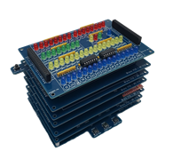
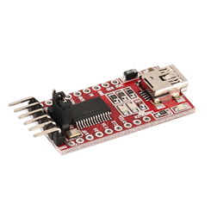

What is UART ?
Universal Asynchronous Receiver / Transmitter
A Protocol to exchange data between two devices (Exp: Bravo and a PC)
UART uses only two wires to transfer data called RX and TX
USB To Serial Adapter
RX
TX
GND
+5V
RX
TX
GND
+5V
USB

Slide 3
Couple of challenges:
Parallel Vs Serial
Parallel Data
Parallel Data
0
1
0
0
0
0
0
1
Sending Character “A”
0
1
0
0
0
0
0
1
Bus0
Bus1
Bus2
Bus3
Bus4
Bus5
Bus6
Bus7
Bus0
Bus1
Bus2
Bus3
Bus4
Bus5
Bus6
Bus7
TX
10000010
RX
Serial Lines
RX
TX
1s are sent by setting the line to high
0s are sent by setting the line to low

Slide 4
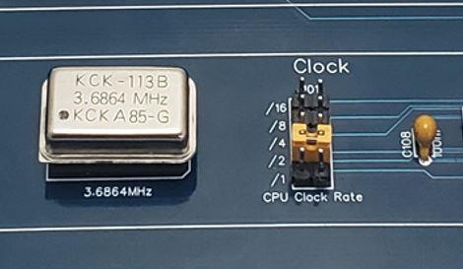
2. Timing / Speed
Since the clocks are not synched, they need to agree on a speed before sending /receiving data
Bravo Clock Speeds
3.6864 MHz
1.8432 MHz
921.6 KHz
460.8 KHz
230.4 KHz
Common UART Speeds
Baud Rates (Standard)
4800
9600
19200
57600
115200
/16

Slide 5
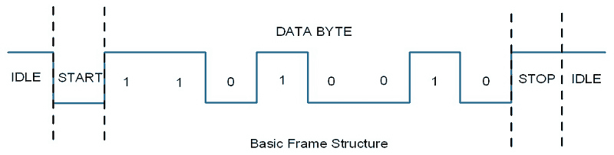
3. Frame Structure / Format
They need to agree on the structure of the frame (Data + other bits) so that they can detect when the line is idle and when the data is sent.
First, the line is set to low to show the START bit
Then data is sent
1s are sent by setting the line to high
0s are sent by setting the line to low
After a predefined number of bits are sent, the line will be set to high as STOP bit
Sending Character “K”
*image Source : https://www.electronicwings.com/raspberry-pi/raspberry-pi-uart-communication-using-python-and-c

Slide 6
Bravo Computer UART Parameters :
Speed :
Divider on Clock Module | Bravo Clock Speed | UART Speed
/1 | 3.6864 MHz | 230,400 bps
/2 | 1.8432 MHz | 115,200 bps
/4 | 921.6 KHz | 57,600 bps
/8 | 460.8 KHz | 28,800 bps
/16 | 230.04 KHz | 14,400 bps
Start Bit: 1 bit
Data : 8 bits
Parity: None
Check a video on YouTube : “Understanding UART” , link in the description

Slide 7
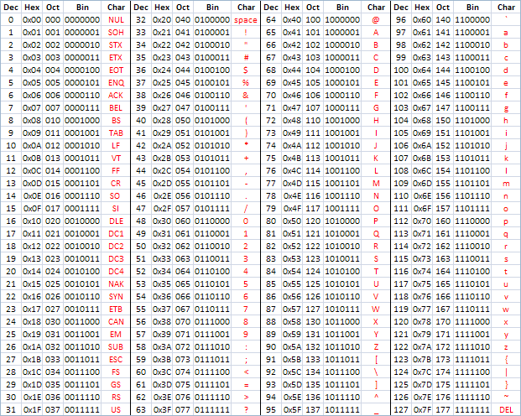
ASCII CODES
Source of image : https://e2e.ti.com/support/microcontrollers/msp-low-power-microcontrollers-group/msp430/f/msp-low-power-microcontroller-forum/521465/ascii-interpretation-over-uart-communication

