Slide 1
GraphQL @lunch.js
We(I) hated GraphQL
When the GraphQL spec launched back in July, I hated it. I even said so publicly on the crater.io.
That was my reaction by just looking at the spec. At that time, it was very hard to find tutorials and there was no official documentation.
Eventually everyone at Kadira grew to love GraphQL as we learnt to understand it. We now believe that this is the future of APIs.
Kadira is the creator of learngraphql.com
https://kadira.io/blog/graphql/why-we-built-the-learn-graphql-project

Slide 2

REST
All entities are considered resources which can be accessed via a URL
/api/quotes/42
/api/partners/1000
Use the HTTP protocol to express your intend
Clean URI based expressions such as HTTP GET /api/quotes/42
Focuses on your resources (e.g. the quote)
Related resources are (hyper) linked
Codes success or failure by using native HTTP Status Codes in server response
e.g. HTTP 404 NOT FOUND
Ideal for CRUD scenario’s
HTTP POST creates a new resource, e.g. HTTP POST /api/quotes
HTTP GET reads an existing resource, e.g. HTTP GET /api/quotes/42
HTTP PUT updates an existing resource, e.g. HTTP PUT /api/quotes/42
HTTP DELETE deletes an existing resource, e.g. HTTP DELETE /api/quotes/42

Slide 3

Does REST requests Scale?
HTTP GET /api/quotes
HTTP GET /api/quotes?user=luke
HTTP GET /api/quotes?user=luke&expiration=2016-10-10&isDeleted=true&netValueMin=10000000&salesOrganization=1000&distributionChannel=10&division=10&customer=1000
HTTP POST /api/quotes
{ "user": "luke", "expiration": "2016-10-10", "isDeleted": true, "minNetValue": 100000000 "salesOrganization": 1000 "distributionChannel": 10 "division": 10 "customer": 1000 }

Slide 4
API Design with REST
Model
Application Screen
“REST Strategy”:
Serve the data that represents the resource you are asking for
“Ad hoc Strategy”:
Serves the data that represents the screen the user is visiting

Slide 5
GraphQL query
{ quotes ( name: "luke", expiration: "2016-10-10" ) { title, customer, totalNetValue }
Field
Arguments
Selection set

Slide 6
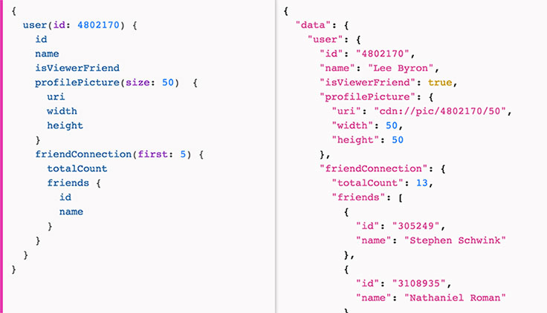
The query response looks as the client would expect

Slide 7
Some GraphQL goals
Hierarchical
Client centric
Backwards compatible
Technology agnostic
Transport agnostic
Strongly types
Introspective

Slide 8

Demo – Type Hierarchy
Character
+ id : string
+ name : string
+ friends : Character
+ appearsIn : EpisodeEnum

Slide 9




Demo – Type Hierarchy cont’d
Human implements Character
+ homePlanet : string
Droid implements Character
+ primaryFunction : string

Slide 10
GraphQL vs Falcor Gajus Kuizinas on StackOverflow http://stackoverflow.com/questions/32057785/what-is-the-difference-between-falcor-and-graphql
I have viewed the Angular Air Episode 26: FalcorJS and Angular 2 where Jafar Husain answers howGraphQL compares to FalcorJS. This is the summary (paraphrasing):
FalcorJS and GraphQL are tackling the same problem (querying data, managing data)
The important distinction is that GraphQL is a query language and FalcorJS is not.
When you are asking FalcorJS for resources, you are very explicitly asking for finite series of values. FalcorJS does support things like ranges, e.g. genres[0..10]. But it does not support open-ended queries, e.g. genres[0..*].
GraphQL is set based: give me all records where true, order by this, etc. In this sense, GraphQL query language is more powerful than FalcorJS.
With GraphQL you have a powerful query language, but you have to interpret that query language on the server.
Jafar argues that in most applications, the types of the queries that go from client to server share the same shape. Therefore, having a specific and predictable operations like get and set exposes more opportunities to leverage cache. Furthermore, a lot of the developers are familiar with mapping the requests using a simple router in REST architecture.
The end discussion resolves around whether the power that comes with GraphQL outweighs the complexity.

Slide 11

Resources
Introduction to GraphQL
https://facebook.github.io/react/blog/2015/05/01/graphql-introduction.html
Learn GraphQL (impressively good training resource)
https://learngraphql.com/
graphql-dotnet (a fairly immature GraphQL implementation in C#)
https://github.com/graphql-dotnet/graphql-dotnet
graphql-relay.js (integration between React/Relay and GraphQL)
https://github.com/graphql/graphql-relay-js
Falcor (Netflix’ competitor to GraphQL)
http://netflix.github.io/falcor/

