Slide 1
Confluent_L100 Deployment Walkthrough

Slide 2
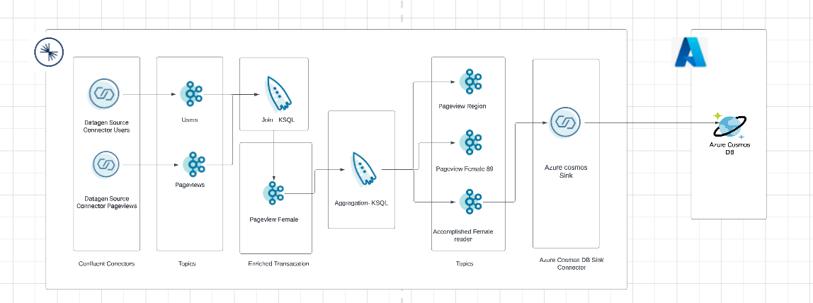
High-level Architecture

Slide 3
Automation Infra setup using Terraform
Prerequisites
Need to Install
Git Bash - https://git-scm.com/downloads
Terraform CLI - https://developer.hashicorp.com/terraform/downloads
Confluent CLI - https://docs.confluent.io/confluent-cli/current/install.html
Azure CLI - https://learn.microsoft.com/en-us/cli/azure/install-azure-cli-linux?pivots=apt

Slide 4
Automation Infra setup using Terraform
Clone the terraform code from git hub using git bash
“git clone”
Navigate to the root folder/ path where the terraform code downloaded and open to code using any code editor(eg:visual studio)
Open the variable.tf file and change the API key and API secret from your confluent cloud account
Open git bash navigate to the terraform script path and run “confluent login”
Open git bash navigate to the terraform script path and run “terraform init”
Ones the init is successful kindly run “terraform plan”
Ones the plan is generated successful run “terraform apply”
It will prompt for confirmation please type “yes”

Slide 5
Automation Infra setup using Terraform
Azure
Note: Kindly install azure cli for using azure command
To login into azure account
Open git bash and type “az login”
It will prompt open bowser kindly authenticate with your azure credentials
Navigate to the root folder/ path where the terraform code for azure downloaded and open to code using any code editor(eg:visual studio)
Open the variable.tf file kindly provide name to azure resource group, resource_group_location, azurerm_cosmosdb_account_name, failover_location
Open git bash navigate to the terraform script path and run “terraform init”
Ones the init is successful kindly run “terraform plan”
Ones the plan is generated successful run “terraform apply”
It will prompt for confirmation please type “yes”

Slide 6
Components created by terraform
The terraform script will create
Environment – Confluent_L100
Cluster – C1
Topic – users and pageview
Source Connectors - DatagenSourceConnector_pv and DatagenSourceConnector_users
Ksql – ksqlDB
CosmosDB – Confluent_L100

Slide 7
Manual steps – Ksql raw stream queries
We are going to create two streams for users and pageview
Open Ksql and run the below query in sequences
CREATE STREAM stream_users_raw ( registertime BIGINT, userid VARCHAR, regionid VARCHAR, gender VARCHAR ) WITH ( KAFKA_TOPIC = 'users', VALUE_FORMAT = 'JSON’ );
CREATE STREAM stream_pageview_raw (viewtime BIGINT, userid VARCHAR, pageid VARCHAR) WITH (KAFKA_TOPIC = 'pageview', VALUE_FORMAT = 'JSON’);
Note: Kindly execute the query in single line to avoid space/ special character error

Slide 8
KSQL Join queries
Join Query for User and Pageview
CREATE STREAM STREAM_PAGEVIEW_FEMALE WITH (KAFKA_TOPIC='pageview_female', PARTITIONS=2, REPLICAS=3) AS
SELECT
STREAM_USERS_RAW.USERID USERID,
STREAM_PAGEVIEW_RAW.PAGEID PAGEID,
STREAM_USERS_RAW.REGIONID REGIONID,
STREAM_USERS_RAW.GENDER GENDER,
STREAM_PAGEVIEW_RAW.VIEWTIME VIEWTIME,
(CAST(STREAM_USERS_RAW.REGISTERTIME AS STRING) + CAST(STREAM_PAGEVIEW_RAW.VIEWTIME AS STRING)) KEY
FROM STREAM_PAGEVIEW_RAW STREAM_PAGEVIEW_RAW
LEFT OUTER JOIN STREAM_USERS_RAW STREAM_USERS_RAW WITHIN 1 HOURS
ON ((STREAM_PAGEVIEW_RAW.USERID = STREAM_USERS_RAW.USERID))
WHERE (STREAM_USERS_RAW.GENDER = 'FEMALE')
EMIT CHANGES;
Note: Kindly execute the query in single line to avoid space/ special character error

Slide 9
KSQL queries-Use case 1
Case 1 : Region wise view count
The page view counts with respect to each region
CREATE TABLE TBL_PAGEVIEW_REGION WITH (KAFKA_TOPIC='pageview_region’,
KEY_FORMAT='JSON', PARTITIONS=2, REPLICAS=3) AS
SELECT
STREAM_PAGEVIEW_FEMALE.REGIONID REGIONID,
COUNT(STREAM_PAGEVIEW_FEMALE.PAGEID) PAGEVIEW
FROM STREAM_PAGEVIEW_FEMALE STREAM_PAGEVIEW_FEMALE
WINDOW TUMBLING ( SIZE 1 HOURS )
GROUP BY STREAM_PAGEVIEW_FEMALE.REGIONID
EMIT CHANGES;
Note: Kindly execute the query in single line to avoid space/ special character error

Slide 10
KSQL queries-Use case 2
Case2 : Page View Count for Certain Users
The page view counts for User 8 and User 9
CREATE TABLE TBL_PAGEVIEW_FEMALE89 WITH
(KAFKA_TOPIC='pageview_female89', KEY_FORMAT='JSON', PARTITIONS=2, REPLICAS=3) AS
SELECT
STREAM_PAGEVIEW_FEMALE.USERID USERID,
COUNT(*) PAGEVIEW_FEMALE89
FROM STREAM_PAGEVIEW_FEMALE STREAM_PAGEVIEW_FEMALE
WINDOW TUMBLING ( SIZE 30 MINUTES )
WHERE ((STREAM_PAGEVIEW_FEMALE.USERID LIKE '%8') OR (STREAM_PAGEVIEW_FEMALE.USERID LIKE '%9'))
GROUP BY STREAM_PAGEVIEW_FEMALE.USERID
EMIT CHANGES;
Note: Kindly execute the query in single line to avoid space/ special character error

Slide 11
KSQL queries-Use case 3
Case 3 : Accomplished Female Reader
A female user must visit page at least for 30 Mins
CREATE STREAM STREAM_ACCOMPLISHED_FEMALE_READER WITH (KAFKA_TOPIC='Accomplished_female_reader', KEY_FORMAT='JSON', PARTITIONS=2, REPLICAS=3) AS SELECT *
FROM STREAM_PAGEVIEW_FEMALE STREAM_PAGEVIEW_FEMALE
WHERE (STREAM_PAGEVIEW_FEMALE.VIEWTIME > 1800000)
EMIT CHANGES;
Note: Kindly execute the query in single line to avoid space/ special character error

Slide 12
CosmosDB sink connector Manual creation
Create CosmosDB sink connector with the below details
Topic name - Accomplished_female_reader
Kafka credentials
Authentication
Configuration
Kafka Cluster Authentication mode | KAFKA_API_KEY
Kafka API Key | kindly update your confluent cloud account API key
Kafka API Secret | kindly update your confluent cloud account API secret
Cosmos Endpoint | Kindly update your cosmos db end point from azure protal
Cosmos Connection Key | Kindly update your cosmos db connection key from azure protal
Cosmos Database name | testdb
Input Kafka record value format | JSON
Topic-Container map | Accomplished_female_reader#terraformtestcontainer
Id strategy | FullKeyStrategy

