Slide 1

FC Trade
Order Book DEX
FC Community2025
FCTRADE.HYDRASF.CLUB

Slide 2
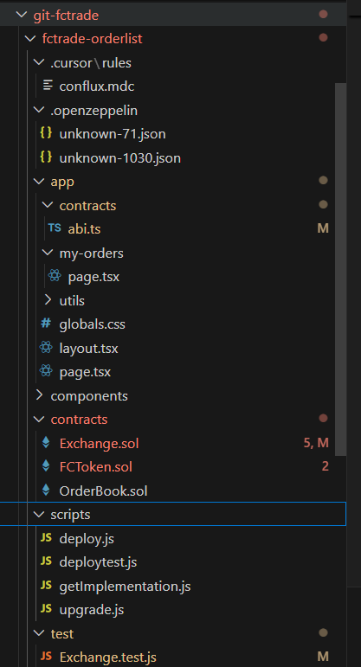
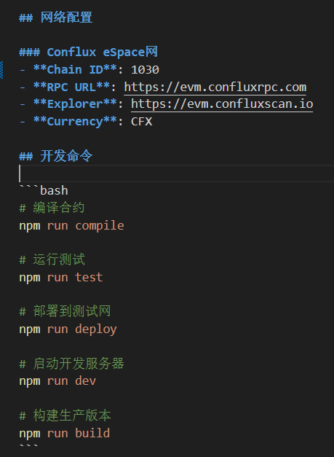
FC Trade的生成
技术栈
Solidity
React
Javascript
Openzeppelin
环境配置
Node.js
Fluent/MetaMask
Yarn
FCTRADE.HYDRASF.CLUB
2

Slide 3
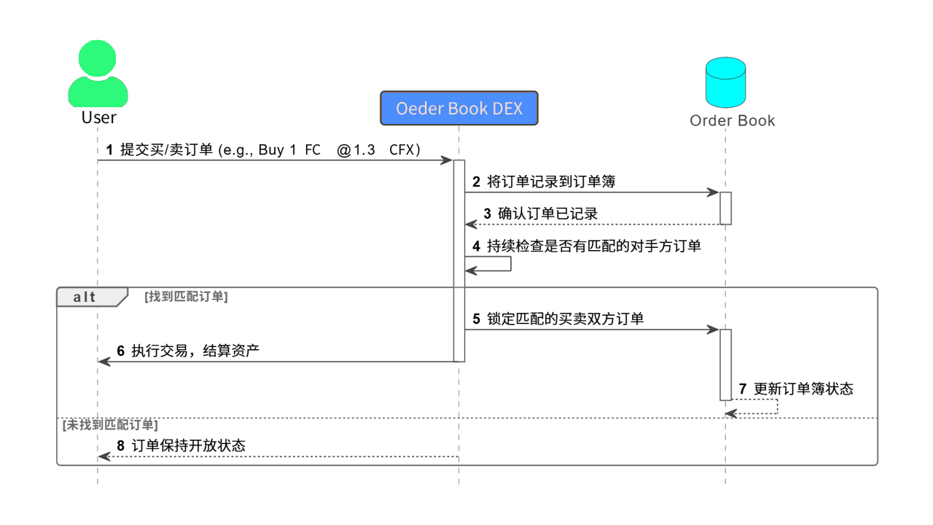
FC Trade的实现-流程
FCTRADE.HYDRASF.CLUB
3

Slide 4
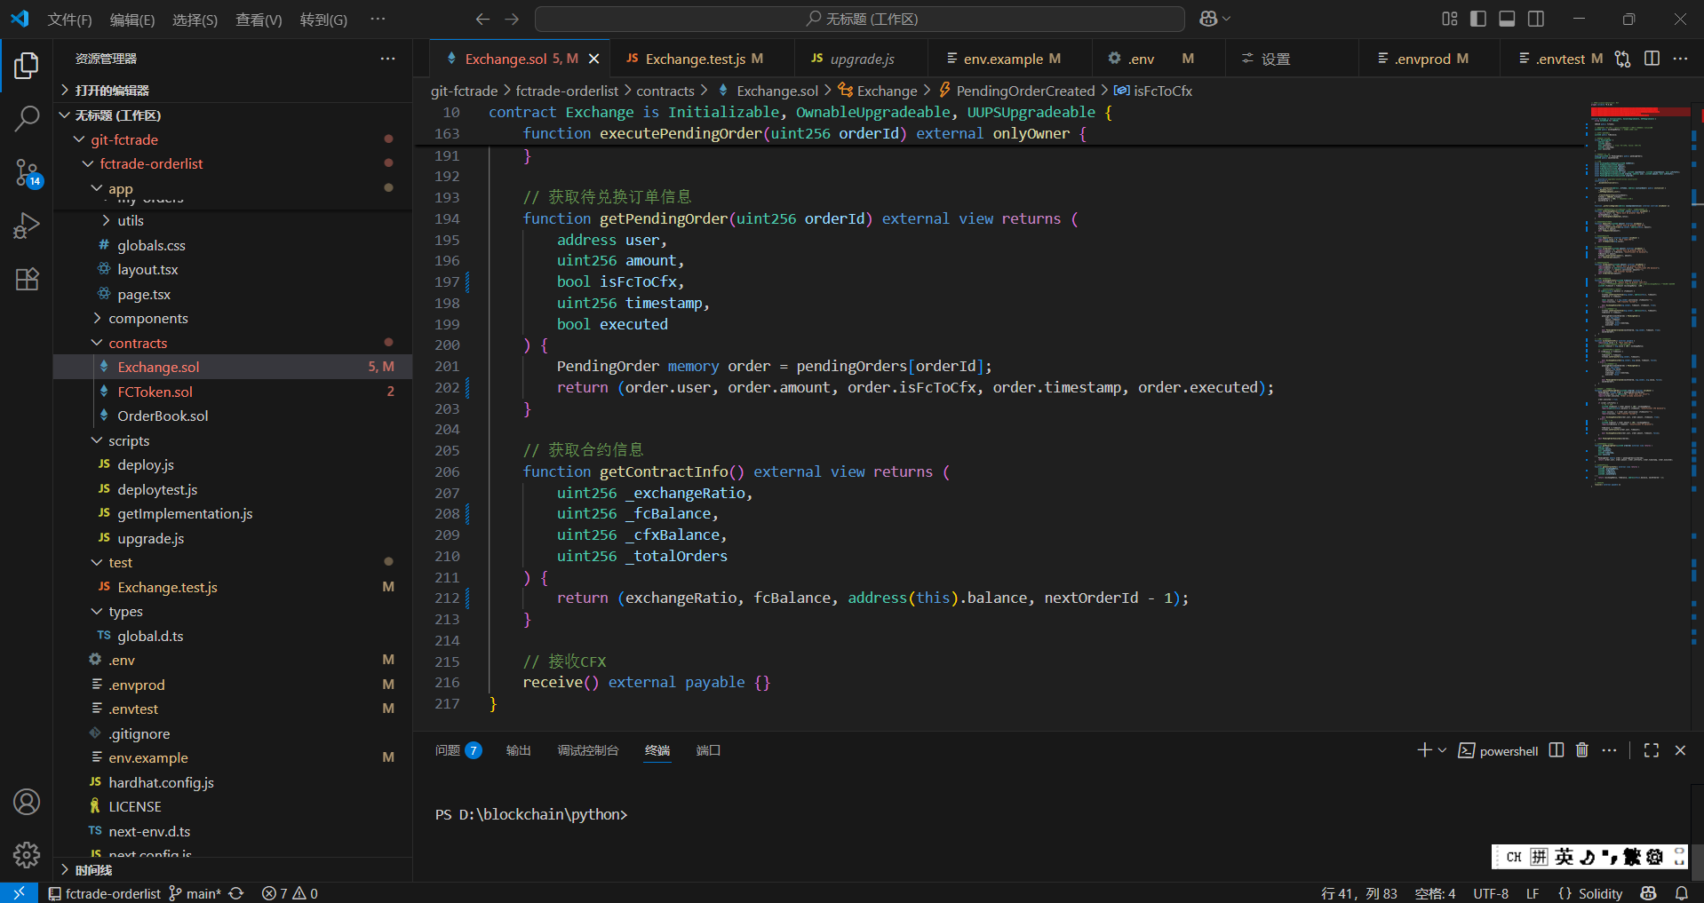
FC Trade的实现-合约
FCTRADE.HYDRASF.CLUB
4

Slide 5
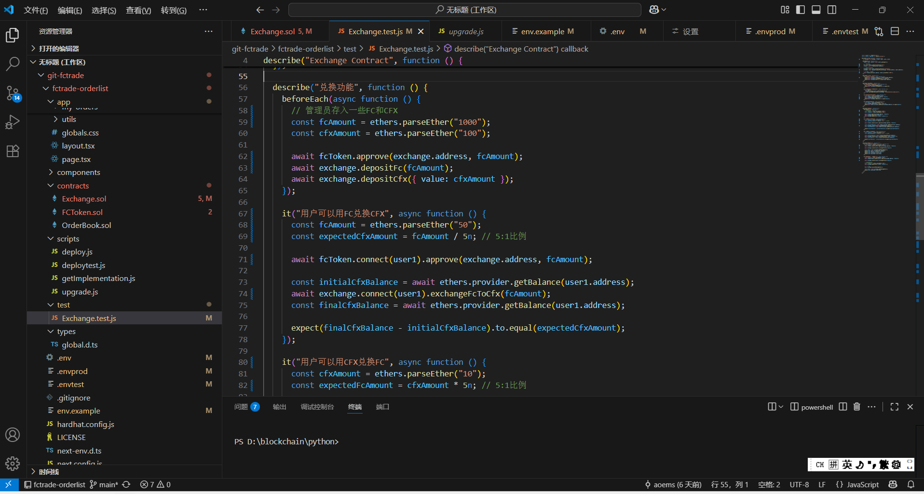
FC Trade的实现-前端
FCTRADE.HYDRASF.CLUB
5

Slide 6
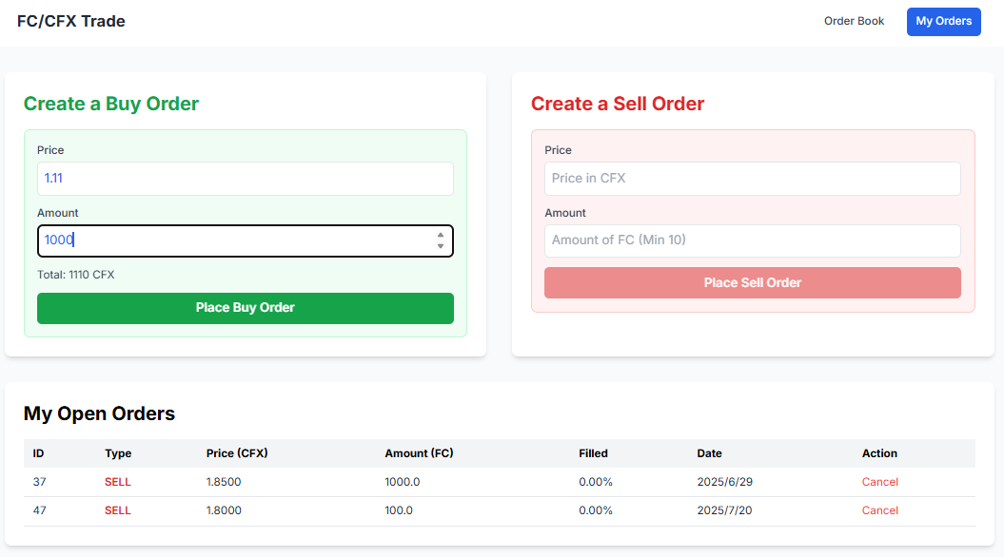
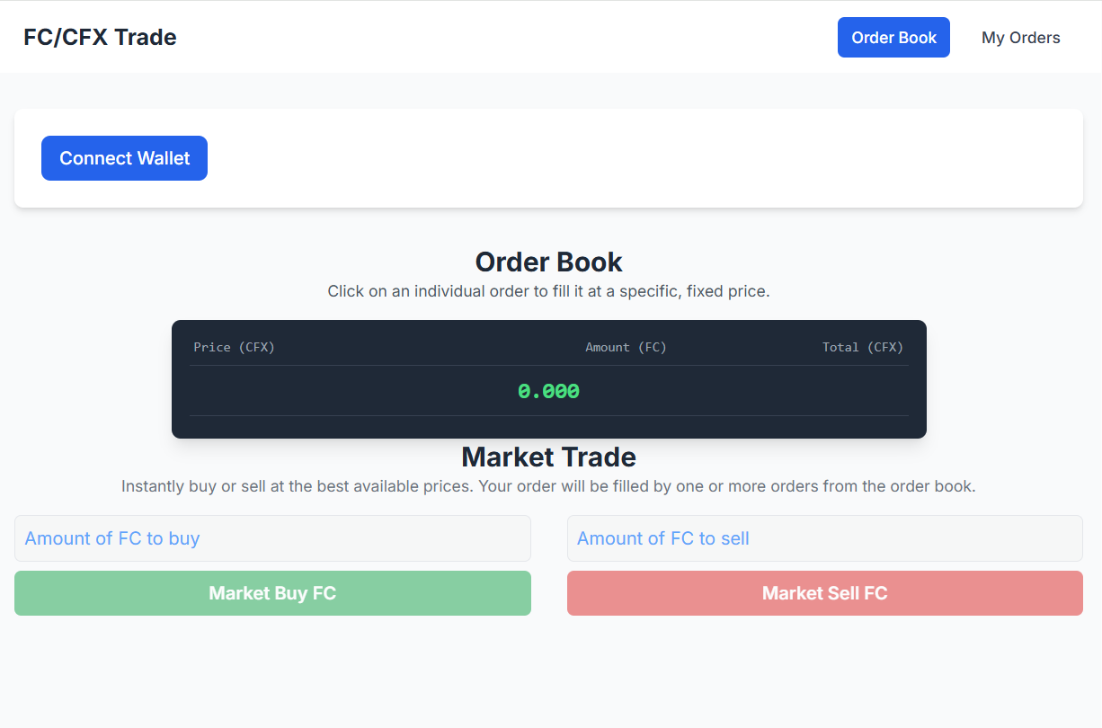
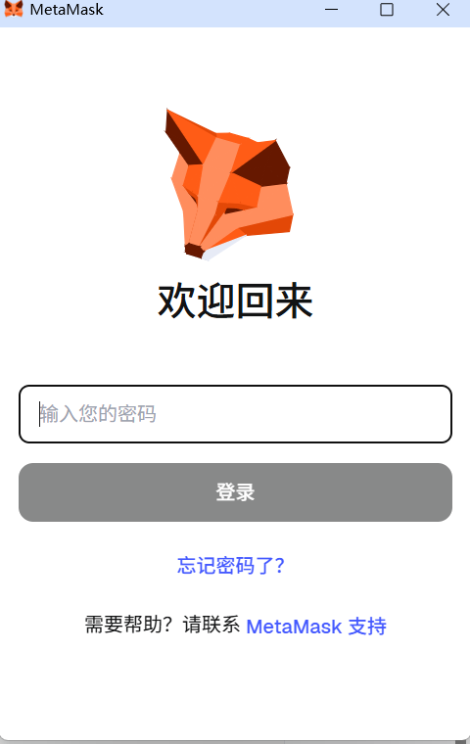
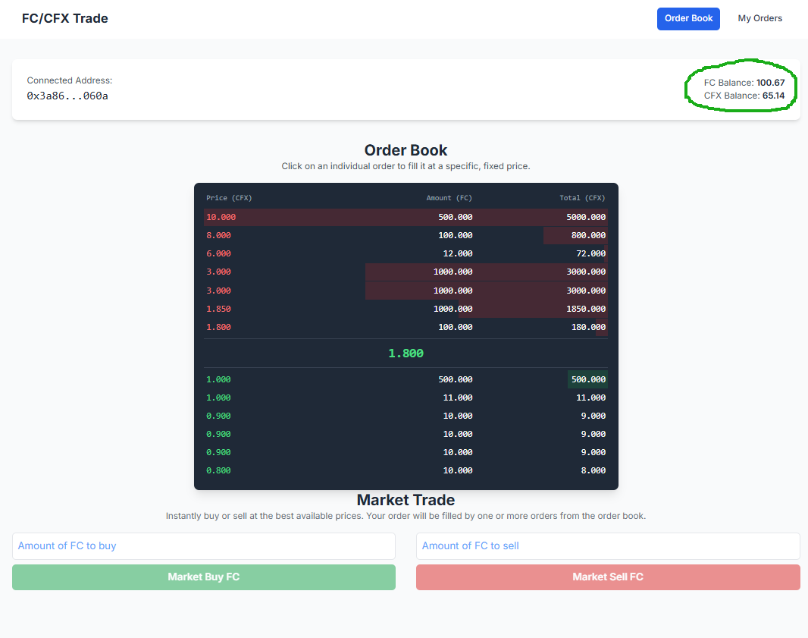
FC Trade的使用
FCTRADE.HYDRASF.CLUB
6

Slide 7
Thank you
FCTRADE.HYDRASF.CLUB

