Slide 1












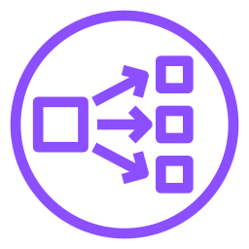


Internet-facing NLB
AWS Cloud
Region
VPC 10.0.0.0/16
Availability Zone 1
Public subnet
App subnet
ASG · target group
DNS 조회
아웃바운드
Route 53
NAT gateway
EC2
EC2
ACM
Alias → NLB
TLS 리스너 인증서
TLS :443
TCP :8080
Users
IGW
NLB
CloudWatch
Availability Zone 2
지표 · 경보
Public subnet
App subnet
아웃바운드
NAT gateway
EC2
EC2
S3
NLB 액세스 로그
Internet-facing NLB · TLS 종료 · 라우팅: Public subnet 0.0.0.0/0 → IGW, App subnet 0.0.0.0/0 → NAT gateway (같은 AZ)

Slide 2



3-tier web app with ALB, AWS WAF and RDS Multi-AZ
AWS Cloud
DNS 조회
Region
VPC 10.0.0.0/16
Route 53
Availability Zone 1
alias → ALB
Public subnet
App subnet
ASG · target group
DB subnet
아웃바운드
SQL
NAT gateway
EC2
EC2
RDS Primary
ACM
CloudWatch
인증서
지표 · 경보
HTTPS :443
HTTP :80
동기식 복제
Users
IGW
ALB
Availability Zone 2
Public subnet
App subnet
DB subnet
아웃바운드
NAT gateway
EC2
EC2
RDS Standby
AWS WAF
S3
Web ACL
액세스 로그
Internet-facing ALB · 두 AZ에 걸친 단일 관리형 로드 밸런서 · AWS WAF 연결 · RDS Multi-AZ

Slide 3

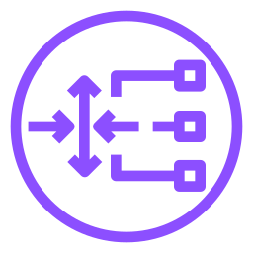
Distributed inspection with Gateway Load Balancer
AWS Cloud
Region
Application VPC 10.0.0.0/16
Security VPC 10.1.0.0/16
Availability Zone 1
Availability Zone 1
GWLBe subnet
App subnet
Appliance subnet
ASG
4
GWLBe
EC2
방화벽
HTTPS :443
1
2
3
GENEVE :6081
Users
IGW
GWLB
Availability Zone 2
Availability Zone 2
GWLBe subnet
App subnet
Appliance subnet
4
GWLBe
EC2
방화벽
① IGW → GWLBe (인그레스 라우팅) ② GWLBe ⇄ GWLB ③ GWLB ⇄ 방화벽 (검사 후 GWLB → GWLBe로 반환) ④ GWLBe → EC2
라우팅 (같은 AZ): IGW 엣지 RT 10.0.1.0/24 (AZ1 App) · 10.0.2.0/24 (AZ2 App) → GWLBe · App RT 0.0.0.0/0 → GWLBe · GWLBe RT 0.0.0.0/0 → IGW

Slide 4







Transit Gateway hub and spoke across two Regions
AWS Cloud
Region ap-northeast-2
Region ap-northeast-1
Services VPC
Prod VPC
DR VPC
10.1.0.0/16
10.2.0.0/16
10.16.0.0/16
On-premises
IPsec
Customer gateway
Internet
Site-to-Site VPN
Transit Gateway A
TGW peering
Transit Gateway B
192.168.0.0/16
AWS 백본
Dev VPC
Test VPC
Analytics VPC
10.3.0.0/16
10.4.0.0/16
10.17.0.0/16
Hub & spoke: VPC·VPN은 리전 TGW에 attachment로 연결 · VPC CIDR과 VPN(BGP) 경로는 TGW 라우팅 테이블에 전파
라우팅: VPC 서브넷 10.0.0.0/8 · 192.168.0.0/16 → TGW · TGW A 10.16.0.0/13 → peering · TGW B 10.0.0.0/13 · 192.168.0.0/16 → peering (정적 경로)

Slide 5
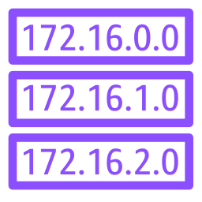


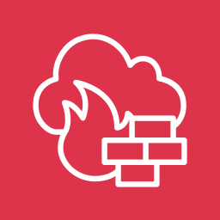
Centralized inspection with AWS Network Firewall
AWS Cloud
Region ap-northeast-2
Inspection VPC 100.64.0.0/16
VPC A 10.1.0.0/16
Availability Zone 1
App subnet
TGW subnet
Firewall subnet
Public subnet
3
4
5
EC2
Firewall RT
TGW ENI
Firewall endpoint
NAT gateway
VPC A · B 전파
1
2
TGW
AWS Network Firewall
IGW
Internet
VPC B 10.2.0.0/16
Availability Zone 2
App subnet
TGW subnet
Firewall subnet
Public subnet
EC2
Spoke RT
TGW ENI
Firewall endpoint
NAT gateway
0.0.0.0/0 → 검사 VPC
① VPC → TGW ② Spoke RT 0.0.0.0/0 → 검사 VPC (appliance mode) ③ 같은 AZ 방화벽에서 검사 (VPC 간은 TGW로 반환) ④ 방화벽 → NAT (인터넷행) ⑤ NAT → IGW
라우팅(같은 AZ): App 0.0.0.0/0 → TGW · TGW 서브넷 0.0.0.0/0 → 방화벽 · 방화벽 서브넷 0.0.0.0/0 → NAT, 10.0.0.0/8 → TGW · 퍼블릭 0.0.0.0/0 → IGW, 10.0.0.0/8 → 방화벽

