Slide 1












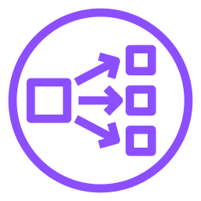


Internet-facing NLB
AWS Cloud
Region
VPC
10.0.0.0/16
Availability Zone 1
Public subnet
App subnet
ASG · target group
DNS 조회
아웃바운드
Route 53
NAT gateway
EC2
EC2
ACM
Alias → NLB
TLS 리스너 인증서
TLS :443
TCP :8080
Users
IGW
NLB
CloudWatch
Availability Zone 2
지표 · 경보
Public subnet
App subnet
아웃바운드
NAT gateway
EC2
EC2
S3
NLB 액세스 로그

Slide 2



3-tier web app with ALB, AWS WAF and RDS Multi-AZ
AWS Cloud
DNS 조회
Region
VPC
Route 53
10.0.0.0/16
alias → ALB
Availability Zone 1
ACM
Public subnet
App subnet
DB subnet
인증서
ASG · target group
아웃바운드
SQL
NAT gateway
EC2
EC2
RDS Primary
AWS WAF
Web ACL
HTTPS :443
HTTP :80
동기식 복제
Users
IGW
ALB
CloudWatch
Availability Zone 2
지표 · 경보
Public subnet
App subnet
DB subnet
아웃바운드
NAT gateway
EC2
EC2
RDS Standby
S3
액세스 로그

Slide 3

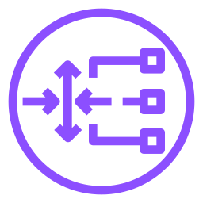
Distributed inspection with Gateway Load Balancer
AWS Cloud
Region
Application VPC
Security VPC
10.0.0.0/16
10.1.0.0/16
Availability Zone 1
Availability Zone 1
GWLBe subnet
App subnet
Appliance subnet
ASG
4
GWLBe
EC2
방화벽
HTTPS :443
1
2
3
GENEVE :6081
Users
IGW
GWLB
Availability Zone 2
Availability Zone 2
GWLBe subnet
App subnet
Appliance subnet
4
GWLBe
EC2
방화벽
1
IGW → GWLBe (인그레스 라우팅)
2
GWLBe ⇄ GWLB
3
GWLB ⇄ 방화벽 (검사 후 GWLB → GWLBe로 반환)
4
GWLBe → EC2

Slide 4







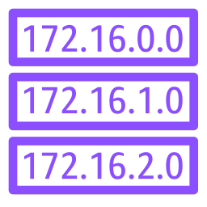
Transit Gateway hub and spoke across two Regions
AWS Cloud
Region ap-northeast-2
Region ap-northeast-1
Services VPC
Prod VPC
DR VPC
Analytics VPC
10.1.0.0/16
10.2.0.0/16
10.16.0.0/16
10.17.0.0/16
VPC attachment
4
On-premises
1
IPsec
2
3
VPN attachment
Customer gateway
Internet
Site-to-Site VPN
Transit Gateway A
TGW peering
Transit Gateway B
192.168.0.0/16
peering attachment
Dev VPC
TGW A RT
Test VPC
TGW B RT
10.3.0.0/16
VPC·VPN 경로 전파
10.4.0.0/16
VPC 경로 전파
10.16.0.0/13 → peering
10.0.0.0/13 · 192.168.0.0/16
→ peering
1
CGW → VPN (IPsec, BGP)
2
VPN → TGW A
3
TGW A → TGW B (정적 경로)
4
TGW B → DR VPC

Slide 5



Centralized inspection with AWS Network Firewall
AWS Cloud
Region ap-northeast-2
Inspection VPC
VPC A
100.64.0.0/16
10.1.0.0/16
Availability Zone 1
Subnet
TGW subnet
Firewall subnet
Public subnet
1
2
3
4
5
VPC attachment
EC2
TGW ENI
Firewall endpoint
NAT gateway
Spoke RT
TGW
Firewall RT
AWS Network Firewall
IGW
Internet
VPC B
VPC A · B 전파
10.2.0.0/16
Availability Zone 2
Subnet
TGW subnet
Firewall subnet
Public subnet
EC2
TGW ENI
Firewall endpoint
NAT gateway
1
VPC → TGW
2
Spoke RT 0.0.0.0/0 → 검사 VPC (appliance mode)
3
같은 AZ 방화벽에서 검사 (VPC 간은 TGW로 반환)
4
방화벽 → NAT (인터넷행)
5
NAT → IGW

