Slide 1

Case Study
Predicting the number of hits
Author: Najib AGHENDA
Application: Data Scientist SEM Bidding

Slide 2
Summary
Problem
Observations
Regression Analysis
Validation
Deliverables
Future Work

Slide 3
1.
Problem

Slide 4
Predicting session hits
We want to predict the number of hits per session
Data set: ~ 1 million entries
Features: row_num, locale, hour_of_day, day_of_week, agent_id, path_id_set, traffic_type, session_duration, hits
Evaluation metric: Root Mean Squared Error (RMSE)
Task: Predicting session hits

Slide 5
2.
Observations

Slide 6
Missing values
Values are missing for the following features
Session duration
~ 0.07% of total values missing
Path id set
~ 0.50% of total values missing
Hits
~ 37.5% of total values missing

Slide 7
Observations and actions
I identified patterns in the missing values :
Session duration
98% of the missing values concern entry page 8101 and traffic type 1
I decided to do a median imputation (after outliers removal)
Path id set
~ 0.50% of total values missing
Too complex for an imputation strategy
I decided to drop these rows
Hits
~ 37.5% of total values missing
Train/test split of the data based on missing hits

Slide 8
Outliers detection
Outliers detected in session duration and hits.
3 outliers detection methods were used :
Z-Score
Modified Z-Score
Isolation Forest
Given that Z-Score had the lowest proportion of outliers (0.68% for session duration and 1.43% for hits), I decided to use this approach and remove to detect and remove the outliers.

Slide 9
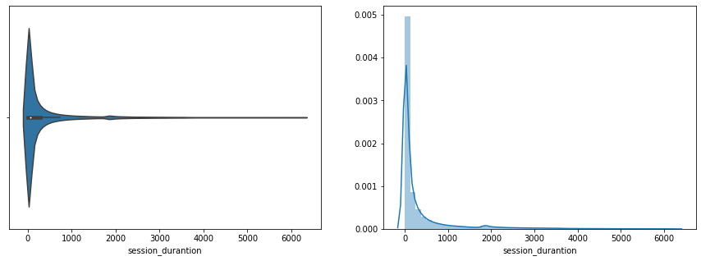
Data distribution
The data distribution for the session duration (see figure) and hits attributes is right-skewed. Therefore, I decided to apply multiple transformation to reduce the skewness

Slide 10
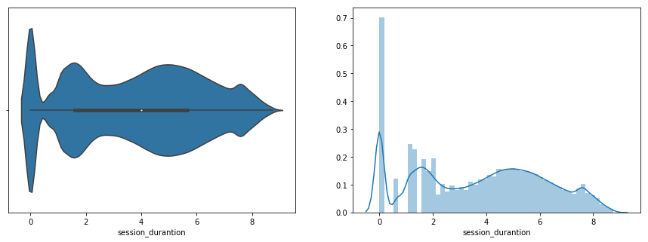
Data distribution
With the use of a log transformation we manage to have a distribution of the data that is less skewed.

Slide 11
3.
Regression Analysis

Slide 12
Models
We used 4 types of regressor algorithms :
Linear Regression
Decision Tree
Random Forest
XGBoost

Slide 13
4.
Validation

Slide 14
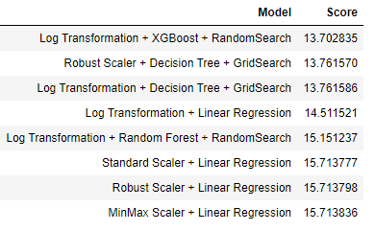
Evaluation
Root mean squared error was used for the evaluation :
We obtain the best results with Log Transformation and XGBoost.

Slide 15
5.
Deliverables

Slide 16
Deliverables
The following results
A jupyter notebook
A CSV file containing the predictions
Can be found at the github address :
https://github.com/confused-pandas/trivago-case-study

Slide 17
6.
Future Work

Slide 18
With more time...
Reducing dimensionality using MCA
Using a grid search instead of a random search
Testing other regressions such as Elastic Net and LASSO.

Slide 19
Thank you !
More information ?
I can be contacted at the following email address :
najib.aghenda@gmail.com

