Slide 1
Web APIs
Unit 04

Slide 2

What is the web browser?

Slide 3
Browsers Access Information on the Web
A web browser, or browser, is a program used to access information on the World Wide Web. Every webpage, image, and video on the web can be accessed via a specific Uniform Resource Locator (URL). Browsers use the URL to retrieve resources from a web server and display them on a user's device.

Slide 4
What is an API?

Slide 5
Application Programming Interface
An API (Application Programming Interface) is a set of methods, properties, events, and URLs that developers use to interact with components of a user's web browser. APIs can also interact with data sets, hardware or software on a user’s computer, and third-party software and services.

Slide 6
What is a Web API?

Slide 7
Web APIs Use JavaScript to Manipulate Webpages
Web APIs are built into the web browser and contain methods that allow us to manipulate a webpage using JavaScript.
We use Web APIs to create elements and add them to the browser or to add and remove styles and attributes—all via JavaScript.

Slide 8
What is the DOM?

Slide 9
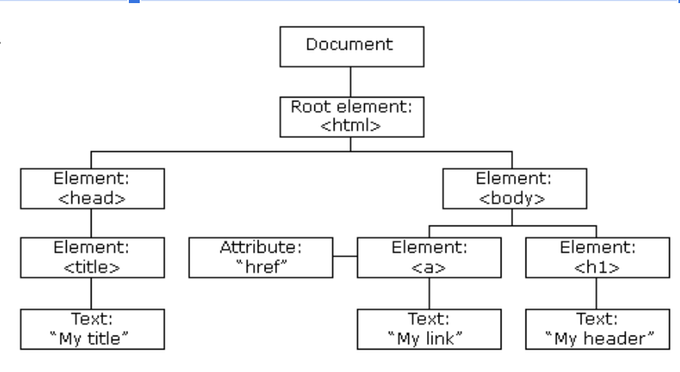
The Document Object Model
When we open a webpage, the browser creates a tree of objects that represent the opened page. That tree of objects is the DOM, or Document Object Model.
Using the DOM, we can manipulate the HTML elements on the page via JavaScript.
Notes:
Note: Sample image

