Slide 1
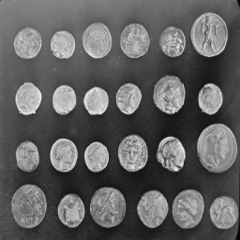
Single-Pixel Imaging
Noisy measurements
and bounded HQS fine-tuning
Zicong Luo 522026230043
Shuhao Yang 502026230083
Yubowen Li 502026230092
Topic 7 / Computational Imaging
01
Notes:
Planned speaking time: 25 seconds.
We compare four reconstruction solvers, complete 10000 total HQS updates and evaluate 30 team-curated Nanjing web photographs. These are externally authored photographs, not team captures. Percentage improvement means reduction in equally weighted mean reconstruction MSE, with first-round HQS as the primary reference. Codex assisted with code, experiments, analysis and writing. Architecture and weights: https://github.com/pwangcs/ProxUnroll.

Slide 2
The measurement model
Y = H X W^T + E
X: image H, W: known sensing factors E: measurement noise
One integrated measurement per mask
A sequence of masks supplies spatial constraints
Fewer measurements leave more ambiguity
02
Notes:
Planned speaking time: 45 seconds.
Y = H X W^T + E simulates integrated single-pixel measurements from existing grayscale images. The experiment does not demonstrate optical acquisition. Source: Duarte et al., doi:10.1109/MSP.2007.914730.

Slide 3
Explicit sparsity and a learned prior
DCT-FISTA
ProxUnroll
Explicit transform penalty
200 optimization iterations
Validation-selected regularization
No network training
Official HQS and ADMM
Six shared-weight stages
Common sensing operator
Noise-aware HQS fine-tuning
Main comparison: identical images, sensing factors, measurements, and noise
03
Notes:
Planned speaking time: 45 seconds.
All four initial solvers use the same matrices and measured values. New and previous HQS variants also share the common MAT operator. DCT-FISTA lambda is fixed from the original separate validation experiment. Sources: Beck and Teboulle, doi:10.1137/080716542; Wang et al., arXiv:2505.23180.

Slide 4
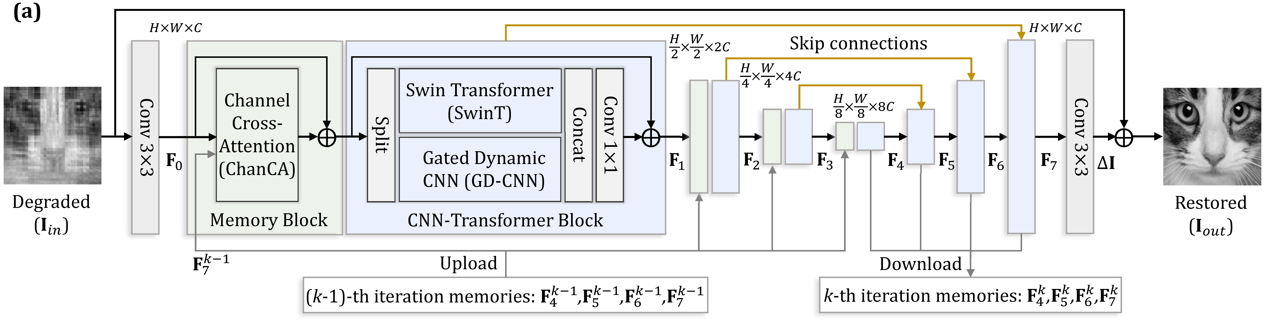
The shared image restorer
Convolution and attention restore the image at multiple scales
Shared weights and feature memory link the six stages
04
Notes:
Planned speaking time: 50 seconds.
The supplied restorer uses convolution, window attention and memory between optimization stages within one image. It does not connect video frames. Source diagram and architecture: https://github.com/pwangcs/ProxUnroll.

Slide 5
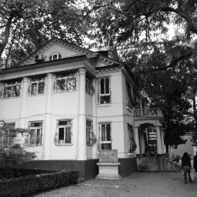
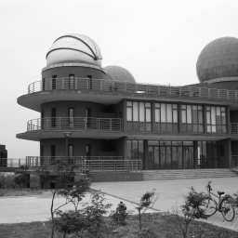
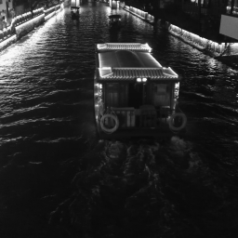
Nanjing campus and scenic web photographs
18 campus photos + 12 scenic photos
Fixed list; test only; 256 × 256 grayscale
NJU Gulou
NJU Xianlin
Qinhuai night
Team-curated web images; original authors credited
05
Notes:
Planned speaking time: 50 seconds.
30 location-selected photographs, locked before inference and used only for testing. 18 campus photographs: Gulou and Xianlin, 9 each. 12 scenic photographs: Xuanwu Lake, Sun Yat-sen Mausoleum, Ming Xiaoling and Qinhuai/Fuzimiao, 3 each. These are externally authored web photographs collected by our team, not our own captures. Full-size PNG transcodes via wsrv.nl precede center-square Y grayscale / area resize to 256 x 256. Hashes and dimensions are recorded. This convenience collection contains related sites and repeated photographers.
Zhongshan Building in Nanjing University Gulou Campus 01 2012-11.JPG; 猫猫的日记本; CC BY-SA 3.0; source https://commons.wikimedia.org/wiki/File:Zhongshan_Building_in_Nanjing_University_Gulou_Campus_01_2012-11.JPG; license https://creativecommons.org/licenses/by-sa/3.0/. Adapted by gray center crop, area resize, and (where applicable) reconstruction. Full credits: runs/nanjing_web30_20261009/ATTRIBUTION.md.
南大仙林天文台.jpg; panoramio用户KrUDSO4†www.panoramio.com; CC BY-SA 3.0; source https://commons.wikimedia.org/wiki/File:%E5%8D%97%E5%A4%A7%E4%BB%99%E6%9E%97%E5%A4%A9%E6%96%87%E5%8F%B0.jpg; license https://creativecommons.org/licenses/by-sa/3.0/. Adapted by gray center crop, area resize, and (where applicable) reconstruction. Full credits: runs/nanjing_web30_20261009/ATTRIBUTION.md.
Night View of Qinhuai River with Scenic Cruise in Fuzi Miao 20170519.jpg; 4084470 0.smil; CC BY 4.0; source https://commons.wikimedia.org/wiki/File:Night_View_of_Qinhuai_River_with_Scenic_Cruise_in_Fuzi_Miao_20170519.jpg; license https://creativecommons.org/licenses/by/4.0/. Adapted by gray center crop, area resize, and (where applicable) reconstruction. Full credits: runs/nanjing_web30_20261009/ATTRIBUTION.md.

Slide 6
Four-method reconstruction on campus scenes
Every source photograph contributes equally
06
Notes:
Planned speaking time: 60 seconds.
All 18 campus originals, every clean ratio. Four methods share the same common MAT sensing operator and the exact same measurements. No favorable photographs are removed. DCT-FISTA uses the frozen original validation lambda and 200 iterations. Both campus and scenic subset tables remain in the six-page report and comparison/dataset_summary.csv.

Slide 7
Completed HQS fine-tuning
Sensing factors frozen; reconstruction parameters trained
800 training originals / 16 selection originals
Full-state continuation preserves the update rule
10000 total round-2 updates; selected 10000
5000 → 10000: 125.2 min
All round-2 phases: 247.0 min
Peak allocated memory: 10.84 GiB
07
Notes:
Planned speaking time: 50 seconds.
800 DIV2K training originals and 16 separate selection originals. First 100-step fine-tuning uses official weights. Round 2 initializes its selected weights with a new Adam optimizer; later continuation restores all optimizer, scheduler, RNG and step states. All six sensing factors stay frozen. Direct GT RMSE weights .01 for five intermediate outputs and .95 for final; noise choices 0,0,.01,.05. Data, objective and noise changes are not separately attributed. The same round-2 rule continues from 5000 to 10000 total updates within a 150-minute continuation budget. Exit code 0, actual checkpoint and training audit establish completion. Source: https://data.vision.ee.ethz.ch/cvl/DIV2K/.

Slide 8
Validation-only checkpoint selection
No test photograph chooses the checkpoint
08
Notes:
Planned speaking time: 60 seconds.
16 selection originals at sampling 10%/25% and noise 0/.01/.05. Mixed PSNR chooses the eligible best checkpoint, with clean PSNR at least initialization minus .03 dB. Initialization remains a candidate. The 5000-budget checkpoint selected step 4500; continuation selected step 10000. New photographs and their reconstruction scores are not used in selection. Full trace: runs/lab244_10000_20261009/finetune/validation.csv.

Slide 9
Clean 10% reconstruction error changes
Requested target: 5–10% less MSE than the 100-step model
09
Notes:
Planned speaking time: 60 seconds.
Ratio of equal-photograph mean MSE: 1 - mean candidate MSE / mean reference MSE. Candidate is the validation-selected 10000-step state. Official and 100-step references concern overall fine-tuning changes. The 5000-budget reference is the selected step-4500 state under the same round-2 rule. Noise repetitions are averaged inside each original. These related-site web samples support descriptive conclusions, not population confidence claims. All sources and preprocessing were locked before inference.

Slide 10
Measurement noise and reconstruction error
Positive: less error Negative: more error
10
Notes:
Planned speaking time: 60 seconds.
All clean/.01/.05 measurement noise levels at 10% sampling, compared with the 100-step HQS checkpoint. The same measurement values reach every method. All three predeclared seeds are averaged per photo; all six locations and every negative case remain in CSV. Strong-noise improvements do not imply equal gains for clean acquisition.

Slide 11
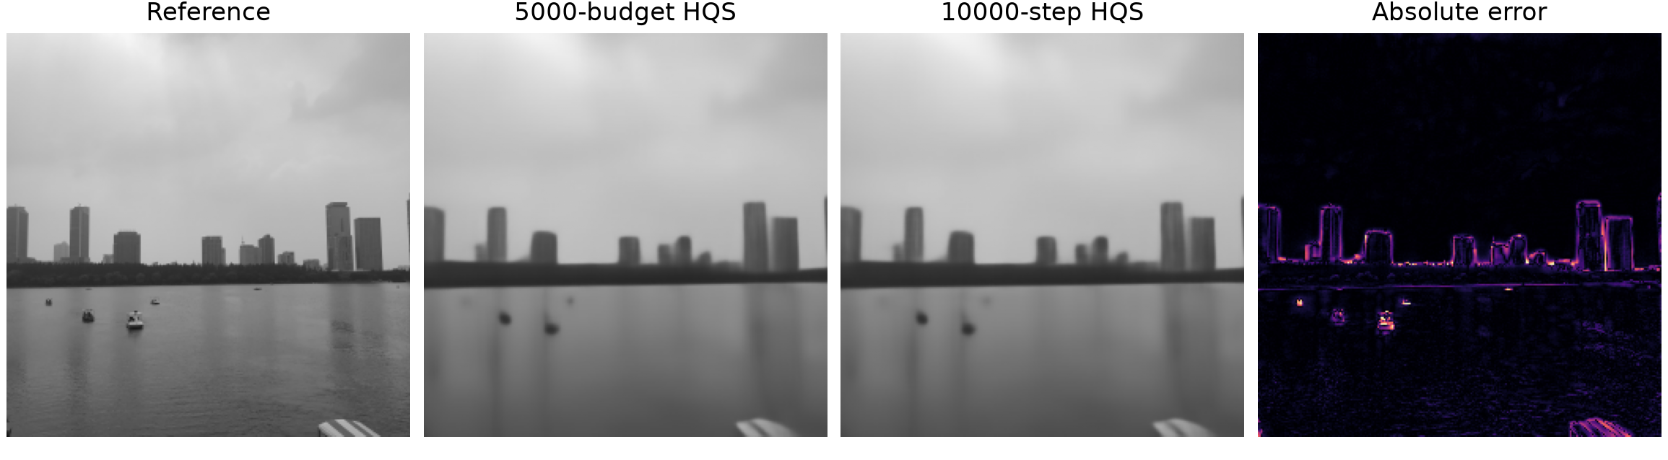
Case that worsens with continued training
MSE reduction vs 5000-budget model: -10.70%
Sampling 1%; noise 0
Skyline region MSE rises 14.02%; training cause unproven
11
Notes:
Planned speaking time: 50 seconds.
Smallest first-seed MSE reduction relative to the 5000-budget state. Photo web_xuanwu_lake_03, sampling 0.01, noise 0.0. Chosen after testing for diagnosis, not for model selection. Xuanwu Lake: small boats, building boundaries and water ripples blur under 1% clean measurements. Diagnostic skyline rows 106-161 raise MSE 14.02%, versus sky 8.72% and water 5.27%. Those bands are selected after test for diagnosis. Smoothing unsupported fine detail is a plausible prior effect, not an isolated training cause. All negative cases retained. 玄武湖13.jpg; 西安兵马俑; CC BY-SA 4.0; source https://commons.wikimedia.org/wiki/File:%E7%8E%84%E6%AD%A6%E6%B9%9613.jpg; license https://creativecommons.org/licenses/by-sa/4.0/. Adapted by gray center crop, area resize, and (where applicable) reconstruction. Full credits: runs/nanjing_web30_20261009/ATTRIBUTION.md.

Slide 12
Results and remaining course work
Clean MSE reduction vs 100-step HQS
Campus: 1.73% Scenic: 1.91%
Retain weak results and every negative case
Web collection adds scene tests; self-capture remains optional
Next: timed rehearsal and the locked DIV2K52 comparison
AI disclosure: Codex assisted with code, experiments and writing
Architecture and official weights: Wang et al., CVPR 2025
12
Notes:
Planned speaking time: 45 seconds.
The collection is external-author web photography curated by the team, not self-captured data. One training seed, related scenes and unknown official-pretraining exposure limit generalization. The earlier 32-image DIV2K clean result was 1.84% improvement for the 5000-budget model; it remains preserved. 52 locked DIV2K holdout originals still await evaluation of the 10000-step model. No more training is selected from these test results. Six-page technical report, three-page literature review and this 12-slide deck are available. Timed rehearsal, student understanding and course registration/submission require the students. Codex assisted with code, execution, analysis, writing and slides. Architecture: Wang et al., CVPR 2025.

