Slide 1
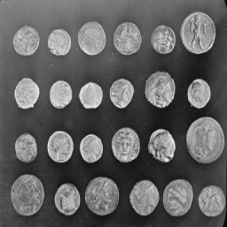
Single-Pixel Imaging
External evaluation
and fixed-operator fine-tuning
Zicong Luo 522026230043
Shuhao Yang 502026230083
Yubowen Li 502026230092
Topic 7 / Computational Imaging
01
Notes:
Planned speaking time: 25 seconds.
We compare four solvers on public Kodak24 and spaced frames from eight laboratory-held HEVC videos. We fine-tune official HQS for 100 bounded steps. Raw measurements and all test deltas are retained. Codex assisted with code, experiments, analysis and writing. Model source: https://github.com/pwangcs/ProxUnroll.

Slide 2
The measurement model
Y = H X W^T + E
X: image H, W: known sensing factors E: measurement noise
One integrated measurement per mask
A sequence of masks supplies spatial constraints
Fewer measurements leave more ambiguity
02
Notes:
Planned speaking time: 45 seconds.
Y = H X W^T + E is a simulation from an existing grayscale image. A detector obtains one integrated response per pattern. Multiple patterns constrain the inverse problem. Reference: Duarte et al., doi:10.1109/MSP.2007.914730.

Slide 3
Explicit sparsity and a learned prior
DCT-FISTA
ProxUnroll
Explicit transform penalty
200 optimization iterations
Validation-selected regularization
No network training
Official HQS and ADMM
Six shared-weight stages
Measurement consistency updates
Fixed-operator HQS fine-tuning
Main comparison: identical images, sensing factors, measurements, and noise
03
Notes:
Planned speaking time: 45 seconds.
Adjoint, DCT-FISTA, official HQS and official ADMM share the same measurements. The HQS fine-tuned variant also uses the same fixed MAT operator. DCT regularization comes from the original disjoint validation study. References: Beck and Teboulle, doi:10.1137/080716542; Wang et al., arXiv:2505.23180.

Slide 4
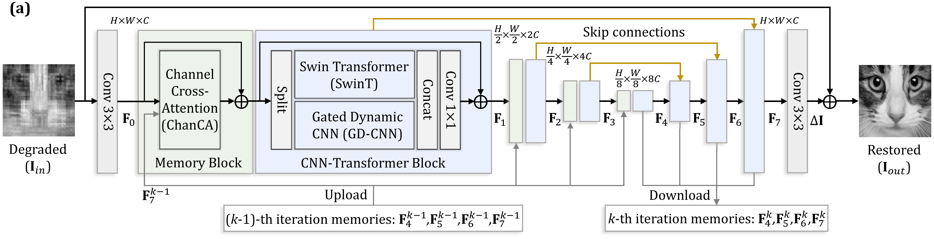
The shared image restorer
Convolution and attention restore the image at multiple scales
Shared weights and feature memory link the six stages
04
Notes:
Planned speaking time: 50 seconds.
This architecture comes from the released ProxUnroll work. Stage memory joins adjacent optimization stages within a single image. It does not join video frames. Source image and architecture: https://github.com/pwangcs/ProxUnroll.

Slide 5
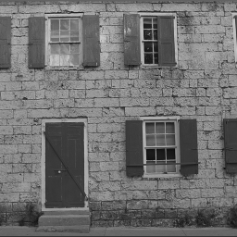
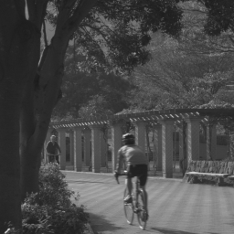
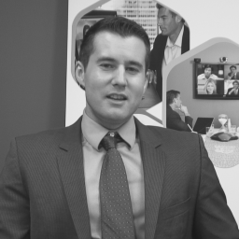
External evaluation protocol
24 Kodak images
24 raw frames from 8 HEVC videos
Center-square crop, then 256 × 256 grayscale
5 clean rates and 2 noise levels with 3 seeds
Equal video weights within each HEVC class
05
Notes:
Planned speaking time: 50 seconds.
24 Kodak images and three zero-based spaced frames from each of five HEVC B and three HEVC E sequences. The rule is 0, floor(N/3), floor(2N/3), using actual stored lengths. BQTerrace has 601 frames and BasketballDrive 501. We use original raw Y planes, maximal center-square cropping and area resize. Raw Y codes are divided by 255 without range expansion. All are public or laboratory-held data. Sources and SHA-256 are in data/test.json.

Slide 6
Kodak reconstruction across sampling rates
06
Notes:
Planned speaking time: 60 seconds.
Clean Kodak means over 24 original images. All solvers use the common MAT operator. Nominal 50% caps at 181 × 181 measurements or 49.9893%. Full CSV and independently recomputed float-array metrics: baseline/metrics.csv and baseline/verification.json.

Slide 7
Results by dataset at 10% sampling
HEVC B: 5 videos HEVC E: 3 videos
07
Notes:
Planned speaking time: 50 seconds.
Kodak treats each original image as one unit. HEVC B and E first average three frames within each video, then average videos equally. There are five B and three E independent videos. All video results remain in baseline/video_summary.csv. Neural timings use CUDA and DCT-FISTA uses CPU, so timing is not a hardware-matched comparison.

Slide 8
Bounded HQS fine-tuning
128 DIV2K training originals
16 separate validation originals
Kodak and HEVC reserved for test
All sensing factors frozen
Six-stage reconstruction parameters updated
100 total steps Continued run: 2.9 min
Peak allocated memory: 10.85 GiB
08
Notes:
Planned speaking time: 50 seconds.
128 seeded DIV2K training originals and 16 disjoint DIV2K validation originals. Kodak and whole HEVC videos are untouched by this new training and selection. Original pretraining exposure is not fully audited. All six sensing factors are frozen. Training uses the upstream proximal trajectory weighted RMSE and a fixed 5e-6 Adam learning rate. Full optimizer, scheduler, RNG and step state are saved separately from selected best weights. DIV2K source: https://data.vision.ee.ethz.ch/cvl/DIV2K/.

Slide 9
Validation selects the checkpoint
Selected step: 100
09
Notes:
Planned speaking time: 60 seconds.
Validation averages 16 originals at clean 10% and 25% rates. Model selection never reads test images. Best step: 100. Bounded training stops at the recorded step/time limit. Full trace: finetune/validation.csv. The short run measured 1.82 seconds per step. Resume verification is recorded separately.

Slide 10
Test change after HQS fine-tuning
Strong-noise HEVC B/E change: -0.03 / -0.04 dB
10
Notes:
Planned speaking time: 60 seconds.
Selected checkpoint minus original HQS under shared measurements. Both 10% and 25% clean rates are reported. Noise results, last-checkpoint results and every image delta are preserved in comparison/paired_comparison.json. Bootstrap uses original Kodak images or whole HEVC videos. A single training seed and few videos limit inference. Positive validation change alone is insufficient evidence of test gain.

Slide 11
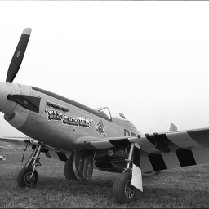


A difficult held-out test case
Reference
Original HQS
Fine-tuned HQS
kodim20 10% sampling Noise 0.05 Change -0.248 dB
11
Notes:
Planned speaking time: 55 seconds.
Outcome-based diagnostic only. This image has the smallest selected-model minus original change among the preselected first-seed conditions across all test images. It was not used for selecting the checkpoint or changing the training recipe. Image: kodim20. Sampling: 10%. Noise RMS: 0.05. Delta PSNR: -0.2477 dB. Every positive and negative delta is preserved. Figure source: retained raw test reconstructions.

Slide 12
Conclusions and limits
Clean-test PSNR gains: 0.14-0.37 dB at 10% sampling
Strong-noise HEVC PSNR decreases slightly
Raw results include failures and recovery checkpoints
Limits: one training seed and a small DIV2K subset
Center cropping changes the benchmark task
HEVC frames use single-image reconstruction
AI disclosure: Codex assisted with implementation, experiments, analysis and writing
Architecture and official weights: Wang et al., CVPR 2025
12
Notes:
Planned speaking time: 50 seconds.
We completed remote sync, larger paired evaluation and bounded fixed-operator HQS fine-tuning. Test changes are conditional on this crop/resizing rule and common operator. Original pretraining exposure is not fully audited. One training seed does not establish a general fine-tuning benefit. HEVC frames are independent images, with no previous/future-frame input. No optical camera, full-color system or course-platform submission is claimed. Codex assisted with code, execution, analysis, writing and presentation. Architecture and weights: Wang et al., CVPR 2025, https://github.com/pwangcs/ProxUnroll.

