Slide 1
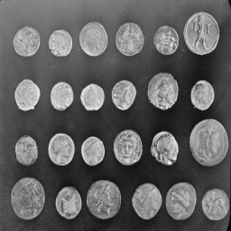
Single-Pixel Imaging
Sparse recovery and proximal unrolling
Zicong Luo 522026230043
Shuhao Yang 502026230083
Yubowen Li 502026230092
Topic 7 / Computational Imaging
01
Notes:
Planned speaking time: 25 seconds.
We study reconstruction when only a fraction of image measurements is available. Our course project pairs the classic compressed-sensing formulation with the released ProxUnroll networks. This is a reproducible software evaluation using pretrained models. It includes controlled comparisons and deliberately difficult inputs. The report and code disclose AI assistance and retain the original model attribution.

Slide 2
The measurement model
Y = H X W^T + E
X: image H, W: known sensing factors E: measurement noise
One integrated measurement per mask
A sequence of masks supplies spatial constraints
Fewer measurements leave more ambiguity
02
Notes:
Planned speaking time: 45 seconds.
A single detector produces one scalar for each spatial mask. An image requires a sequence of masks, so single pixel does not mean one observation. In our simulation, separable factors implement the masks efficiently. The adjoint maps measurements back to image space but cannot determine the unobserved component. A reconstruction prior resolves some of this ambiguity. We simulate this arithmetic and do not claim an optical prototype. Source: Duarte et al., https://doi.org/10.1109/MSP.2007.914730.

Slide 3
Explicit sparsity and a learned prior
DCT-FISTA
ProxUnroll
Explicit transform penalty
200 optimization iterations
Validation-selected regularization
No network training
Released pretrained restorer
Six shared-weight stages
Measurement consistency updates
HQS and ADMM variants
Main comparison: identical images, sensing factors, measurements, and noise
03
Notes:
Planned speaking time: 45 seconds.
Our classical comparator minimizes squared measurement error plus an L1 penalty on an orthonormal DCT representation. FISTA combines a gradient step, transform-domain thresholding, and momentum. Its regularization weight is chosen only on validation images. The modern comparator replaces the hand-designed shrinkage step with a learned image restorer. Both use the same measurement residual in the main experiment. This comparison is not the exact reconstruction implementation of the 2008 paper. Sources: Beck and Teboulle, https://doi.org/10.1137/080716542; Wang et al., https://arxiv.org/abs/2505.23180.

Slide 4
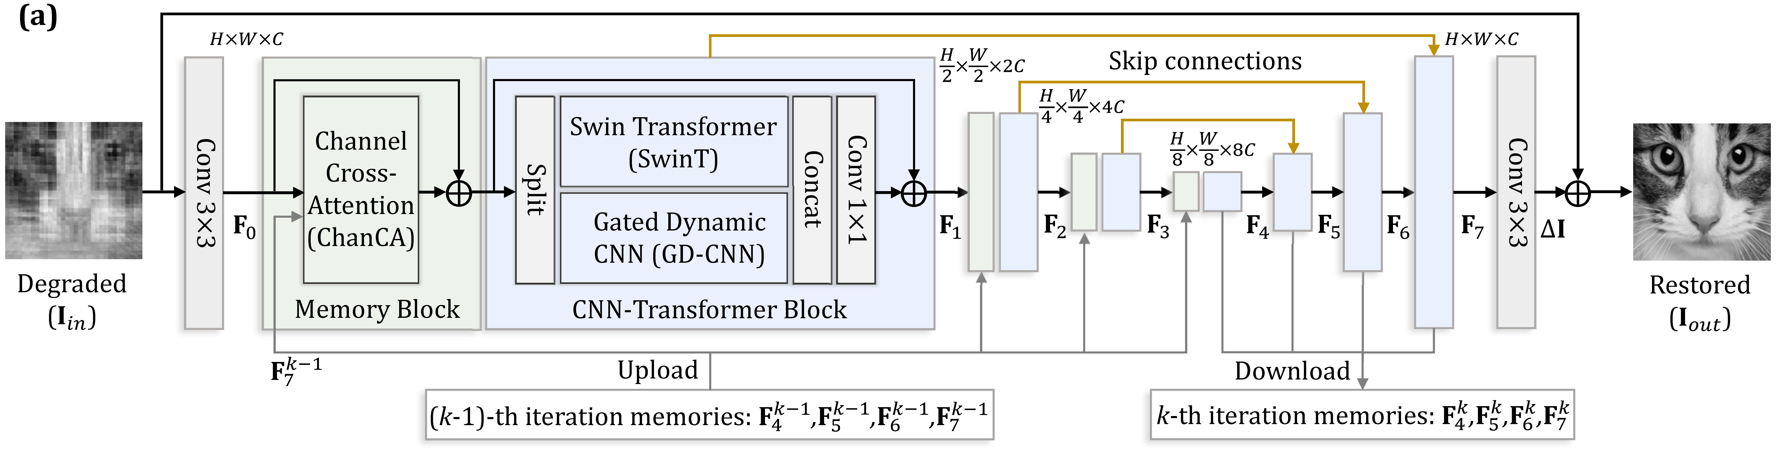
The shared image restorer
Convolution and attention restore the image at multiple scales
Shared weights and feature memory link the six stages
04
Notes:
Planned speaking time: 55 seconds.
The released restorer has an encoder-decoder structure combining convolution and window attention. Feature memory passes information between stages. HQS applies a data-consistency correction and then the restorer. ADMM also updates a dual state that records the split-variable disagreement. The pretrained weights remain fixed in our experiments. The training-time target uses the clean image, but our reconstruction interface receives measurements only. We test equality with the original clean forward path. Figure from the official ProxUnroll repository, fig/network.png, https://github.com/pwangcs/ProxUnroll.

Slide 5
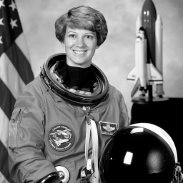
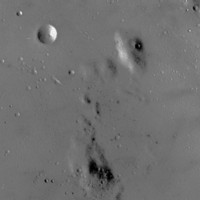
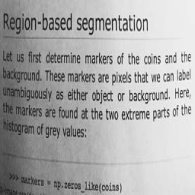
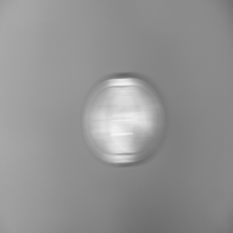
Evaluation design
6 evaluation images + 2 validation images
2 stress targets, reported separately
5 clean rates: 1%, 4%, 10%, 25%, 50%
2 noise levels at 10%, each with 3 seeds
Common MAT-file operator for the main comparison
05
Notes:
Planned speaking time: 45 seconds.
We use six regular evaluation images and two independent validation images, all resized to 256 by 256 grayscale. Two procedural stress targets test periodic detail and small text. The clean experiment sweeps five sampling ratios. At ten percent sampling, two Gaussian noise levels each use three seeded realizations. We found that the checkpoints contain different sensing factors. The main comparison therefore supplies the same factors from the released MAT file to both networks, and separate diagnostics retain each native operator. The study includes operator transfer and is not an official Set11 or CBSD68 benchmark. Data source: https://scikit-image.org/docs/stable/api/skimage.data.html.

Slide 6
Reconstruction quality across rates
06
Notes:
Planned speaking time: 55 seconds.
The chart shows mean PSNR on the same six evaluation images. The horizontal labels are nominal sampling ratios. The raw files record realized ratios after rounding and the stored-matrix row limit. Nominal 50% uses 49.9893%. HQS minus DCT-FISTA at ten percent is 5.21 dB on average. These values describe this small image suite and this common operator. They do not establish superiority over all classical algorithms. Source: coursework/results/summary.csv; measurements generated by coursework/run_experiments.py.

Slide 7
Local reconstruction time
CPU evaluation at 256 x 256; 4 threads; excludes acquisition
07
Notes:
Planned speaking time: 35 seconds.
The chart uses median reconstruction time at nominal ten percent. All methods run locally, and this run uses cpu. Timing excludes measurement generation and data transfer. Neural execution follows a full warmup. FISTA includes its spectral-norm calculation. One timed execution is recorded for each input, so these are workflow measurements rather than a dedicated hardware benchmark. The result should not be compared directly with GPU timings in the paper. Source: coursework/results/summary.csv and provenance.json.

Slide 8
Measurement noise sensitivity
08
Notes:
Planned speaking time: 45 seconds.
We perturb the measurements before reconstruction. Noise standard deviation is a fixed fraction of the clean measurement RMS. Every solver receives exactly the same realization. Three seeds reduce dependence on a single random draw, but the six images remain the unit of aggregation. The noise model does not simulate photon counting, detector calibration, motion, or quantization. The chart therefore supports a claim about this perturbation model only. Source: coursework/results/summary.csv.

Slide 9
Stages and feature memory
HQS: 34.31 dB with memory / 30.58 dB without memory
09
Notes:
Planned speaking time: 45 seconds.
We retain the output of every restorer stage. This reveals the finite optimization trajectory instead of looking only at the final image. At ten percent, disabling HQS memory gives 30.58 dB compared with 34.31 dB for the intact checkpoint. This is an inference intervention. A causal architecture ablation would require retraining. Six-stage behavior also cannot prove convergence under infinitely repeated updates. Sources: coursework/results/stages.csv and interventions.csv.

Slide 10
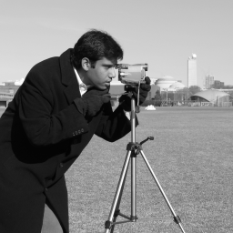



A shared-input visual comparison
Reference
DCT-FISTA
HQS
ADMM
Nominal sampling ratio: 10% Common sensing operator
10
Notes:
Planned speaking time: 55 seconds.
These images use the camera test image at ten percent nominal sampling, with no measurement noise. All methods receive the same data. Compare the edges and local textures, not just the overall silhouette. Images use a fixed display range and come directly from the saved reconstructions. Metrics are computed before export to eight-bit PNG. Source: coursework/data/camera.png and coursework/results/reconstructions/camera_cr0.1_noise0_*.png.

Slide 11


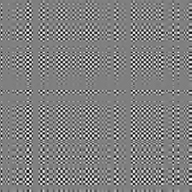
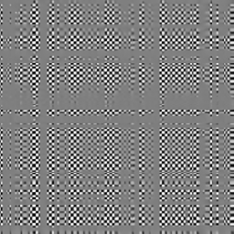
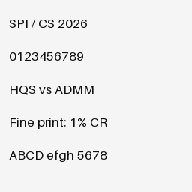

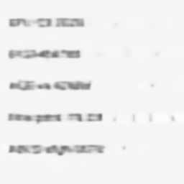
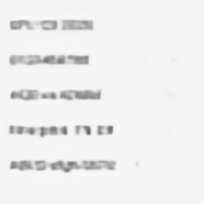
Failure cases: texture and small text
Reference
DCT-FISTA
HQS
ADMM
Top: checkerboard at 10% Bottom: small text at 1%
11
Notes:
Planned speaking time: 90 seconds.
The top row uses a periodic checkerboard at ten percent. The bottom row uses small text at one percent. These targets are generated, not self-collected photographs. Under undersampling, image priors must resolve ambiguity, and the selected structure can be incorrect. Inspect contrast, repeated boundaries, missing strokes, and merged letters. Neither PSNR nor SSIM directly certifies legibility. These examples motivate additional measurements or task-specific validation before relying on fine details. Sources: coursework/data and coursework/results/reconstructions; fixed conditions and unretouched outputs.

Slide 12
Conclusions and limits
Shared measurements make solver comparisons interpretable
Fine detail can fail despite plausible global appearance
Raw results and reproduction commands accompany the reports
Limits: small image suite, common-operator transfer, pretrained models
No optical acquisition, retraining, or full-color reconstruction
AI disclosure: Codex assisted with code, experiments, analysis, and writing.
Architecture and weights: Wang et al., CVPR 2025.
12
Notes:
Planned speaking time: 60 seconds.
The contribution is a reproducible controlled study around the released model, with a classical baseline, parameter validation, noise tests, stage records, and failure cases. The main comparison holds sensing fixed, but that requires transfer away from the checkpoint-native operators. The study has six regular evaluation images, no training-set overlap audit, no retraining, and no optical camera experiment. Our files include raw results and reproduction commands. Codex assisted with code, experiment execution, analysis, English writing, and presentation preparation. The original authors supplied the architecture and weights. The team must understand and review the work before submission.

