Slide 1
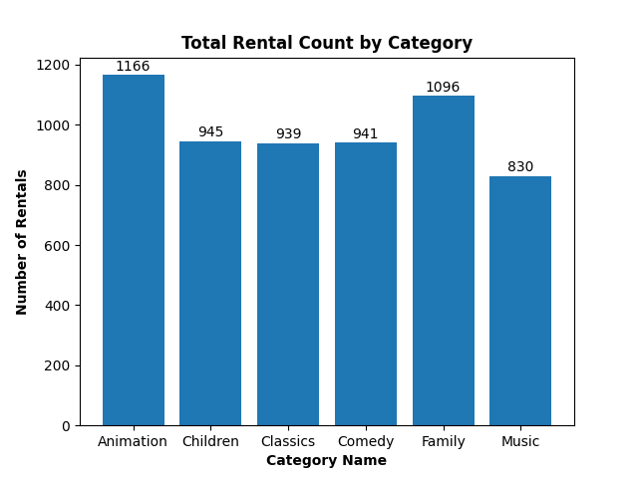
Question 01
The chart illustrates the rental trends for various family movie categories.
The data clearly indicates that the 'Animation' category is the most preferred among families, closely followed by the 'Family' category. There's a similar level of interest in the 'Children,' 'Classics,' and 'Comedy' categories. In contrast, the 'Music' category records the lowest level of rental activity among families.
Ref: set_01/q_01.sql

Slide 2
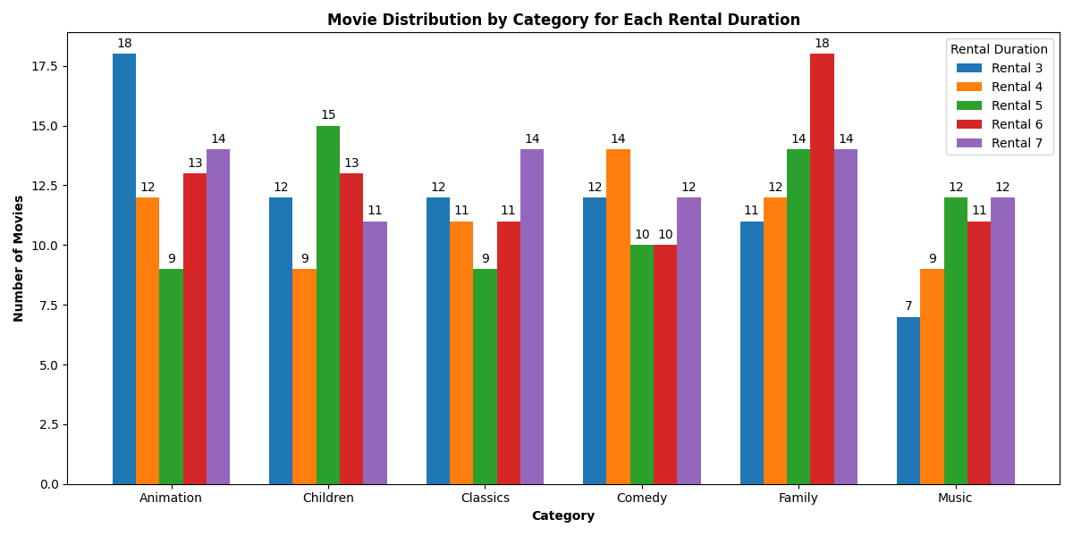
Question 02
The chart displays how movies in each family movie category are distributed across various rental durations.
Notably, the 'Family' category has the highest number of movies rented for 6 days, while the 'Animation' category has the most movies rented for 3 days. This comparison highlights the rental duration differences between 'Family' movies and other categories.
Ref: set_01/q_02.sql

Slide 3
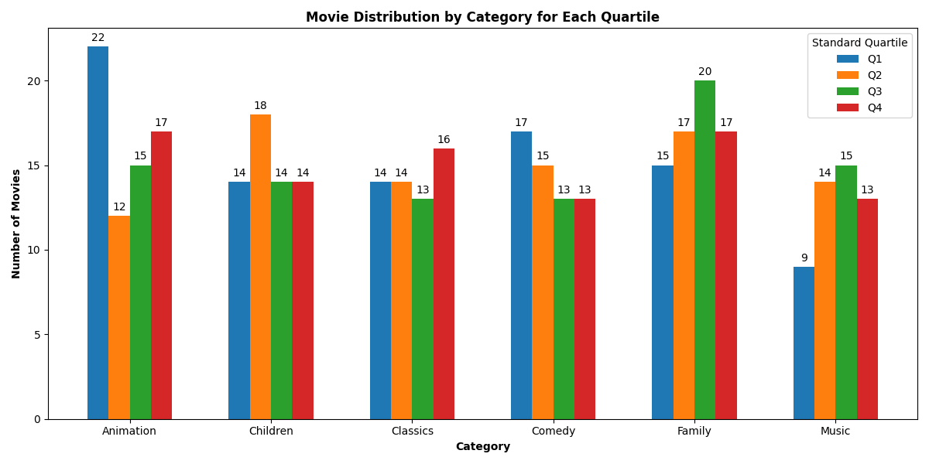
Question 03
This plot illustrates the distribution of movies within each quartile for each family movie category when all movies in the database are sorted by rental duration in ascending order.
For example, if we focus on the 'Animation' category, it's evident that it has the highest number of movies in the first quartile within its own category and compared to other categories. Within the 'Animation' category, there are 17 movies in the fourth quartile, ranking second, followed by the number of movies in the third and fourth quartiles. Similarly, we can make comparisons for other categories.
Ref: set_01/q_03.sql

Slide 4
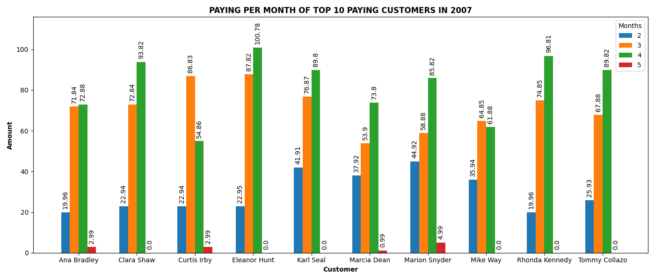
Question 04
The chart illustrates the top 10 paying customers of 2007, arranged alphabetically by their names.
It also displays the respective monthly payments made by these customers in 2007. Notably, Eleanor Hunt stands out as the customer with the highest monthly payment, amounting to $100 in April 2007.
Ref: set_02/q_02.sql

