Slide 1
Getting Past the AI Gatekeeper: Node.js /Javascript vs. Python
Clare Bates Congdon
January 16, 2019

Slide 2
Outline
Overview of Artificial Intelligence (AI)
Example AI application (Energy Grid)
Programming languages often used for AI
What is Node.js and how does it relate to Javascript?
Comparisons

Slide 3
Terminology / positioning
CS >> AI >> ML
ML << Stats << Math

Slide 4
What is ‘Artificial Intelligence’?
Most of CS:
Design and implement a solution to a problem
AI:
We don’t know how to solve the problem
But we know “what a solution looks like”
Search the space of possible solutions
There are too many possibilities to consider them all
Have to be “clever” about where we look

Slide 5
What is ‘Machine Learning’?
AI:
Heuristic search for a solution to the problem
ML:
Build a model, based on experience
Infer regularities in that experience
→ Use experience in a domain to improve our performance

Slide 6
Generalizations and Inference
Our model is a generalization of our previous experience
We use the model to make inferences
When we infer, we are making an informed decision
But sometimes, if we’d seen more data / had more experience, we’d discover that our model is not quite correct.

Slide 7
TensorFlow / Deep Learning
TensorFlow is a form of “neural nets”
An ML approach inspired by human nervous system
“Deep learning” refers to many layers in the learned model
(Some other forms of ML also use the phrase “deep learning”)

Slide 8
Example AI Project: Fractal Energy Grid
Energy Grids of the Future:
Consumer participation and choice
Decentralized control
Two-way energy flows
Increased reliability, security (cyber and physical) and resiliency
(need some illustrations in here)
(maybe another slide or two about this…)

Slide 9
Some Important Facets of this Solution
Decentralized
Fractal architecture
Smart edge devices,
e.g., battery decides to charge when price is low and to discharge when price is high
Use AI and ML to respond well to fluctuations
(needs a bit more here…)

Slide 10
“The official languages” of AI and ML
Python is enormously popular right now
Java
R, LISP, …
But why Python?

Slide 11
Some language considerations
Execution speed,
Development…
Speed, maintenance, environment
Available libraries...
Python has become popular in part because of the wide availability of a large variety of libraries

Slide 12
Node and Javascript
Javascript is one of the most popular programming languages in use today
The backbone of most internet applications
… But it was not ideal for the “server side”
Node.js was originally developed to manage the server side of web applications
Seamless [interface] with “front end” JS

Slide 13
Node.js and Javascript
Execution speed:
Node.js is implemented in C
Development…
Familiar language with “C Family” syntax
Large and growing community produces a wealth of libraries

Slide 14
How is Node.js a benefit to IS projects?
Speed
Node/Javascript designed to connect computers and processes across the internet
we need to communicate across devices
Many libraries available in Node, such as:
Google TensorFlow
…. (other stuff goes here)

Slide 15
Back to the Energy Grid
Different processes/agents
Independently learning, but
Communicating with each other

Slide 17
Take Home
People don’t think about Javascript as a language to use for Artificial Intelligence applications…
…But here’s why it is.

Slide 18
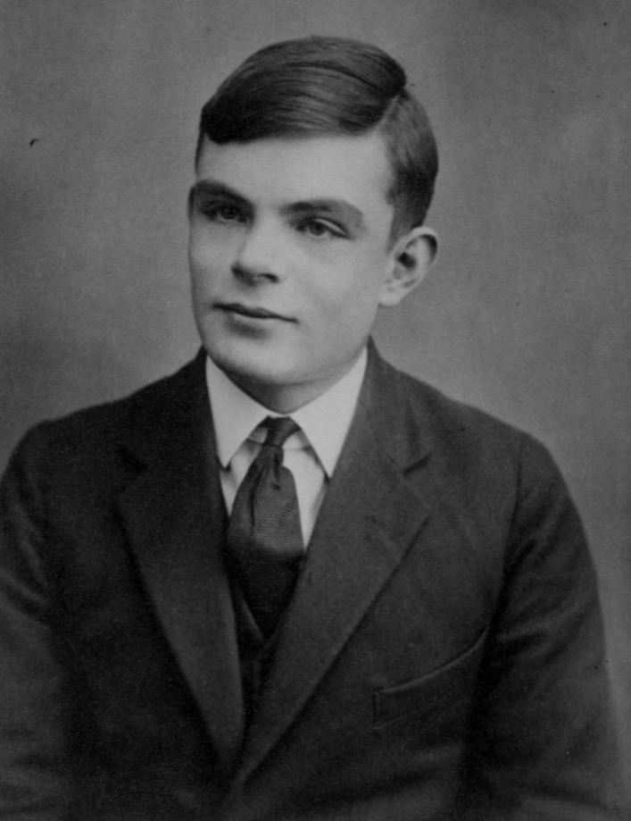
Why is it called “Machine Learning”?
Electronic computers
in the 1940’s
What is a “computer”?
Alan Turing’s genius
Alan Turing, via Wikipedia

Slide 19
AI/ML has more “science” than CS
Studying the system that we created
(Because it’s not a natural system, we have the ability to perturb it)
Do ‘experiments’ to conduct our investigations
Can also involve hypothesis testing

Slide 20
“Building a model”
With ML, we often talk about “building a model”
of our data, of our experience
Goal is largely to create a model of what we’ve seen before – an abstraction
And then be able to use this to make (good) predictions about what will happen in the future

Slide 21


Some characteristics of learning
For both human and machine learning
Learning can be slow
Learning can be error prone
E.g., we make generalizations without enough experience
…?

Slide 22

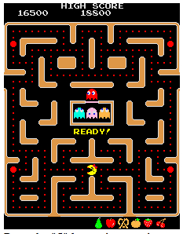
Two Forms of Machine Learning
Data Mining:
Find patterns/regularities in a data set
Use this to make predictions about “new data”
Agent learning:
Find patterns/regularities in the world
Use this to make future decisions
In both cases, the learning builds a model that we can use to make predictions about the world or “what to do next”

Slide 23
Two Forms of Machine Learning
“Supervised”, aka classification
E.g., are you a good credit risk?
“Unsupervised”, aka clustering
E.g., do individual voters have similar stances on issues?

Slide 24
Two Forms of Machine Learning
“Incremental”
New relevant data/experiences are available
Want to continually adjust the model
“Non-incremental”
We have “a data set”
How can we understand it

Slide 25
Two Forms of Machine Learning
“Symbolic”
E.g., not just who is at risk for a heart attack
But also, we’d like some insight as to WHY
“Sub-symbolic”
We don’t need to know “why”
Just make good predictions

Slide 26
Today
Data mining
Supervised
Incremental
Subsymbolic

Slide 27
An Aside: “Big Data”
Doesn’t mean “I have a LOT of data”
Typically refers to “the four V’s”:
Volume – yes, lots of data
Variability – heterogenous types/sources
Velocity – often, the data is coming in “real time”
Veracity – often, there are errors in the data

