Slide 1
Getting Past the AI Gatekeeper: Node.js /Javascript vs. Python
Clare Bates Congdon
January 16, 2019

Slide 2
Outline
Overview of Artificial Intelligence (AI)
Example AI application (Energy Grid)
Programming language considerations:
Picking the right tool for the job
A look at Python, Javascript, and Node.js
Strength of Node.js /Javascript for modern AI systems

Slide 3
What is ‘Artificial Intelligence’?
Most of CS:
Design and implement a solution to a problem
AI:
We don’t know how to solve the problem
But we know “what a solution looks like”
Search the space of possible solutions
There are too many possibilities to consider them all
Have to be “clever” about where we look

Slide 4
What is ‘Machine Learning’?
AI:
Heuristic search for a solution to the problem
ML:
Build a model, based on experience
Infer regularities in that experience
→ Use experience in a domain to improve our performance

Slide 5
Generalizations and Inference
Our model is a generalization of our previous experience
We use the model to make inferences
When we infer, we are making an informed decision
But sometimes, if we’d seen more data / had more experience, we’d discover that our model is not quite correct.

Slide 6
TensorFlow / Deep Learning
TensorFlow is a form of “neural nets”
An ML approach inspired by human nervous system
“Deep learning” refers to many layers in the learned model
(Some other forms of ML also use the phrase “deep learning”)
(? NN illustration?)

Slide 7
Example AI Project: Fractal Energy Grid
Energy Grids of the Future:
Consumer participation and choice
Decentralized control
Two-way energy flows
Increased reliability, security (cyber and physical) and resiliency
(? Goofy illustration here?)

Slide 8
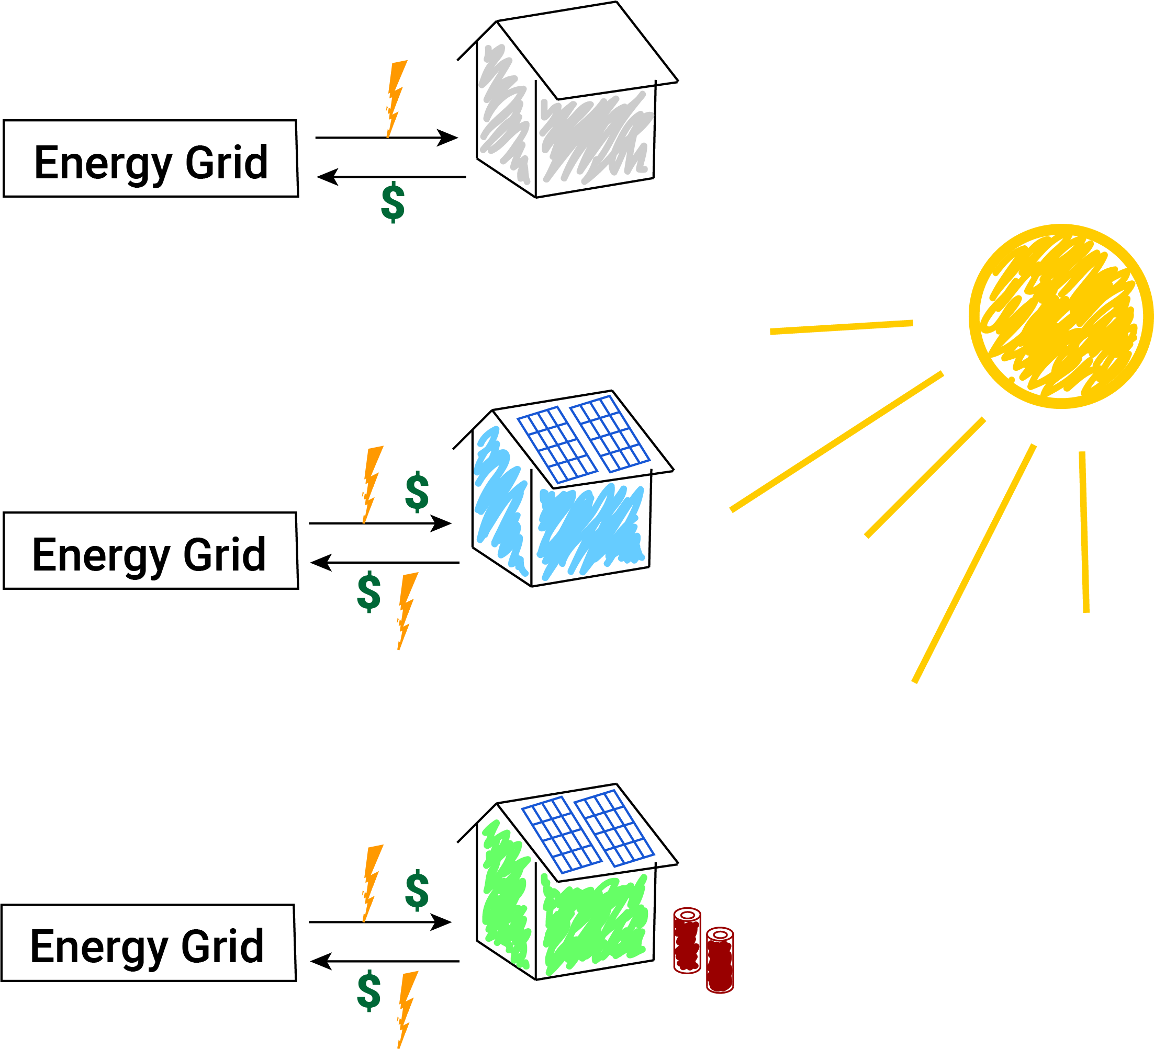
Three Example Houses
Consumer
Consumer/
Producer
… with
Batteries
AI system will help save money here:
When should I
buy power?

Slide 9
Fractal Energy Grid
(figure here; fractal grid)
(places where learning can help)
(e.g., renewables)

Slide 10
Fluctuating demands and prices
Supply and demand controls energy prices
(mainly to describe that consumer prices will fluctuate in the new world, too)

Slide 11
How an xGraph solution can help
Decentralized: Not “an AI system”, but multiple interacting systems
Fractal architecture
Smart devices,
e.g., battery decides to charge when price is low and to discharge when price is high
Use AI and ML to respond well to fluctuations
(needs a bit more here…)

Slide 12
“The official languages” of AI and ML
Python is enormously popular right now
Java
R, LISP, …
But why Python?

Slide 13
Some language considerations
Execution speed
Available libraries
Development…
Language features, ease of development, maintenance, programming environment
Python has become popular in part because of the wide availability of a large variety of libraries

Slide 14


Geek Slide, number 1
Speed: Compiled vs. interpreted languages
Ultimately, code is running on specific hardware
Has to be translated
In real time == interpreted
Ahead of time == compiled
Interpreted code can be faster to develop
Compiled code is faster to run
Reconsider
images

Slide 15

Geek Slide, number 2
What is a “library”?
Code that’s already been
written/tested
that you can use in your
program
Availability of good libraries
speeds the development process

Slide 16
Geek Slide, number 3
Development concerns, e.g.:
Ease of learning the language
Operations that the language simplifies
Development and maintenance of code
Programming environments
(maybe more stuff goes here)

Slide 17
Python
Favored for ML these days largely due to the availability of libraries
Interpreted language at heart, but can be compiled (“cython”)
Syntactically clean language results in small programs
Been around since 1991: plenty of tools and community

Slide 18
Javascript
Favored for web development these days largely due to its use within the browser (“client-side” Javascript)
Great visualization libraries, e.g., D3
Library code has to be small and fast for browser use – limits utility for AI and ML
Interpreted language
Been around since 1995: plenty of tools and community

Slide 19
Node.js
Relatively new environment (2009)
Created to be able to run Javascript “server side” (vs. client side)
Node V8 engine compiles Javascript code
Large and growing community produces a wealth of open-source libraries
Javascript connects the devices on the internet: asynchronous communication is a core feature.

Slide 20
Some important facets
Python: great libraries for ML, quick to develop, quick to run
Javascript: Built for the web, asynchronous communication, lots of libraries (but not for ML)
Node.js: JavaScript benefits,…

Slide 21
Some example Node.js ML libraries
Multiple neural net libraries
Including TensorFlow
ML.js project
“on the way to being Javascript's scikit-learn.”
Decision trees, K-Nearest Neighbor, Naïve Bayes, K-means clustering, etc.
“Machine_learning” node.js library
(similar ML approaches)

Slide 22
Back to the Energy Grid
Different processes/agents
Independently learning, but
Constantly communicating with each other
(more deets here and/or illustration)

Slide 23
How is Node.js a benefit to IS projects?
Speed
Communication among independent devices
“asynchronous communication”
Advanced modern AI systems are “systems of systems” that need to be able to communicate with each other
(more to say here? Or just an illustration)

Slide 24
Summary
People don’t think about Javascript as a language to use for Artificial Intelligence applications, but:
Node.js provides robust communication needed by advanced AI systems
Node.js is implemented in C++ and is fast
Node.js has a strong community and ever-increasing availability of libraries

