Slide 1
Getting Past the AI Gatekeeper: Node.js/Javascript vs. Python
Clare Bates Congdon
January 16, 2019

Slide 2
Terminology / positioning
CS >> AI >> ML
ML << Stats << Math

Slide 3
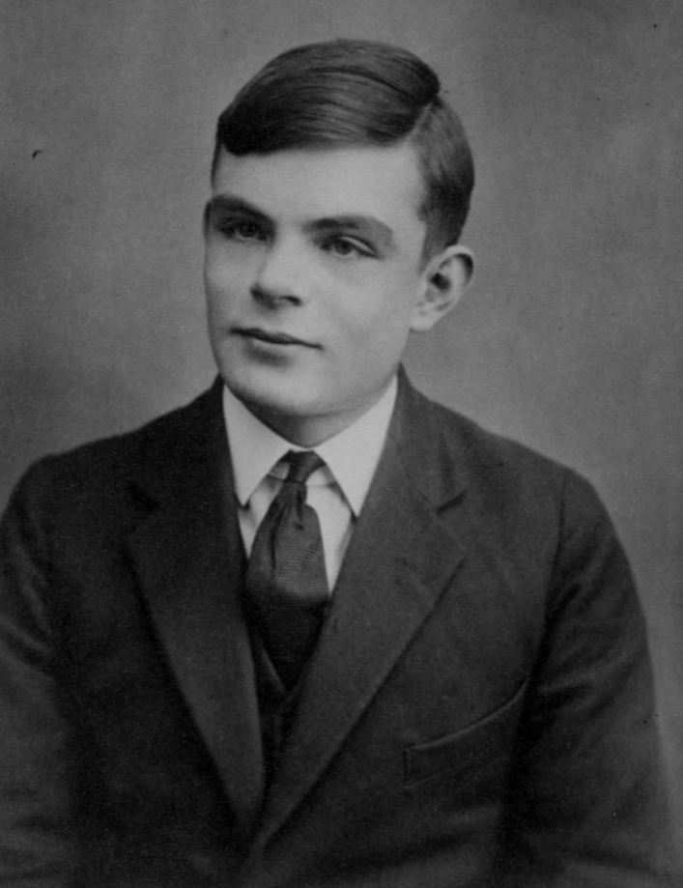
Why is it called “Machine Learning”?
Electronic computers
in the 1940’s
What is a “computer”?
Alan Turing’s genius
Alan Turing, via Wikipedia

Slide 4
What is ‘Artificial Intelligence’?
Most of CS:
Design and implement a solution to a problem
AI:
We don’t know how to solve the problem
But we know “what a solution looks like”
Search the space of possible solutions
There are too many possibilities to consider them all
Have to be “clever” about where we look

Slide 5
AI/ML has more “science” than CS
Studying the system that we created
(Because it’s not a natural system, we have the ability to perturb it)
Do ‘experiments’ to conduct our investigations
Can also involve hypothesis testing

Slide 6
“Building a model”
With ML, we often talk about “building a model”
of our data, of our experience
Goal is largely to create a model of what we’ve seen before – an abstraction
And then be able to use this to make (good) predictions about what will happen in the future

Slide 7
Generalizations and Inference
Our model is a generalization of our previous experience
We use the model to make inferences
When we infer, we are making an informed decision
But sometimes, if we’d seen more data / had more experience, we’d discover that our model is not quite correct.

Slide 8


Some characteristics of learning
For both human and machine learning
Learning can be slow
Learning can be error prone
E.g., we make generalizations without enough experience
…?

Slide 9

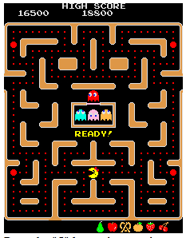
Two Forms of Machine Learning
Data Mining:
Find patterns/regularities in a data set
Use this to make predictions about “new data”
Agent learning:
Find patterns/regularities in the world
Use this to make future decisions
In both cases, the learning builds a model that we can use to make predictions about the world or “what to do next”

Slide 10
Two Forms of Machine Learning
“Supervised”, aka classification
E.g., are you a good credit risk?
“Unsupervised”, aka clustering
E.g., do individual voters have similar stances on issues?

Slide 11
Two Forms of Machine Learning
“Incremental”
New relevant data/experiences are available
Want to continually adjust the model
“Non-incremental”
We have “a data set”
How can we understand it

Slide 12
Two Forms of Machine Learning
“Symbolic”
E.g., not just who is at risk for a heart attack
But also, we’d like some insight as to WHY
“Sub-symbolic”
We don’t need to know “why”
Just make good predictions

Slide 13
Today
Data mining
Supervised
Incremental
Subsymbolic

Slide 14
An Aside: “Big Data”
Doesn’t mean “I have a LOT of data”
Typically refers to “the four V’s”:
Volume – yes, lots of data
Variability – heterogenous types/sources
Velocity – often, the data is coming in “real time”
Veracity – often, there are errors in the data

Slide 15
TensorFlow / Deep Learning
TensorFlow is a form of “neural nets”
An ML approach inspired by human nervous system
“Deep learning” refers to many layers in the learned model
(Some other forms of ML also use the phrase “deep learning”)

