Slide 1
5-step Random-Walking problem
Fall 2015 CS8830 Reinforcement Learning
Final Project
Presenter: Qingyang Li
GT user name: qli7

Slide 2
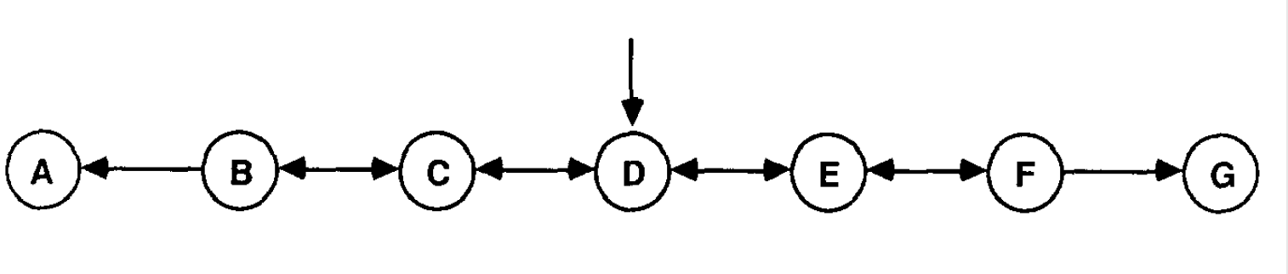
5-step Random-walking

Slide 3
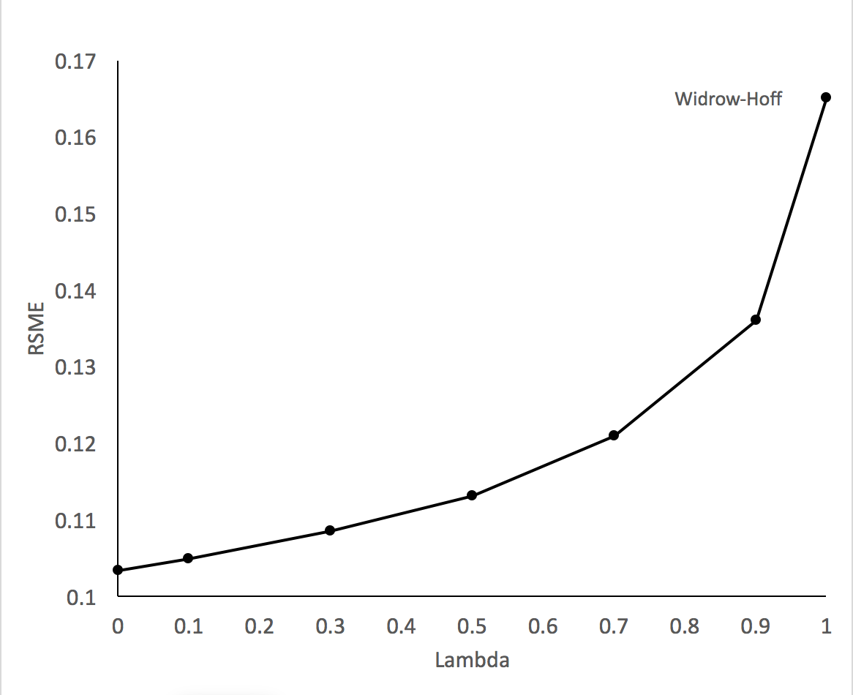

Slide 4
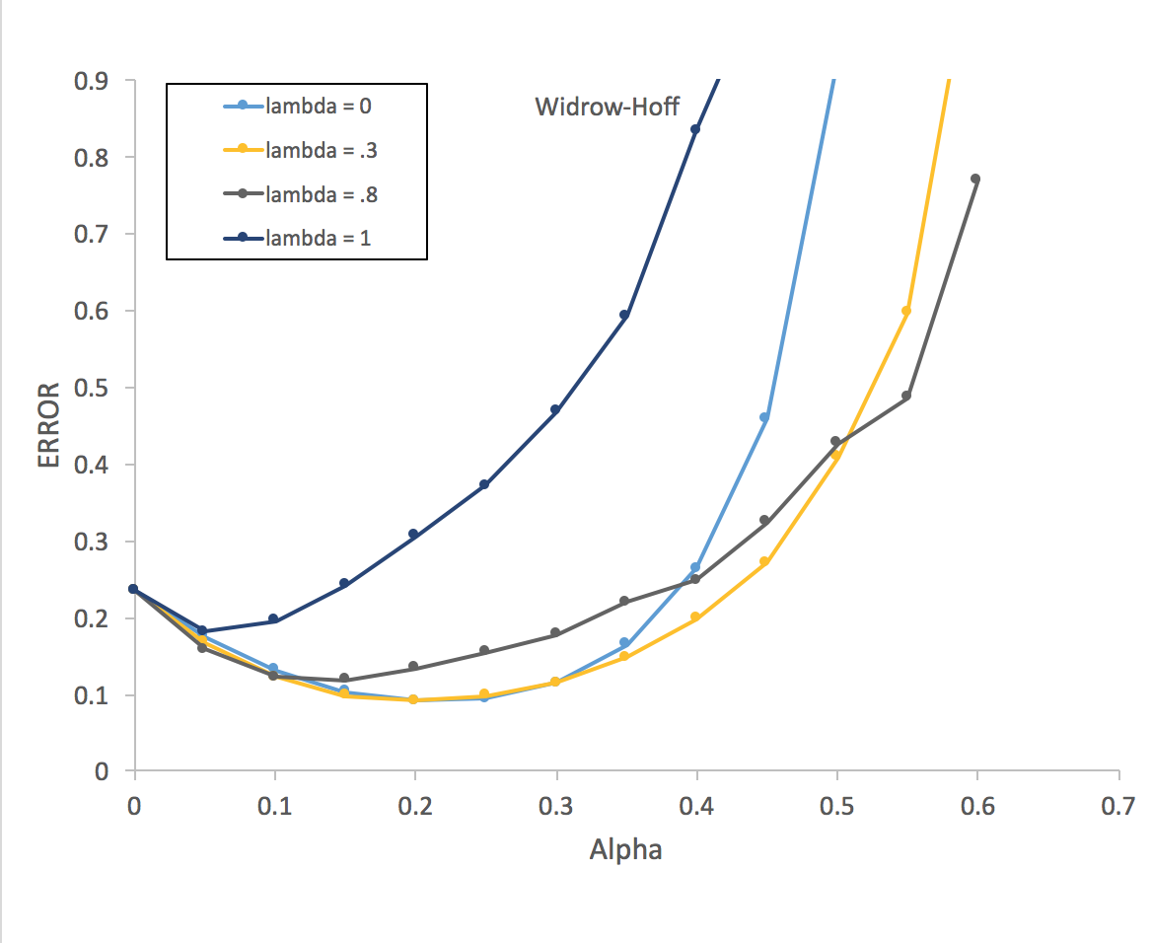

Slide 5
