Slide 1
Solving Five-step Random-Walk Problem
Fall 2015 CS8830 Reinforcement Learning
Final Project
Presenter: Qingyang Li
GT user name: qli7

Slide 2
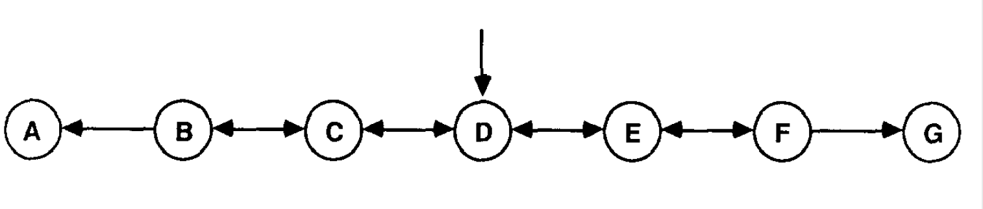
Five-step Random-walk
Absorbing States: A, G, with reward of 0 and 1, respectively
Markov chain of states: B, C, D, E, F.
50% chance move right or left
Goal: estimate weight vector w
Ideal prediction is T = {1/6 2/6 3/6 4/6 5/6}

Slide 3
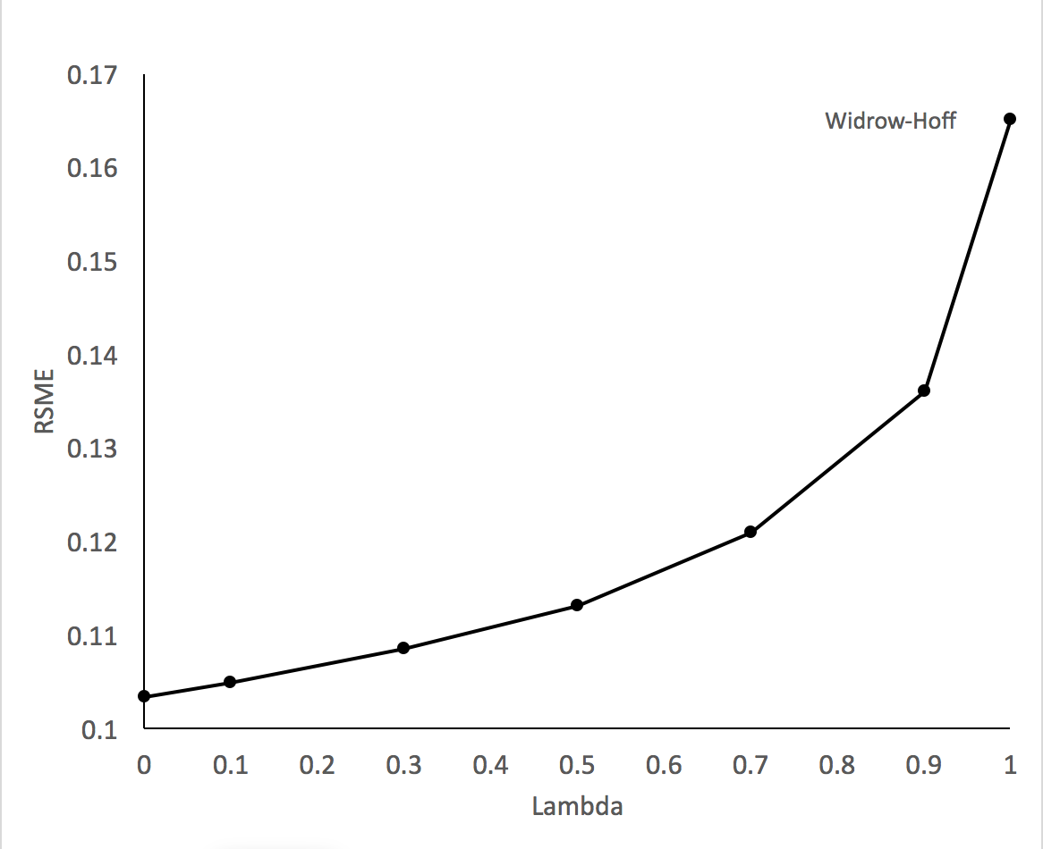
Experiment 1 – Repeated Presentations
Method and parameters:
1000 sequences, grouped as 100 training sets
Initial weights were set to 0.5
Accumulate Δw for sequences in a training set and update w after experiencing a whole set
Repeat until converge
Calculate error against T and average over 100 training sets
λ = 0.0, 0.1, 0.3, 0.5, 0.7, 0.9, 1.0; α = 0.05; ε = o.ooo5
Results:
Error increases as λ increases
Trends matches Figure 3 in Sutton’s paper
Average error on the random-walk problem

Slide 4
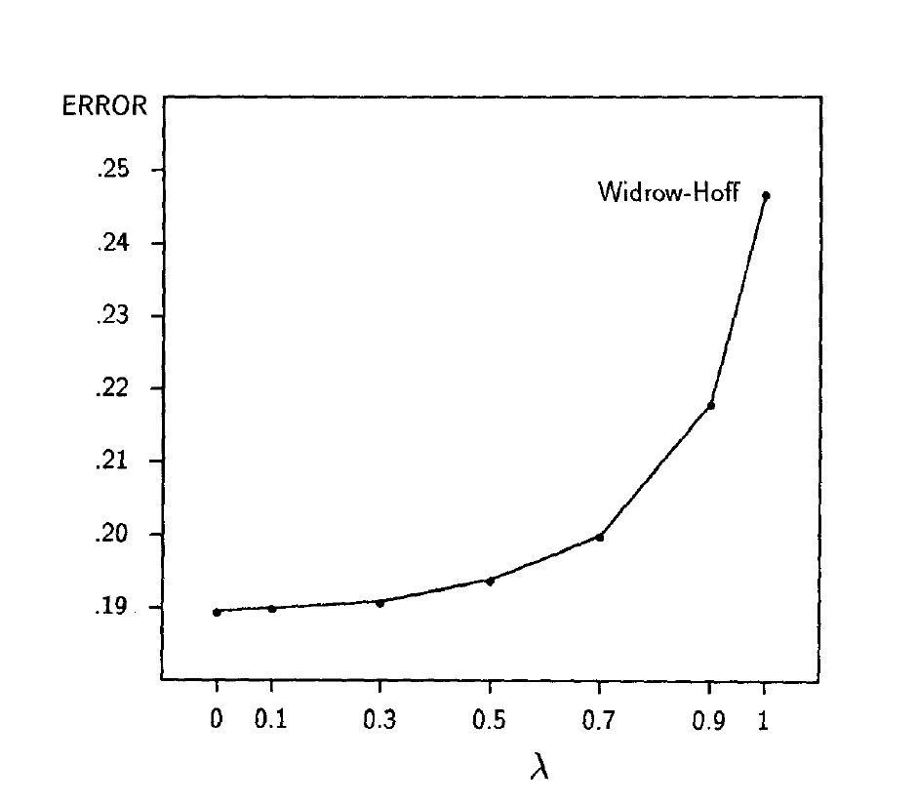
Experiment 1 – Repeated Presentations
Average error on the random-walk problem

Slide 5
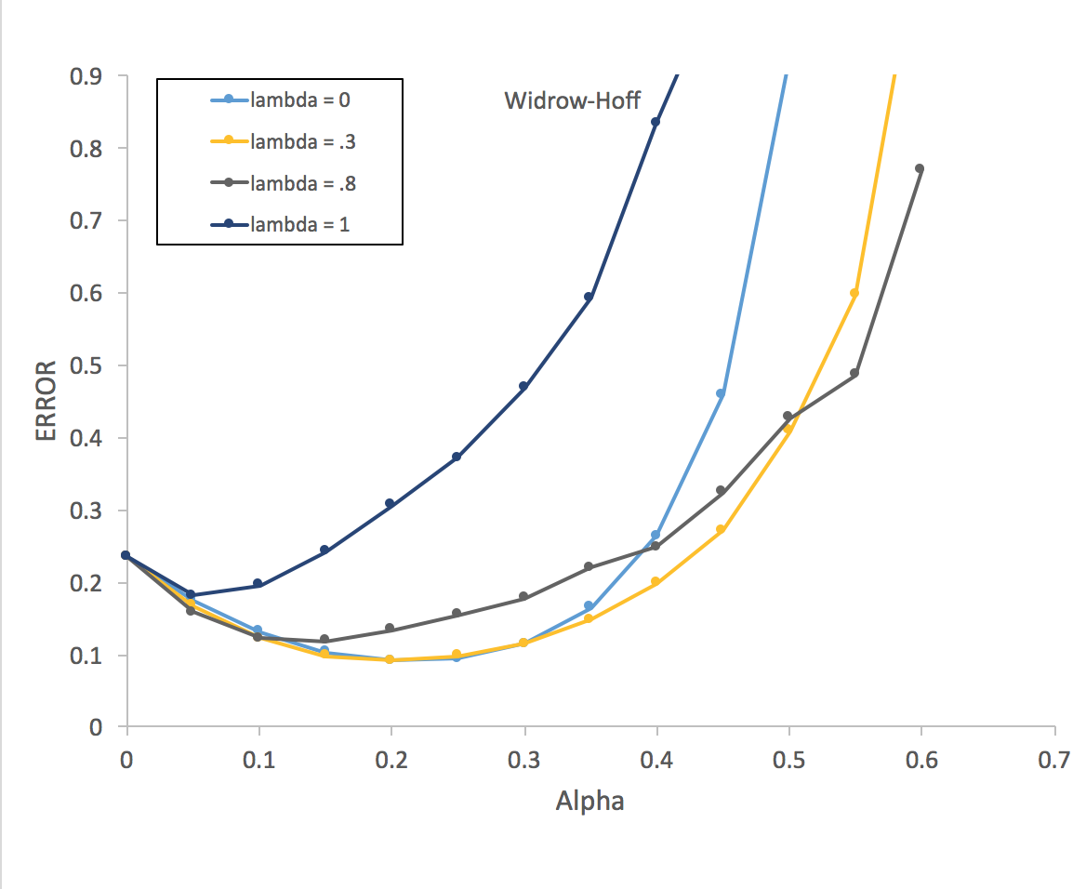
Experiment 2 - Experiencing 10 sequences
Method and parameters:
Initial weight was set to 0.5
Only train on data once
Update w after experiencing each sequences
Calculate mean error over 100 training sets
λ = .0, .1, .2, .3, .4, .5, .6, .7, .8, .9, 1.0
α = 0.0, 0.05, 0.1, 0.15,…., 0.55, 0.6
Results:
Learning rates affect performance
TD(1) performed worst under different values of α
TD(0)’s error increase rapidly for a > 0.4
Trends matches Figure 4 in Sutton’s paper
Best α is around 0.2
Average error on random walk problem after 10 sequences

Slide 6
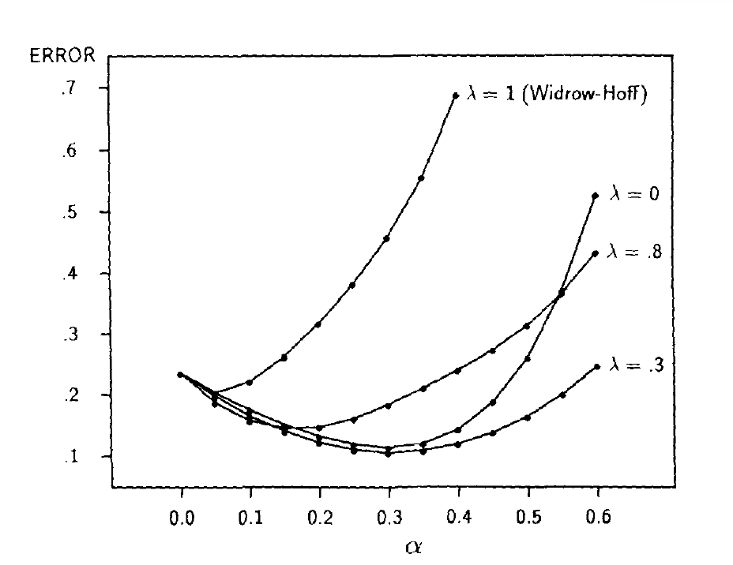
Experiment 2 - Experiencing 10 sequences
Average error on random walk problem after 10 sequences

Slide 7
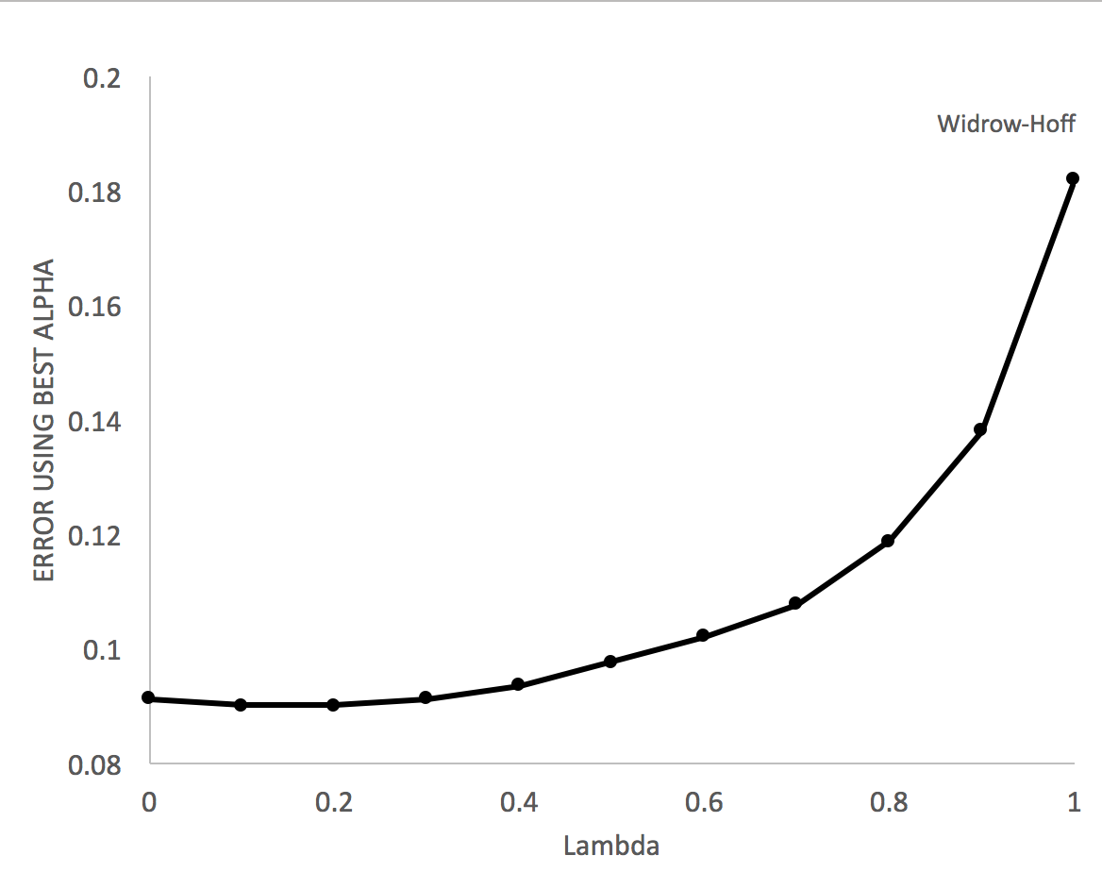
Experiment 2 - Experiencing 10 sequences
Method and parameters:
Calculate mean error for each λ using the corresponding best α
Results:
TD(0) did not performed the best (matched paper results)
TD(0.2) performed best (TD(0.3) in the paper
Trends matches Figure 5 in Sutton’s paper
Average error at best α on random-walk problem

Slide 8
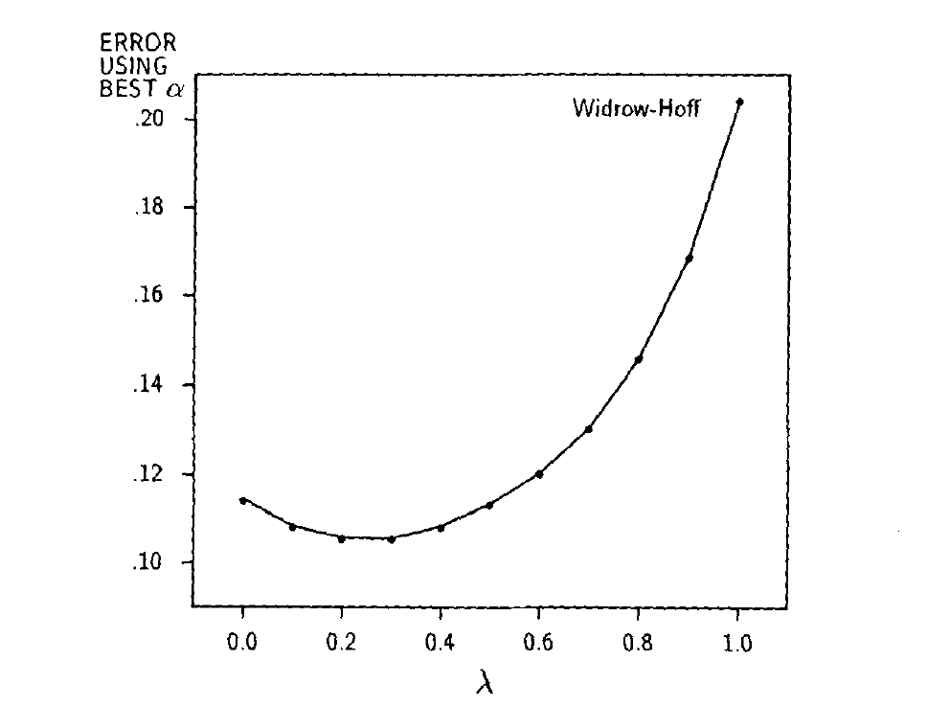
Experiment 2 - Experiencing 10 sequences
Average error at best α on random-walk problem

Slide 9
Summary
The results supports the paper’s claims
Not a perfect match though
Numerical differences
Randomly generated training set
Unreported α and ε in experiment 1

