Slide 1
CS739: Capstone Project
UR MARKETPLACE
Hoang Duc Cong (dhx496@uregina.ca)
August 15, 2023

Slide 2
Problem Statement
New students struggle to find textbooks
Students leave old textbooks from previous courses unused
No mobile channels for students in UofR to exchange these materials

Slide 3
Motivation
High demand on students to have a such channel.
Eliminate wasting of learning materials
Build a stronger institutional community

Slide 4
Related Work
University of Regina: Textbook Buy and Sell (Textbook Smart)
University of Regina Students (Facebook Group)!
UR Campus store

Slide 5
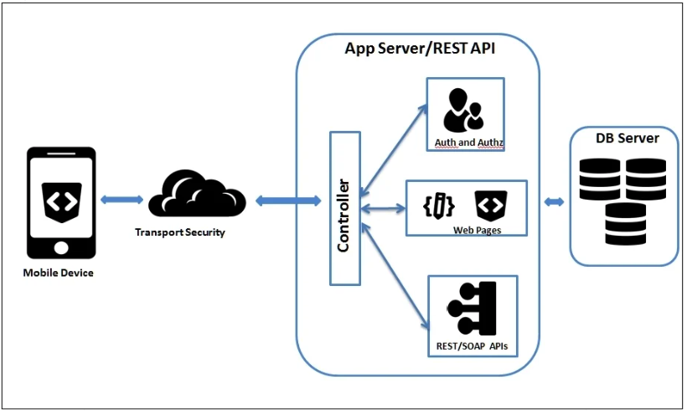
Proposed Solution
Architecture
Client server model
A mobile application (Android)
NodeJS/Express/MongoDB server

Slide 6
Approach / Methodology
Designing
Ideation
Interface design
Evaluating
Cognitive Walkthrough
Prototyping
Implementing
Low/medium fidelity
Back end (NodeJS/MongoDB)
Front end (React Native)
Figma

Slide 7



Implementation
Back End
NodeJS, Express
MongoDB, Mongoose
JWT
Front End
React Native + Expo
Redux, Async Storage
Location, map
Google Book API

Slide 8
DEMO

Slide 9
Thanks!
Questions?

Slide 10
References
https://docs.expo.dev/
https://reactnative.dev/
https://www.mongodb.com
https://reactnavigation.org/
https://redux.js.org/

Slide 11
Appendix I
Jira:cs739.atlassian.net/jira/software/projects/CP/boards/
GitHub: git@github.com:conghd/CS739_Capstone_Project.git

