Slide 1
EE454: Introduction to
Systems-on-chip
Phase 3
TAs: Shukai Duan
Presented by Shukai Duan
Notes:
1

Slide 2
Phase 3
Cuda Programming

Slide 3
Cuda Programming
CUDA is an extension to the C and C++ languages for scalable parallel programming of manycore GPUs and multicore CPUs
With the more recent models the GPU excels in data parallel and throughput computing, executing high performance computing applications as well as graphics applications
CUDA abstractions: a 1) thread groups, 2) shared memories, and 3) barrier synchronization
CUDA abstractions are hierarchical and provide a clear parallel structure to conventional C code for one thread of the hierarchy

Slide 4
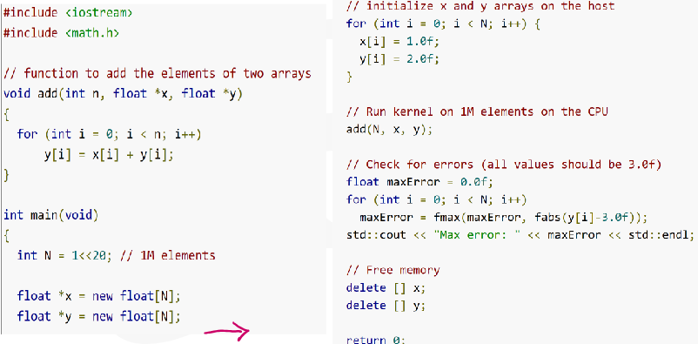
Sample Example
A simple C++ program that adds the elements of two arrays with a million elements each:

Slide 5
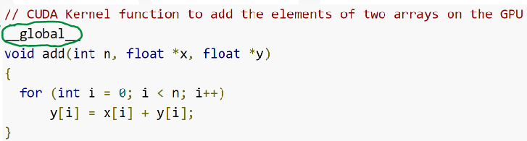
Example (contd.)
We must turn the add function into a function that the GPU can run, called a kernel in CUDA
Kernels

Slide 6
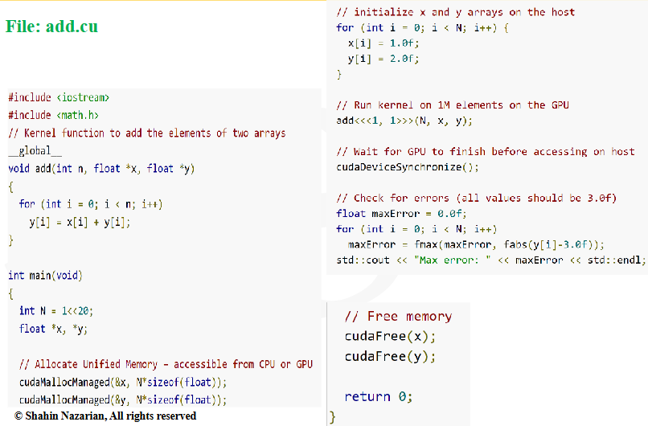
Example (contd.)

Slide 7
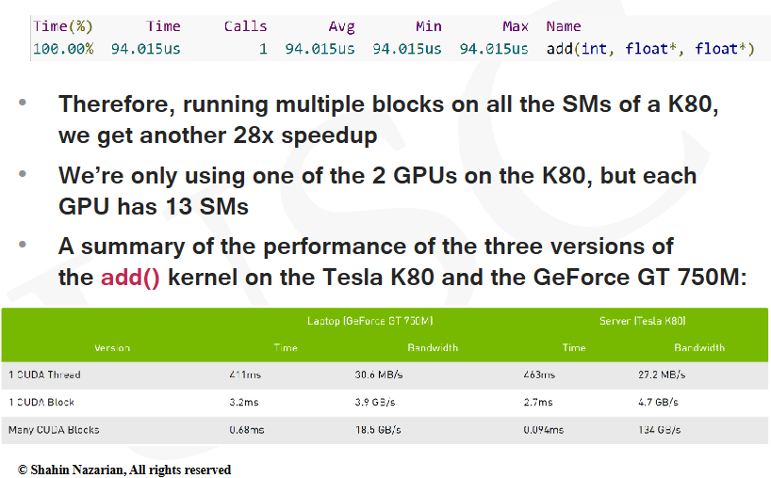
Speed Summary

Slide 8
Task
For phase 3, we will program linear layer with cuda programming and analyze speed, timing etc. with FPGA result.
Because we have a difficult problem on phase2, we make phase 3 an easier phase.

Slide 9
Submission
Cuda code: Phase3.cu
Short report

Slide 10
Thank You!

