Slide 1

VIRTUAL PRIVATE
NETWORKS (VPN)
HANOI UNIVERSITY
Class: 2c10
    - Nguyen Van Cong
    - Tran Phi Hung
    - Dang Thi Duyen
    - Nguyen Trung Kien
    - Lai Thi Mai

Slide 2

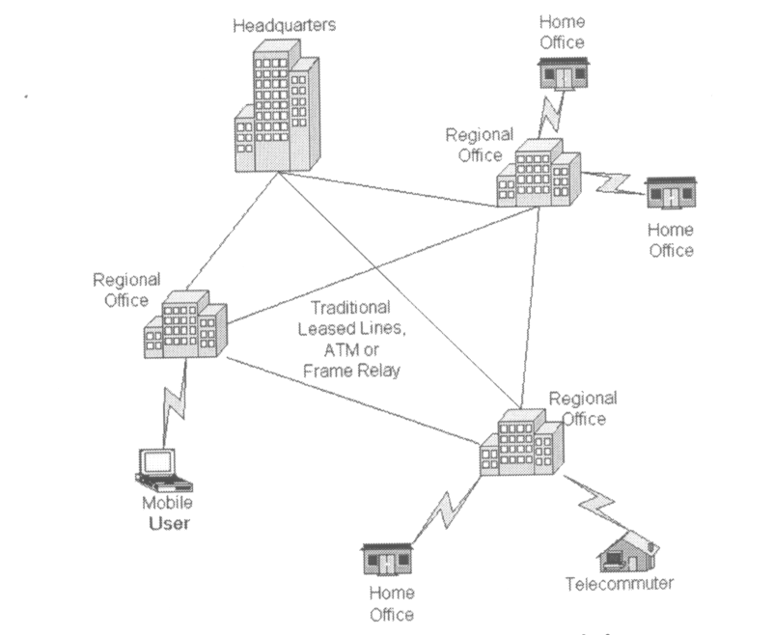
Traditional connectivity

Slide 3
VIRTUAL PRIVATE NETWORKS
1. The definition
2. Why have VPN
3. VPN network protocols
4. Advantages and Disadvantages
5. VPN application ( openVPN )

Slide 4
Definition
The VPN ( Virtual Private Networks) is the secure connection between two or more endpoints. It can also be seen as an extension to a private network.
The are 2 key types of VPN Scenarios :
- Site to site VPN
- Remote access VPN

Slide 5
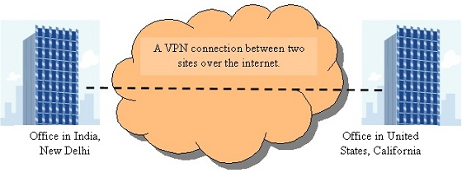
Site to site VPN
Data is encrypted from one VPN gateway to the other, providing a secure link between two sites over the internet.
This would enable both sites to share resources over the VPN link.

Slide 6
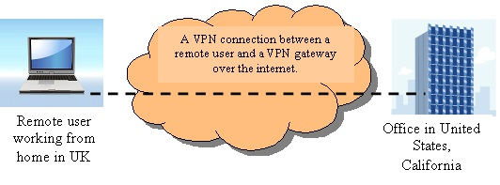
Remote access VPN
VPN scenario would be made from an individual computer to a VPN gateway.
This would enable a user to access their e-mail, files and other resources at work from wherever they may be, providing they have an internet connection.

Slide 7
Why have VPN
saving cost on resources (e-mail servers, file servers, etc )
providing a superb solution for companies with several branch offices
providing all data packets with high level of security.

Slide 8
VPN Networking protocols
PPTP -- Point-to-Point Tunneling Protocol
L2TP -- Layer 2 Tunneling Protocol
IPsec -- Internet Protocol Security
SSL VPN (Secure Socket Layer)

Slide 9
PPTP -- Point-to-Point Tunneling Protocol
Being a protocol or technology supports the use of VPN’s.
Helping remote users dialing into their local internet security providers to connect securely to their networks via the internet.
Being considered as a weak security protocol according to many experts.

Slide 10
L2TP -- Layer 2 Tunneling Protocol
Being an extension of the PPTP (Point to point tunneling protocol)
used by internet service providers to provide VPN services over the internet.
L2TP combines the functionality of PPTP and L2F
with some additional functions using some of the
IPSec functionality.
L2TP can be used in conjunction with IPSec to provide encryption, authentication and integrity.

Slide 11
IPsec -- Internet Protocol Security
Operating on layer 3 and can protecting any protocol that runs on top of IP.
Being a framework consisting of various protocols and algorithms which can be added to and developed.
Providing flexibility and strength in depth, being almost perfect solution for securing VPN’s.
setting up on the corporate network and on the client end. IPSec is used for both site to site and remote user connectivity.

Slide 12
SSL VPN (Secure Socket Layer)
Providing excellent security for remote access users as well as ease of use.
there is no client software if a user was using the SSL portal to access applications on the network .
SSL can also imitate the way IPSec works via a lightweight software
thousands of end user’s would be able to access the corporate network without the support of an administrator and possible hours of configuring and trouble shooting, unlike IPSec. The end user would just need to know the address of the SSL VPN portal

Slide 13
Advantages and disadvantages

Slide 14
Advantages
Cost Savings
Eliminating the need for expensive long-distance leased lines
Reducing the long-distance telephone charges for remote access.
Transferring the support burden to the service providers
Operational costs

Slide 15
Scalability
Flexibility of growth
Efficiency with broadband technology

Slide 16
Disadvantages
VPNs require an in-depth understanding of public network security issues and proper deployment of precautions
Availability and performance depends on factors largely outside of their control
Immature standards
VPNs need to accommodate protocols other than IP and existing internal network technology

Slide 17
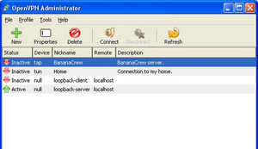
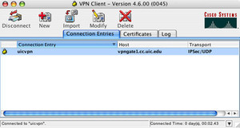
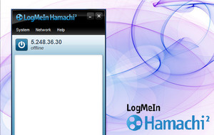
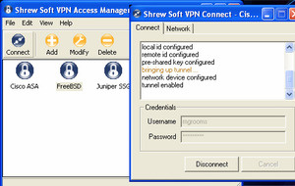
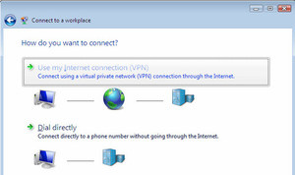
APPLICATIONS

Slide 18

OpenVPN

Slide 19
Cisco VPN

Slide 20
LogMeIn Hamachi

Slide 21
Shrew Soft

Slide 22
Windows Built-in VPN

Slide 23
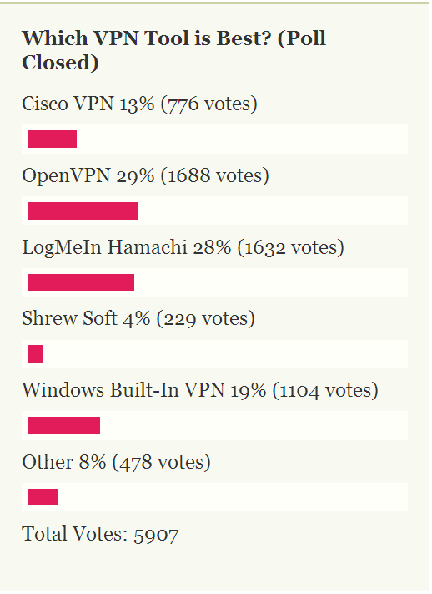
VPN software

Slide 24
APPLICATIONS

Slide 25
Information
OpenVPN
- Full-featured VPN solution
- Wide range of configurations:
  + remote access,
  + site-to-site VPNs,
  + WiFi security,
  + enterprise-scale remote access solutions with load balancing, failover, and fine-grained access-controls.

Slide 26
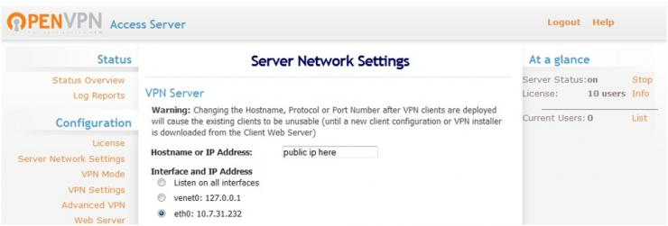
Setting the sever network

Slide 27
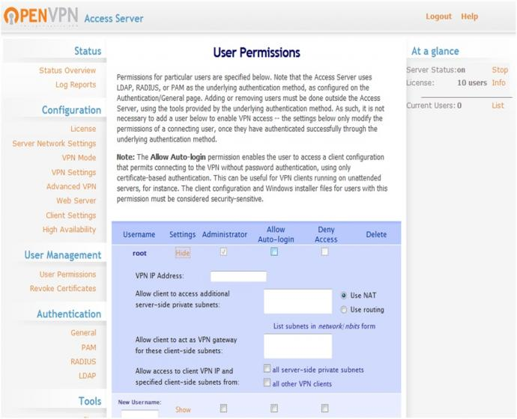
User Permissions

Slide 28
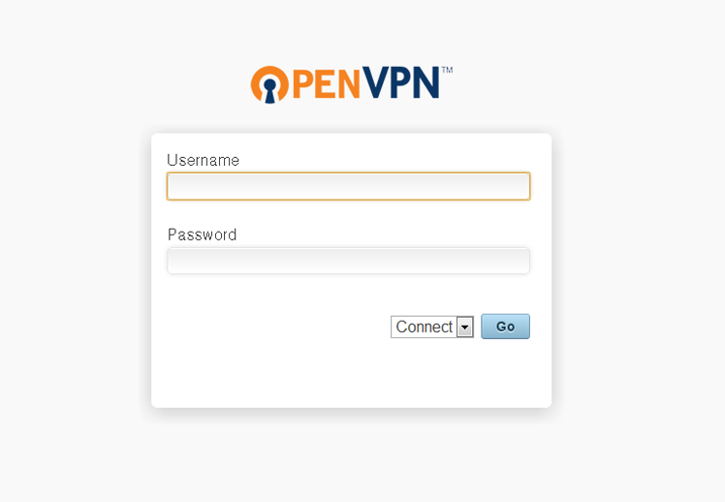
Connect clients

Slide 29


Slide 30


Q & A

Slide 31
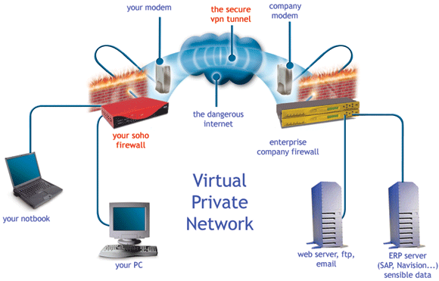

Slide 32
How does VPN works
VPN networks are often operated as client-server applications. Good example could be an implementation of MS Windows PPTP or OpenVPN on the Linux Platform. VPN server is directly running on a firewall, where it creates virtual network interface and additional virtual network subnet. VPN server is waiting for connections on the external network interface of the firewall where it performs authentication of a VPN client application. After successful VPN client authentication a VPN client is given an IP address from a virtual subnet. Consequently, an encrypted tunnel is created between VPN client and VPN server, which is used for safe transfer of packets between two distant networks via the Internet. Services, which a VPN client can connect to, can furthermore be defined by firewall rules. This way firewall ensures that VPN client can connect only to services it is allowed to connect. If the previous couple sentences looked to you little difficult to understand, do not despair! Everything will become clearer once we see how encrypted tunnel works in an example.

Slide 33
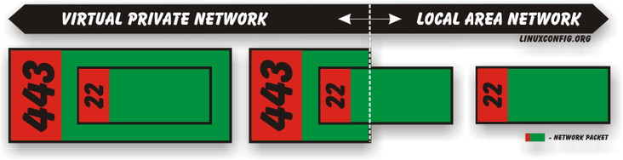
VPN Encrypted Tunnel Fundamentals
VPN tunnels are generally considered as something mysterious and everybody who mentions them, is "cool" :-) However, there is nothing to be afraid about, in the fact principle of Virtual Private Network is very simple. Data in IP networks are exchanged in packets. Information about destination and a source of the packet can be found in the packet's header. The actual user data are carried as a payload. Let’s imagine that ssh client wants to talk to ssh server over the Virtual Private Network. Packets leaving a host's network interface located on the local network are sent with a destination port number 22. When this packet reaches a VPN tunnel it is encapsulated into the VPN packet where original packet is now treated as a payload. If the VPN server listens on the port 443, the VPN packet will carry a destination port 443.
When looking at the previous figure it is apparent that this kind of network data transfer over the VPN is a waste of transfer rate because original packet has a smaller payload space just because it needs to fit into the VPN tunnel packet. In VPN analogical sense this can be considered as a drawback.

Slide 34
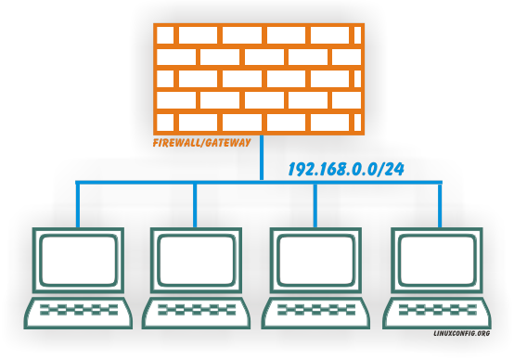
The theory behind Virtual Private Network
Let's imagine a small company network consisting just from a single subnet, in which all clients are connected to the Internet via company's gateway, which can also used as a firewall. How the connection is done, is not important, it is enough to mention that external gateway network interface uses external ip address. This scenario is visualized on the following figure:
In case that an employee wants to connect to some company's services from outside world, his/her attempt would be rejected by the firewall. Not just because this attempt is coming from completely different subnet but also because the ports to the particular services are not open. Once the VPN server starts functioning on the gateway, it automatically creates a virtual network interface with subnet 192.168.2.0/24, which would then start accepting a connection from external network. Once employee passes VPN server's authentication, a VPN server will assign an IP address from a 192.168.2.0/24. For 192.168.1.0/24 hosts would be the systems on 192.168.2.0/24 network appear that they are located on the separate local subnet, but in fact the communication is done by encrypted VPN tunnel over the Internet.

Slide 35
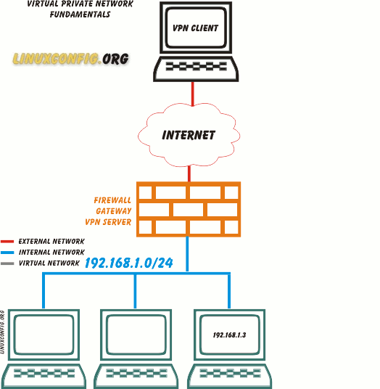
5.1. VPN fundamentals
The following image will try to explain fundamental principles of VPN server-client communication. The gif animation will change every 14 seconds. The aim of this animation is to explain a logic behind a VPN communication in simplest form as possible. Please note, that there are many other factors behind the scenes which had been for the sake of simplicity omitted.
Notes:
Try to explain fundamental principles of VPN server-client communication
a logic behind a VPN communication in simplest form as possible

Slide 36
1/14: VPN Client establishes a connection with a VPN Server via external network interface.
2/14: VPN Server assigns IP address to a vpn client from a local virtual subnet 192.168.2.0/24.
3/14: VPN Client prepares a packet for a host 192.168.1.3 located within a private subnet 192.168.1.0/24.
4/14: VPN Client encrypts and hides an original packet inside the outer public packet.
5/14: The packet is dispatched by the VPN client via public network to the VPN Server.
6/14: A network packet acquired from the public network is decrypted and decapsulated by the vpn server. This way VPN server obtains a packet for the private network.
7/14: VPN Server handles a newly acquired packet as it was sent locally on a 192.168.1.0/24 subnet.
8/14: Packet is delivered to the host with destination IP address 192.168.1.3.
9/14: Host with IP address 192.168.1.3 creates a network packet with destination IP 192.168.2.2.
10/14: VPN Server receives a reply packet.
11/14: According to the VPN Server's routing table, this packet links up with the Virtual Private Network.
12/14: VPN server encrypts and hides an original packet inside the outer public packet.
13/14: The packet is dispatched by the VPN server via public network to the VPN client.
14/14: The network packet acquired from the public network is decrypted and decapsulated by the vpn Client. This way VPN client obtains a packet from the private network.

