Slide 1




Slide 2

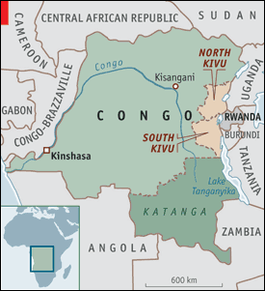
Heart of Africa
Straddles the Equator
Bordered by 9 countries
Third largest country in area
and fourth largest
in population with 65 million
The size of Western Europe
Second largest rainforest in
the world behind the Amazon

Slide 3

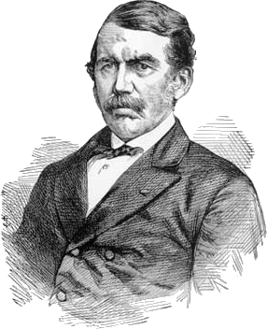
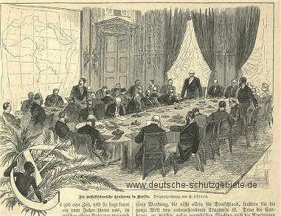

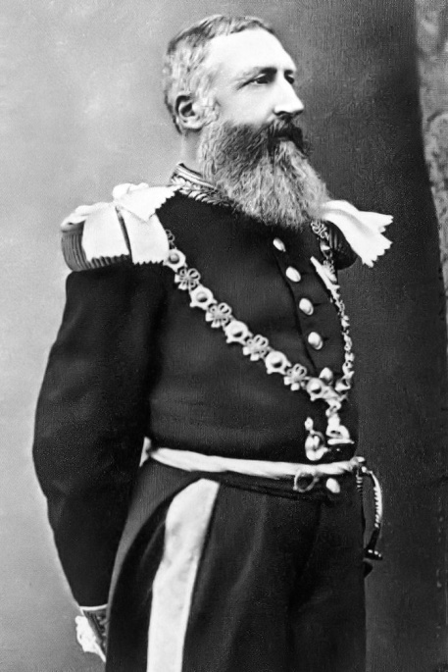
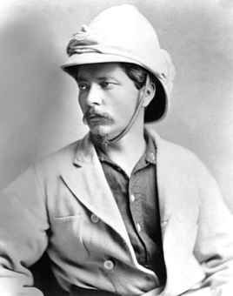



1884-85 Berlin Conference
2010 = 125 Year Anniversary
King Leopold's Reign (1885 – 1908)
An estimated 10 – 15 million died

Slide 4

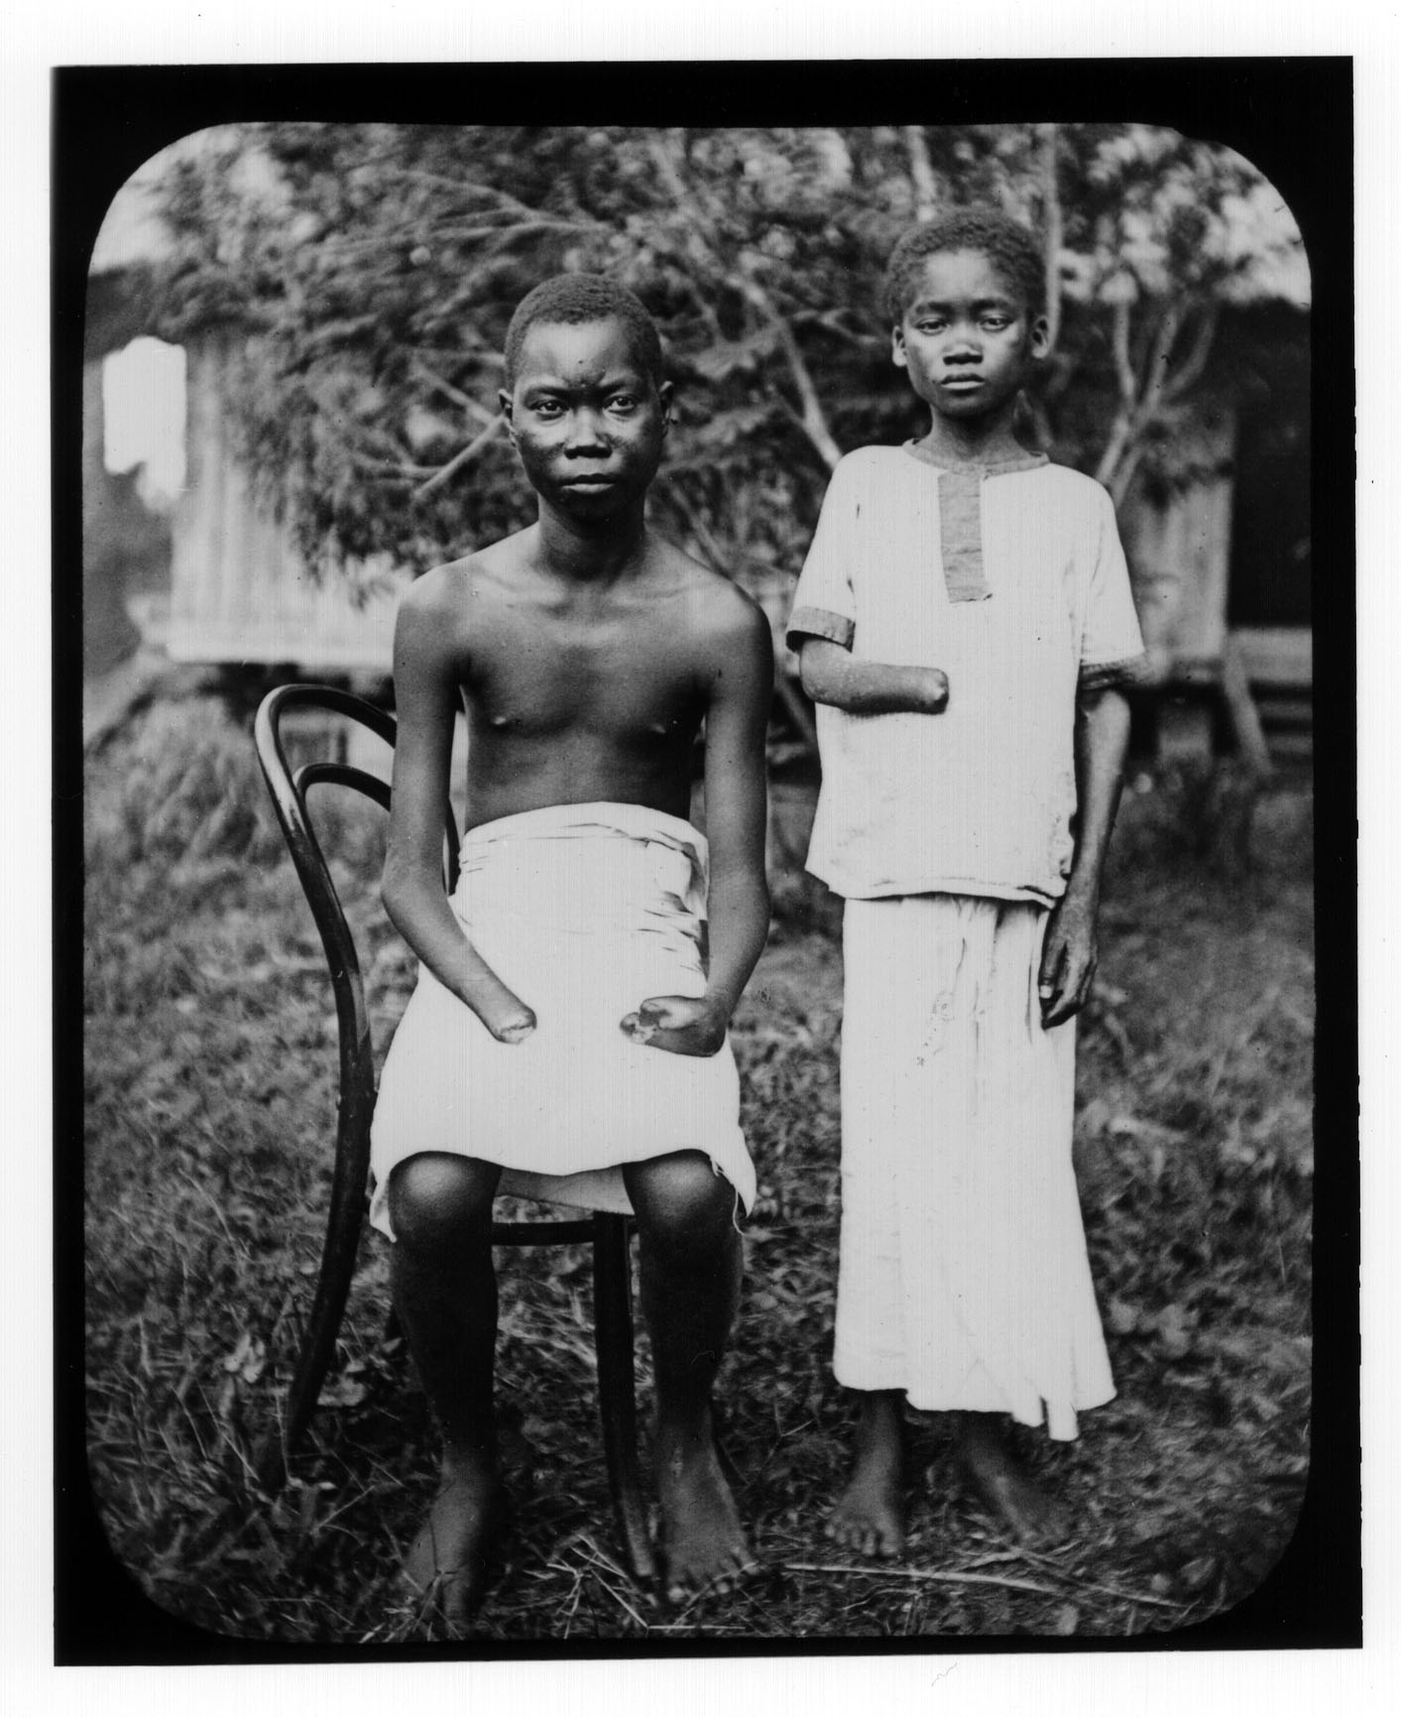
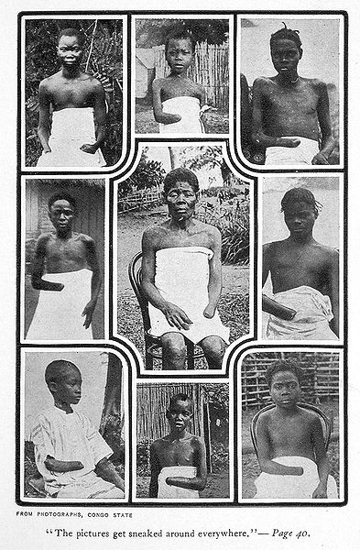


Slide 5

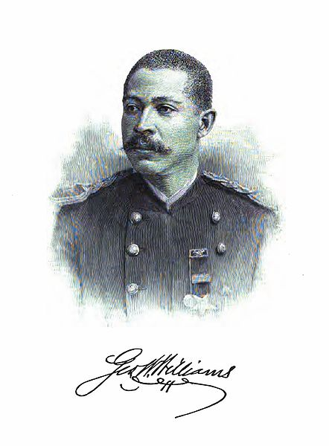
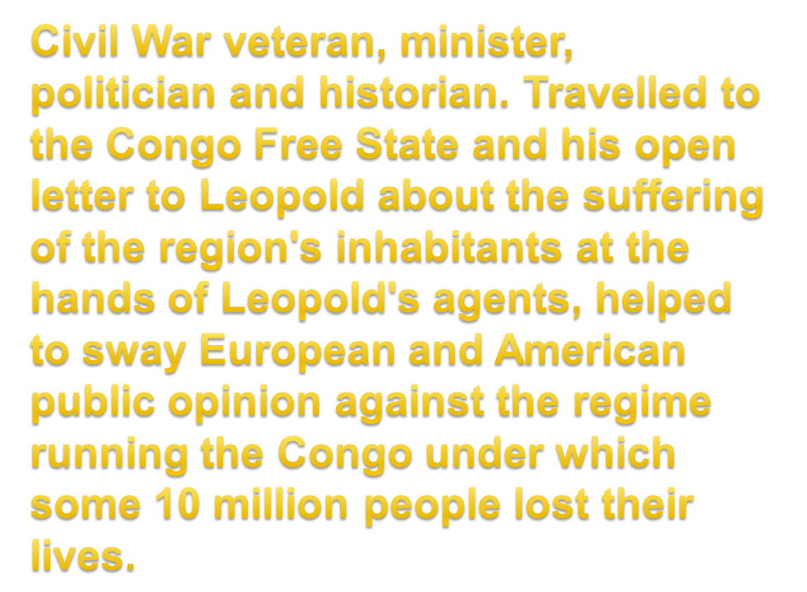

Slide 6

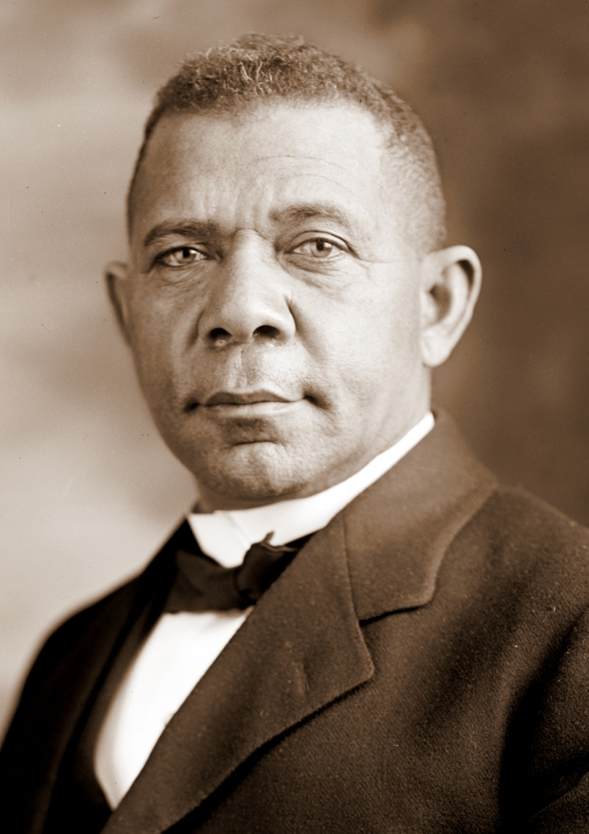
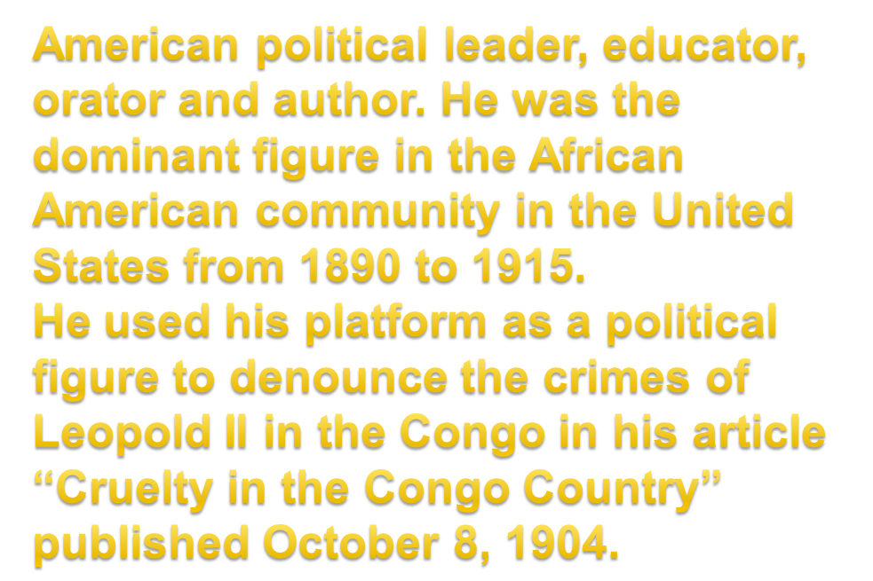

Slide 7

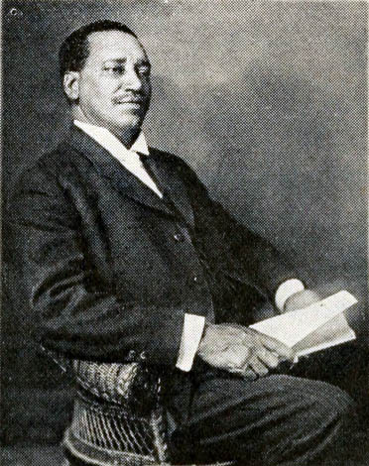
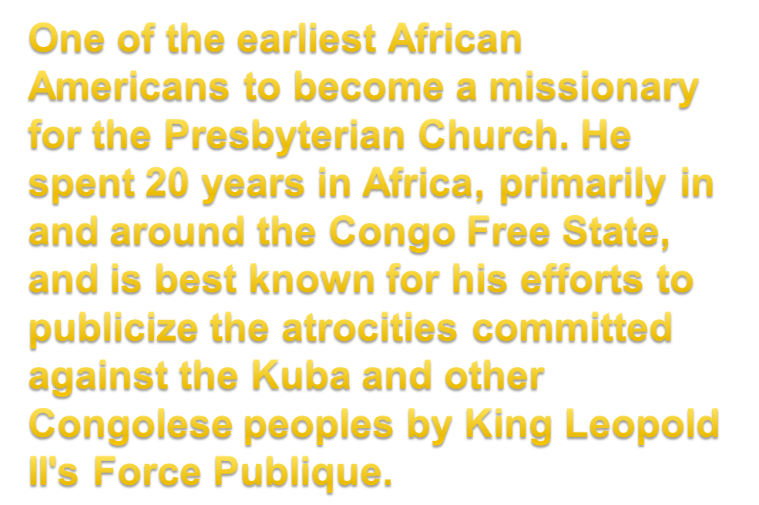

Slide 8

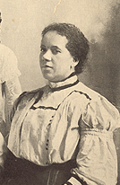
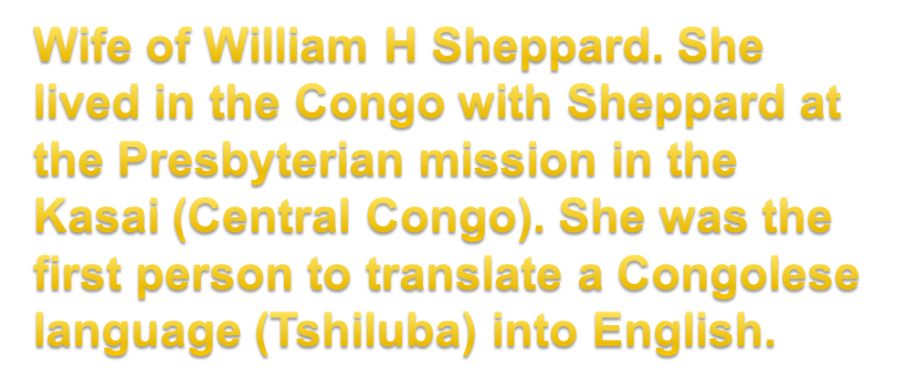

Slide 9

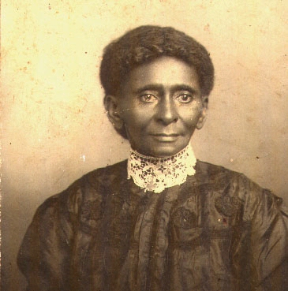
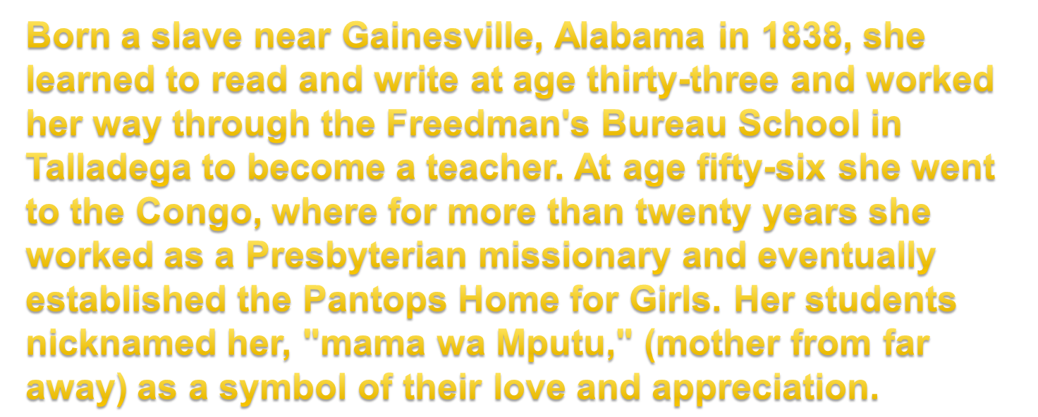

Slide 10
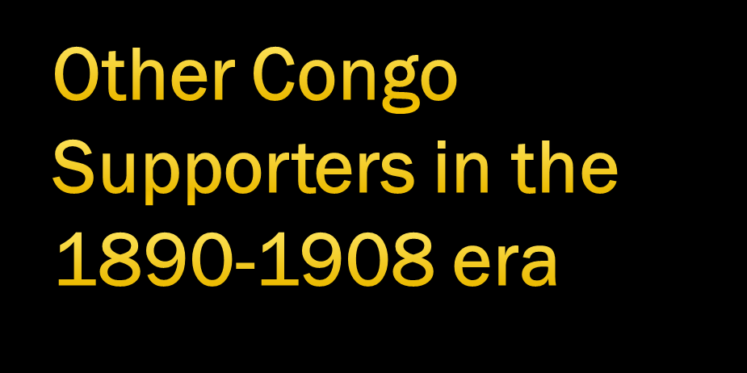
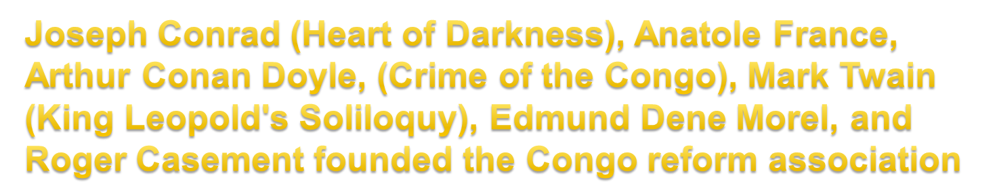

Slide 11

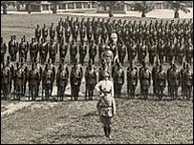
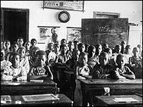
Economic Consolidation and Extractive relationship
Independence movements disguised as cultural associations
U.S. provided access to Congo’s uranium for its Manhattan Project during WWII
Belgium accumulates debt in the name of the Congolese people

Slide 12

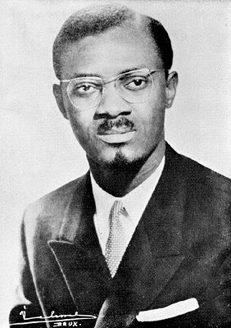
Congo elects Patrice Lumumba as Prime Minister (June 30, 1960 Lumumba takes office)
Lumumba assassinated on January 17, 1961 with Belgium, French, British and UN Involvement
Lumumba wanted the wealth of the Congo to be utilized for the people of the Congo and Africa at-large
Crushing of the Democratic aspirations of the Congolese people
Set back the advance of the entire African continent

Slide 13

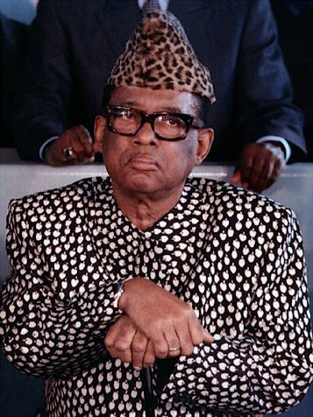
Mobutu Era (1960 – 1997)
Installed, backed and maintained primarily by the United States
Reign marked by Kleptocracy
Destruction of the country
Overthrown in May 1997

Slide 14

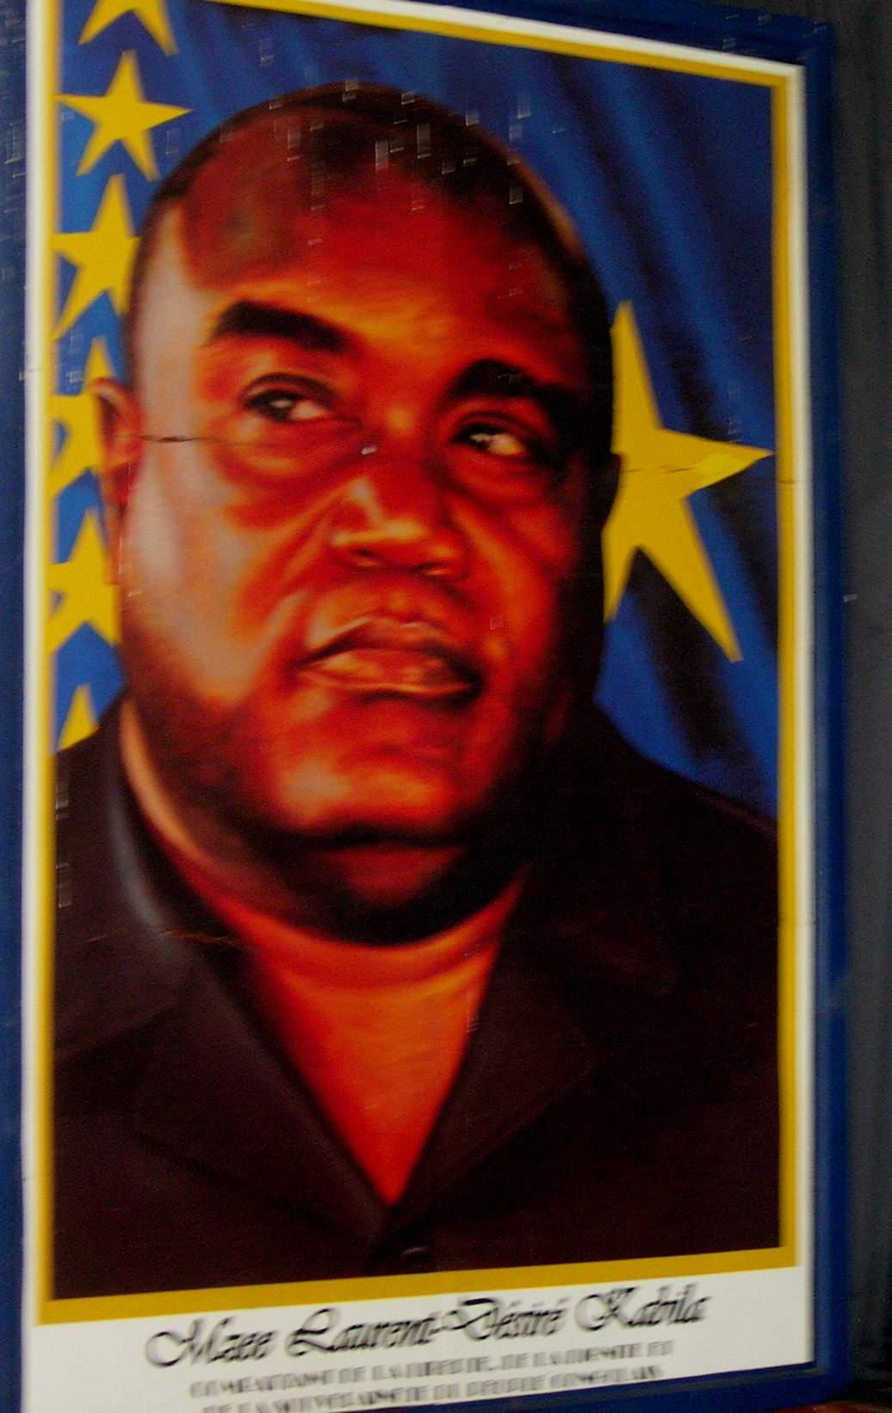
Kabila’s time (1996 – 2001)
Rwanda invades in October of 1996 using the Hutu unchecked presence in Congo as the rationale for the invasion
Kabila made spokesperson of Rebellion
May 1997 - Brought to power by Rwanda and Uganda with the help of Angola and the backing of the United States

Slide 15

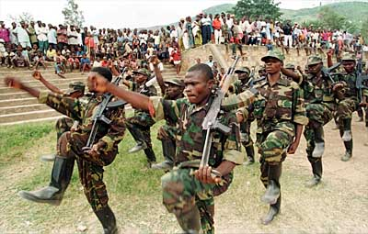
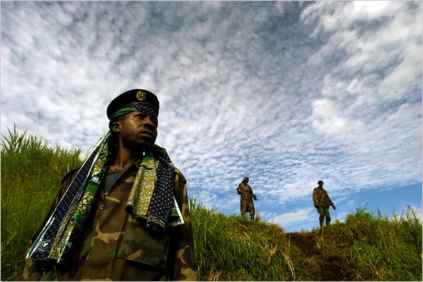
Launched in 1998 with the second invasion of Congo by Rwanda and Uganda
Attempt to remove Kabila
Kabila appeals to Zimbabwe, Angola and Namibia
Marked by the systemic rape of Congo’s natural resources
Geopolitics - 11 African Countries implicated
Laurent Kabila assassinated in 2001 and replaced by his son Joseph Kabila who later was installed after the 2006 elections

Slide 16



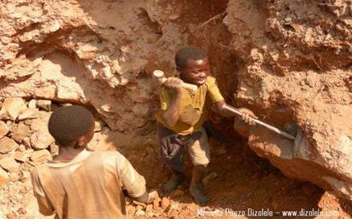
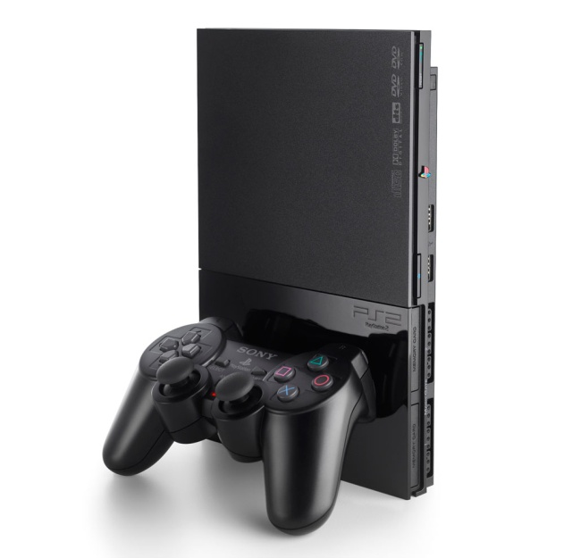
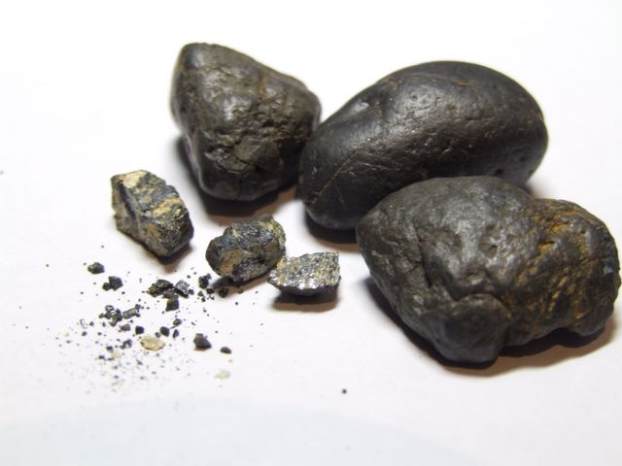

Slide 17

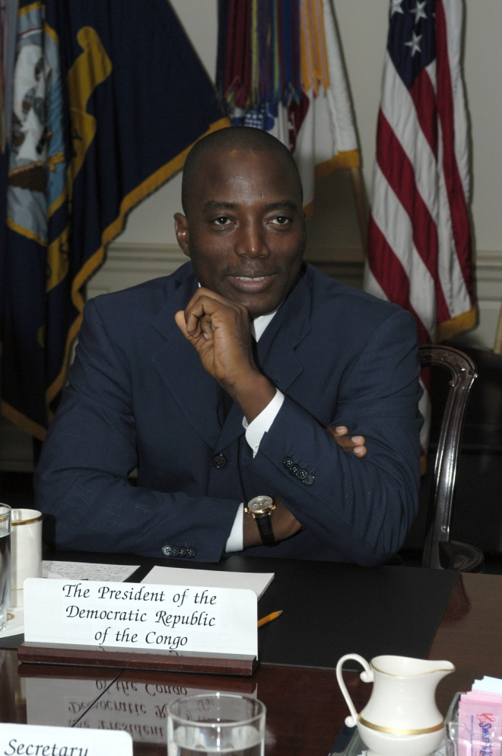
Transitional Government (2003 – 2006)
One + Four (One president and four vice presidents)
Structural flaws of elections in 2006
Rebel groups in the North and East of Congo

Slide 18

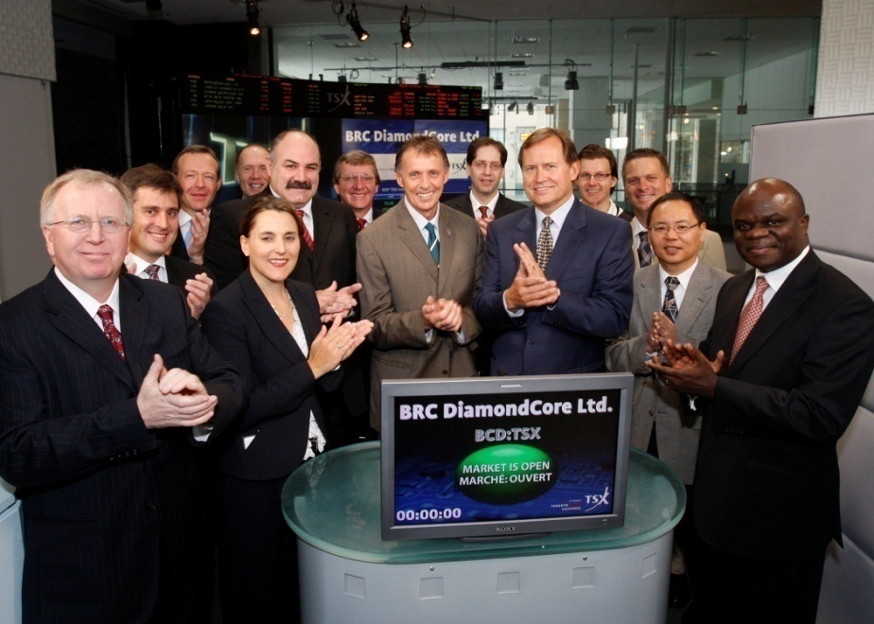
Forrest International (George Forrest)
Nikanor (Dan Gertler)
Katanga Mining (Glencore)
Dodge Phelps (Freeport McMoRan)
Anvil Mining
First Quantum
Trinitech & Eagle Wings
Kemet
HC Starck
Citibank
American Mineral Fields/Adastra
Cabot Corporation
OM Group
AngloGold Ashanti
World Bank
International Monetary Fund
Heritage Oil
Blattner Group
Banro
Traxis Woldwide
Comprehensive List found on Website

Slide 19
THE FIVE KEYS TO UNDERSTANDING CONGO
The affairs of the Congo have not been determined by the people of the Congo
2. Congo is trapped in the midst of a geo-strategic battle for her precious and strategic resources
3. Congo’s challenge is both internal and external
4. Congo is central to the future of the African continent
5. Congo is blessed with enormous natural and human potential

Slide 20
CONGO: CHALLENGES AND PRESCRIPTIONS
CHALLENGES
Historical: Slavery, Personal Rule, Colonialism, Assassinations, Dictatorship, Kleptocracy, Wars = Organizational Deficiency
External Forces: Foreign Governments, Neighboring States, Multilateral Institutions, Foreign Corporations, Local Elites
PRESCRIPTIONS
Global diplomatic and political engagement
Strengthening of local institutions

Slide 21




Slide 22



