Slide 1
Group Project – Default Team
Kings College London
7CCSMGPR
Module Tutor – Dr. Laurent Tratt
Alain Doebeli
Christakis Vasiliou
Ignacio Dominguez Garcia-Guijas
James Kayongo
Konstantinos Oikonomou
Nikolaos Rizos

Slide 2
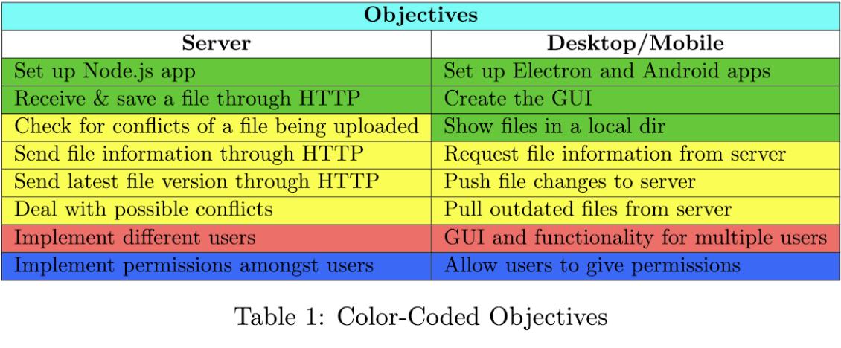
Project Objectives
Initial
Subsequent
Optional
Quality of Life
Completed Objectives: Green, Yellow, Red

Slide 3
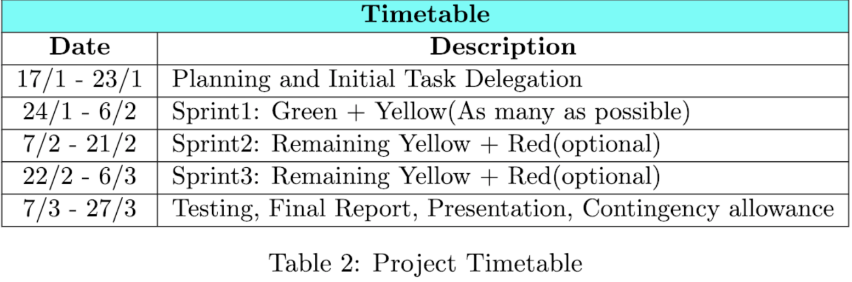
Project Methodology - Schedule
Agile – Scrum
2 Week Sprints
Sprint Review
GitHub -> Projects
Peer Assessment:
Points split equally to every member

Slide 4
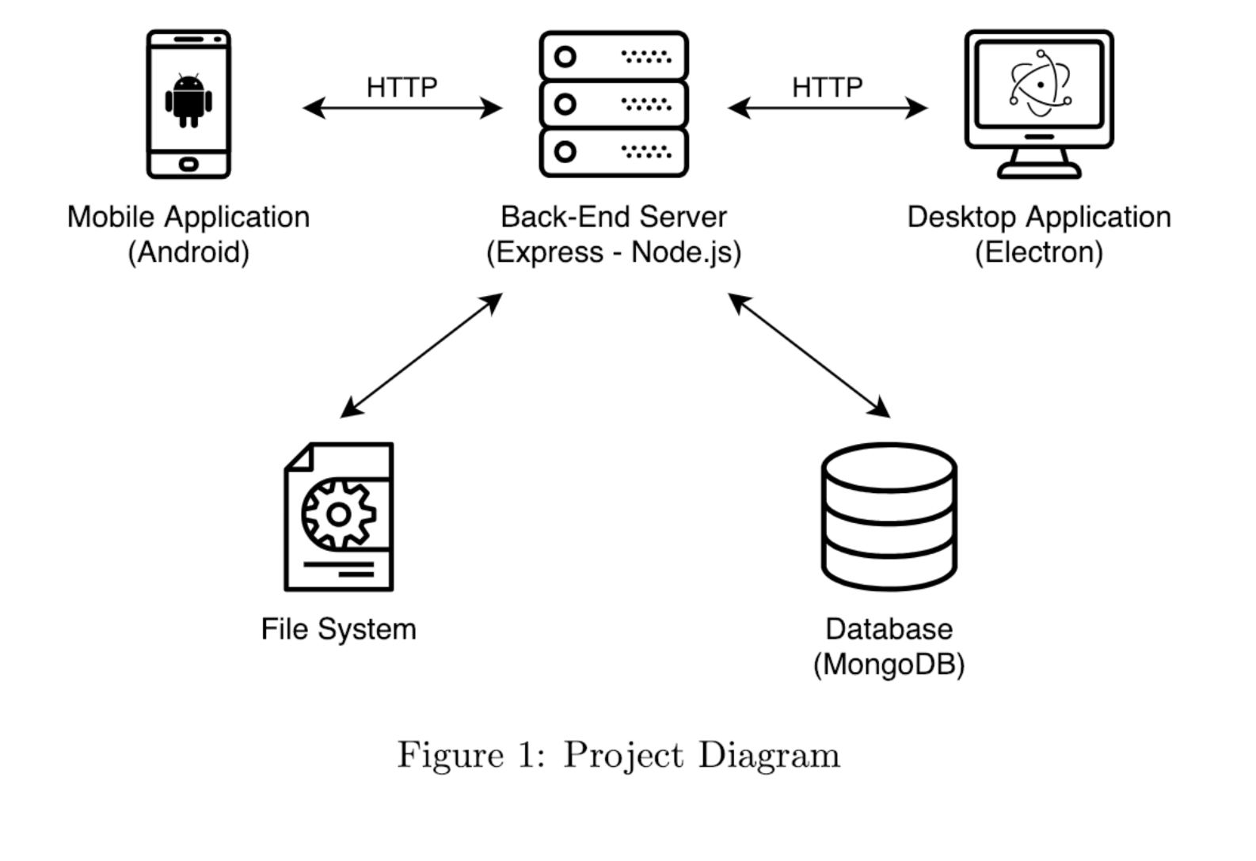
Proposed Architecture Diagram

Slide 5
Implementation
Desktop Application
Electron
Request
Crypto
Electron json storage
Diff2html
Mobile Application
Android SDK
OkHttp
Persistent Cookie Jar
Server
Node.JS
ExpressJS
MongooseJS
PassportJS
Express-sessions
bcryptJS
Isbinaryfile
jsDiff

Slide 6

Testing
White Box Testing: Pull Requests review on GitHub
Black Box Testing: 2 Different Techniques
Test Cases: Usage scenarios for all three applications
Hallway Usability Testing: 10 random individuals test the applications
Testing Results
Relevant bugs found and corrected
GUI changes based on feedback from hallway users

Slide 7

Demonstration

Slide 8
Use Cases Steps
Create user1 in Desktop App
Login to user1 in Desktop App
Create user2 in Mobile App
Login to user2 in Mobile App
Show that when mobile App closes the user does not logout
Upload user2_file1 from mobile
Logout user1 from Desktop App
Login to user2 in Desktop App
Show that only files from user2 are visible
Download & Open user2_file1 in Desktop App
Edit & Upload user2_file1 from desktop App
Download user2_file1 from Mobile App and open it
Edit user2_file1 in Mobile App and Upload it
In Desktop App, Show the diff of conflict and force upload it
Show the diff in Mobile App, correct and upload it
Download & Delete user2_file1 from Desktop App
Refresh Mobile App and show that it was indeed deleted
Upload & Download Image and Video files

Slide 9
Evaluation
Weaknesses
HTTP instead of HTTPS
Folder inside folder
File size
IOS compatibility
Strengths
Thorough Testing (Black Box, Hallway Testing)
Users implementation
No-SQL Database
Input Sanitization
Server performance
Cross-platform desktop app
Future Work
Tackle weaknesses
Create IOS App
Implement QoL objectives (blue)

Slide 10

Questions ???

